Slide 1

A Deep Learning approach to Identify the Credit worthiness
Aniket Chhabra

Slide 2
Business Objective
Banks and financial institutions face a common problem of identifying users or organizations that will default in paying back loans. While banks and financial institutions work on huge databases, data science comes to the rescue.
The objective of this session is to use credit dataset (bureau + characteristics) to predict the credit worthiness of individuals. A solution of this problem will help the banks/credit firms to reduce their financial loss(s) and build a process of fraud detection via identifying the credit risk individual/firms thereby, providing decision supports to credit risk control.

Slide 3
Neural Network Basics

Slide 4
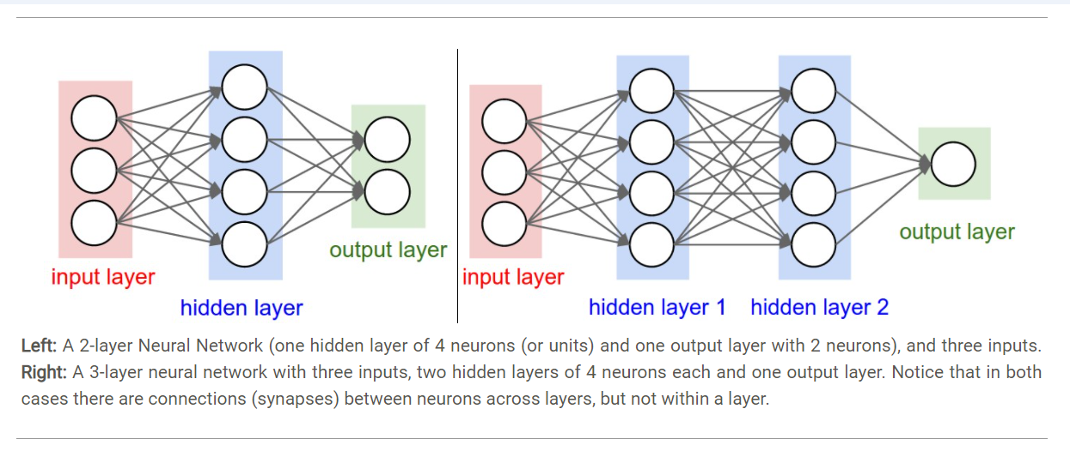
Architecture of ANN
The first network (left) has 4 + 2 = 6 neurons (not counting the inputs), [3 x 4] + [4 x 2] = 20 weights and 4 + 2 = 6 biases, for a total of 26 learnable parameters.
The second network (right) has 4 + 4 + 1 = 9 neurons, [3 x 4] + [4 x 4] + [4 x 1] = 12 + 16 + 4 = 32 weights and 4 + 4 + 1 = 9 biases, for a total of 41 learnable parameters
Modern Neural Networks contain on orders of 100 million parameters and are usually made up of approximately 10-20 layers (hence deep learning). However, as we will see the number of effective connections is significantly greater due to parameter sharing

Slide 5
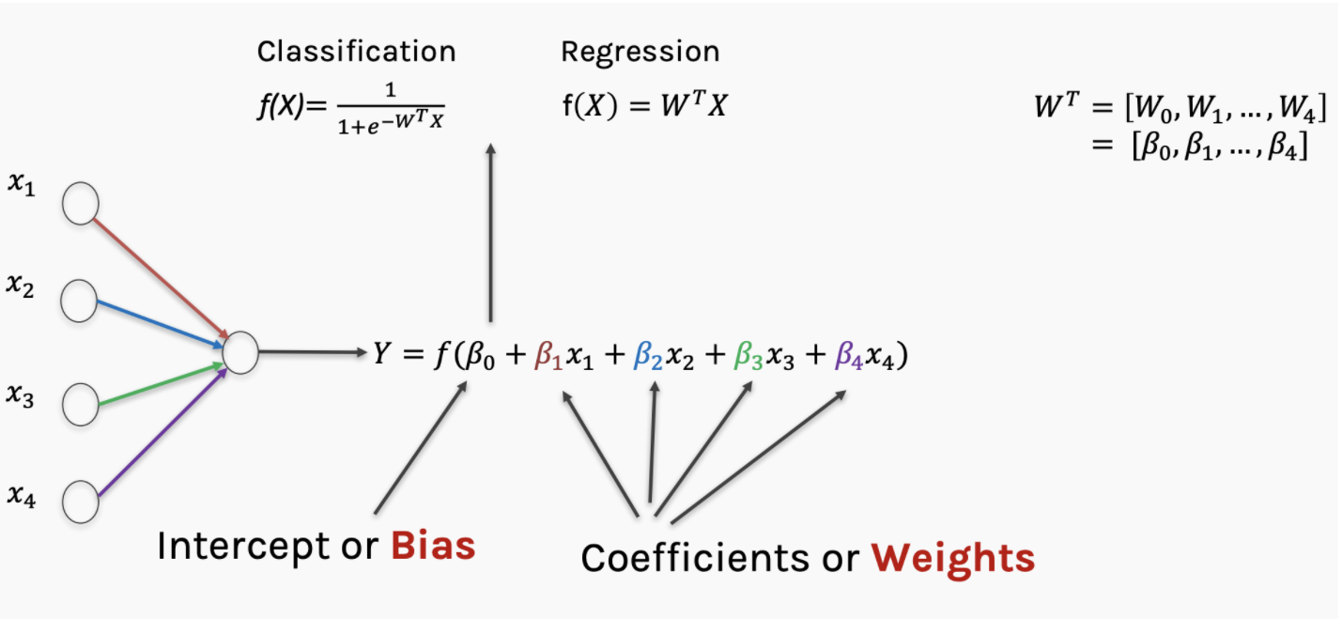
Weights and Biases

Slide 6
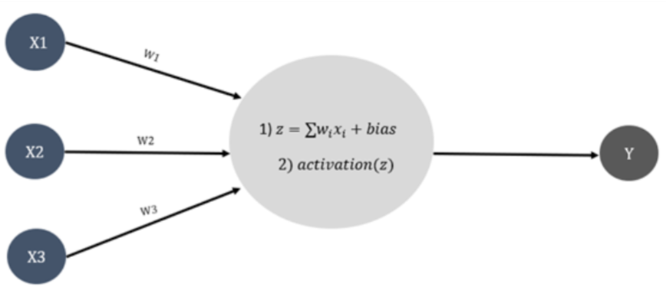
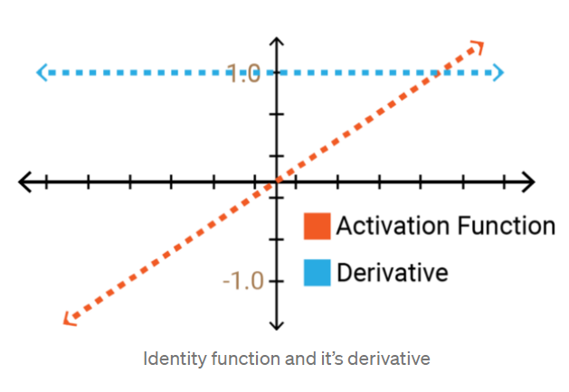
Activation Functions – What and Why
The activation function is a mathematical “gate” in between the input feeding the current neuron and its output going to the next layer. They basically decide whether the neuron should be activated or not.
Linear Activation Function?
Why do we use an activation function?
If we do not have the activation function the weights and bias would simply do a linear transformation. A linear equation is simple to solve but is limited in its capacity to solve complex problems and have less power to learn complex functional mappings from data
Equation: f(x) = x
Derivative: f’(x) = 1
Range: (-∞, +∞)
Back-propagation is not possible
All layers of the neural network collapse into one

Slide 7
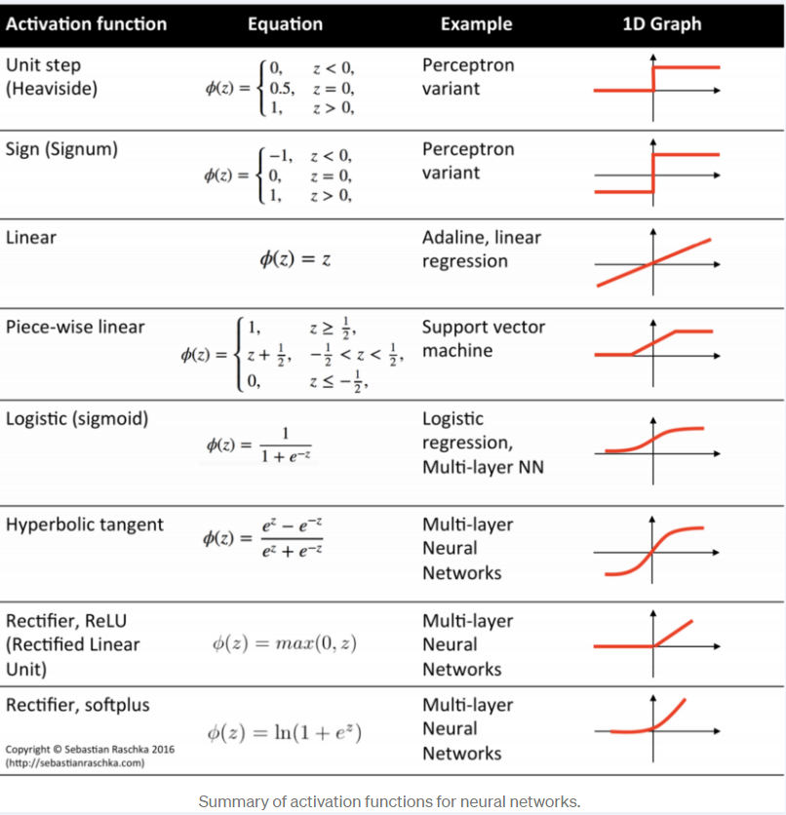



Activation Functions – Top ones
For Binary Classifier – (0,1) –
Output layers
Binary Classifier – (-1,1) but suffers dead neuron problem
Mostly used for hidden layers
For Multiclass Classifiers-output layers
Notes:
https://patrickhoo.wixsite.com/diveindatascience/single-post/2019/06/13/activation-functions-and-when-to-use-them
However, the use of activation functions mostly depends on the data, problem in hand and the range of the expected output.

Slide 8


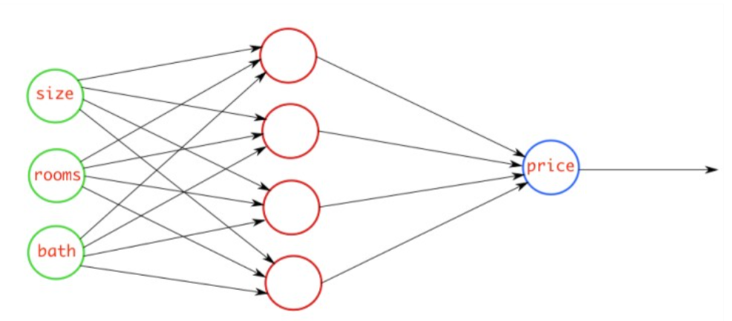
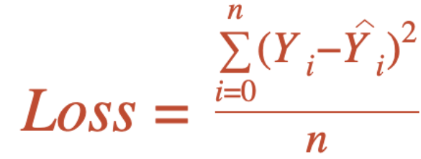




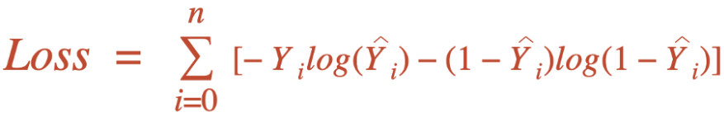
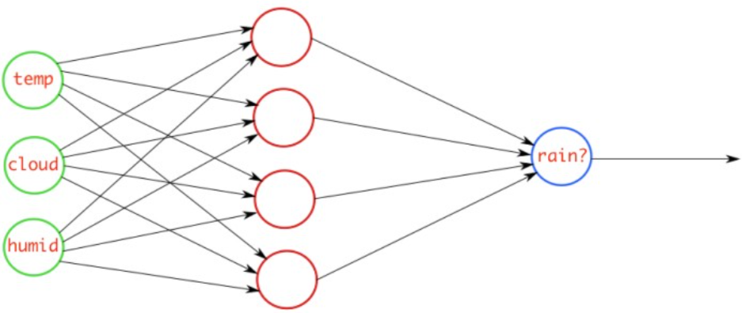





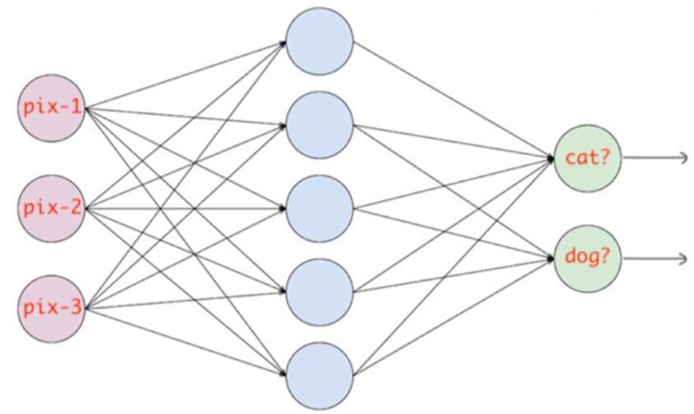
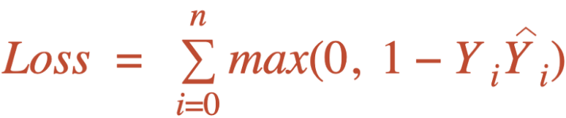
Loss Functions in Neural Networks
Loss is nothing but a prediction error of Neural Net. Keras and Tensorflow have various inbuilt loss functions for different objectives.
There must be the same number of output nodes as the classes. And the final layer output should be passed through a softmax activation so that each node output a probability value between (0–1).

Slide 9
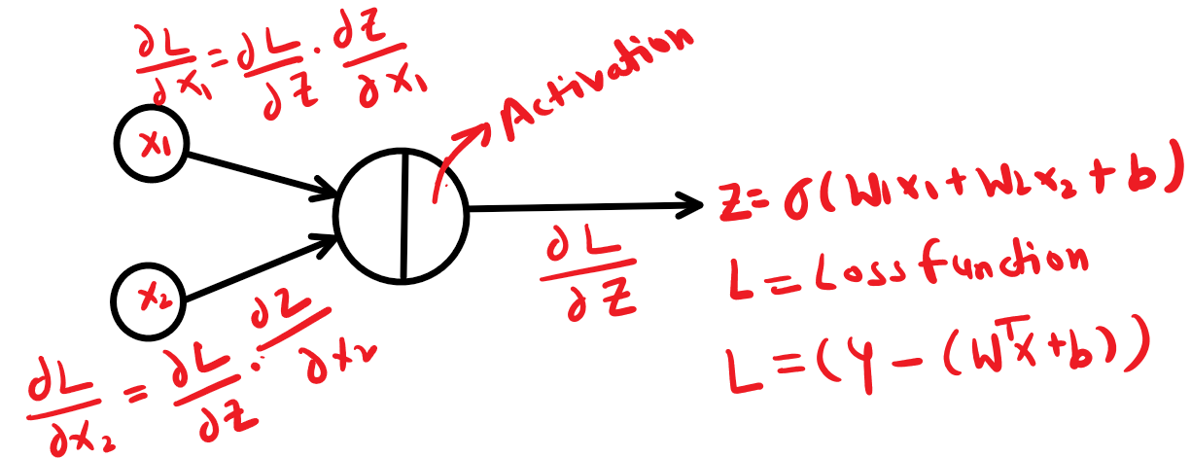
Backpropagation in Neural Networks
Backpropagation is the essence of neural network training. It is the method of fine-tuning the weights of a neural network based on the error rate obtained in the previous epoch (i.e., iteration). Proper tuning of the weights allows you to reduce error rates and make the model reliable by increasing its generalization.
Backpropagation

Slide 10

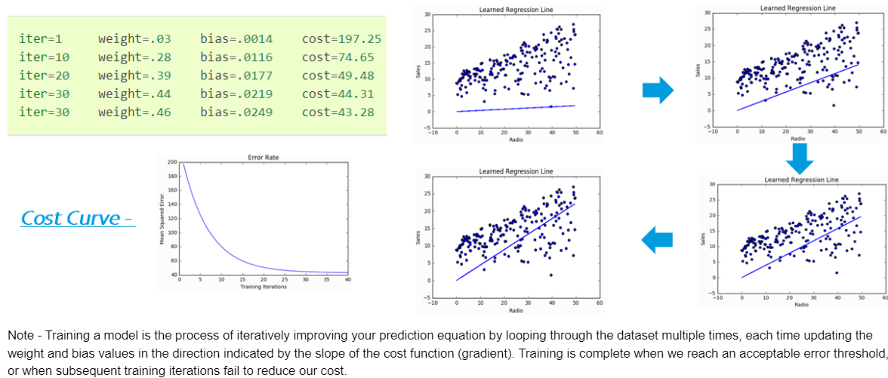

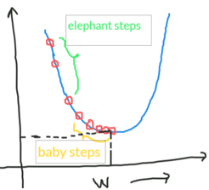



Gradient Descent
Gradient descent is an iterative optimization algorithm for finding the local minimum of a function. As NNs are trained using the backpropagation technique, GD is crucial part of the process

Slide 11
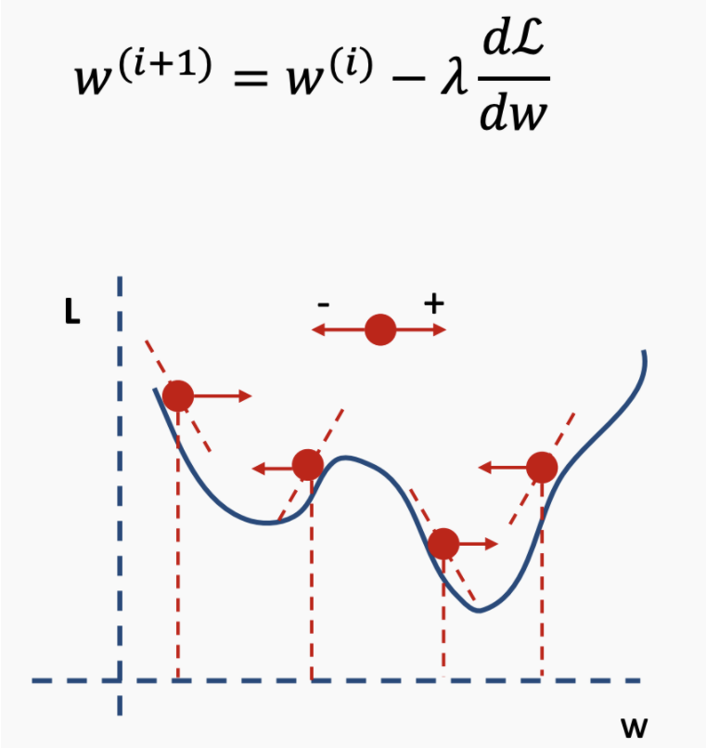
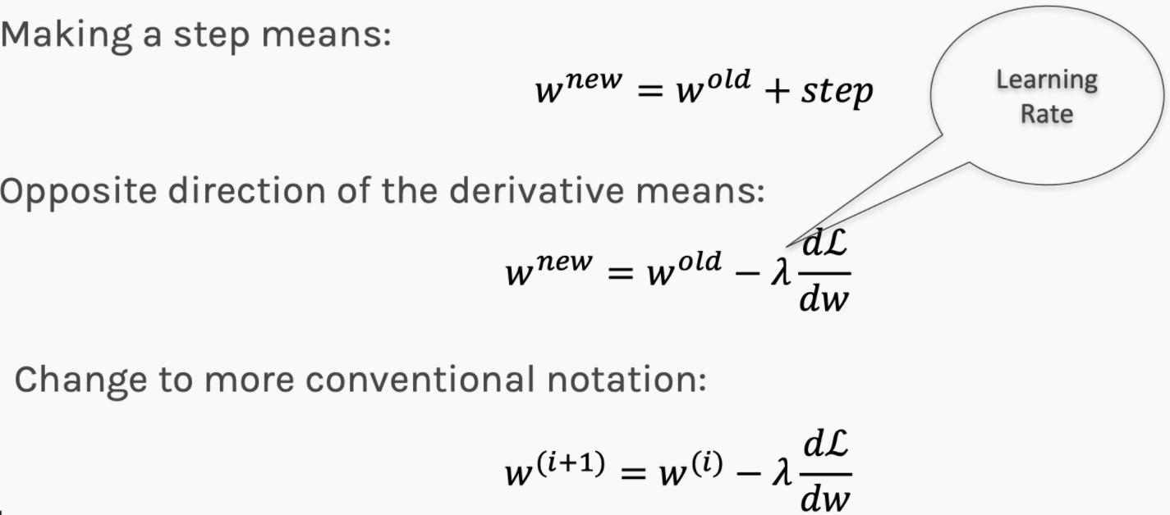
Update Rule in Gradient Descent
How do we take iterative/steps? Or Update/Delta rule in GD – Opposite direction of the derivative and step we take is proportional to derivative.
Our new weight is the addition of the old weight and the new step, whereby the step was derived from the loss function and how important our relevant parameter is in influencing the learning rate (hence the derivative).

Slide 12
Python Notebook – Keras Basics to build an ANN Model

Slide 13
ANN Application – Credit Data

Slide 14
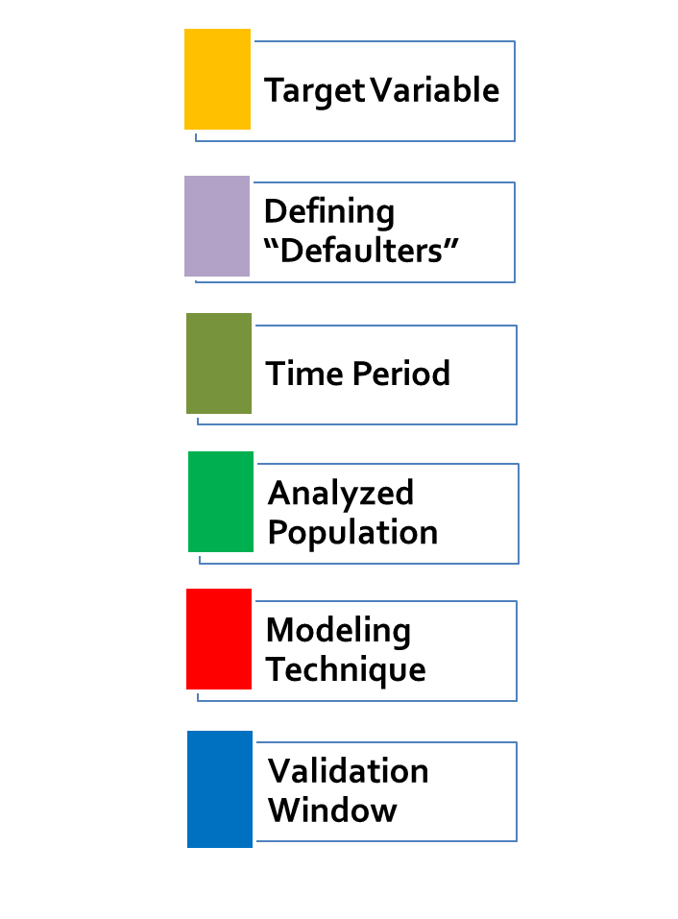
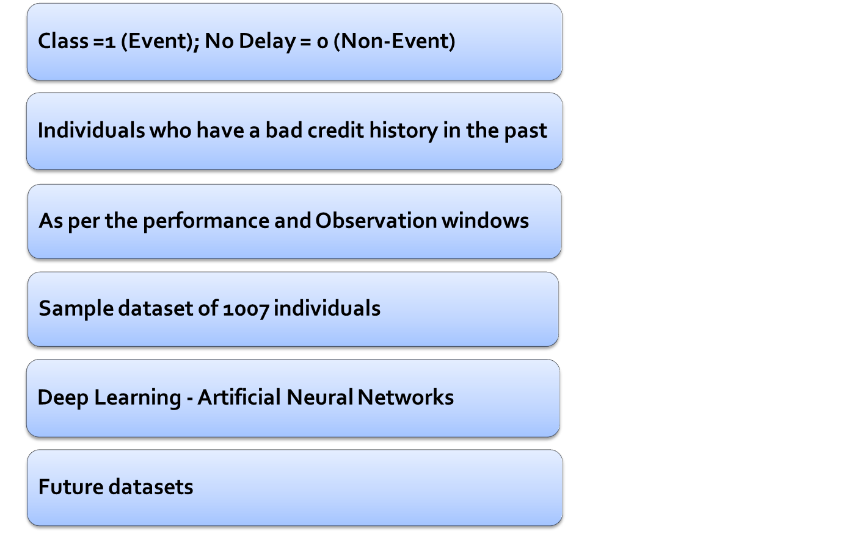
Dataset Overview

Slide 15
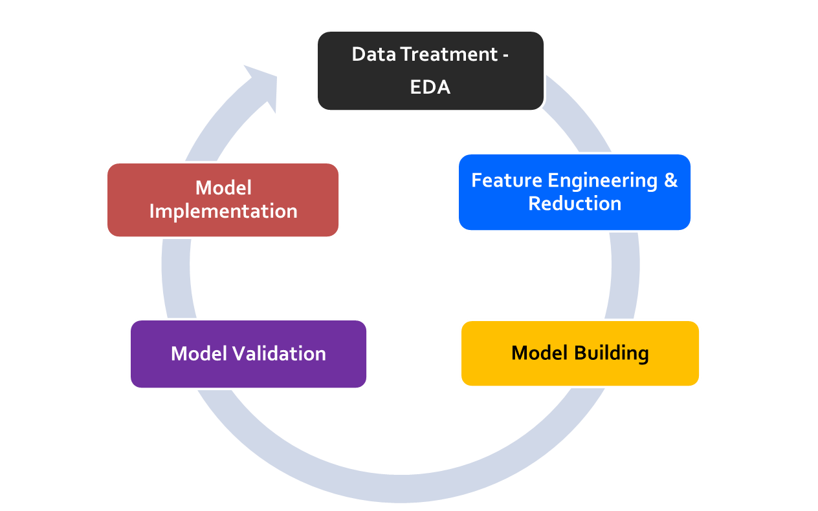
Model Framework
Missing value treatment
Outlier treatment
Removing inconsistencies/Data Level
Implement the model for future datasets
Target Variable Identification
New Independent Features
Remove unwanted features
Identify the best predictive model – Random Forest/Boosting
Tune the model to fit best accuracy
Test the model on test data
Validate the results with Jan-2020 data

Slide 16
Python Notebook – ANN Application

Slide 17
Appendix –
Hyperparameter Tuning

Slide 18
Questions asked on Neural Networks
Shallow versus Deep Neural Networks?
Forward propagation v/s Backward propagation?
How many Neurons and Nodes are required to build a neural networks?
What Activations functions should be used and when?
What loss functions should be used and when?
What is Gradient Descent Algorithm and why do we need it?
Hyperparameter Tuning in Neural Networks?

Slide 19
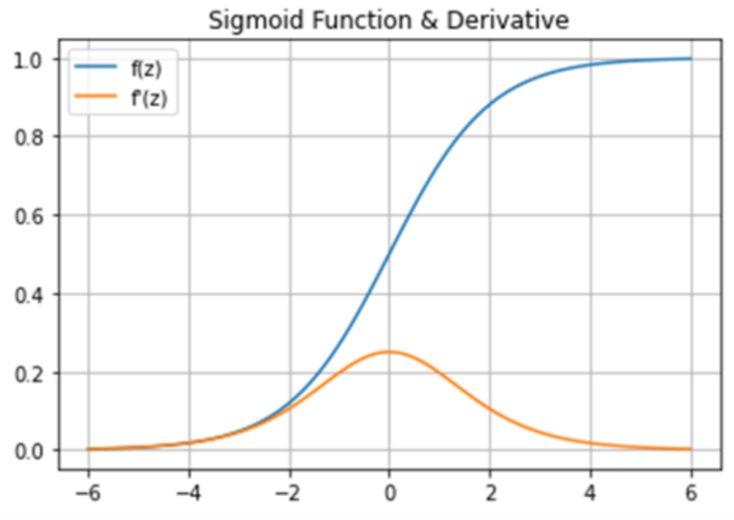
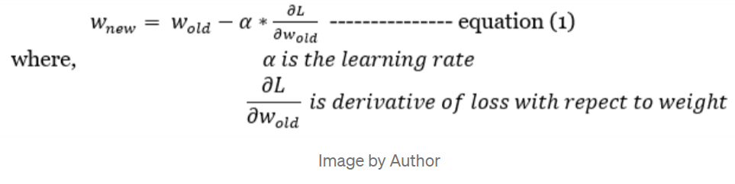
Activation Functions – Top ones
Sigmoid –
  The function looks like S-shaped curve
  This function transforms the input values between 0 and 1 and centered at 0.5 ie. not zero centered.
  The function is monotonic and differentiable. Note, the derivative of sigmoid function ranges between 0 to 0.25.
Disadvantages –
Vanishing Gradient: In neural network, during the backpropagation stage, weight(w) is updated as below.
Due to chain rule of differentiation, the derivative can be so low that weight might not get changed or updated significantly.
Computationally Expensive due to its exponential nature.

