Slide 1

A Machine Learning approach to Predict the Delays in Flights
Aniket Chhabra

Slide 2
Business Objective
Over the last few years (before COVID-19 time), the demand of air travel has been continuously growing across the world (domestic + International). But this has also led to increase in air traffic causing many flight delays on the ground and in the air. These delays cause significant losses to the carriers and also have environmental impact. Active research and analytics have been applied/used in the aviation industry to leverage the data and prevent these delays by predicting them and optimizing the operations of the companies accordingly.
The objective of this session is to use Jan-2019 dataset to predict the flight delays at the destination airport specifically for the month of January in upcoming years

Slide 3
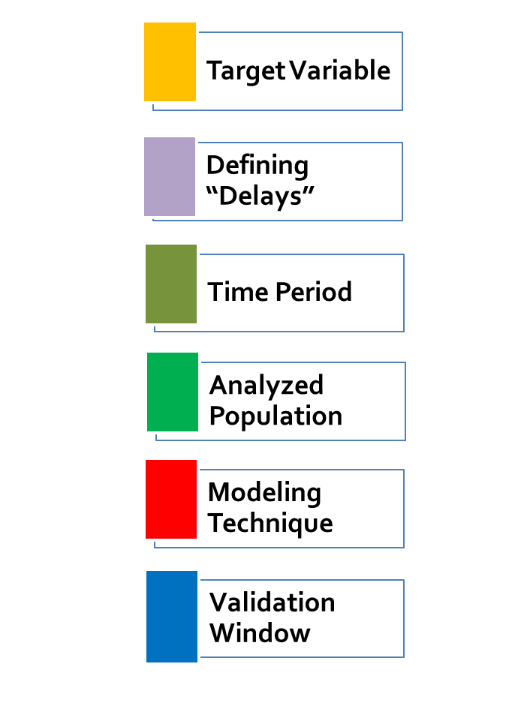
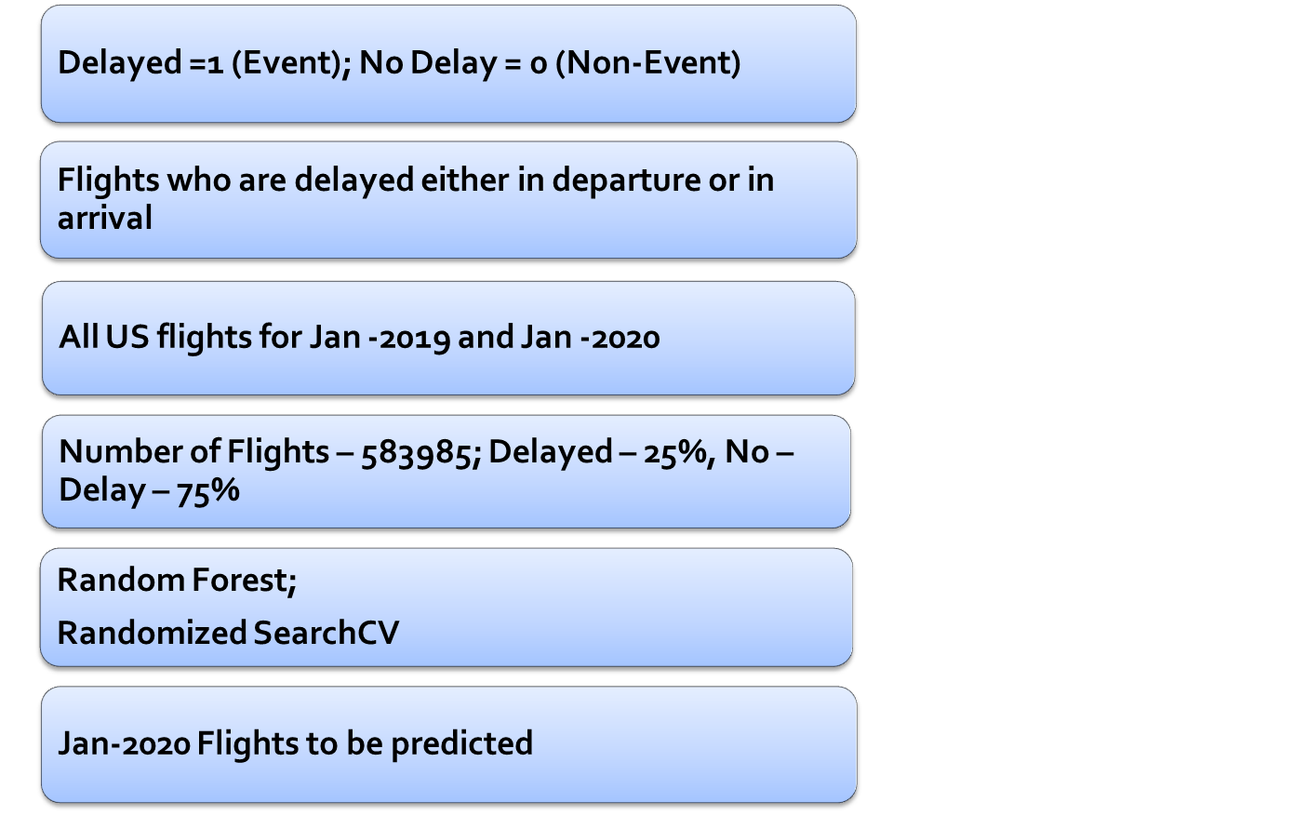
Dataset Overview

Slide 4
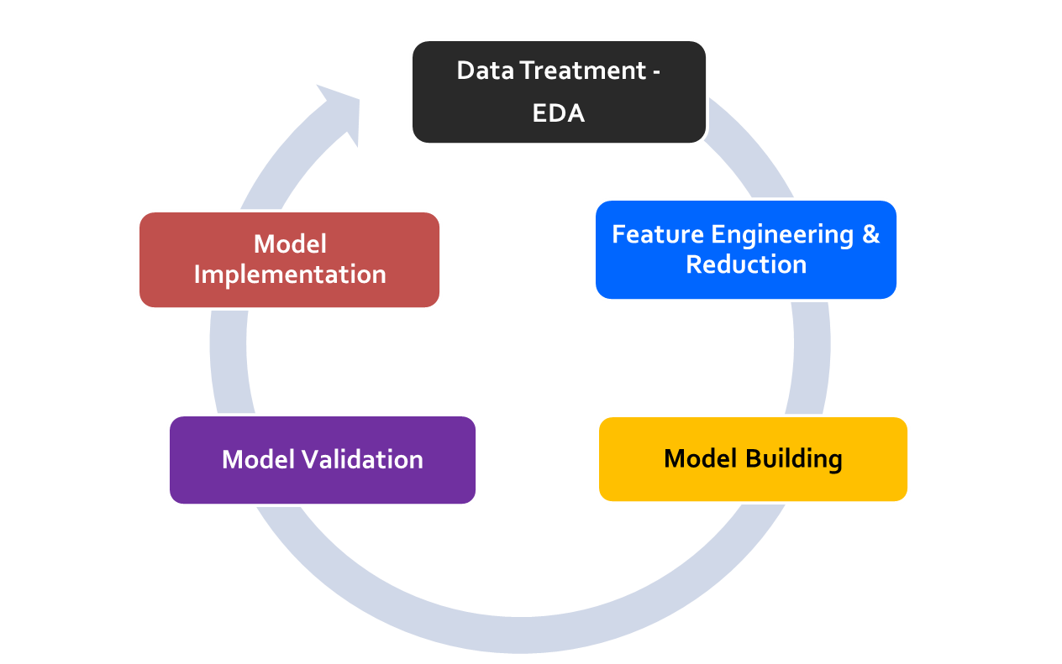
Model Framework
Missing value treatment
Outlier treatment
Removing inconsistencies/Data Level
Implement the model for future datasets
Target Variable Identification
New Independent Features
Remove unwanted features
Identify the best predictive model – Random Forest/Boosting
Tune the model to fit best accuracy
Test the model on test data
Validate the results with Jan-2020 data

Slide 5
Python Notebook

Slide 6
Model Results I – Significant Features/Factors causing Delays in flight
Variable Explored
DAY_OF_MONTH
DAY_OF_WEEK
OP_UNIQUE_CARRIER
OP_CARRIER_AIRLINE_ID
OP_CARRIER
TAIL_NUM
OP_CARRIER_FL_NUM
ORIGIN_AIRPORT_ID
ORIGIN_AIRPORT_SEQ_ID
ORIGIN
DEST_AIRPORT_ID
DEST_AIRPORT_SEQ_ID
DEST
DEP_TIME
DEP_DEL15
DEP_TIME_BLK
ARR_TIME
ARR_DEL15
CANCELLED
DIVERTED
DISTANCE
Significant Features Ranks
DEP_TIME
ARR_TIME
DEP_TIME_BLK
DISTANCE
DEST
ORIGIN
DAY_OF_MONTH
OP_UNIQUE_NUMBER
DAY_OF_WEEK

Slide 7
Model Output, Recommendations & Next Steps
Best approach is random forest model with 77% F-1 score
Departure time, Arrival time and Distance are main factors which are impacting the delays in flights at the destination.
Get the departure days and departure time to flights on specific days on which flights are likely to delay more - the decision rules will help us to achieve that.
Share the results with stakeholders and business – to work on the days/flights which will delay in upcoming years

Slide 8
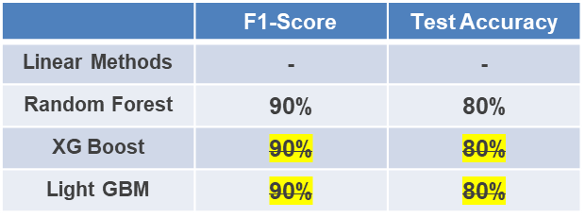

Model Findings
Significant Drivers
Best Model
City
Social Class
  Ensemble
Random Forest
XG Boost
Light GBM
  Personal Details
Primary and Secondary Businesses
Type
and area
Financial Details
Loan
Amount
  House Details
  Accuracy
Loan Details
Purpose
No. of Installments
Accuracy Measures
Feature Importance Plot

Slide 9
[QUESTION]: Do a descriptive analysis of all the variables -
[SOLUTION]: Attached Jupiter notebook named “data-science assignment.ipynb” contains exploratory data analysis.
[QUESTION]: There is a new customer who needs a loan. Which models will be best suited to predict the loan_amount that can be granted to the customer?
[SOLUTION]: OLS method is suggested here to predict loan amount for the individuals. Other ML algorithms like random forest, XG boost, ANN etc. can also be applied to this estimation.
[QUESTION]: Build a model to predict the maximum loan_amount that can be granted to the customer. Which all variables are good predictors?
[SOLUTION]: Loan tenure, loan installments, social class, city and loan purpose are emerging as important factors in determining maximum loan amount. Stats model package results are attached in Jupiter notebook named “Data_Science_Assignment_Challenge.ipynb”
[QUESTION]: Build at least one model from scratch that fits this data, without using any third-party packages like sklearn, glm, lm, rpart, etc. You are free to use linear algebra packages like scipy, numpy or any blas derivative. We would be more interested in the convergence of the algorithm rather than the prediction accuracy.
[SOLUTION]: OLS Convergence Algorithm is built from scratch in numpy to estimate cost/error reduction. Convergence of the algorithm is providing "Optimal Parameters" and reducing the cost by "30%".
[QUESTION]: Is loan_purpose a significant predictor? The business has insisted on using loan_purpose as a predictor. Al If it is not already a significant contributor, can we still modify the model to include it?
[SOLUTION]: Yes, few of the categories of loan purpose are coming as significant parameter in determining loan amount however, as suggested in Recommendations slide, more relevant data can help improve accuracy of the model.
[QUESTION]: How will you measure the fitness of the model? Which metrics (accuracy, recall, etc.) are most relevant?
[SOLUTION]: Mean Absolute Percentage Error (MAPE) is considered as one of the primary metric in evaluation of model performance. Few more evaluation metrics like MSE, RMSE, Cost Reduction are explained in attached excel named “Model_Evaluation_Metrics_Estimation”.

