Slide 1
Estimating Credit Worthiness of Rural India
An ML Approach
Aniket Chhabra
15-Sep-2021

Slide 2
Agenda
Background and Business Objective
ML model Lifecyle
Model Building Blocks
Drivers Identification of Credit Worthiness
Exploratory Data Analysis & Feature Engineering Results
Model Results/Findings
Next Steps and recommendations
Challenges
Appendix

Slide 3
Background & Business Objective
In the Banking industry, loan applications are generally approved post a thorough background check of the
customer's repayment capabilities wherein the Credit Score plays a significant role in identifying customer's financial behaviour (specifically default). However, people belonging to the rural India don't have a credit score thus making direct assessment a difficult process.
The downloaded dataset is a collection of loan applications of rural customers. We need to understand the drivers which are significant in identifying their repayment capabilities by fitting a Regression/Classification algorithm.
A predictive model will…
identify a set of applications which are eligible for the loan and How much loan should be provided
provide the drivers which are significant in determining the repayment capabilities of the loan applicants
standardizing the process of loan application i.e. approval and rejection

Slide 4








Model Lifecycle
Define Project: Business Objective discussions, requirement gathering and approvals
Model Validation and Deployment:
Validate the models with various methods and governance tools
Deployment with available environment
Data Collection: Characteristics of ideal signals –
Available early in process
Reliable and robust data
Independent of other signals
Note – The above steps explains the ideal data collection scenario. Here we have the dataset download from public source
Predictive Model
Model Development: Apply the appropriate modeling technique. Classification techniques -
Ensemble methods like – Random Forest, Boosting Algorithms
Data Analysis: Deep diving the data to identify patterns amongst the drivers and target
Identify the target
Patterns amongst the target and predictors and within predictors
New Feature generation/ feature engineering
Statistical Hypothesis: Validate the data driven hypothesis with business

Slide 5
Model Building Blocks
Data Source
Credit worthiness for rural India dataset provided
Number of Variables
Total Variables = 21; Numerical – 6; Categorical – 15; Id - 1
Target Feature
Loan Amount
Tools Used
Python – Jupyter notebook
Analysis Population
A cross sectional dataset of individuals – 40,000 records
Modeling Technique
Random Forest
XG Boost
Implementation Window
Not applicable

Slide 6
Drivers for identification of credit worthiness
Age
City
Sex and
Social Class
Personal Details
Primary and Secondary Businesses
Home ownership
And area
Loan
Amount
Financial Details
House Details
Type of house, sanitary and water availability
Income and
Expenses
Family
dependents
No. of
occupants
Loan Details
Loan Purpose
and Tenure
Loan
Amount
No. of
Installments

Slide 7
Exploratory Data Analysis – Findings and Approach
Data Cleaning
Missing Values – 13% of social class, water availability & Secondary Business categories are NULL followed by City – 5%;
Median imputation for numerical features; Unknown categories for categorical features
Outliers – Capping method – Age, Annual Income, monthly expenses and house area
Data inconsistencies – Text cleaning like – spell corrections, incorrect names etc. fixed manually
Feature Engineering
Target Feature – Converted into classification approach due to large outliers and skewed distribution (99% of the loan applications are below 20K whereas >80% are <10K
10k+ - 17%, 0-10K –83%
Numerical features – Income, Expenses, House area, loan tenure and installments have low correlation with Loan amount. Converting the numerical features to buckets (categories) to identify the pattern/relationship with the target feature
Grouping the categories for City, Social Class and Primary business have many categories. Grouped them into less number of categories using multiple techniques like – Target Mean encoding and manual methods

Slide 8
ML Model Findings – Best Approach
Driver Analysis
Loan purpose is coming one of the most significant drivers from the analysis – especially categories like education loan, manufacturing and Recycle& waste management
Primary business of the applicants also matter here, like papad making, traditional weaving and other categories
Primary findings also suggest that social class/caste is also important factor in determining the loan amount eligible
ML Model Findings
Algorithm Applied: Random forest and XGboost
Accuracy Metric: F1 score validation
Best Model (so far) – XGboost with 60% F1 score
 | F1-Score | Precision | Recall | Criteria | Scope of Improvement
Random Forest | 58% | 66% | 51% | Overfitting Model | No
XG Boost | 60% | 46% | 86% | No overfitting | Yes

Slide 9
Recommendations & Next Steps
Currently, social class and city are emerging as important factors which ideally not be primary criteria for granting commercial loans
More data around individual’s current assets, existing liabilities, loan/credit history should be incorporated since significant variations are observed for multiple categories
Data around business health check and complexity can also prove helpful here like – Turnover of the business etc.
Next Steps:
More data cleaning steps can be used to clean the data like – city, social class and primary business
Apply class Imbalance handling techniques like – SMOTE, Random Oversampling
Share the results with stakeholders and business and generate the feedback loop

Slide 10
Challenges
Credit data unavailability leads to the scope of human bias/error while determining the loan eligibility.
Social class/City should not be criteria for a financial transactions or opportunities
Features like City, Primary Business type and Loan purpose have sparse information. Need more sophisticated source to collect the data

Slide 11
Appendix

Slide 12
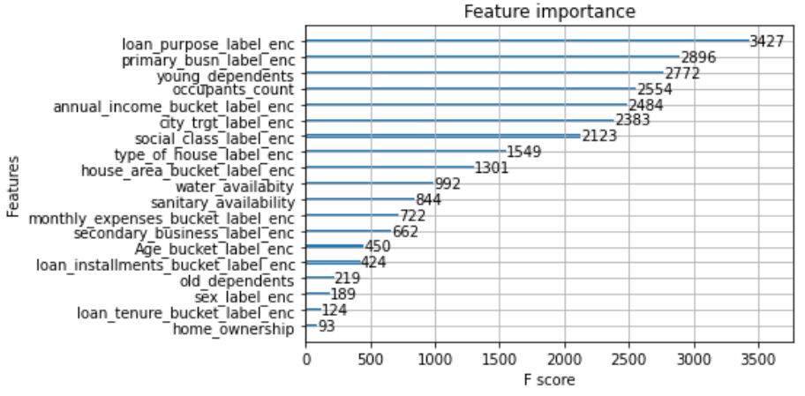
Feature Importance Plot – XGboost
Feature Importance: How many times was the feature is split on

Slide 13
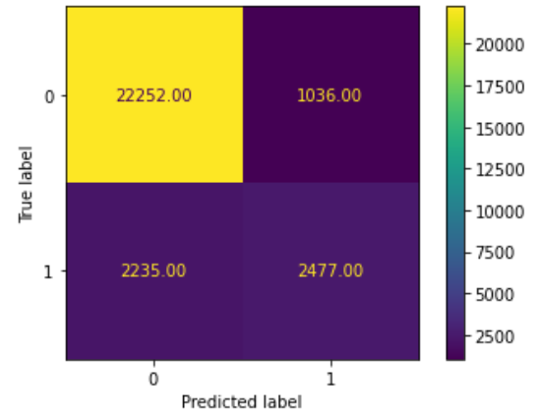
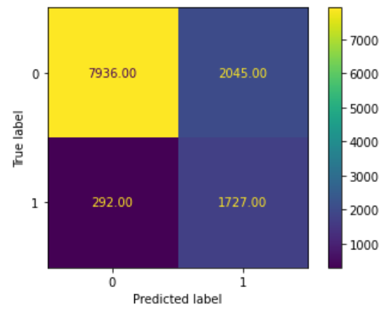
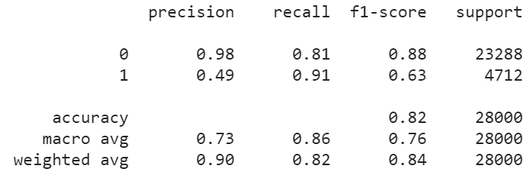
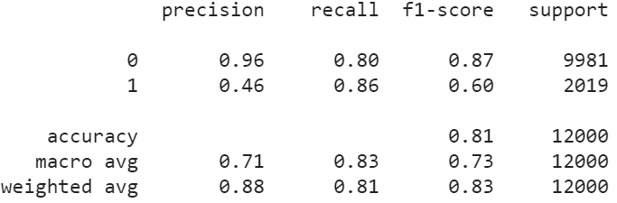
Confusion/Classification Metrices of XGBoost
Train Data
Test Data

Slide 14
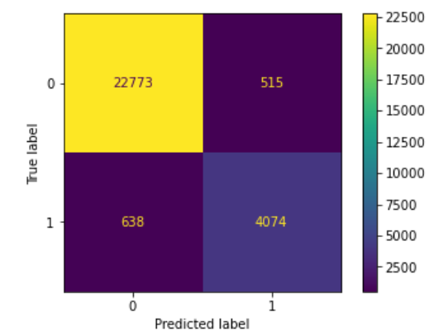
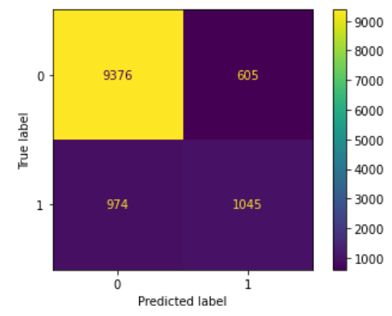
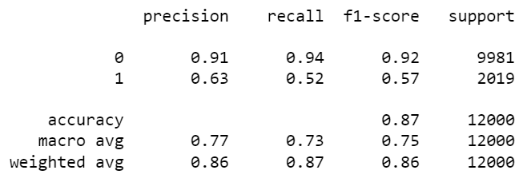
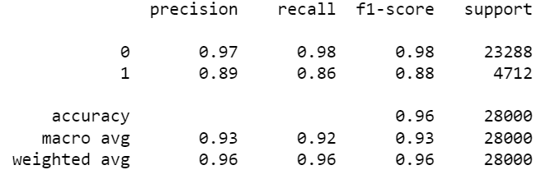
Confusion/Classification Metrices of Random Forest
Train Data
Test Data

Slide 15
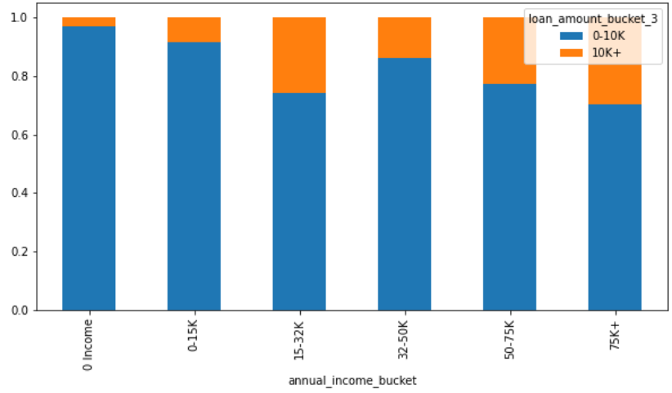
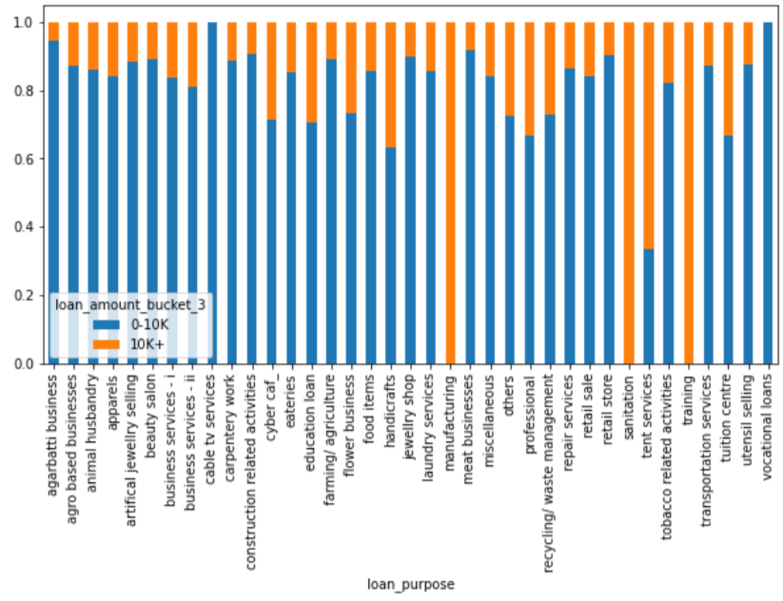
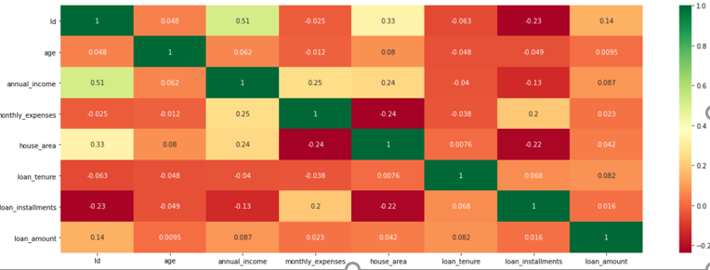
Exploratory Data Analysis Results
Annual Income – from continues to categories
Loan Purpose Categories
Full EDA Link:
https://colab.research.google.com/drive/1iwAiRg_ukhaU-k8-I46bDNzpVsM01E4u#scrollTo=sJBEqDdmVcMf
Correlation Matrix

