Slide 1
Estimating Credit Worthiness for Rural India
Assignment Challenge – Case Study

Slide 2
Analysis Overview
New York city’s permitted Restaurant inspection data – The Restaurant are graded by DOHMH
To frame an analysis and generate insights for the business to help them replicate the work in other areas
The model application is currently - Exploratory Data Analysis to find patterns in the data and recommendation based on the findings
Background and Objective
Data Source
Restaurant Inspection Data – https://data.cityofnewyork.us/Health/DOHMH-New-York-City-Restaurant-Inspection-Results/43nn-pn8j/data - Updated Daily
Number of Variables
Total Variables = 18; Numerical – 3; Categorical – 15
Time Period
Inspection Date – October 2011 to December – 2018
Tools Used
R, Tableau and MS Excel
Analysis Population
Number of Restaurant – 384,597 records – Includes restaurants with multiple visits of Inspections
Modeling Technique
Exploratory Data Analysis – Data Mining
Implementation Window
To be Decided

Slide 3

Analysis Journey
Recommendations
Market Basket Analysis – Association Rule analysis to be performed
Supervised Learning - Predictive Models
Data Analysis – Part -1(Findings)
Most restaurants serve American Cuisine – highest frequency
86% of the American Cuisine are Grade ‘A’
‘10F’ (Non-food contact) is the most common violation amongst Restaurants followed by ‘08A’ (Facility not vermin)
Data Analysis – Part – 2 (Findings)
Chi-Square Test of Independence – Significant Relationship between Grade and Type of Cuisine
Prioritization of DOHMH towards restaurants who are in either pending or not graded categories
Data Structure/Glimpse
To view the structure of the data
Observations: 384,597
Variables: 18
Data Treatment
Missing Values – 45% of Grades are NULL followed by Score – 5%
Outliers – Not checked
Removing Inconsistencies –Checked

Slide 4
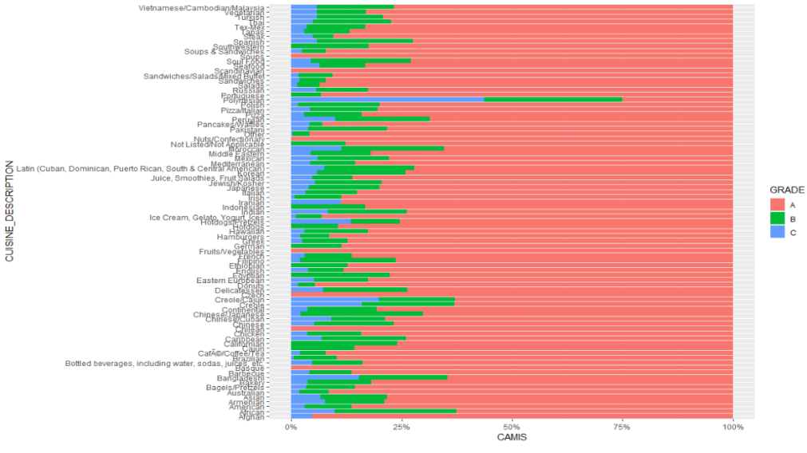
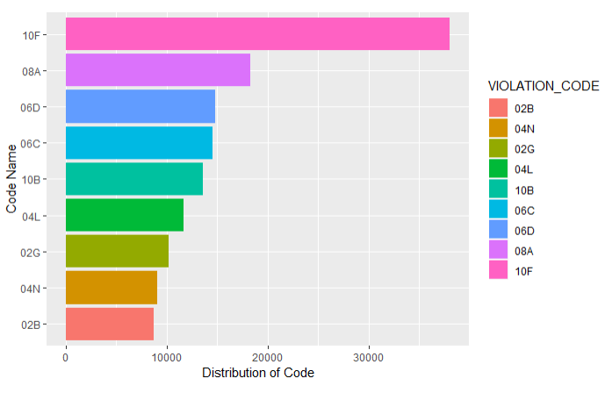
Analysis Output and Insights
Current Grade by Type of Cuisine
95% Afghan Cuisines serving restaurants are Grade 'A‘, but frequency is low compare to other categories
86% American Cuisine are Grade 'A' – That’s because its a New York city's data most restaurants serve American Cuisine
44% of Polynesian Cuisine are Grade 'C' though less number of restaurants serve this cuisine – Highest ‘C’
Stack bar – Cuisine type distributed by Grade – A,B,C
Distribution of Violation Code
Most common violation is '10F' followed by '08A‘, which means most of the violations are to do with nonfood contact and Unacceptable material used.
Bar plot – Violation codes Distribution
**The R codes of all visualizations are attached at the end of this presentation

Slide 5
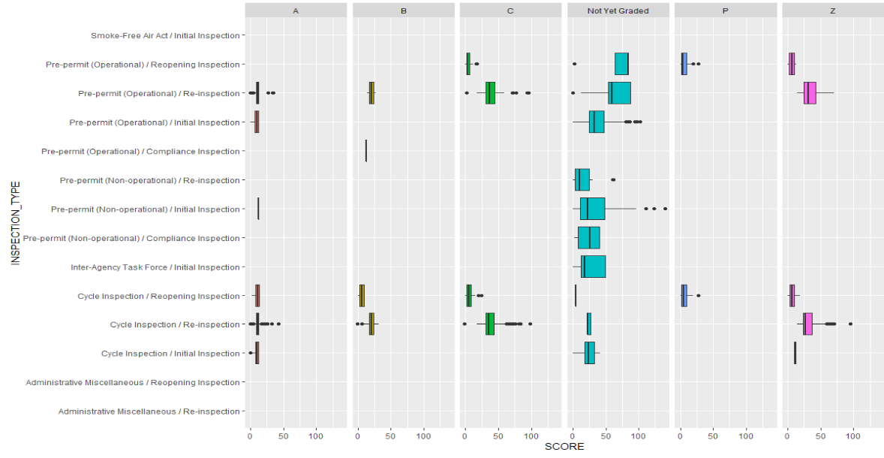
Analysis Output and Insights Continued...
Relationship between Types of Cuisines and Restaurant Grade
Chi-Square Test applied
Chi-Square Statistic - 9632.4, DOF – 504
P-value - 0.000002 (Reject the null - This means there is a significant Statistical Relationship between Grades and Types of Cuisine)
Chi-square test shows that there is a statistically significant relationship between restaurant grade and type of cuisine and if we see the 3rd bar plot (tableau file for more clear plot) from Q-1(a), it shows that most popular restaurants with most popular cuisines have higher Grades which also means better inspection score (more clean/hygenic) - So visitors should not be advised to go to less popular restaurants
Box Plots – Facet based on Grades to check the average scores
Recommendation for Prioritization
Prioritization based violation codes whose grades are in pending category like - '10F‘ followed by ‘08A’
Most Re-inspections in pending grades category- needs prioritization
Average scores of Not yet graded, pending categories like – P and Z is significantly higher than already graded – Needs prioritization
The Inspection should start with Grades P, Z and Not yet graded categories

Slide 6
Recommendations and Repository
Extended Recommendations
Not much advantage of location over the quality of food – No significant difference amongst average scores
Restaurants who had higher chances of getting low grades are not getting inspected in initial phases – grade pending
2/3rd of restaurants getting grade ‘A’ in reinsertion
Recommendation of Association rules analysis on findings like – which violations are occurring together or associated with each other
Supervised learning – Scope of building a predictive model
Analysis Repository
R- Code of the Analysis
R- Code of the Analysis
R- Plots Folder
**Please use R plots folder and R Code(2nd attachment) in case R-markdown file does not work

Slide 7
Thank You

