Slide 1
Job Readiness in AI & Data Science
Aniket Chhabra (Lead Data Scientist - PayPal)

Slide 2
Introduction
Assistant Manager (Finance & Pricing Analytics)
Genpact India, Gurugram
Jul 2011 - Nov 2015
Lead (Business Analytics & Research)
Fidelity Investments, Bengaluru
Nov 2015 - Jan 2019
PGPBA
Great Lakes Institute of Management, Gurgaon/Bangalore
July 2015 - July 2016
Senior Technical Product Manager (Global Data Science)
PayPal India, Chennai
Jan 2019 - Present
Notes:
https://towardsdatascience.com/preparing-your-data-science-resume-portfolio-22af6bada8b9
https://towardsdatascience.com/5-things-to-consider-in-a-data-science-masters-degree-48a84028959d
https://nyudatascience.medium.com/a-message-from-master-in-the-making-sree-govindaprasad-3f282c5ff297
https://towardsdatascience.com/was-it-worth-studying-a-data-science-masters-c469e5b3e020

Slide 3
Objective
What is Data Science?
Data Science Process
Pre-requisites
Roles and Market Opportunities
Data Science Readiness Toolkit
Where we can learn from
Q&A
Agenda
Notes:
https://towardsdatascience.com/preparing-your-data-science-resume-portfolio-22af6bada8b9
https://towardsdatascience.com/5-things-to-consider-in-a-data-science-masters-degree-48a84028959d
https://nyudatascience.medium.com/a-message-from-master-in-the-making-sree-govindaprasad-3f282c5ff297
https://towardsdatascience.com/was-it-worth-studying-a-data-science-masters-c469e5b3e020

Slide 4
Objective
Machine Learning Scientist/Artificial Intelligence are one of the most coveted job profiles of the current times. With a significant increase in overlap between IT/Technology and Data Science (especially Programming and Data Science Models) has widened the scope resulting in plethora of opportunities in the market. In our today's session, I am going to introduce you to the AI/ML career building nuances which will help transform you into tomorrow's professionals. We will talk about the necessary background required, an understanding of different technologies/frameworks, resume highlights followed by available jobs in the market.
Notes:
https://towardsdatascience.com/preparing-your-data-science-resume-portfolio-22af6bada8b9
https://towardsdatascience.com/5-things-to-consider-in-a-data-science-masters-degree-48a84028959d
https://nyudatascience.medium.com/a-message-from-master-in-the-making-sree-govindaprasad-3f282c5ff297
https://towardsdatascience.com/was-it-worth-studying-a-data-science-masters-c469e5b3e020

Slide 5
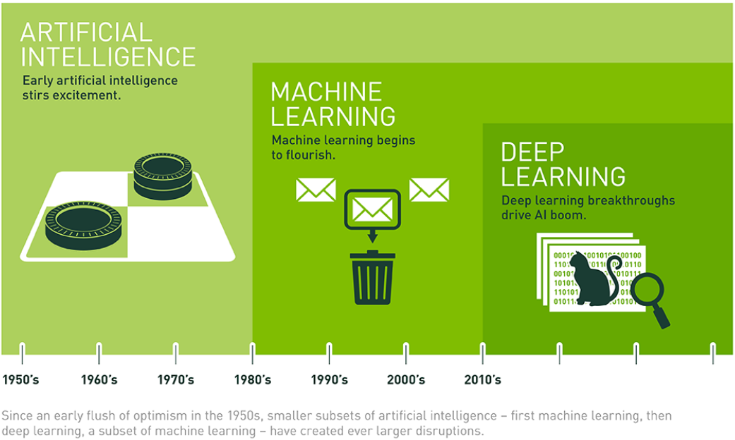
History of Data Science
“Data Science is about extraction, preparation, analysis, visualization, and maintenance of information. It is a cross-disciplinary field which uses scientific methods and processes to draw insights from data. ”
Notes:
https://towardsdatascience.com/preparing-your-data-science-resume-portfolio-22af6bada8b9
https://towardsdatascience.com/5-things-to-consider-in-a-data-science-masters-degree-48a84028959d
https://nyudatascience.medium.com/a-message-from-master-in-the-making-sree-govindaprasad-3f282c5ff297
https://towardsdatascience.com/was-it-worth-studying-a-data-science-masters-c469e5b3e020

Slide 6
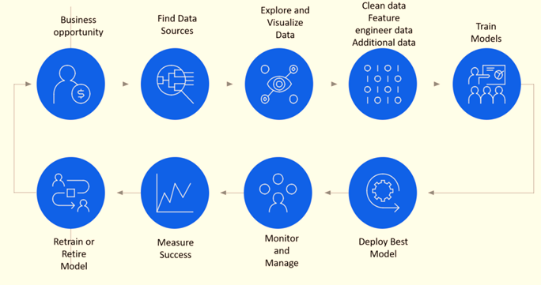
Data Science Process
The most valuable skill of a Data Scientist is to be aware of the know-hows of the data and use it to provide/enhance business value. This includes imparting necessary insights to resolve business challenges, use machine learning models for better decision making which in turn help business in attaining their objectives.
Notes:
https://towardsdatascience.com/preparing-your-data-science-resume-portfolio-22af6bada8b9
https://towardsdatascience.com/5-things-to-consider-in-a-data-science-masters-degree-48a84028959d
https://nyudatascience.medium.com/a-message-from-master-in-the-making-sree-govindaprasad-3f282c5ff297
https://towardsdatascience.com/was-it-worth-studying-a-data-science-masters-c469e5b3e020

Slide 7



Pre-requisites
Key skills required to learn Data Science
Mathematics
Statistics
To understand the technicality behind the ML and DL models
Topics like – Linear Algebra, Calculus, Set theory, discrete theory
To understand the basis of Data Science and helps in interpretation
Topics like – Probability Theory, Basic Statistics, Hypothesis Testing etc.
Programming
Analytical Thinking
To code behind the data and ML models
Tools like – Python/R/SAS, SQL, Tableau, Power BI
Problem solving approach
Creating/Analytical thinking to formulate solution of the business probelm
Education
Higher Education**
Undergraduation – Engineering, Economics, Statistics, maths are more prevalent
For others + Data Science professional certificate/diploma
Doing Masters in Data Science or Compue vision
Post getting the experience
** Optional but beneficial
Notes:
https://towardsdatascience.com/preparing-your-data-science-resume-portfolio-22af6bada8b9
https://towardsdatascience.com/5-things-to-consider-in-a-data-science-masters-degree-48a84028959d
https://nyudatascience.medium.com/a-message-from-master-in-the-making-sree-govindaprasad-3f282c5ff297
https://towardsdatascience.com/was-it-worth-studying-a-data-science-masters-c469e5b3e020

Slide 8
Roles and Market Opportunities
The role of Data Scientist is to build -
Data Mining
Predictive Modeling & Insights
Data Driven solutions towards business goals
Skills required -
Programming - Python/SQL/R
Traditional Models/ML/DL(in few cases)
Cloud - Started gaining traction
Roles available in the market
The role of BA/DS is -
Data driven business solutions/framework
Data Insights
Consulting skills
Skills required -
Programming - SQL/Python/R
ML Models (not in the all the cases)
Data Scientist
Common skills required - Problem solving
Result orientation
Client engagement
Business acumen
The role of ML Engineer is -
Data Management Tools - DBMS
Data Pipelines/Cubes
ML Deployment
Skills required -
Programming - Python/SQL/R
ML Models (not in the all the case
Cloud - Being utilized
Business Analyst
OR
Decision
Scientist
ML Engineer
OR
Data Engineer
ROLES
Notes:
https://medium.com/@jasonkgoodman/advice-on-applying-to-data-science-jobs-6e62b25518e5
https://m.signalvnoise.com/practical-skills-that-practical-data-scientists-need/

Slide 9
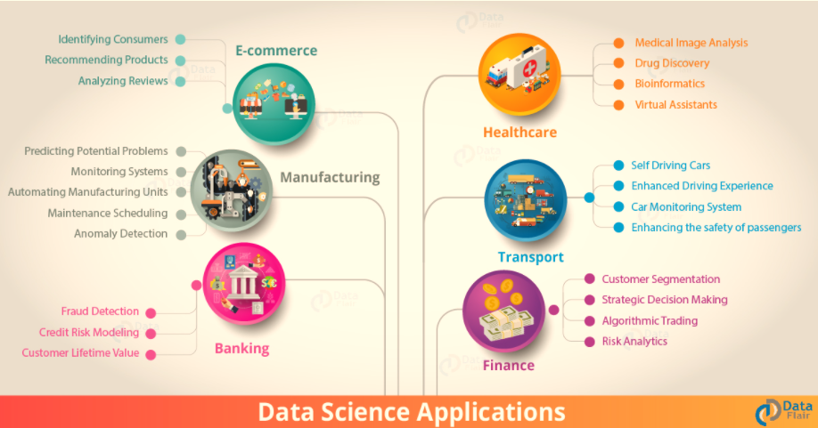
Industries Leveraging Data Science
Major Data Science Applications in the Industries
Notes:
https://towardsdatascience.com/preparing-your-data-science-resume-portfolio-22af6bada8b9
https://towardsdatascience.com/5-things-to-consider-in-a-data-science-masters-degree-48a84028959d
https://nyudatascience.medium.com/a-message-from-master-in-the-making-sree-govindaprasad-3f282c5ff297
https://towardsdatascience.com/was-it-worth-studying-a-data-science-masters-c469e5b3e020

Slide 10
Data Science Readiness Toolkit
Grow yourself as a Data Scientist
Short & crispt (1 page preferably)
Usage of keywords
Highlight technical skills
Inumerate projects in a structured manner – What, How and Why?
Meaningful and interesting elevator pitch
Projects mention
Highlight courses and certifications
Aligned with resume
Share content
LinkedIn
Resume
Try to invest time in writing blogs, articles, white-papers, videos etc.
Participation in Grand Master categories
Practice projects based on skills/interests
Participation in competitions
Link your achievements and participations with Linked-in
Factors
GitHub
Kaggle
Store you code and content in sharable repositories
Create structured repositories
Share your work links in resume and Linked-in profile
Notes:
https://towardsdatascience.com/preparing-your-data-science-resume-portfolio-22af6bada8b9
https://towardsdatascience.com/5-things-to-consider-in-a-data-science-masters-degree-48a84028959d
https://nyudatascience.medium.com/a-message-from-master-in-the-making-sree-govindaprasad-3f282c5ff297
https://towardsdatascience.com/was-it-worth-studying-a-data-science-masters-c469e5b3e020

Slide 11
Where we can learn from
Additional areas to learn from
Papers
Courses
Arxiv, Stanford, Specific Publications
DSBA, AIML, DSE etc..
Blogs
Awareness
Medium, Kaggle, GL
Networking/Seminars/
Sessions/Conferences
Additional
Videos
Data Science Groups/Community
Great Learning Academy
Notes:
https://towardsdatascience.com/preparing-your-data-science-resume-portfolio-22af6bada8b9
https://towardsdatascience.com/5-things-to-consider-in-a-data-science-masters-degree-48a84028959d
https://nyudatascience.medium.com/a-message-from-master-in-the-making-sree-govindaprasad-3f282c5ff297
https://towardsdatascience.com/was-it-worth-studying-a-data-science-masters-c469e5b3e020

Slide 12

Notes:
https://towardsdatascience.com/preparing-your-data-science-resume-portfolio-22af6bada8b9
https://towardsdatascience.com/5-things-to-consider-in-a-data-science-masters-degree-48a84028959d
https://nyudatascience.medium.com/a-message-from-master-in-the-making-sree-govindaprasad-3f282c5ff297
https://towardsdatascience.com/was-it-worth-studying-a-data-science-masters-c469e5b3e020

Slide 13
THANK YOU
Notes:
https://towardsdatascience.com/preparing-your-data-science-resume-portfolio-22af6bada8b9
https://towardsdatascience.com/5-things-to-consider-in-a-data-science-masters-degree-48a84028959d
https://nyudatascience.medium.com/a-message-from-master-in-the-making-sree-govindaprasad-3f282c5ff297
https://towardsdatascience.com/was-it-worth-studying-a-data-science-masters-c469e5b3e020

