Slide 1
Data Science Overview and
Hands on in Python
Proprietary content.
©Great Learning.
All Rights Reserved. Unauthorized use or distribution prohibited.

Slide 2
Agenda
What is Data Science?
Why to learn Data Science?
Top domains using Data Science
Tools required for Data Science
How to use Python?
Case study in Python
Proprietary content.
©Great Learning.
All Rights Reserved. Unauthorized use or distribution prohibited.

Slide 3
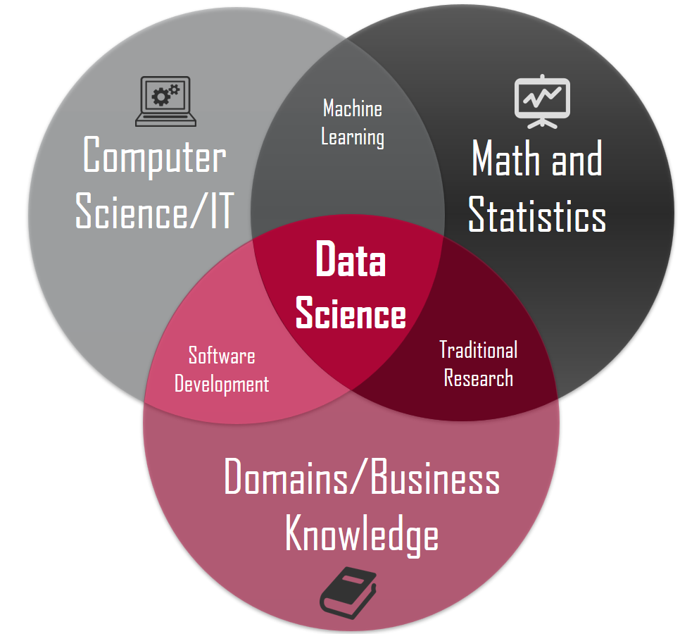
What is Data Science?
Proprietary content.
©Great Learning.
All Rights Reserved. Unauthorized use or distribution prohibited.

Slide 4

Why to learn Data Science?
Proprietary content.
©Great Learning.
All Rights Reserved. Unauthorized use or distribution prohibited.

Slide 5

Top 07 domains where Data Science is being used
Proprietary content.
©Great Learning.
All Rights Reserved. Unauthorized use or distribution prohibited.

Slide 6

Data Science
Proprietary content.
©Great Learning.
All Rights Reserved. Unauthorized use or distribution prohibited.

Slide 7
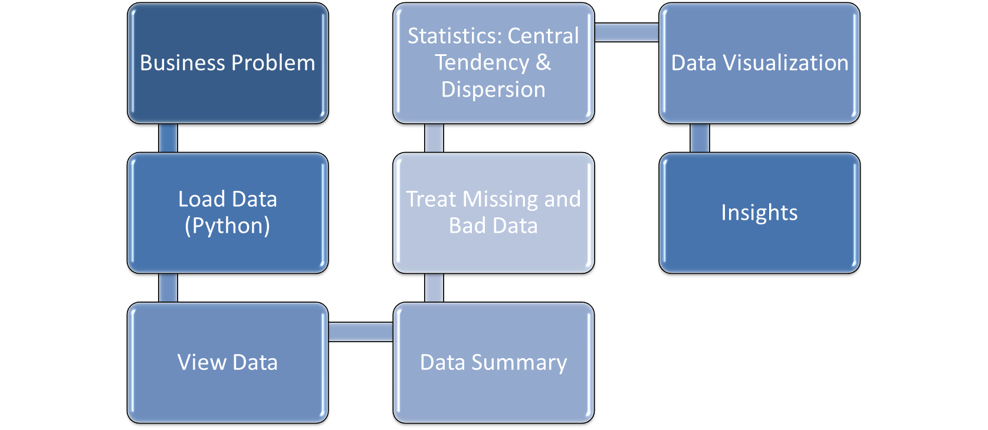
What steps to follow in Python?
Proprietary content.
©Great Learning.
All Rights Reserved. Unauthorized use or distribution prohibited.

Slide 8

Case Study IPL Matches
Understanding the details available from different IPL of all seasons, lot of insights can be generated. Such insights could help us understand the winning pattern in reference to different teams, matches , venue along with how the same was related to toss decision.
Lets look into the available dataset and EXPLORE…..
Data:
Proprietary content.
©Great Learning.
All Rights Reserved. Unauthorized use or distribution prohibited.

Slide 9
Insights from Case Study
  Total of 18 columns/variables are present
  Most of the matches were played at Eden Gardens Venue
  Mumbai Indians won toss maximum number of times
  Most number of times toss decision was to field rather than bat. (Trend was different in initial years and Chennai super kings have opted for a bat most of the time)
  Till date there has been 9 times tie for toss decision.
  Mumbai Indians have won maximum number of matches followed by Chennai Super Kings
  Teams won by average 13 runs however max run difference was 146.
  Teams won by average 3 wickets however maximum wicket difference was 10.
  In Indian cities fielding is preferred barring Chennai where batting was opted most often.
Proprietary content.
©Great Learning.
All Rights Reserved. Unauthorized use or distribution prohibited.

Slide 10


