Slide 1
Servicing Segmentation Update
Jay Kulkarni, Aniket Chhabra, Ashwin Rajagopalan
September 7, 2021

Slide 2
Agenda
Complexity Score V2.0 Update
Introduction
Complexity Timelines
Complexity Score Framework
Dimensions determining complexity
Score distribution and overall summary
Servicing Segments 2021 – Distributional view of Complexity Scores
Regional View of Complexity – US,UK and DEATCH regions update with use cases
Capacity Planning – To be Discussed

Slide 3
Identifying Merchant Complexity to support the portfolio allocation program for Servicing Organization
standardized score to every serviceable merchant based upon account characteristics and touch points with CSMs
What
A quantitative metric to measure the complexity of all servicing accounts
Why
Current allocation is based only on TPV/Revenue. We need a more scientific approach for strategic allocation and distribution of merchants to CSMs based upon the complexity of merchants since the higher the complexity, the higher the need for servicing
How
Developed a heuristic model which incorporates multiple dimensions like – financial, demographical attributes of an account, strategic expansions, servicing efforts with challenges and product adoption
CSMs Portfolio
Allocation
REV Portfolio
Optimization
Provide a framework to allocate accounts to CSMs while optimizing for a balance between revenue under management, accounts under management, and account complexity
Assess productivity of CSMs by Market to identity opportunities for optimization and load balancing
Servicing prioritization based on High/low touch accounts

Slide 4
Complexity Score roadmap from V1 to V2 – How the score itself developed (color codes); Add 2022 timeline as well – H2 plan what will be adding
Complexity score journey from 2020 to 2021 portfolio allocation for servicing organization
2020
2021
September | October |  |  |  | August | September | October
Week 28th | Week 5th | Week 19th | Week 26th | Week 31st | Week 23rd | Week 13th | Week 31st
Account complexity initial discussion
Add colors
Distinguish use case v/s complexity development
How is complexity chaning? Over the period of time
Requirement Gathering
V1.5 launch - 2021 data refresh
V1.0 score
Launch + Feedback
Regional stakeholders feedback collection
Additional supportive dimensions incorporation – verticals, product adoptions, BT integrations
Additional views for account allocation
v2.0 launch – Additional Dimension
Discussion on v2.0 Methodology
Additional supportive dimensions incorporation – verticals, product adoptions, BT integrations
Substantial improvements in the score itself
Portfolio Allocation 2021
Portfolio Allocation 2022

Slide 5
Complexity Score v2.0
Aniket Chhabra

Slide 6
Complexity Score Development framework
Data Collection Process
Data Transformation/ Feature Generation
Model Building – Score Calculation
Key parameters identification and data collection –
Discussion CSMs Org
Servicing effort level features
Merchant/Account characteristics
Product level data
CSM key program indicators – Parity, C&D and Lead pass
Weights assignment and Calibration
Assigned weights to each of parameters selected.
Feedback collection on features like BT integrations and BT Payment types and account’s vertical complexity
Normalization – Data normalization exercise to generate the data at same scale
Methodology – Weighted Index score
Complexity Score = w1*x1 + w2*x2 +…+ w10*x10
W – assigned weight
Xi – parameters
Low
Medium
High

Slide 7
FAQ??
Why the score is not fully distributed?

Slide 8
Complexity score updated to simplify understanding and use
Update includes strategic expansion dimensions to add more importance to accounts who require high touch*
Merchant Complexity Score Dimensions
Merchant Characteristics (25%)
Merchant Performance (15%)
Servicing Efforts (15%)
Strategic
Expansion (45%)
Regional Expansions
Current suite of products – PP, BT and Unbranded
Account /Brand Expansions – recent addition of new complex products like – BT, Unbranded
Tenure of an Account
No. of Corridors
Verticals - Travel, Ticketing and Gambling
No. of Accounts
Merchant KPIs (TPV/REV)
Presentment Improvement
Retention/Decline
Technical/ Integration Support
Issues /Appeals, chargebacks and Limitations
Add GPS Support data – correlation analysis
*Note – Refer to the attached excel file link for detailed factor list

Slide 9
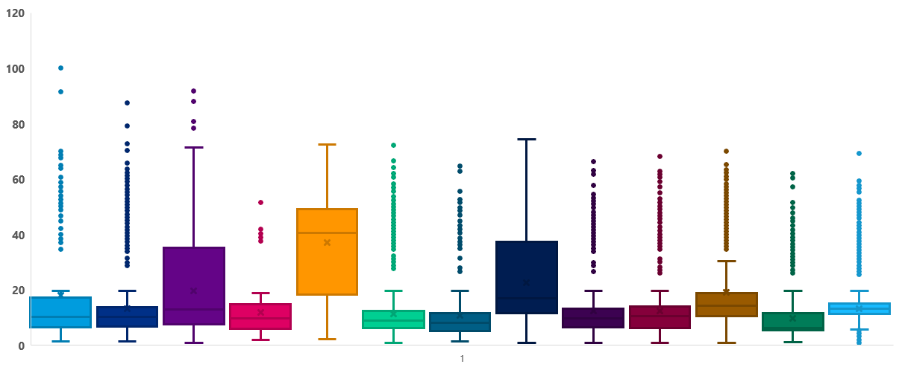
Score Distribution across Servicing Segments 2021
Complexity score decreases as we move from Global accounts to servicing segments 2021; B1 score significantly higher than A; similarly higher scores B1,B2 and B3 retain segments than their grow counterparts
Global Accounts | A | B1 | B1 G | B1 R | B2 | B2 G | B2 R | B3 | B3 G | B3 R | C | D
18 | 13 | 20 | 12 | 37 | 11 | 11 | 23 | 12 | 13 | 19 | 10 | 13
10 | 10 | 13 | 10 | 41 | 9 | 8 | 17 | 10 | 10 | 14 | 6 | 13
Mean
Median

Slide 10
Regional View of Complexity

Slide 11
US Region

Slide 12
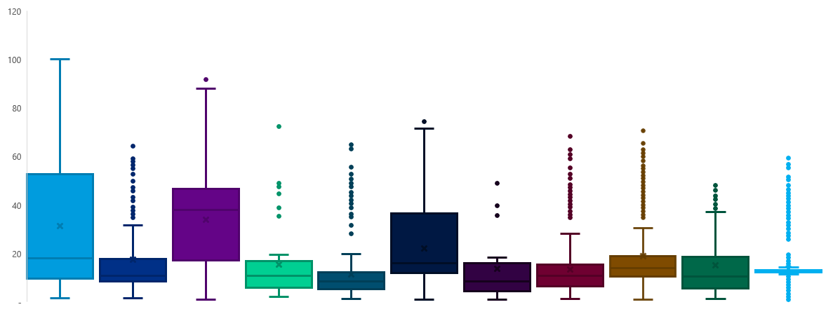
Score Distribution across Servicing Segments 2021
Global Accounts and B1 accounts are high complex than other segments; B1 score significantly higher than A; similarly higher scores B2 and B3 retain segments than their grow counterparts
Global Accounts | A | B1 | B2 | B2 G | B2 R | B3 | B3 G | B3 R | C | D
31 | 17 | 34 | 15 | 11 | 22 | 14 | 13 | 19 | 15 | 14
18 | 11 | 38 | 11 | 8 | 16 | 9 | 11 | 14 | 10 | 13
Mean
Median

Slide 13
Merchant level case studies
LIVE Nation high complex due to L3M account/brand expansion and existing BT with multiple integrations with Ticketing vertical; Home Depot less complex due to no exiting complex products and Retail vertical with less L12M TPV;
Entity Name | Servicing Segment-2021 | Complexity Score | # of Child Accounts | Vertical | Existing Product Suite | L3M Account/Brand Expansion | L12M TPV | Other reasons for high/low score
LIVE NATION ENTERTAINMENT, INC. | GA | 99 | 69 | Ticketing | Branded XO + BT (chase Integration) + Others | BT | $4B | High # of disputes, CB and parity score
Crown Gaming Inc. | RMG/FRAN | 67 | 14 | Gambling | Branded XO + BT (DCC Integration) + Others | BT | $1.4B | L3M new BT activation
HelloFresh Inc. | A | 55 | 11 | Groceries | Branded + Unbranded XO + BT (Wells Integration) + Others | BT | $1.5B | L3M new Branded + BT activation
BetMGM LLC | D | 37 | 10 | Gambling | Branded XO | - | $250M | Less complex product suite and TPV
The Home Depot, Inc. | A | 10 | 8 | Retail | Branded XO + Others | - | $2.5B | Less complex product suite, Retail Industry

Slide 14
UK Region

Slide 15
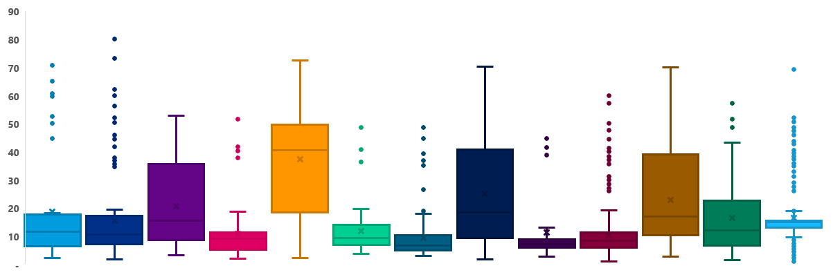
Score Distribution across Servicing Segments 2021
B1 score significantly higher than A and Global Accounts; similarly, much higher scores B1,B2 and B3 retain segments than their grow counterparts
Global Accounts | A | B1 | B1 G | B1 R | B2 | B2 G | B2 R | B3 | B3 G | B3 R | C | D
19 | 16 | 21 | 11 | 38 | 12 | 9 | 25 | 11 | 10 | 23 | 16 | 17
12 | 11 | 16 | 9 | 41 | 9 | 7 | 18 | 7 | 8 | 17 | 12 | 15
Mean
Median

Slide 16
Merchant level case studies
JD Sports is high complex due to L3M account/brand expansion and existing BT with multiple integrations with L3M decline; Designer Habitat less complex due to no exiting complex products and Retail vertical with less L12M TPV;
Entity Name | Servicing Segment-2021 | Complexity Score | # of Child Accounts | Vertical | Existing Product Suite | L3M Account/Brand Expansion | L12M TPV | Other reasons for high/low score
JD SPORTS FASHION PLC | A | 80 | 52 | Fashion | Branded + Unbranded XO + BT (Multiple Integration) + Others | Unbranded + Email Pmt | $595M | L3M Declining
SPORTSDIRECT.COM RETAIL LIMITED | A | 60 | 37 | Fashion | Branded XO + BT (Multiple Integration) + Others | Branded solution | $553M | -
NOTTINGHAM REHAB LIMITED | B2 Retain | 55 | 5 | Health | Branded + Unbranded XO + BT (DCC Integration) + Others | - | $26M | L3M Declining
Avanquest North America Inc. | B1 | 46 | 8 | Retail | Branded XO + BT (Multiple Integration) + | - | $162M | -
Designer Habitat Ltd | B3 Grow | 10 | 2 | Retail | Branded XO + Others | - | $9M | L3M Declining

Slide 17
DEATCH Region

Slide 18
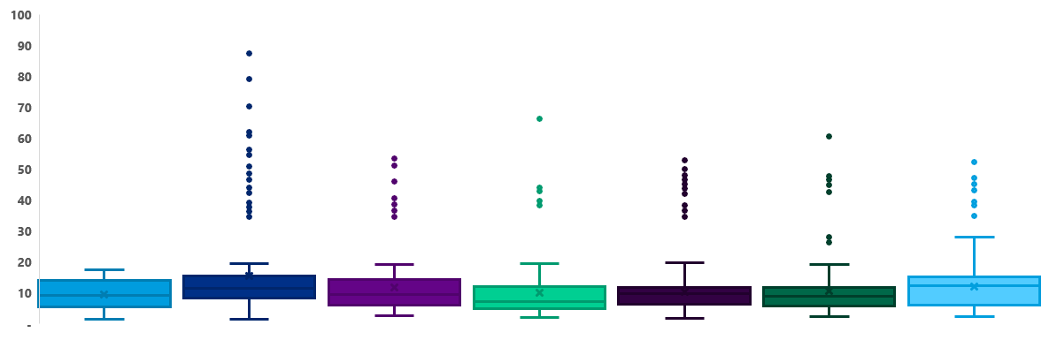
Score Distribution across Servicing Segments 2021
Complexity scores does not vary across the segments due to not much variation in existing product adoption (Branded + Unbranded); Though there are accounts across segments with high complexity scores
Global Accounts | A | B1 | B2 | B3 | C | D
19 | 16 | 21 | 12 | 11 | 16 | 17
12 | 11 | 16 | 9 | 7 | 12 | 15
Mean
Median

Slide 19
Merchant level case studies
Free Now is high complex due to L3M account/brand expansion and existing BT with multiple integrations; Private Sales GmbH less complex due to no exiting complex products like–BT and Fashion vertical with less L12M TPV;
Entity Name | Servicing Segment-2021 | Complexity Score | # of Child Accounts | Vertical | Existing Product Suite | L3M Account/Brand Expansion | L12M TPV | Other reasons for high/low score
FREE NOW | A | 80 | 9 | Travel | Branded + BT (Multiple Integration) | BT | $98M | High # of restrictions & disputes
MSH/METRO AG – Parent | A | 60 | 23 | Retail | Branded XO + Unbranded XO (PP plus) + BT (Multiple Integration) + Others | Branded solution + Others | $2B | High # of restrictions , disputes and parity score
Daimler AG | A | 51 | 12 | Travel | Branded + BT (Multiple Integration) + Others | - | $47M | High Parity Score
CRAGHOPPERS | D | 44 | 3 | Fashion | BT (Multiple Integrations) | - | $534K | L3M Declining
Private Sale GmbH | A | 10 | 1 | Fashion | Branded XO + Others | - | $54M | High Tenure, Less disputes and restrictions

Slide 20
Possible Use Cases of Complexity Score V2.0

Slide 21
Possible use cases with updated complexity score
Key personas and use cases from the CSM org
Business Operations
Observe movements in portfolio complexity before/after segmentation
CSM Portfolio Allocation
Portfolio allocation of accounts to CSMs
Portfolio Prioritization
Capacity Planning
Required capacity across regions
Optimization of revenue under management
Prioritize high-value and more complex accounts for servicing

Slide 22
Appendix

