Slide 1
Data Analytics (Science) Landscape for Professionals with Non-Technical Backgrounds
Aniket Chhabra

Slide 2
Agenda
To be updated

Slide 3






Data Analytics Process (Know How?)
Data
Analysis
Insights
Extracted
Data
Decision & Analysis Outcomes
Stored
Data

Slide 4
Analytics Layers: Where do we sit in the pyramid?
Key Roles and Responsibilities
Non-technical background professionals
Decision Support
Data Analytics
Data Science
Data Engineer
Database Admin (DBA)
Identify strategic focus areas, key questions, take decisions, understand performance etc.
Measure performance, Analyze solutions, Data deep dives/Insights, Identify actionable, KPI measurement, Visualization
Predictive Modelling, Extracting deeper insights from data, Identify patters etc.
Transform Data, Deploy solutions & databases, ETLs
Database warehousing, Data lakes, ETLs, Data Architecture

Slide 5
Analytics Foundation Analytics Competencies Can Foster Business Value: A Systematic process within each domain to enable & realize near term benefits & long-term organization goal
Value
Analytical Competencies
Information Management & Governance
Business Intelligence & Reporting
Business Analytics
Web Analytics
Data Visualization
Statistical Modeling
Data Science & Artificial Intelligence
Storytelling – The Art
How can we
make it happen ?
Prescriptive Analytics
What will
happen?
Predictive
Analytics
Why did it
happen ?
Diagnostic Analytics
What
happened ?
Descriptive Analytics
Complexity

Slide 6








Value Proposition: Analytics & Data Science Converting the business problem into different type of analytical solutions: Churn Reduction
Prescriptive
Descriptive
Pricing Incentives
Cross Sell and Upsell
Run targeted marketing campaign to engage the customers
What is the trend of churn rate
What is the trend across product and merchant segment
What is the trend across region
PREDICTIVE
Diagnostic
Find correlation between various metrics and attributes
Segment the customer base
Run AI/ML/DS model to identify and predict churn
Why is the cause of customer churn
Is the quality of customer getting acquired changed in last few weeks
Is there any pricing issue
Any other Issues

Slide 7
What you will be doing on a day-to-day basis?
Define Problem
Specify Goals
Select Solution
Execute Solution
Monitor Solution
Create Alternatives
Converting
“Business Problem” to
“Data Problem” is the
“most critical step”
Methodologies
Analytics Cycle
Root cause analysis
Cost benefit analysis
Sample based analysis
Performance Reporting & Dashboarding – Business Intelligence
AB Testing

Slide 8




How to get into Data Analytics from Non-Technical Background UpGrad is providing the platform to make the transition
Career Transition
Winning Mantra is Here…
Job Portal Access
How to apply to right set of job roles
How to apply to other job portals
Understanding the Context – Business Problem
Choose the right set of Display of Data
Eliminate the clutter
Story Telling
Focus your attention on what you want
Menstorship
Career Guidance
Doubt clarifications
Relevant Learning Materials
Resume Prep
Case Studies
Basics/Foundations of Data Analysis
Data Analytics case studies
Data Science case studies
A/B Testing
Technical Skills
SQL
Python/R
Tableau/Power BI/QlikView
Excel
Basic Statistics

Slide 9
Business Case Studies

Slide 10

Credit Risk Analytics

Slide 11
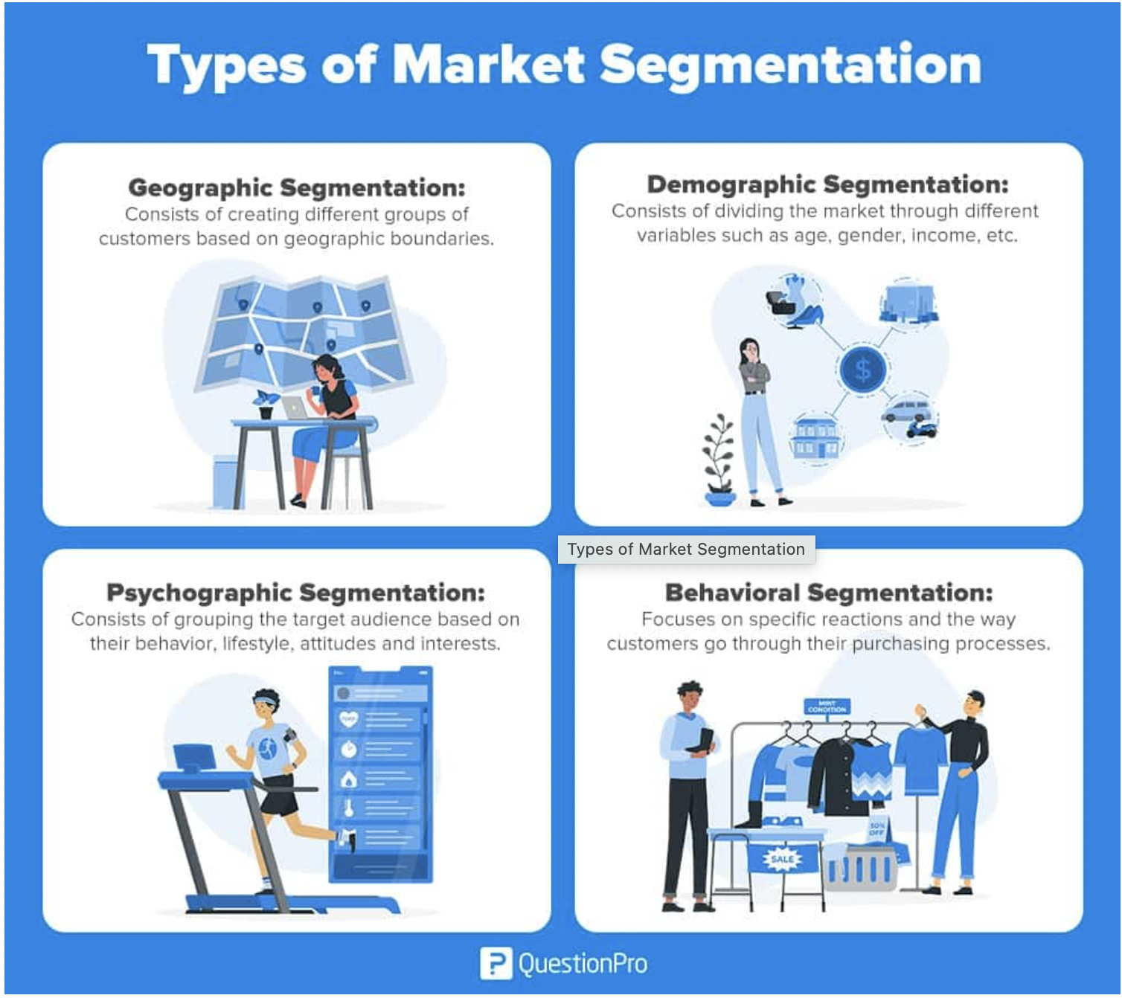
Market Segmentation
Notes:
https://www.questionpro.com/blog/what-is-market-segmentation/

Slide 12
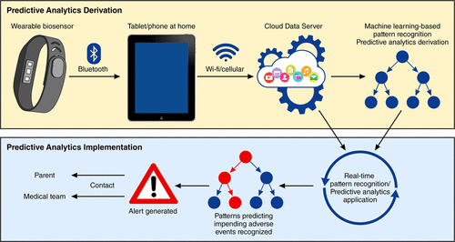
Healthcare Analytics – Wearable Gadgets

Slide 13
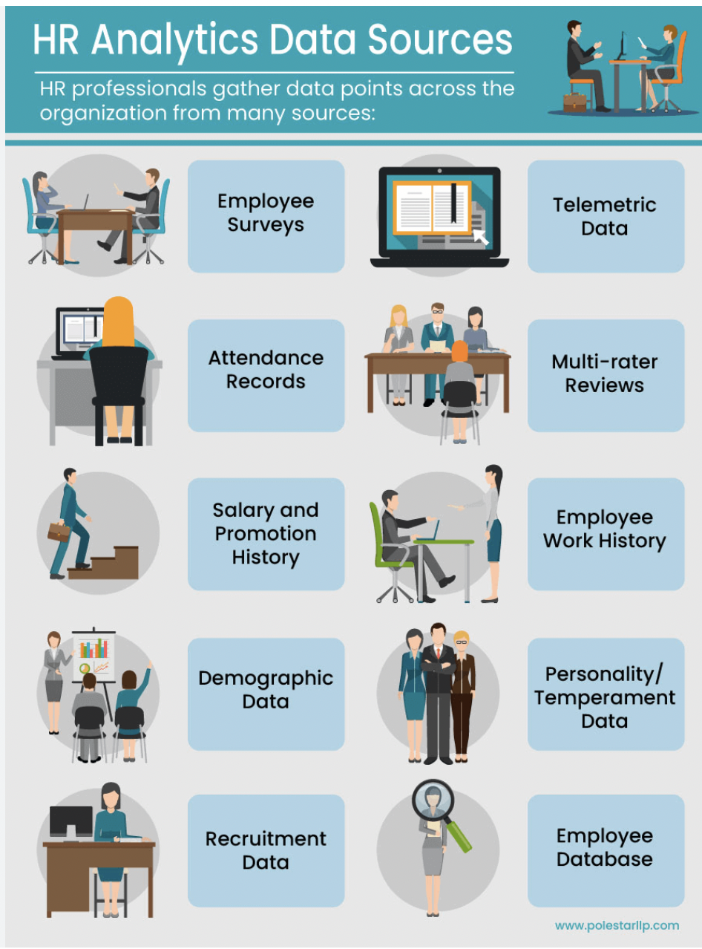
HR Analytics – Scope

Slide 14
Q&A

