Slide 1
Data Analytics/Science Landscape for Professionals with Non-Technical Backgrounds
Aniket Chhabra

Slide 2
Agenda
To be updated

Slide 3






Data Analytics Process (Know How?)
Data
Analysis
Insights
Extracted
Data
Decision & Analysis Outcomes
Stored
Data

Slide 4
Analytics Layers: Where do we sit in the pyramid?
Key Roles and Responsibilities
Non-technical background professionals
Decision Support
Data Analytics
Data Science
Data Engineer
Database Admin (DBA)
Identify strategic focus areas, key questions, take decisions, understand performance etc.
Measure performance, Analyze solutions, Data deep dives/Insights, Identify actionable, KPI measurement, Visualization
Predictive Modelling, Extracting deeper insights from data, Identify patters etc.
Transform Data, Deploy solutions & databases, ETLs
Database warehousing, Data lakes, ETLs, Data Architecture

Slide 5
Analytics Foundation Analytics Competencies Can Foster Business Value: A Systematic process within each domain to enable & realize near term benefits & long-term organization goal
Value
Analytical Competencies
Information Management & Governance
Business Intelligence & Reporting
Business Analytics
Web Analytics
Data Visualization
Statistical Modeling
Data Science & Artificial Intelligence
Storytelling – The Art
How can we
make it happen ?
Prescriptive Analytics
What will
happen?
Predictive
Analytics
Why did it
happen ?
Diagnostic Analytics
What
happened ?
Descriptive Analytics
Complexity

Slide 6
Different Career paths

Slide 7
Junior Professional (0-5 years exp.) Non analytics/science professional with < 5 years of experience with little or no experience with data i.e. – Operations, Finance, Program managers, Marketing etc.
Background
<5 years of experience and non-technical domains
No exposure to technical skills/tools like – SQL, Python, Excel, Tableau and analytical tools
Education –
Goal – Aspiring a Data scientist/Analyst role
Existing Technical Skills
Required Skills
Career Paths/Roles
Responsibilities
Ops Tools
Finance/Accounting Frameworks
Marketing Measurements
A professional certification/Degree
Data Analytical skills – Descriptive, diagnostic etc.
Data Science skills – ML skills
Junior Data Analyst – Finance, Marketing
Junior Data Scientist - Finance, Marketing
Business Intelligence Analyst - Finance, Marketing
Product Analyst/Data Scientist
Becoming a domain expert in your vertical
Improving product experience through data driven insights
Work with business in measuring and reporting KPIs, ad-hoc analysis
BI dashboards for senior leaders
Data Modeling, ML solutions

Slide 8
Mid-Senior Professional (5-10 years exp.) with quantitative background Non analytics/science professional with 5-10 years of experience with little or no experience with data i.e. – Operations, Finance, Program managers, Marketing etc.
Background
5-10 years of experience and non-technical domains
No exposure to technical skills/tools like – SQL, Python, Excel, Tableau and other analytical tools
Education – Maths/stats/economics
Goal – Aspiring a Senior Data scientist/Analyst role
Existing Technical Skills
Required Skills
Career Paths/Roles
Responsibilities
Finance/Accounting Frameworks
Marketing Measurements
Business/domain expertise
Business KPIs tracking
Data analysis, Numbers interpretation, Excel reporting etc.
A professional certification/Degree
Data Science skills – ML solutions, Advanced
Advanced Data Analytics – Prescriptive data, strategy etc.
Senior Data Analyst – Finance, Marketing
Senior Data Scientist - Finance, Marketing
Business Intelligence Analyst - Finance, Marketing
Senior Product Analyst/Data Scientist
Identify Key metrics to track the performance of the business
Engage in problem solving with other teams in collaboration
Support new product launches and setup A/B tests
Develop ML solutions to the business problems

Slide 9
Mid-Senior Professional (5-10 years exp.) non quantitative background Non analytics/science professional with 5-10 years of experience with little or no experience with data i.e. – Operations, Finance, Program managers, Marketing etc without any Math, statistical and economics education
Background
5-10 years of experience and non-technical domains
No exposure to technical skills/tools like – SQL, Python, Excel, Tableau and other analytical tools
Education – Social Science, Diploma etc.
Goal – Aspiring a Senior Data scientist/Analyst role
Existing Technical Skills
Required Skills
Career Paths/Roles
Responsibilities
Ops Tools
Finance/Accounting Frameworks
Marketing Measurements
Business/domain expertise
Business KPIs tracking
A professional certification/Degree
Data Analytical skills – Descriptive, diagnostic and prescriptive
Competitive Intelligence data analytics
Senior Data Analyst – Finance, Marketing
Senior Data Scientist - Finance, Marketing
Business Intelligence Analyst - Finance, Marketing
Senior Product Analyst/Data Scientist
Identify Key metrics to track the performance of the business
Engage in problem solving with other teams in collaboration
Support new product launches and setup A/B tests
Develop ML solutions to the business problems

Slide 10
Senior Professional (10+ years exp.) Non analytics/science professional with 10+ years of experience with little or no experience with data i.e. – Operations, Finance, Program managers, Marketing etc.
Background
5-10 years of experience and non-technical domains
No exposure to technical skills/tools like – SQL, Python, Excel, Tableau and other analytical tools
Education –
Goal – Aspiring a Senior Data scientist/Analyst role
Existing Technical Skills
Required Skills
Career Paths/Roles
Responsibilities
Ops Tools
Finance/Accounting Frameworks
Marketing Head
Business/domain head
Business KPIs tracking
A professional certification/Degree
Deep understanding of across the funnel marketing/customer/product analytics
Data Science/ML capabilities
Data backed decision making
Manager/Sr. Manager – Finance/Marketing/ Product Analytics
Manager/Sr. Manager – Data Science
Manager/Sr. Manager – Business Intelligence
Partner closely with Business owners to understand and setup right metrics for the performance
Guide/Cultivate best practices of analytics/ML Science
Strategic thinking in data driven solutions/approach

Slide 11
Appendix

Slide 12
What you will be doing on a day-to-day basis?
Define Problem
Specify Goals
Select Solution
Execute Solution
Monitor Solution
Create Alternatives
Converting
“Business Problem” to
“Data Problem” is the
“most critical step”
Methodologies
Analytics Cycle
Root cause analysis
Cost benefit analysis
Sample based analysis
Performance Reporting & Dashboarding – Business Intelligence
AB Testing

Slide 13








Value Proposition: Analytics & Data Science Converting the business problem into different type of analytical solutions: Churn Reduction
Prescriptive
Descriptive
Pricing Incentives
Cross Sell and Upsell
Run targeted marketing campaign to engage the customers
What is the trend of churn rate
What is the trend across product and merchant segment
What is the trend across region
PREDICTIVE
Diagnostic
Find correlation between various metrics and attributes
Segment the customer base
Run AI/ML/DS model to identify and predict churn
Why is the cause of customer churn
Is the quality of customer getting acquired changed in last few weeks
Is there any pricing issue
Any other Issues

Slide 14




How to get into Data Analytics from Non-Technical Background UpGrad is providing the platform to make the transition
Career Transition
Winning Mantra is Here…
Job Portal Access
How to apply to right set of job roles
How to apply to other job portals
Understanding the Context – Business Problem
Choose the right set of Display of Data
Eliminate the clutter
Story Telling
Focus your attention on what you want
Menstorship
Career Guidance
Doubt clarifications
Relevant Learning Materials
Resume Prep
Case Studies
Basics/Foundations of Data Analysis
Data Analytics case studies
Data Science case studies
A/B Testing
Technical Skills
SQL
Python/R
Tableau/Power BI/QlikView
Excel
Basic Statistics

Slide 15
Business Case Studies

Slide 16
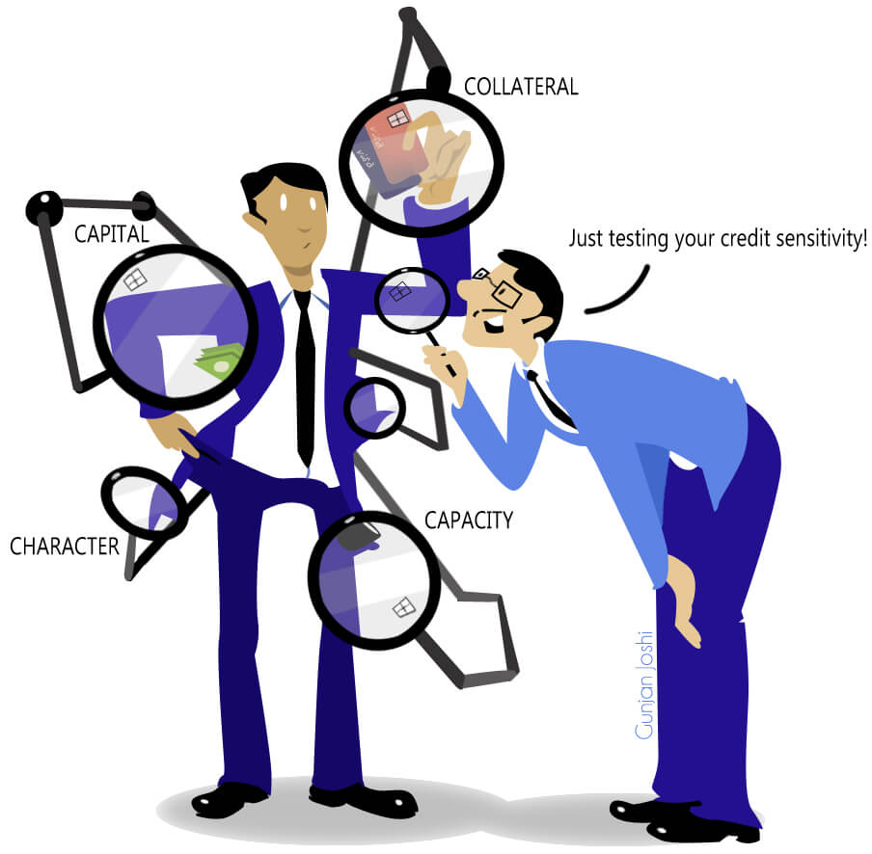
Credit Risk Analytics

Slide 17
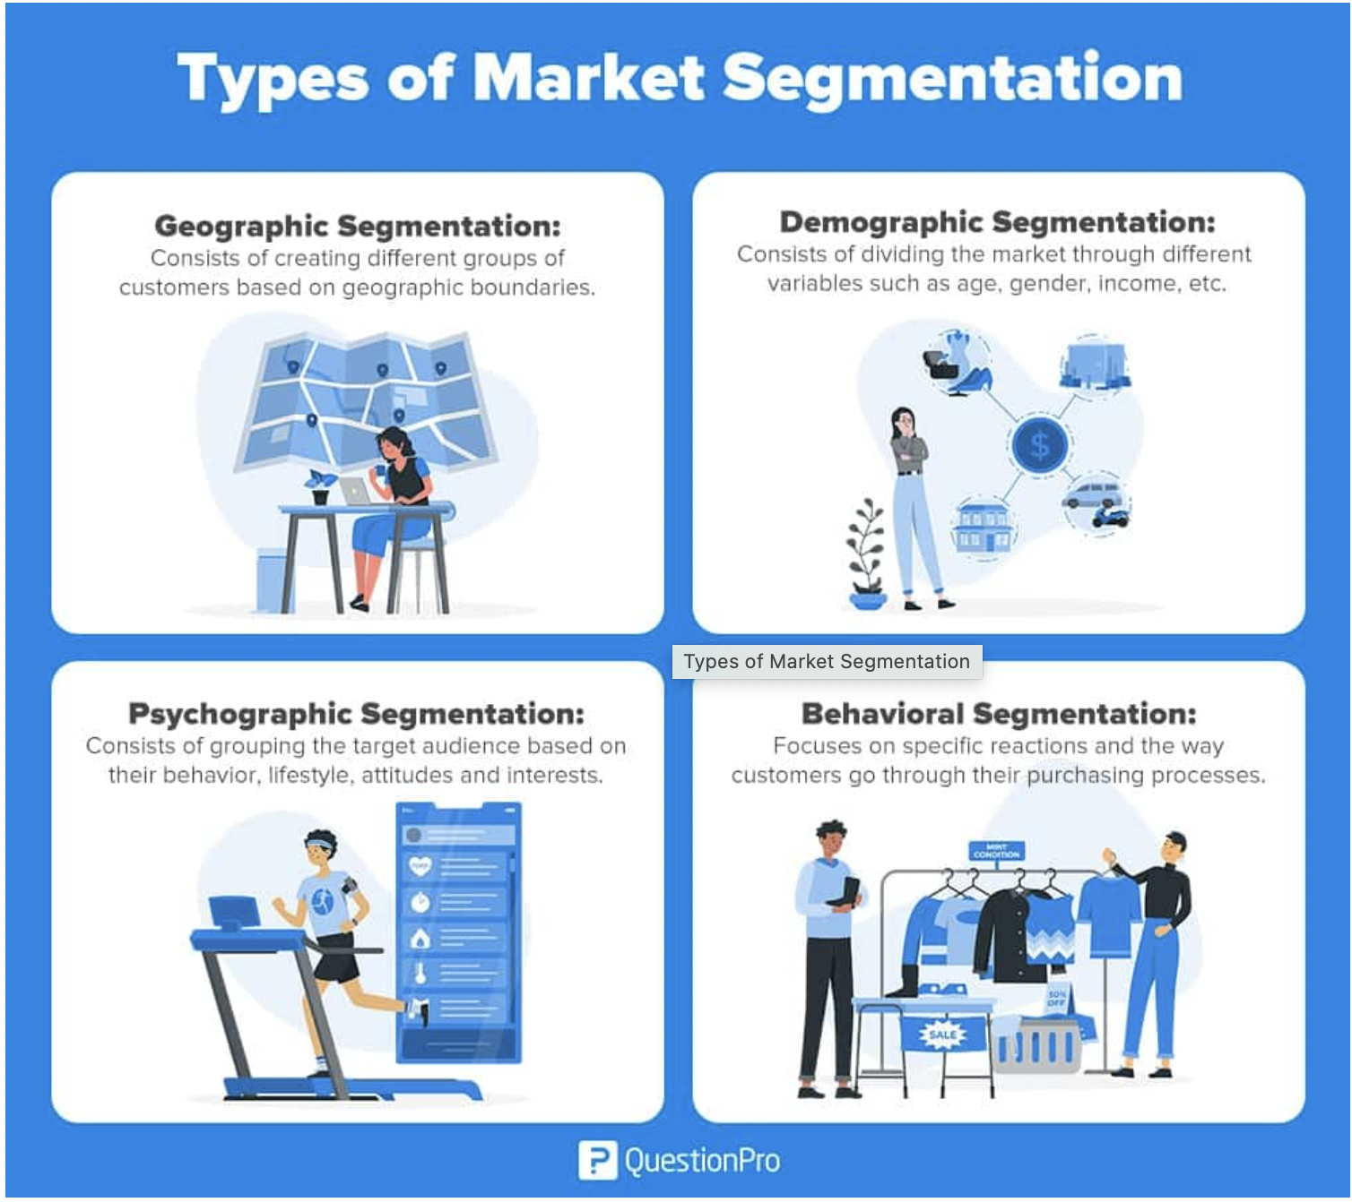
Market Segmentation
Notes:
https://www.questionpro.com/blog/what-is-market-segmentation/

Slide 18
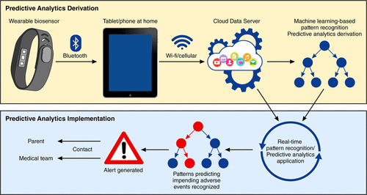
Healthcare Analytics – Wearable Gadgets

Slide 19
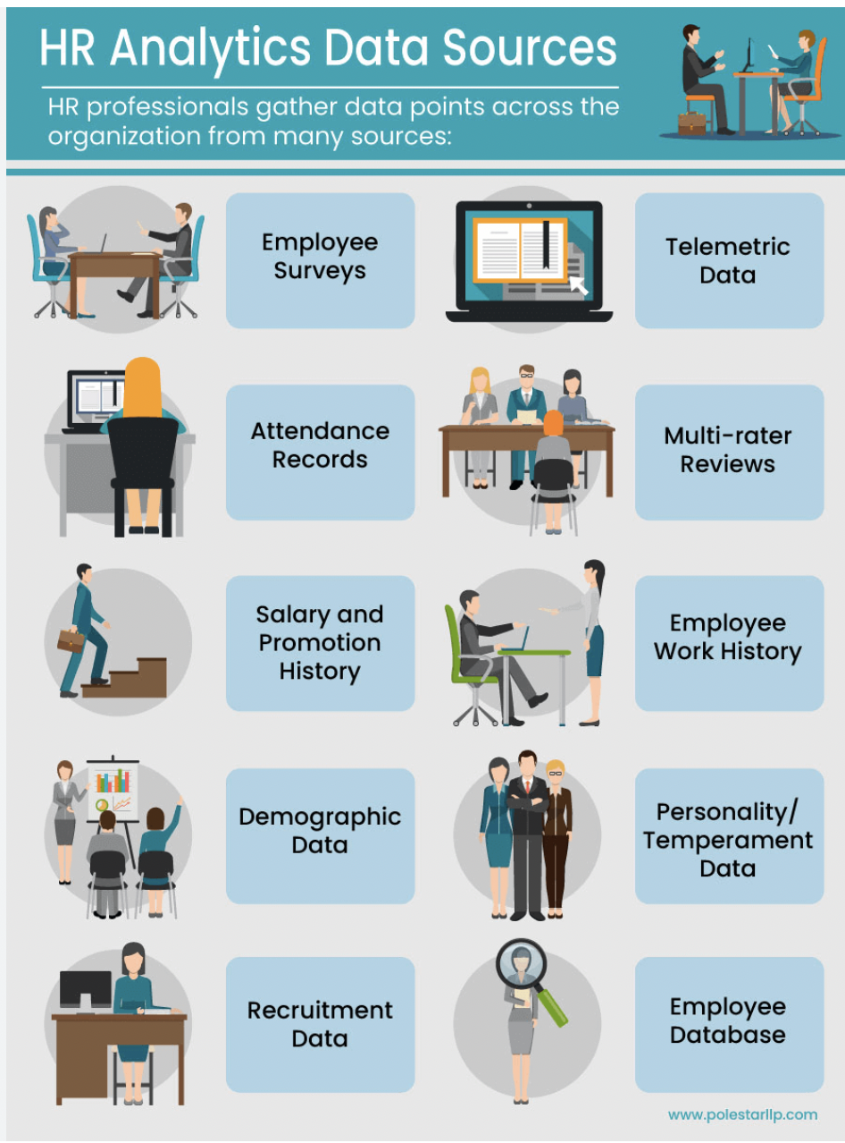
HR Analytics – Scope

Slide 20
Q&A

