Slide 1
Data Analytics/Science Landscape for Professionals with Core-Engineering Backgrounds
Aniket Chhabra

Slide 2
Agenda
To be updated

Slide 3






Data Analytics Process (Know How?)
Data
Analysis
Insights
Extracted
Data
Decision & Analysis Outcomes
Stored
Data

Slide 4
Analytics Layers: Where do we sit in the pyramid?
Key Roles and Responsibilities
Non-technical background professionals
Decision Support
Data Analytics
Data Science
Data Engineer
Database Admin (DBA)
Identify strategic focus areas, key questions, take decisions, understand performance etc.
Measure performance, Analyze solutions, Data deep dives/Insights, Identify actionable, KPI measurement, Visualization
Predictive Modelling, Extracting deeper insights from data, Identify patters etc.
Transform Data, Deploy solutions & databases, ETLs
Database warehousing, Data lakes, ETLs, Data Architecture

Slide 5
Analytics Foundation Analytics Competencies Can Foster Business Value: A Systematic process within each domain to enable & realize near term benefits & long-term organization goal
Value
Analytical Competencies
Information Management & Governance
Business Intelligence & Reporting
Business Analytics
Web Analytics
Data Visualization
Statistical Modeling
Data Science & Artificial Intelligence
Storytelling – The Art
How can we
make it happen ?
Prescriptive Analytics
What will
happen?
Predictive
Analytics
Why did it
happen ?
Diagnostic Analytics
What
happened ?
Descriptive Analytics
Complexity

Slide 6
Different Career paths

Slide 7
Junior Professional- Core Engineering Profile (0-5 years exp.) Core Engineering Profile professional with < 5 years of experience with little or no experience with data i.e. Electrical, Chemical, Mechanical Engineering etc.
Background
<5 years of experience in core engineering/fresher roles
No exposure to technical skills/tools like – SQL, Python, Excel, Tableau and analytical tools
Education – Mechanical/Chemical/non-computer science/non-IT
Goal – Aspiring a Data scientist/Analyst role
Existing Technical Skills/domain
Required Skills
Career Paths/Roles
Responsibilities
Manufacturing plant – Automation
Chemical Engineering
Oil & Gas industry exposure
BHEL, SAIL, Indian Oil etc.
No IT exposure
A professional certification/Degree
Data Analytical skills – Descriptive, diagnostic etc.
Data Science skills – ML skills
Junior Data/Business Analyst – across domain
Business Intelligence Analyst/ Dashboard Reporting – across domain
Data Scientist (as a fresher – if the candidate is exceptional)
Work with business in measuring and reporting KPIs, ad-hoc analysis
Improving product experience through data driven insights
BI dashboards for senior leaders
Data Modeling, ML solutions

Slide 8
Mid-Senior Professional - Design Engineers (5+ years exp.) Design Engineering professionals with 5+ years of experience with little or no experience with data i.e. – Manufacturing, Automobiles, Energy, Electrical etc.
Background
5+ years of experience Design Engineering domains
No exposure to technical skills/tools like – SQL, Python, Excel, Tableau and other analytical tools
Education – Mechanical/Chemical/non-computer science/non-IT
Goal – Aspiring a Senior Data scientist/Analyst role
Existing Technical Skills
Required Skills
Career Paths/Roles
Responsibilities
Supervisors/ Managers
Product Development
BHEL, SAIL, Indian Oil etc.
No IT exposure
A professional certification/Degree
Data Analytical skills – Descriptive, diagnostic etc.
Advanced Data Analytics – Prescriptive data, strategy etc.
Data/Business Analyst – Existing/cross domain if possible
Business Intelligence Analyst/ Dashboard Reporting – existing domain
Research programs – masters degree (if candidate is interested)
Outside India – if candidate is interested/open
Identify Key metrics to track the performance of the business
Engage in problem solving with other teams in collaboration
Support new product launches and setup A/B tests

Slide 9
Mid-Senior Professional - Production /Manufacturing Engineers (5+ years exp.) Production /Manufacturing Engineers professionals with 5+ years of experience with little or no experience with data i.e. – Manufacturing, Automobiles, Energy, Electrical etc.
Background
5+ years of experience and Product/manufacturing domains
No exposure to technical skills/tools like – SQL, Python, Excel, Tableau and other analytical tools
Education – Mechanical/Chemical/non-computer science/non-IT
Goal – Aspiring a Senior Data scientist/Analyst role
Existing Technical Skills
Required Skills
Career Paths/Roles
Responsibilities
Supervisors/ Managers
Manufacturing plant – Automation
No IT exposure
A professional certification/Degree
Data Analytical skills – Descriptive, diagnostic etc.
Advanced Data Analytics – Prescriptive data, strategy etc.
Data/Business/ Product Analyst
Business Intelligence Analyst/ Dashboard Reporting – existing domain
Research programs – masters degree (if candidate is interested)
Outside India – if candidate is interested/open
Identify Key metrics to track the performance of the business
Engage in problem solving with other teams in collaboration
Product capabilities

Slide 10
Mid-Senior Professional - Chemical Engineers (5+ years exp.) Chemical Engineers professionals with 5+ years of experience with little or no experience with data i.e. – Chemical Power Plants etc.
Background
5+ years of experience and Chemical engineering domains
No exposure to technical skills/tools like – SQL, Python, Excel, Tableau and other analytical tools
Education – Mechanical/Chemical/non-computer science/non-IT
Goal – Aspiring a Senior Data scientist/Analyst role
Existing Technical Skills
Required Skills
Career Paths/Roles
Responsibilities
Supervisors/ Managers
Chemical Engineering – Power Plant/Factory/labs
Oil & Gas industry exposure
No IT exposure
A professional certification/Degree
Data Analytical skills – Descriptive, diagnostic etc.
Data/Business/ Product Analyst
Business Intelligence Analyst/ Dashboard Reporting – existing domain
Research programs – masters degree (if candidate is interested)
Outside India – if candidate is interested/open
Identify Key metrics to track the performance of the business
Engage in problem solving with other teams in collaboration
Business Reporting

Slide 11
Mid-Senior Professional - Civil Engineers (5+ years exp.) Chemical Engineers professionals with 5+ years of experience with little or no experience with data i.e. – Civil/Construction Engineering etc.
Background
5+ years of experience in Civil engineering domains
No exposure to technical skills/tools like – SQL, Python, Excel, Tableau and other analytical tools
Education – Civil/non-computer science/non-IT
Goal – Aspiring a Senior Data scientist/Analyst role
Existing Technical Skills
Required Skills
Career Paths/Roles
Responsibilities
Supervisors/ Managers
Civil Engineering – Construction/ Industrial etc.
No IT exposure
A professional certification/Degree
Data Analytical skills – Descriptive, diagnostic etc.
Domain change required
Data/Business/ Product Analyst
Business Intelligence Analyst/ Dashboard Reporting – Different domain
Identify Key metrics to track the performance of the business
Business Reporting – Data
Engage in problem solving with other teams in collaboration

Slide 12
Mid-Senior Professional – Pharma Graduates (5+ years exp.) Pharma Graduates professionals with 5+ years of experience with little or no experience with data i.e. – Civil/Construction Engineering etc.
Background
5+ years of experience in pharma domains
No exposure to technical skills/tools like – SQL, Python, Excel, Tableau and other analytical tools
Education – Pharma Graduate
Goal – Aspiring a Senior Data scientist/Analyst role
Existing Technical Skills
Required Skills
Career Paths/Roles
Responsibilities
Supervisors/ Managers
Pharma Graduates -
No IT exposure
A professional certification/Degree
Data Analytical skills – Descriptive, diagnostic etc.
Domain change required
Data/Business/ Product Analyst – health care
Business Intelligence Analyst/ Dashboard Reporting – Existing/Different domain
Business Reporting – Data
Identify Key metrics to track the performance of the business

Slide 13
Appendix

Slide 14
What you will be doing on a day-to-day basis?
Define Problem
Specify Goals
Select Solution
Execute Solution
Monitor Solution
Create Alternatives
Converting
“Business Problem” to
“Data Problem” is the
“most critical step”
Methodologies
Analytics Cycle
Root cause analysis
Cost benefit analysis
Sample based analysis
Performance Reporting & Dashboarding – Business Intelligence
AB Testing

Slide 15








Value Proposition: Analytics & Data Science Converting the business problem into different type of analytical solutions: Churn Reduction
Prescriptive
Descriptive
Pricing Incentives
Cross Sell and Upsell
Run targeted marketing campaign to engage the customers
What is the trend of churn rate
What is the trend across product and merchant segment
What is the trend across region
PREDICTIVE
Diagnostic
Find correlation between various metrics and attributes
Segment the customer base
Run AI/ML/DS model to identify and predict churn
Why is the cause of customer churn
Is the quality of customer getting acquired changed in last few weeks
Is there any pricing issue
Any other Issues

Slide 16




How to get into Data Analytics from Non-Technical Background UpGrad is providing the platform to make the transition
Career Transition
Winning Mantra is Here…
Job Portal Access
How to apply to right set of job roles
How to apply to other job portals
Understanding the Context – Business Problem
Choose the right set of Display of Data
Eliminate the clutter
Story Telling
Focus your attention on what you want
Menstorship
Career Guidance
Doubt clarifications
Relevant Learning Materials
Resume Prep
Case Studies
Basics/Foundations of Data Analysis
Data Analytics case studies
Data Science case studies
A/B Testing
Technical Skills
SQL
Python/R
Tableau/Power BI/QlikView
Excel
Basic Statistics

Slide 17
Business Case Studies

Slide 18

Credit Risk Analytics

Slide 19
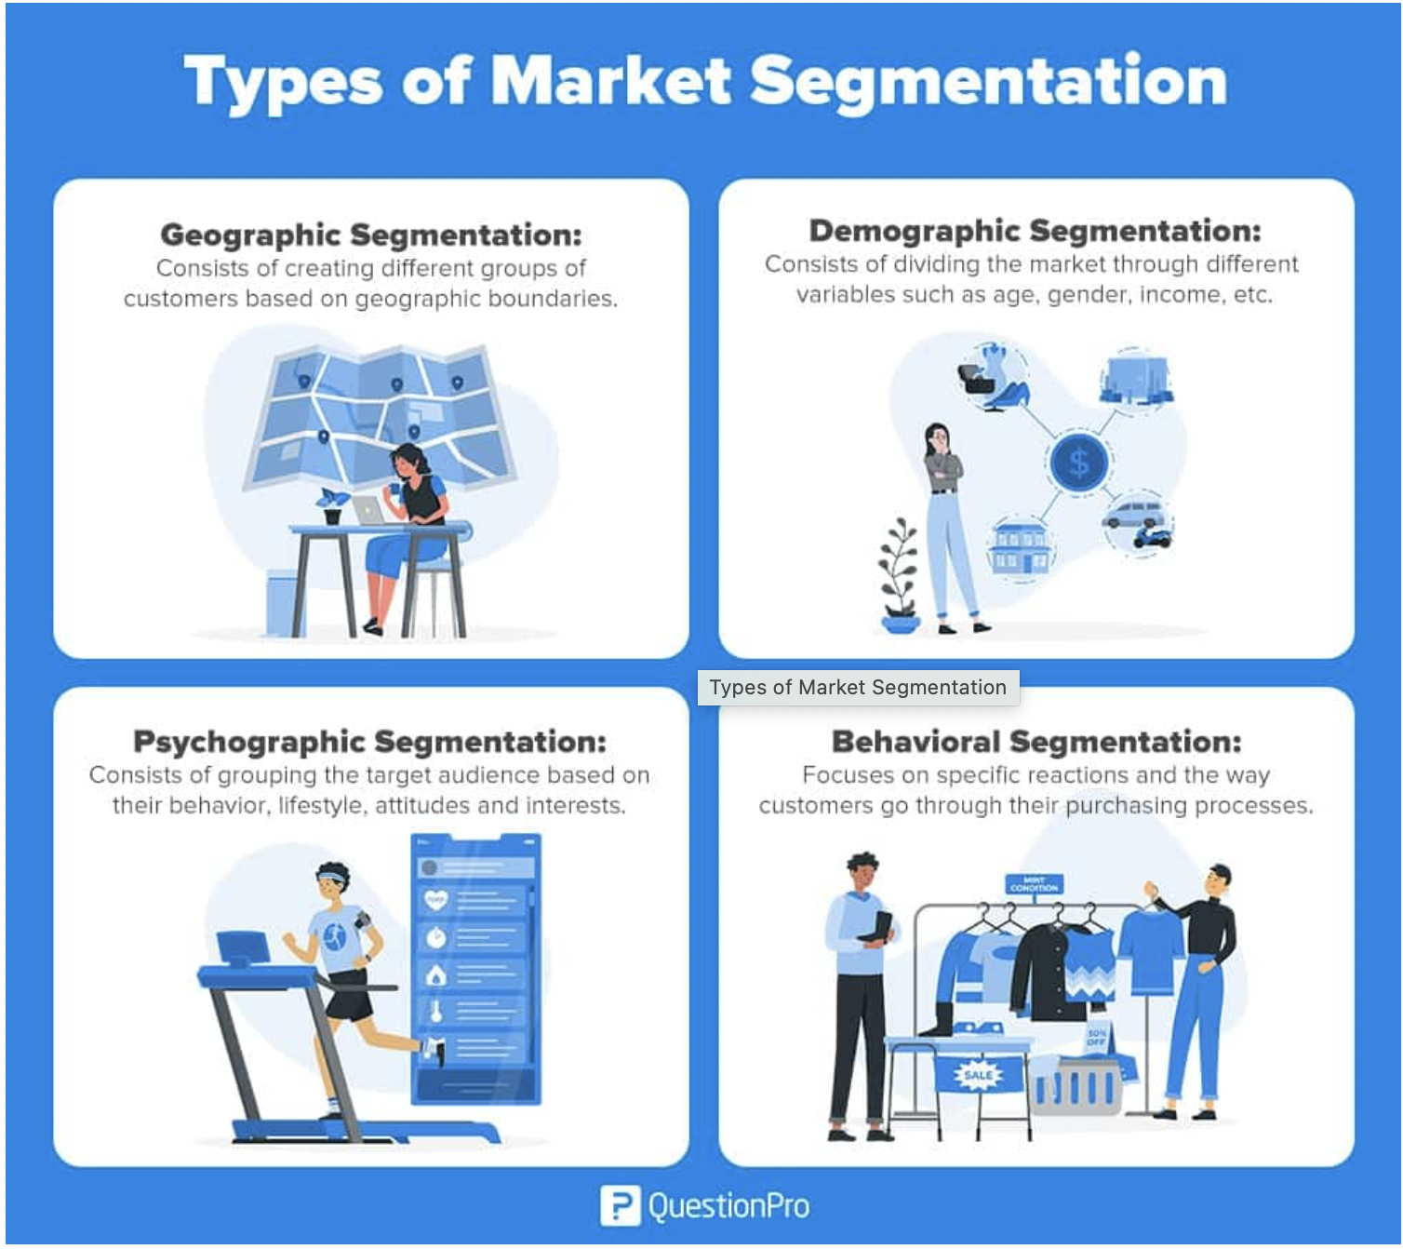
Market Segmentation
Notes:
https://www.questionpro.com/blog/what-is-market-segmentation/

Slide 20
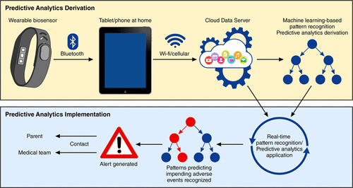
Healthcare Analytics – Wearable Gadgets

Slide 21
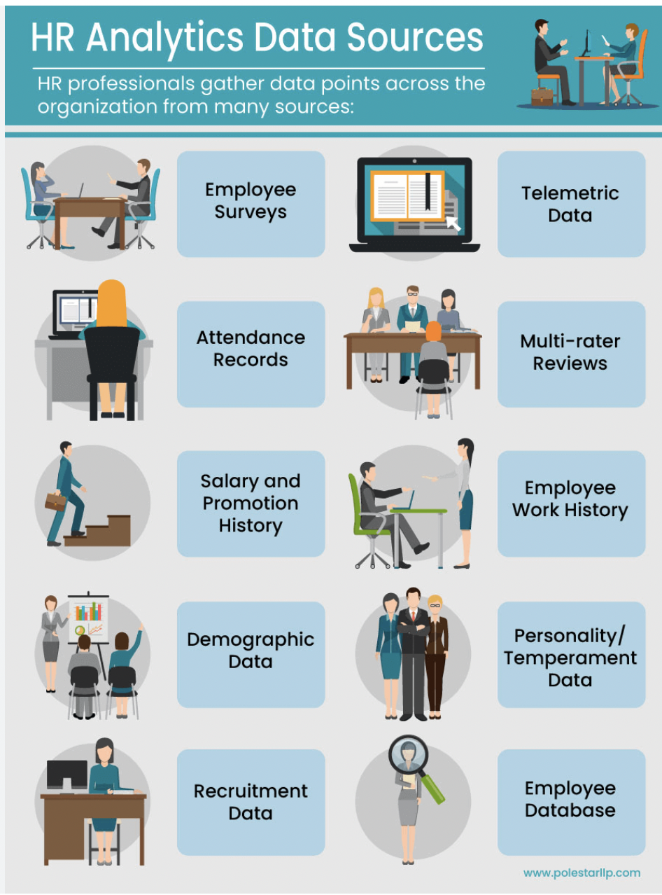
HR Analytics – Scope

Slide 22
Q&A

