Slide 1
Automatic detection of Diabetes Diagnosis
Aniket Bhushan
13mf10006

Slide 2
DATASET
Diabetes disease dataset from UCI database.
Dataset contains 768 samples , where each sample has 8 features which are eight clinical findings :
1. Number of times pregnant
2. Plasma glucose concentration a 2 hours in an oral glucose tolerance test
3. Diastolic blood pressure (mm Hg)
4. Triceps skin fold thickness (mm)
5. 2-Hour serum insulin (mu U/ml)
6. Body mass index (weight in kg/(height in m)^2)
7. Diabetes pedigree function
8. Age (years)
Now each sample takes values either of ‘1’ diabetic or ‘0’ non – diabetic. So, it is a two class classification problem
500 has negative diabetes test and 268 positive.

Slide 3
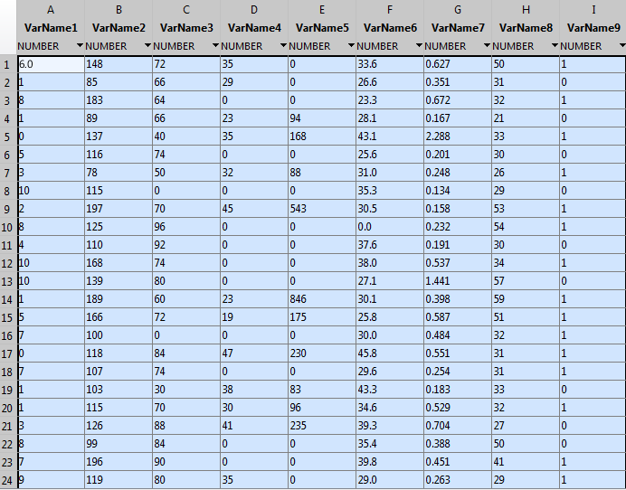

Slide 4
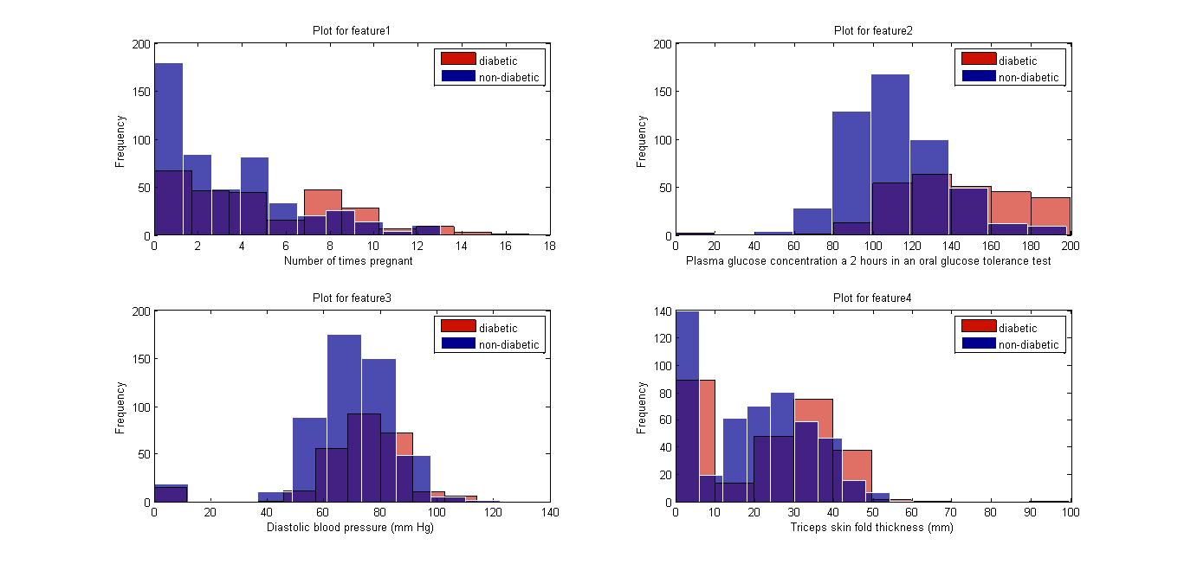
Class conditional feature distribution

Slide 5
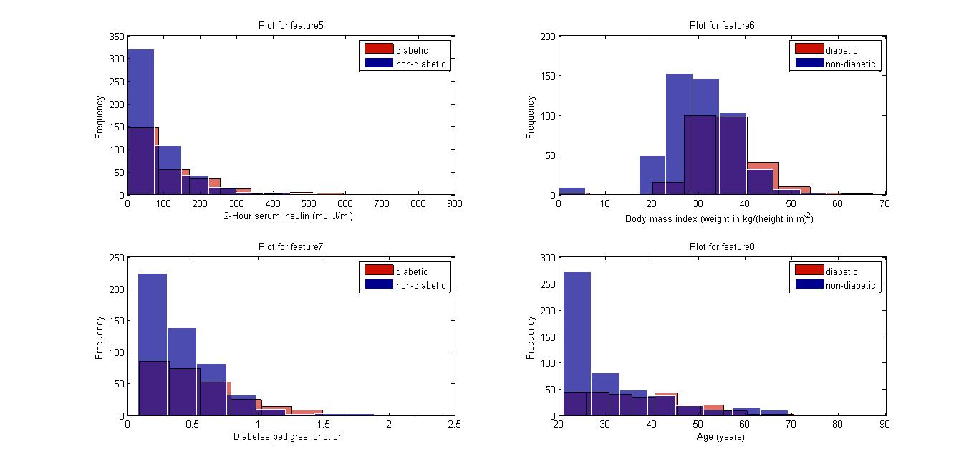

Slide 6
T-test and Statically significant features
1. Plasma glucose concentration .. p-value : 2.6442e-36
2. Body mass index .. p-value : 6.5662e-17
3. Age (years).. p-value : 1.2015e-11
4. Number of times pregnant.. p-value : 6.8219e-09
5. Diabetes pedigree function .. p-value : 6.1005e-06
6. 2-Hour serum insulin.. P-value : 0.0010469
7. Triceps skin fold thickness.. p-value : 0.049356
8. Diastolic blood pressure. p-value : 0.087354

Slide 7
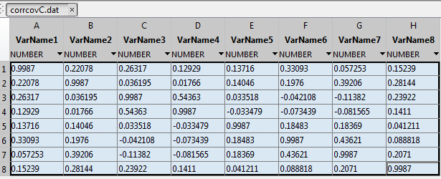
Dimensionality reduction using PCA
We get 8 eigenvectors and Corresponding 8 eigenvalues of correlation matrix of X

Slide 8
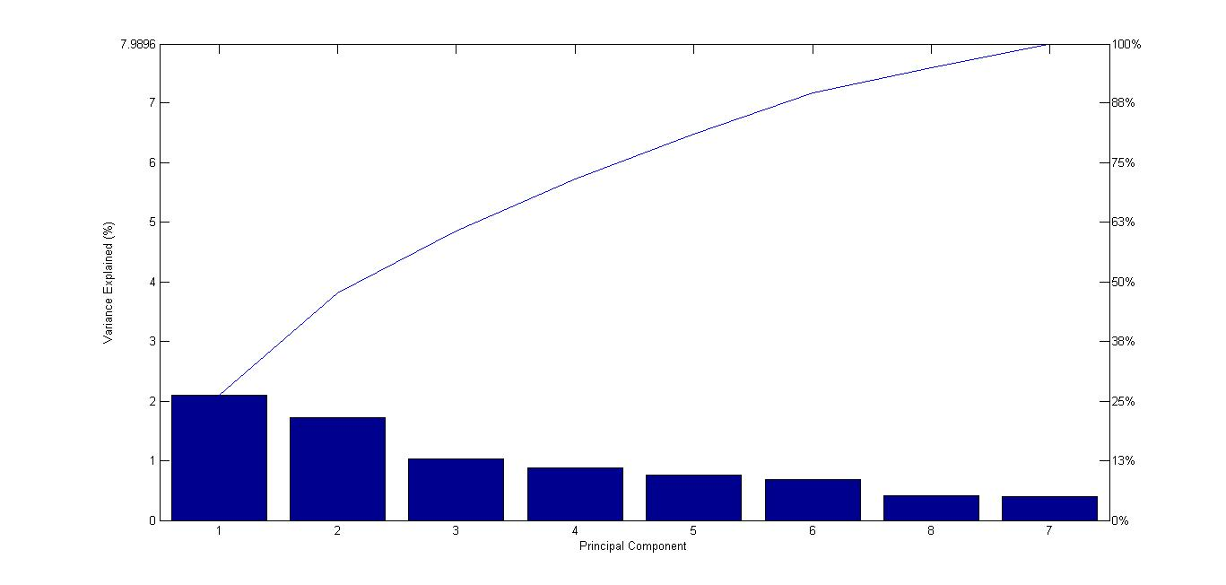
Selection of number of principal components

Slide 9
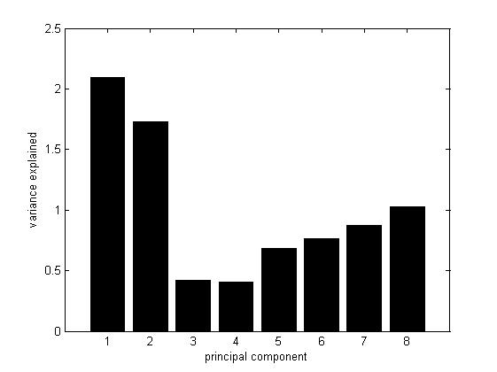
Principal components
k :1 variance retained :0.261797
k :2 variance retained :0.478199
k :3 variance retained :0.606902
k :4 variance retained :0.716344
k :5 variance retained :0.811637
k :6 variance retained :0.896965
k :7 variance retained :0.947523
k :8 variance retained :1.000000
So, 6 principal components with 89.69 % variance retained.

Slide 10
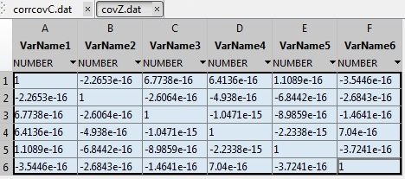
New feature set correlation matrix

Slide 11
DATASET
FEATURE Evaluation Using T-test.
FEATURE SELECTION USING PCA
K – Fold cross validation
Test set
Training set
Naïve Bayes' on test set
Train Naïve Bayes'
Evaluate Accuracy

Slide 12
Reduced dataset after dimensionality Reduction
We get U_reduce
To get Z (reduced dataset) ,Z = projectData(X,U_reduce,p)
So now we have reduced dataset with 6 principal components and 768 samples .

Slide 13
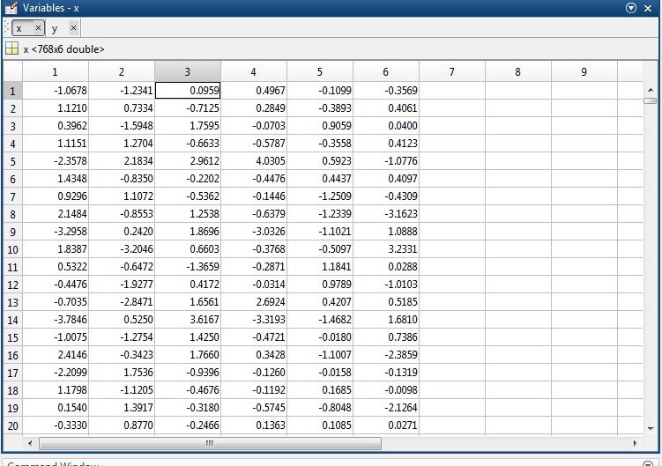
Reduced feature vector

Slide 14
K – fold cross validation
Here k = 10; so 10 fold cross validation
Whole dataset is assigned randomly into 10 partitions
Indices = crossvalind('Kfold',m,10);
So we get 10 equal partitions.

Slide 15
Test and Train set
Out of 10 partitions , each time 1 partition is selected and as Test set and remaining 9 partitions are clubbed in to train set
Run the loop for each partition as the Test set exactly once.

Slide 16
Naïve Bayes classification
In each Iteration ,Fitting the training set using Naïve Bayes classifier
class = NaiveBayes.fit(X(train,:),Y(train,:));
Prediction for the test set using ,C2 = class.predict(X(test,:));
Calculating the confusion matrix using ,cMat2 = confusionmat(Y(test,:),C2);
On the test size of size 77,
Confusion Matrix .
 | Diabetic (predicted) | Non-Diabetic (Predicted)
Diabetic(Actual) | 43 = TP | 7 = FN
Non-Diabetic (Actual) | 12 = FP | 15 = TN

Slide 17
Sensitivity and specificity
Performance of Naïve Bayes classifier
Sensitivity : 78.03 %
Specificity : 67.74 %
Accuracy : 75.13 %

