Slide 1
Zomato Data Analysis
Data Mining Project
Anchit Gupta - MT19060

Slide 2
Project Overview
The main objective of this project to predict the restaurants rating class.
Why Zomato?
Zomato is one of the largest online food delivery and restaurants searching company.
Data Source:
Kaggle:Kaggle:Himanshu Poddar

Slide 3
Data Preprocessing
Renaming the ambiguous attributes names.
Dealing with NULL values
Some are missing in very less number.
Others, can be removable or their values can be derived using some methodology.
Removing attributes which are known to have no contribution to classification task.
Compound attribute to asymmetric attributes(One Hot Encoding)
Notes:
Rating out of 5 impurity

Slide 4
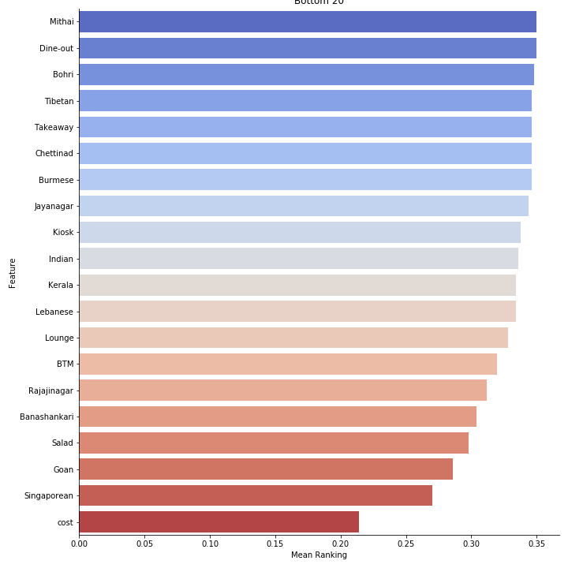
Feature Engineering
Feature Importance using :
Linear Regression
Lasso
Ridge
RFE
Notes:
Top 20
Bottom 20
.35 range is choosen
Review explain why not added

Slide 5
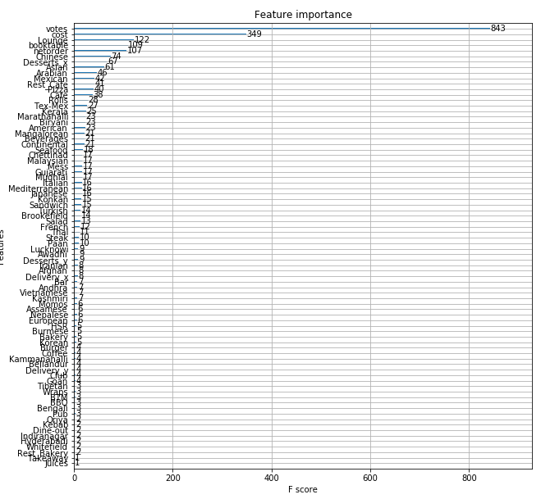
Feature Engineering
Also shown but not used:
Using XGBoost feature importance by F-Scores.

Slide 6
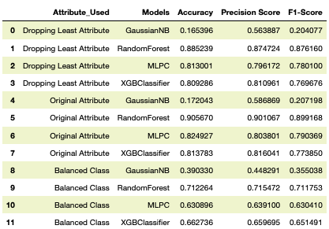
Results
In this I explore 4 types of classification models and used 2 variants of dataset.
Balancing the class is not giving the desired results.
Removing even weak attributes decreasing our scores.
Notes:
Weak -> less importance

