Slide 1

Angular 2
Anchit Gupta
1408210023

Slide 2
Angular 2 Overview
Client Side framework
From Google & Microsoft
Open Source Community
It’s in Alpha for More than 2 years, stable version released last year in October Google I/O 2016

Slide 3
History
Angular is a framework for developing mobile and desktop client side applications. The first version (1.x) was developed in 2009. Google plays an important role in its development. The second version (2) is already available for users in stable build.
The second version is kind of a new framework. Angular was rewritten from scratch. Apart of the same name there is nearly nothing in common. It's second version is called Angular2.

Slide 4
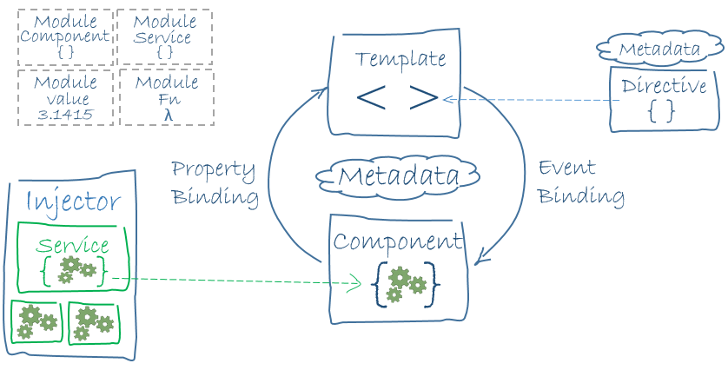
Architecture Diagram

Slide 5
Now Architecture diagram depicts 8 building blocks of Angular2. These are
Modules
Components
Templates
Metadata
Data binding
Directives
Services
Dependency Injection

Slide 6
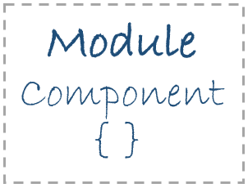
1.Modules
Angular applications are composed of modules. Modules contain Angular’s objects (components, directives and pipes) and also our own app’s objects.
2.Components
A component is a class that controls a specific part of the screen, called the view. It could be something large and always visible, like a navigation bar, or something tiny and feature specific like a single custom made control. Most of the application visual logic will be here.

Slide 7
3.Templates
A template is a form of HTML that tells Angular how to render the component.
4.Metadata
Metadata is a way of processing the class. Consider you have one component called MyComponent which will be a class until you tell Angular that it's a component. You can use metadata to the class to tell Angular that MyComponent is a component .

Slide 8
5.Data Binding
Data binding is the synchronization of data between the model and view components. To display the component property, you can put its name in the view template, enclosed in double curly braces. Two-way data binding merges property and event binding in a single notation using the directive ngModel.
6.Directives
Directives are instructions given to Angular elements to alter their behavior. The most common directive is the @Component declaration, which can be thought of as a directive with a template, meaning it has a clear definition of the elements it will create and manipulate.

Slide 9
7. Services
Service is a broad category. It could be anything: a value, a function, or a feature that an application needs.
8. Dependency Injection
Dependency injection is a coding pattern in which a class receives its dependencies from external sources rather than creating them itself.

Slide 10
How the Angular2 work?
In the 2016 Google I/O Brad Green said It is not merealy a framework but a Platform.In summarize way it’s working can be explaines as:
The AngularJS framework works by first reading the HTML page, which has embedded into it additional custom tag attributes.
Angular interprets those attributes as directives to bind input or output parts of the page to a model that is represented by standard JavaScript variables.
The values of those JavaScript variables can be manually set within the code, or retrieved from static or dynamic JSON resources.

Slide 11
Why Angular2 faster than others?
Angular2 uses “template compiler” or “offline compiler” the so-called Ahead-of-time (AoT) compilation. Many JavaScript frontend frameworks basically render the templates dynamically into the browser’s DOM at runtime, which requires a templating engine of some kind. Angular 2 templates and it’s components are made in a way that Angular 2 is able “to reason about your app’s templates” and thus to generate an AST and consequently to translate all of templates into pure JavaScript code at compile time.

Slide 12
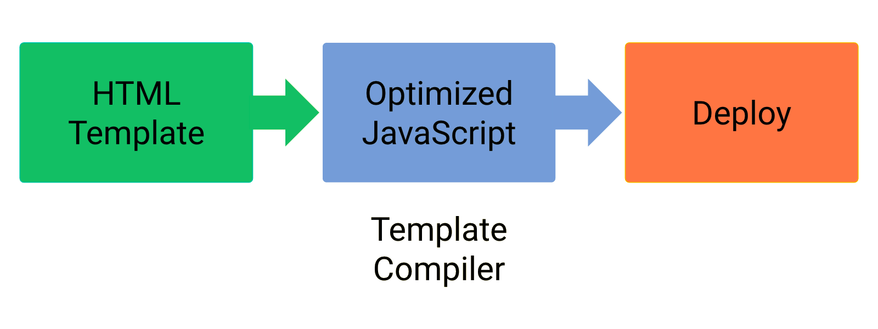
On contrary Angular2 can be viewed as

Slide 13
Languages
You have options:
•
TypeScript
•
Dart
•
ES6
•
ES5

Slide 14
Typescript
TypeScript is a free and open-source programming language developed and maintained by Microsoft. It is a strict superset of JavaScript, and adds optional static typing and class-based object-oriented programming to the language.
The code we write in TypeScript is compiled into JavaScript.

Slide 15
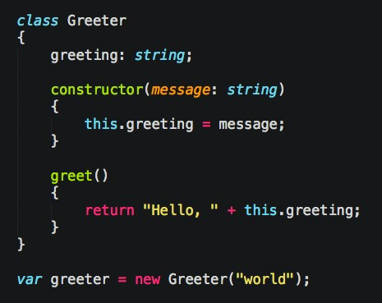
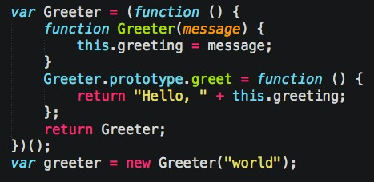
Example of typescript

Slide 16
Dart
Dart is an open-source general-purpose programming language originally developed by Google and later approved as a standard by ECMA (ECMA-408). Dart is used for building web, server, mobile applications and IoT devices.
Dart is an open source class based, object oriented, optionally typed programming language that allows us to develop browser based one page web applications and server side applications.

Slide 17
Dart
The syntax seems friendly both to those who are used to JavaScript and to those who are used to Java\PHP\C#.
We can execute the code either by using a Dart VM or by compiling it into JavaScript.

Slide 18
Dart
The first web application developed for production using Angular 2 was developed in Dart.
It was developed by the Google for their precious project called ‘Google Fiber’

Slide 19
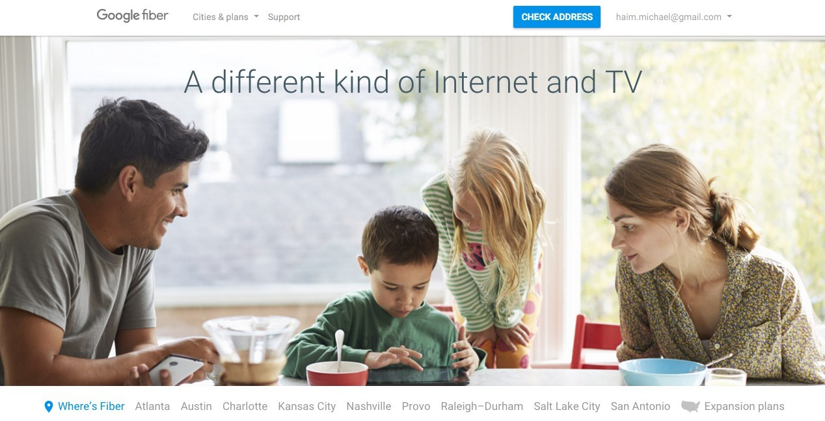

Slide 20
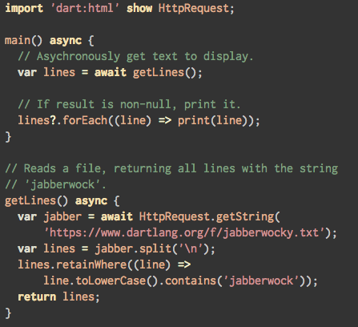

Slide 21
Angular 2 for Dart
AngularDart is the AngularJS version in Dart. Google bases the development of AngularJS on TypeScript working closely with Microsoft. Doing so assists with the compiling of code developed using Angular Dart into JavaScript.

Slide 22
Next version of JavaScript
ES6
•
•
Many parts implemented today
•
Many already have polyfills

Slide 23
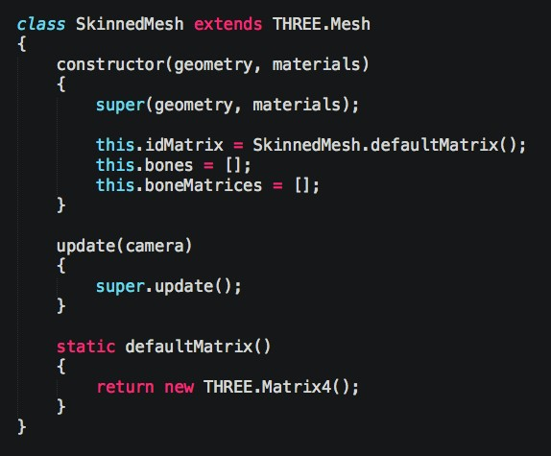

Slide 24
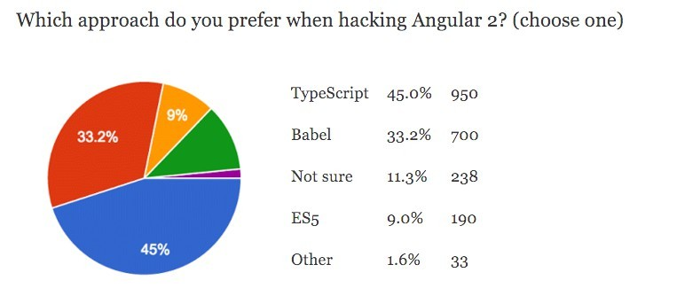
What is The Preferred Language?
Survey that was published by AngularJS blog indicates that TypeScript is probably the preferred option.

Slide 25
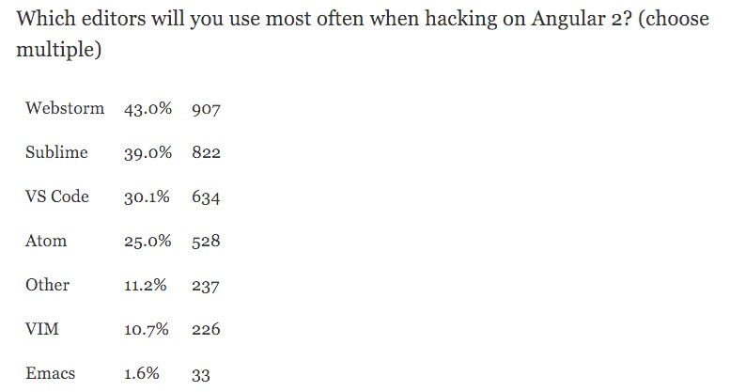


What is The Preferred Editor?
Survey that was published by Angular2 blog shows the following results:
https://www.jetbrains.com/webstorm/
http://www.sublimetext.com/

Slide 26
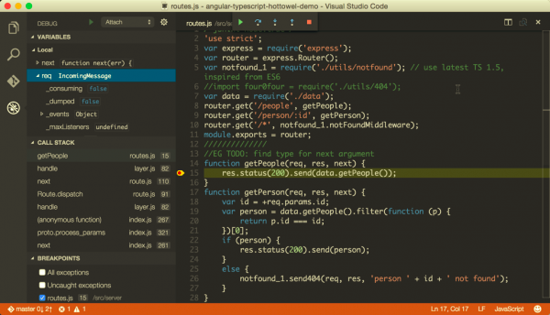
Virtual Studio Code

Slide 27
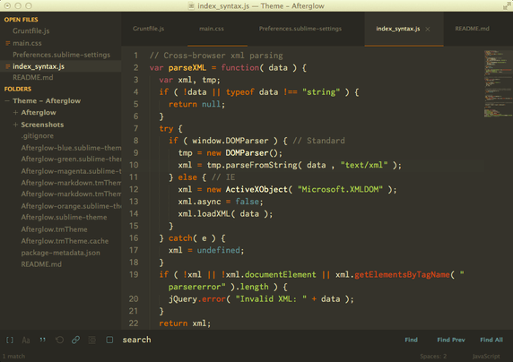
Sublime Text3

Slide 28
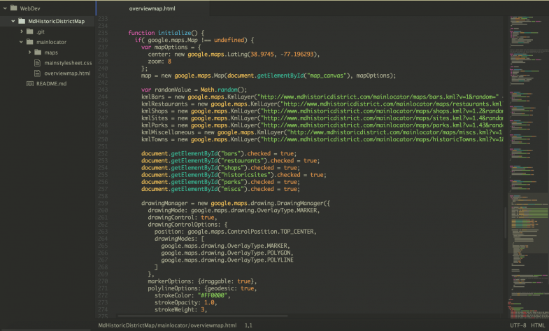
Atom

Slide 29
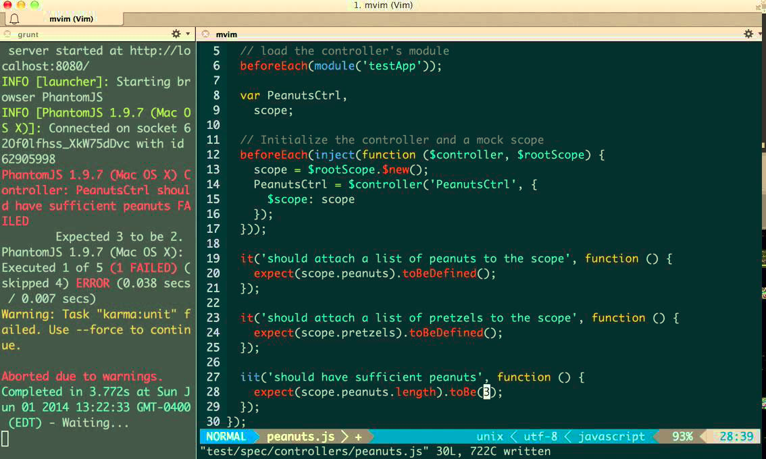
Vim Ide

Slide 30
Angular1 vs Angular2

Slide 31
Differences
Performance improvements
Mobile Support
TypeScript Supported
No $scope in Angular 2
Component based Programming

Slide 32
Why Angular2
3 Main Reasons

Slide 33
Angular 2 Performance
Angular 2 is significantly faster comparing with Angular 1. The ultrafast change detection and view caching allows a smoother virtual scrolling and a smoother view transitions. The server side pre-rendering allows a faster initial loads. The offline compilation allows a faster startup.

Slide 34
2. Expressive Code
The easy-to-write syntax reduces the complexity of the source code and contributes to its expressiveness. The structured rich templates are readable and simple to understand.

Slide 35
3. Cross Platform
The Angular 2 frameworks targets all platforms. Whether it is a desktop application, web application or a mobile application.

Slide 36
Why Angular2 over
React JS
Typescript
Dependency Injection
Polymer JS
Not recommend for large projects
Ember JS
Outdated

Slide 37
Angular2 Capabilities
The Angular framework provides us with various essential features such as mobile gestures, animations, filtering, routing, data binding, support for internationalisation and many more.

Slide 38
Conclusion
Support 4 languages
Faster development
Material Designing
Easy Debugging
Less Complex codes
Used for both Mobile and Desktop Platforms
If an application is a heavy load, then Angular 2 keeps it fully UI responsive.

Slide 39
Thank You

