Slide 1
Analysis Of Migration In India
Presented by:
Ankit Agarawal MT19021
Anchit Gupta MT19060

Slide 2
Motivation
Analysing the migration network can help planning the cities better and to avoid population burst in some areas of the country.
Very good results have been obtained by using graph mining and machine learning techniques for some of the quite difficult problems.
Migration network analysis is a comparatively less explored domain and there is scope for a lot of work here.

Slide 3
Dataset
Our data set includes the migration counts for the 35 States/UT’s(2011 and 2001) along with the source state of the migrants.
The data has
India’s population each decade state wise distribution.
State wise migration distribution of year 2011 and 2001.
Cross country migration data with countries including Countries of Bangladesh etc.
Crime data of the each state year wise including year of year 2011.
GDP , HDI, Crime rate, Employment rate & Literacy rate data of each state for the years 2001 and 2011.

Slide 4
Dataset
Data has been gathered from around 80 files and summarized into various versions as per use cases.
Data of the year 2001 was quite cluttered, so the data has been gathered manually from these files.
The 2011 data has been gathered fully as data contains:
Migration data from Rural to All
Migration data from Urban to All
Migration data from All to All
As some of the 2001 data on the census website was corrupted so only the Total to Total Migration data has been gathered for 2001.

Slide 5
Dataset
Each dataset contains the Migration State from where which Migrant is originally from and state where he/she is migrated to.
So, each file in the end contains 350 * 3 rows approx.
For each row 25 features are present which contains the migrations values.
Census Data of 2001 and 2011 also taken.
For normalizing the migration values with population.
The Data of literacy rate and GDP rate is also taken on year 2001 and 2011.
For the embedding purpose in GCN.

Slide 6
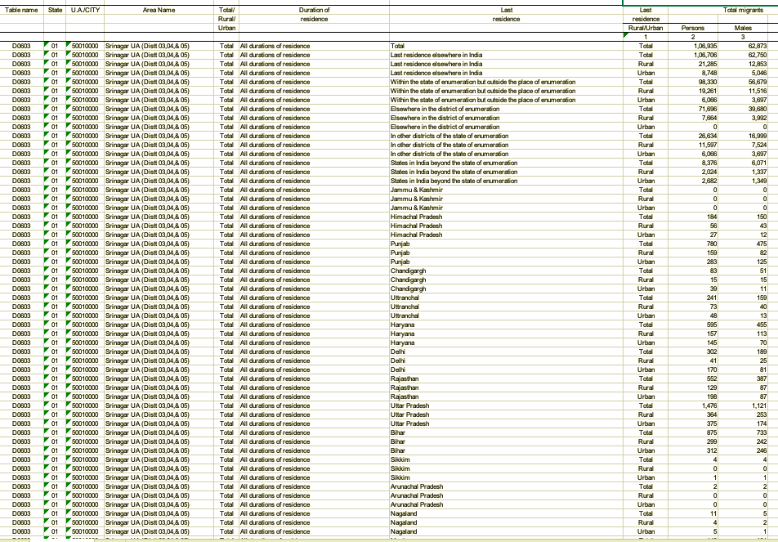

Slide 7
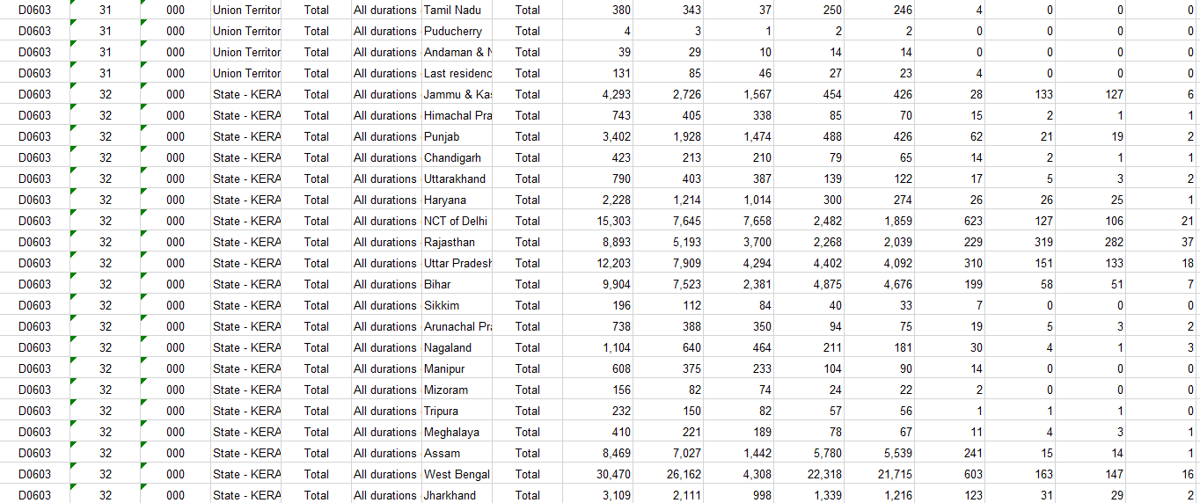

Slide 8
Literature Review
We have reviewed the following 2 works:
Tokyo based migration analysis in which the author tries to show the relation between the population and migration population.
Author shows the population with HDI(Human Development Index) ranking follows the scale free network property.
Also show the causes of centralization of migration in high HDI cities.
Another one is USA migration data analysis;
Which shows the effect of migration due to recession and cheap house holding prices,
Also shows migration influence due to the political reasons.

Slide 9
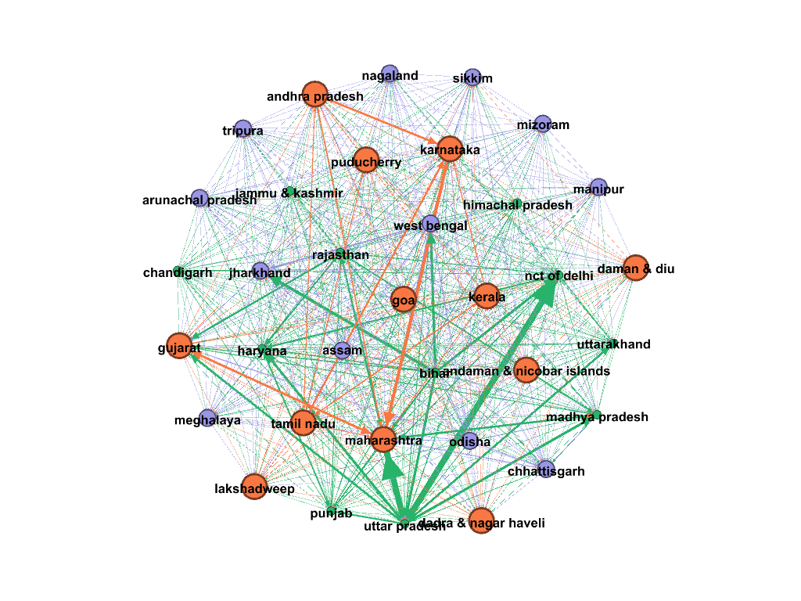
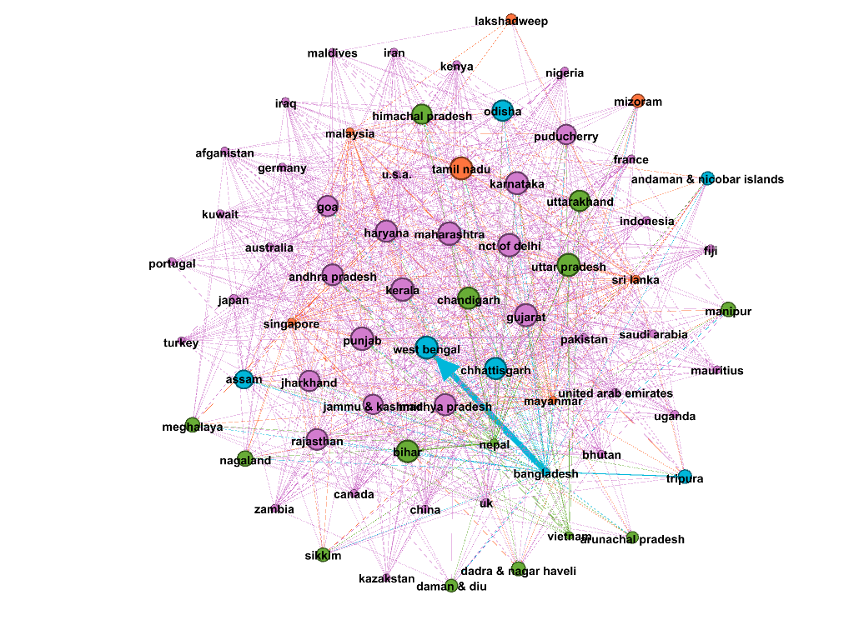
Migration network of inter-state migrants
Avg. Degree = 33.457
Network Diameter = 2
Avg. Clustering coefficient = 0.984

Slide 10
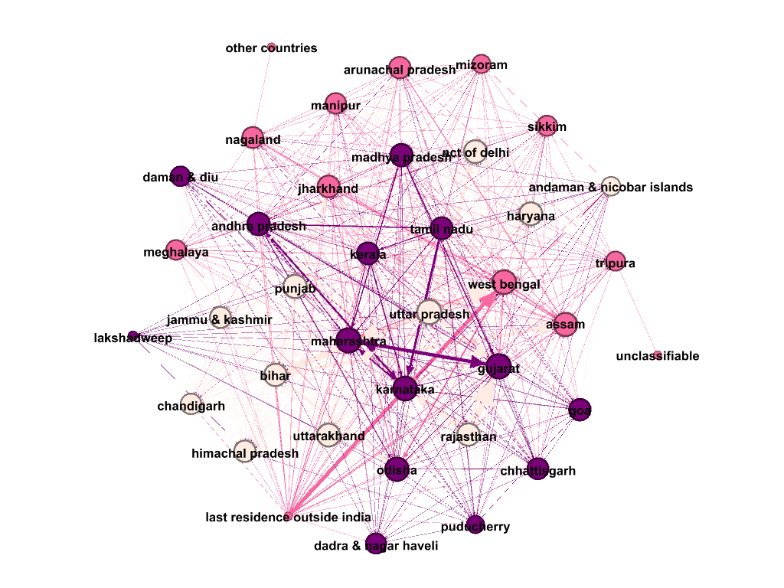
Migration network of inter-state migrants for business purpose
Avg. Degree = 26.342
Network Diameter = 3
Avg. Clustering coefficient = 0.794

Slide 11
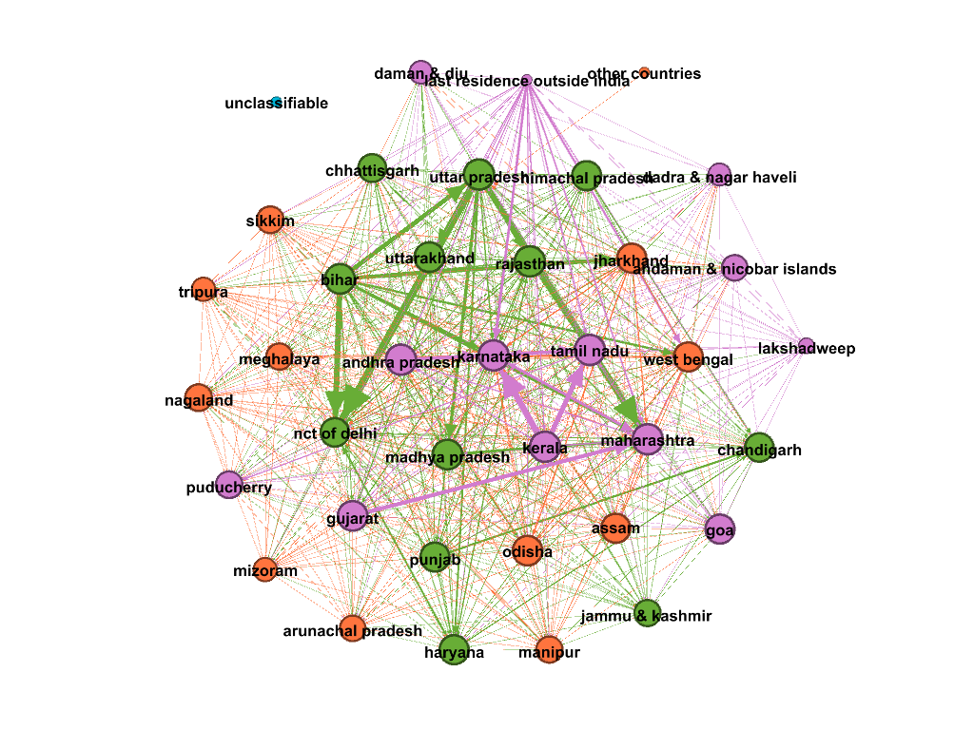
Migration network of inter-state migrants for education
Avg. Degree = 28
Network Diameter = 3
Avg. Clustering coefficient = 0.824

Slide 12
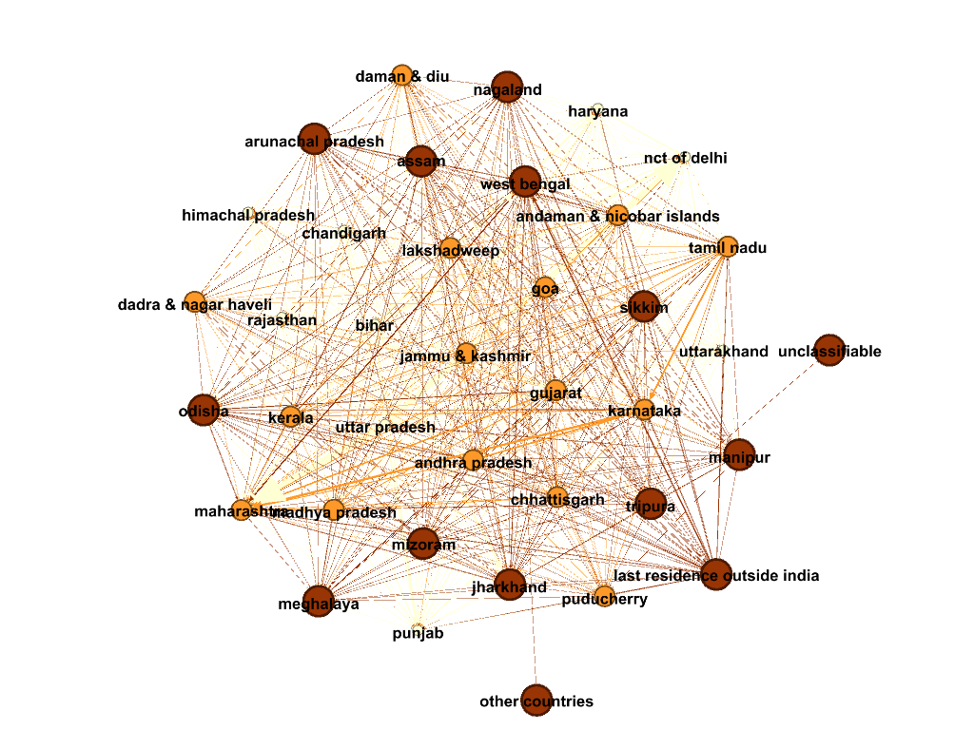
Migration network of inter-state migrants for employment
Avg. Degree = 31.316
Network Diameter = 3
Avg. Clustering coefficient = 0.892

Slide 13
Migration network of cross-country migrants
Avg. Degree = 12.681
Network Diameter = 1
Avg. Clustering coefficient = 0

Slide 14
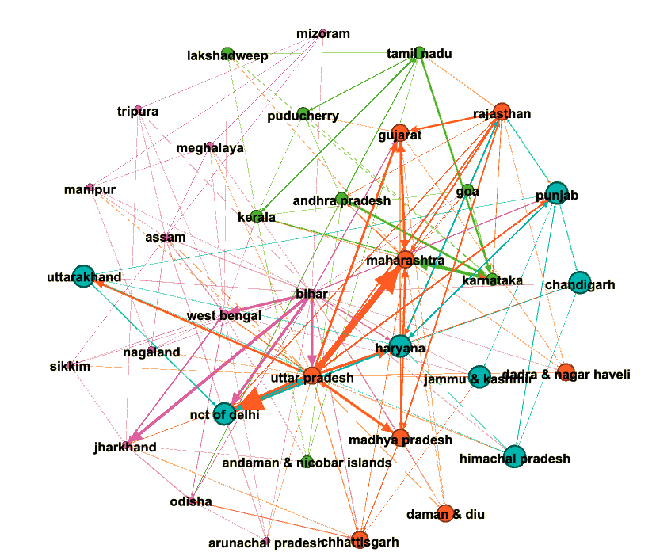
Most Migrating in each state

Slide 15
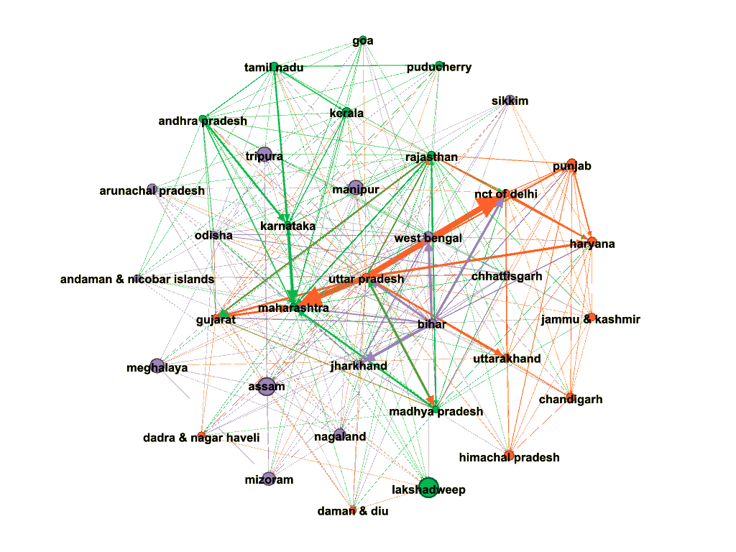
10 Most Migrating in each state

Slide 16
Graphs Plotted
Now ranks for cities are calculated based on their Human Development Index (HDI) values.
Graphs are plotted by keeping the rank on X-axis and other values on Y-axis

Slide 17
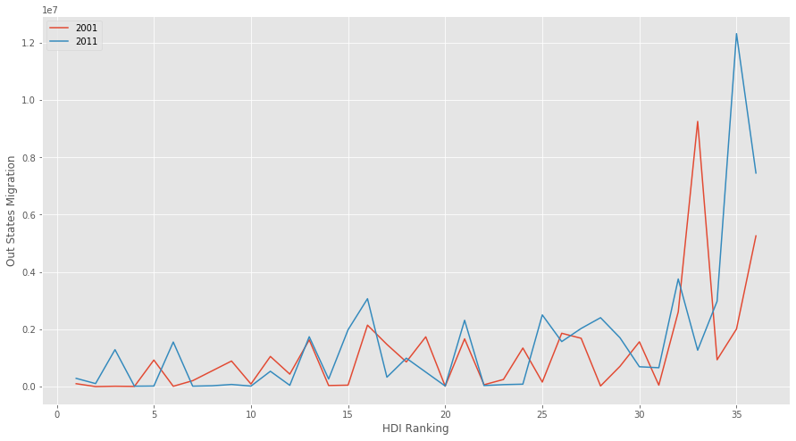
Graph plotted for HDI ranks vs out migration for states/UTs

Slide 18
Graph plotted for HDI ranks vs out migration for states/UTs
The graph plotted in the previous slide shows that there is a relationship between the rank of a state/UT based on HDI and the count of people migrating out from that place. It can be seen that there are less people migrating out from places which have a higher rank as compared to the ones with lower HDI ranks.

Slide 19
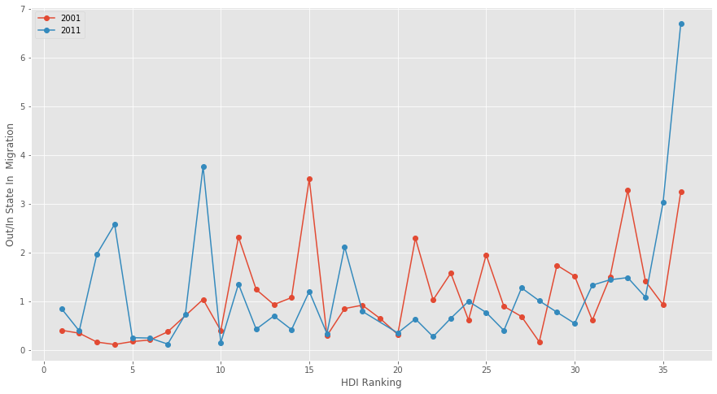
Graph plotted for HDI ranks vs out / in migration for states/UTs

Slide 20
Graph plotted for HDI ranks vs out / in migration for states/UTs
The graph plotted in the previous slide shows that in the year 2001 mostly the in migration is greater than the out migration for the states/UTs with higher HDI ranks. Also, out migration is greater than the in-migration for the states/UTs with lower HDI ranks.
The graph for the year 2011 follows the above relation for lesser no. of places as compared to that in 2001 which might mean that in year 2011 there are significant factors other than HDI which contribute to the migration.

Slide 21
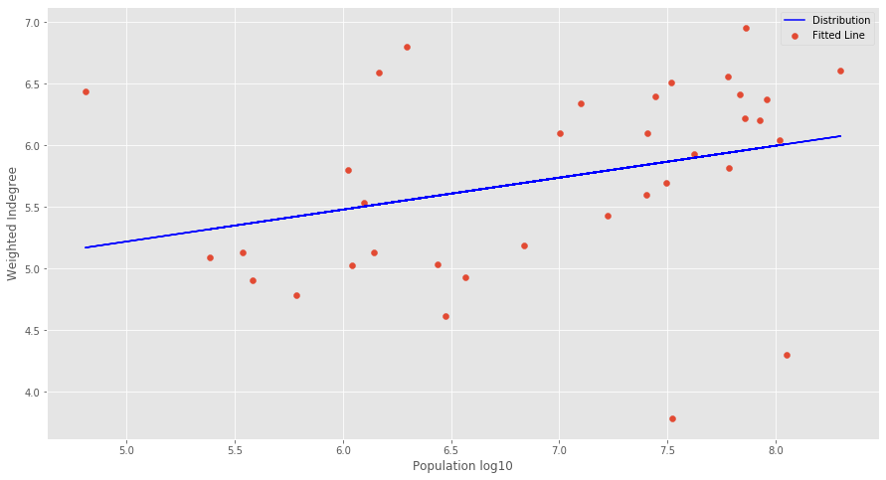
Graph of log population vs weighted indegree

Slide 22
Graph of log population vs weighted indegree
The above graph shows that there is higher in-migration at the places which are already highly populated.

Slide 23
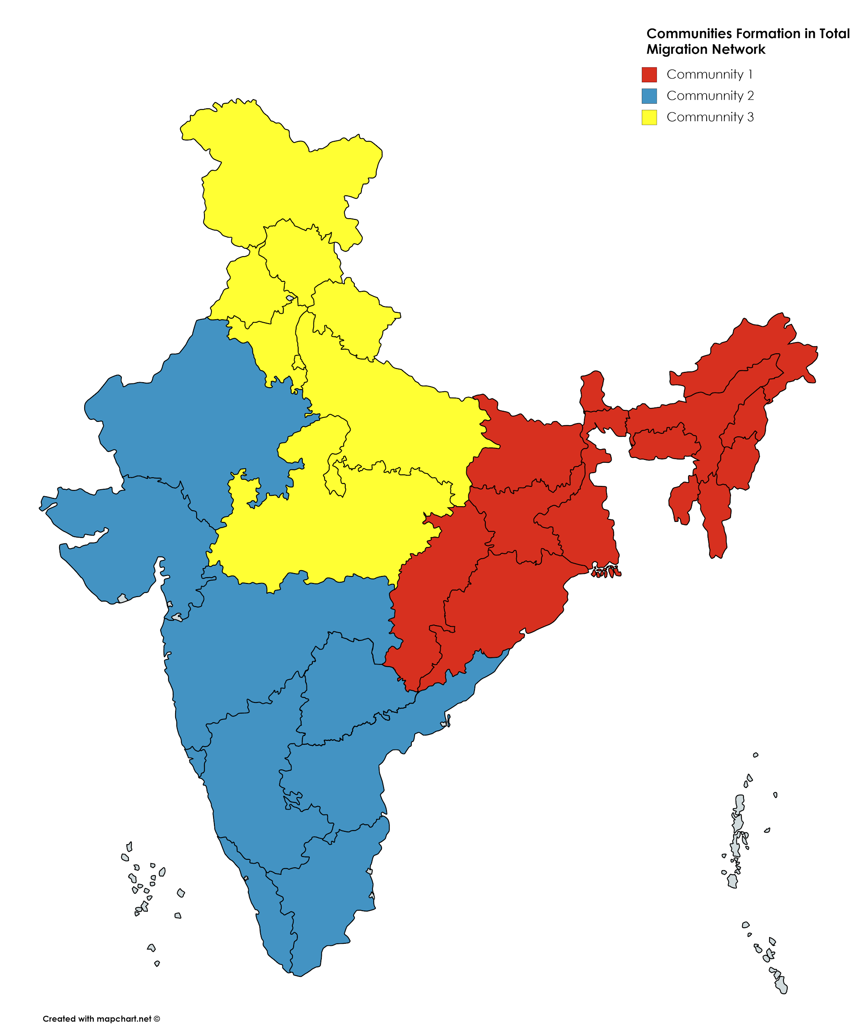
Network Analysis
Firstly we check the communities in the network formed using the total migration data of each state to stimulate what behaviour is persisting by migration flow.
Communities are created in the map as connected components.
Strong migration is between Community 1 and 2 & Community 2 and 3.

Slide 24
Network Analysis
In this we have performed the network analysis using the Weighted PageRank and HITS algorithm.
Using random walker we try to stimulate the behaviour of migration of each state with overall nodes.
For this we have used migration data of education of year 2001 and 2011.
By comparing both the graphs we saw that rise of the Rajasthan and Tamil Nadu as the new emerging educational hotspots in 2011.

Slide 25
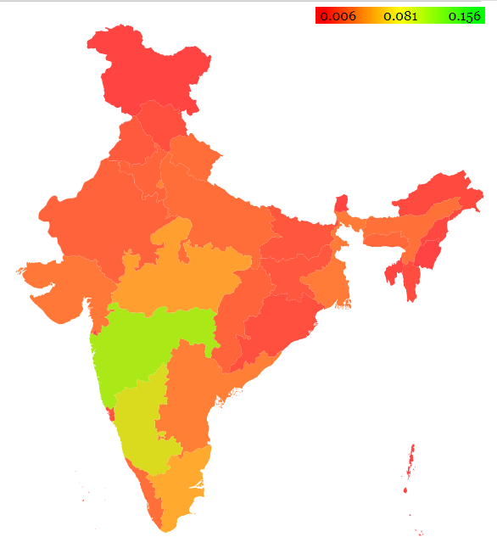
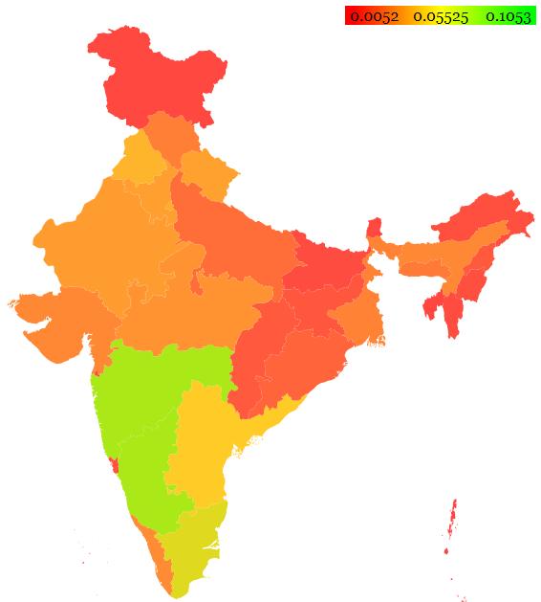
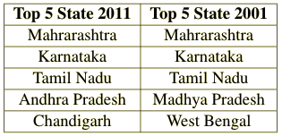
Migration Due to Education in 2001
Migration Due to Education in 2011

Slide 26
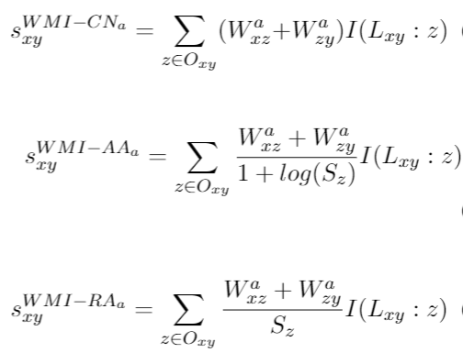
Weighted Link Prediction
Traditional methods like Common neighbour, Adamic Adar and Resource allocator consider edges as unweighted.
Modified version of these methods used where the weight which is by default considered as 1 previously is replaced by the actual edge weight.

Slide 27
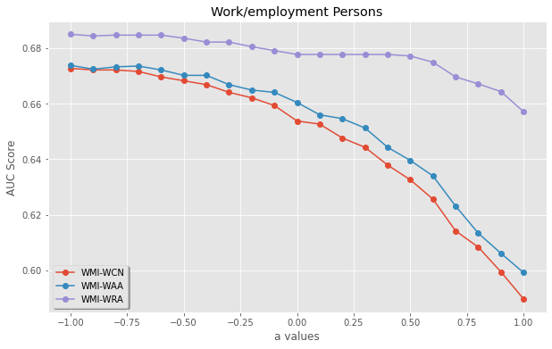
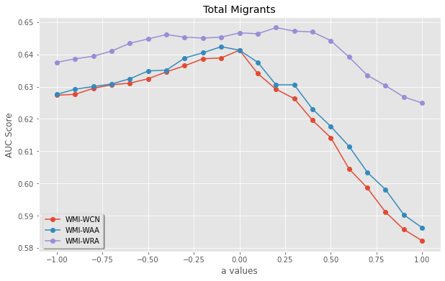
Using this we can say that when using the migration network weak ties should be neglected as for being relatively small edge weight as they can still playing an important role in the analysis of migration network.
So any further study on it must not neglect the even small migration value

Slide 28
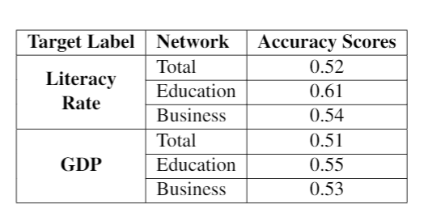
Node classification using GCN
Classify states based on literacy rate and GDP.
Use the node embeddings obtained using GCN.
Embeddings by considering all 6 attributes i.e. in-migrants, out-migrants, PageRank, population, area, density. The results were not good.
Only 4 attributes population size, density and decadal growth and a 2 layer shallow neural network used. Better results obtained.

Slide 29
Challenges:
Gathering the data to make it useful in way to analyze graphically.
In-consistency of data: the common point of different years data.
File Corruption: such as 2001 Delhi data inter migration data is corrupted and have to deal row wise.
In-complete data: such as crime data of some states are not available.
Using of different tools at the same time to analyze and record the data which is most time taking.
Names of the states and new states emerged in causes problem while comparing.
Notes:
Server maintainance

Slide 30
References:
Spatial analysis of centralization and decentralization in the population migration network | Proceedings of the 2006 Asia-Pacific Symposium on Information Visualisation - Volume 60
Goldade, Travis & Charyyev, Batyr & Gunes, Mehmet. (2018). Network Analysis of Migration Patterns in the United States. 770-783. 10.1007/978-3-319-72150-7_62.
Article Source: Link Prediction in Weighted Networks: A Weighted Mutual Information Model
Zhu B, Xia Y (2016) Link Prediction in Weighted Networks: A Weighted Mutual Information Model. PLOS ONE 11(2): e0148265. https://doi.org/10.1371/journal.pone.0148265

Slide 31
Thank You

