Slide 1
Blind system identification (BSI) Date：2022. 01. 24
Telecom Electroacoustics Audio(TEA) Lab
Presenter:
Anchi Yuan
Notes:
Hello everyone
I’m today’s presenter siang. I’m going to share some of my present work in source separation problem. My topic is comparative studies of source separation using semi-blind and blind source separation approaches.

Slide 2
Outline
Multi-channel least mean square (MCLMS)
Simulation setting
Simulation results
Future work

Slide 3
MCLMS

Slide 4
MCLMS

Slide 5
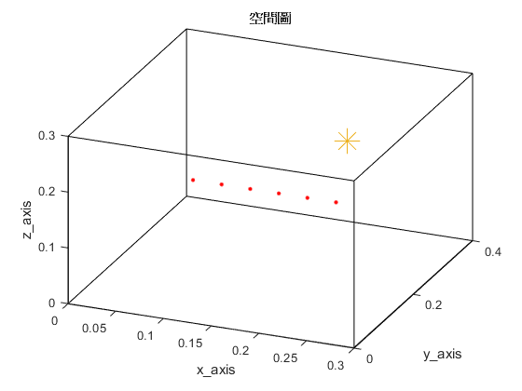
Simulation setting
Six microphones uniform linear array (ULA)
Sampling frequency = 16kHz
Reverberation time T₆₀ = 0.009s (9ms)
Ground-truth RIR samples = 256
Room dimension = 0.3m x 0.4m x 0.3m
Microphone spacing = 0.02m
Source type: white noise
source
(0.2, 0.3, 0.2)
H = 0.3m
y
mic
(0.1, 0.1, 0.2)
z
x
W = 0.4m
L = 0.3m

Slide 6
Simulation results (MCLMS)

Slide 7
Simulation results (TDEDA)

Slide 8
Simulation results (Proposed CTF method)
Method | ME
Proposed CTF method | 1.6916
TDEDA | 8.5429
MCLMS | 12.1922

Slide 9
Future work
Multi-channel frequency domain least mean square (MCFLMS)
Multi-channel CTF least mean square (MCCTFLMS)

Slide 10
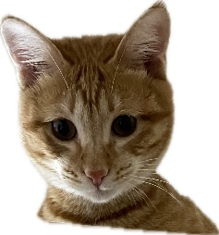

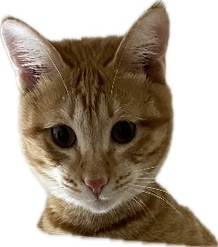
© anchi_0203

