Slide 1
Blind system identification (BSI) Date：2022. 01. 31
Telecom Electroacoustics Audio(TEA) Lab
Presenter:
Anchi Yuan
Notes:
Hello everyone
I’m today’s presenter siang. I’m going to share some of my present work in source separation problem. My topic is comparative studies of source separation using semi-blind and blind source separation approaches.

Slide 2
Outline
Normalized Multi-channel frequency domain least mean square (NMCFLMS)
Simulation setting
Simulation results
Future work

Slide 3
NMCFLMS
Yiteng Huang and J. Benesty, "A class of frequency-domain adaptive approaches to blind multichannel identification," in IEEE Transactions on Signal Processing, vol. 51, no. 1, pp. 11-24, Jan. 2003.

Slide 4
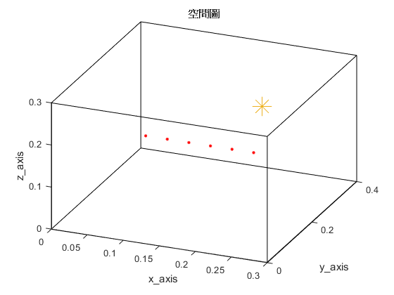
Simulation setting
Six microphones uniform linear array (ULA)
Sampling frequency = 16kHz
Reverberation time T₆₀ = 0.009s (9ms)
Ground-truth RIR samples = 256
Room dimension = 0.3m x 0.4m x 0.3m
Microphone spacing = 0.02m
Source type: white noise
source
(0.2, 0.3, 0.2)
H = 0.3m
y
mic
(0.1, 0.1, 0.2)
z
x
W = 0.4m
L = 0.3m

Slide 5
Simulation results (NMCFLMS)

Slide 6
Simulation results (Proposed CTF method)

Slide 7
Simulation results
Method | NRMSPM(dB)
Proposed CTF method | -27.03
MCLMS | -26.10
NMCFLMS | -0.01

Slide 8
Future work
Multi-channel CTF least mean square (MCCTFLMS)

Slide 9
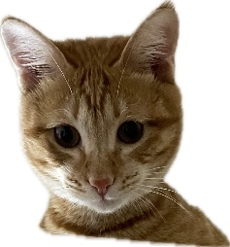

© anchi_0203

