Slide 1
Blind estimation of acoustic transfer functions (ATFs) and dereverberation based on convolutive transfer functions (CTFs) Date：2022. 10. 18
Telecom Electroacoustics Audio(TEA) Lab
Presenter:
Anchi Yuan
Notes:
Hello everyone
I’m today’s presenter siang. I’m going to share some of my present work in source separation problem. My topic is comparative studies of source separation using semi-blind and blind source separation approaches.

Slide 2
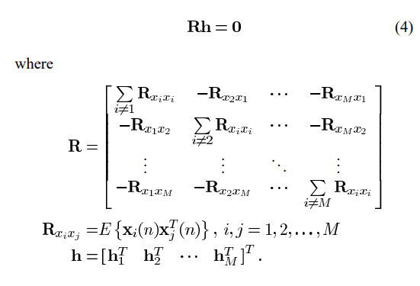

Slide 5


