Slide 1
Blind system identification (BSI) Date：2022. 11. 30
Telecom Electroacoustics Audio(TEA) Lab
Presenter:
Anchi Yuan
Notes:
Hello everyone
I’m today’s presenter siang. I’m going to share some of my present work in source separation problem. My topic is comparative studies of source separation using semi-blind and blind source separation approaches.

Slide 2
Outline
Adaptive Eigenvalue decomposition Algorithm (AEDA)
Simulation setting
Simulation result
White noise
Speech
Speech (Rxx with diagonal loading)
Benesty approach
Simulation result
White noise
Speech
Summary

Slide 3
Adaptive Eigenvalue decomposition Algorithm (AEDA)

Slide 4
Simulation setting
Uniform linear array (ULA)
Sampling frequency = 16kHz
Reverberation time T₆₀ = 0.012s
Ground-truth RIR samples = 200
Room dimension = 0.3m x 0.4m x 0.3m

Slide 5
White noise

Slide 6
Simulation result (3 mics, source:white noise)

Slide 7
Simulation result (4 mics, source:white noise)
掉下來的原因是因為此點1*10^(-19) 後面幾點-1*10^(-18)所以取絕對值再畫成log scale後此點會比較低，但還是必須取最後一點(matlab值太小時之數值問題)

Slide 8
Simulation result (5 mics, source:white noise)

Slide 9
Simulation result (6 mics, source:white noise)

Slide 10
Simulation result (7 mics, source:white noise)

Slide 11
Speech

Slide 12
Simulation result (3 mics, source:speech)

Slide 13
Simulation result (4 mics, source:speech)

Slide 14
Simulation result (5 mics, source:speech)

Slide 15
Simulation result (6 mics, source:speech)

Slide 16
Speech
Rxx with diagonal loading
(In order to make all eigenvalue be positive)

Slide 17
Simulation result (6 mics, source:speech)
Diagonal loading = 10^(0)

Slide 18
Simulation result (6 mics, source:speech)
Diagonal loading = 10^(-3)

Slide 19
Simulation result (6 mics, source:speech)
Diagonal loading = 10^(-6)

Slide 20
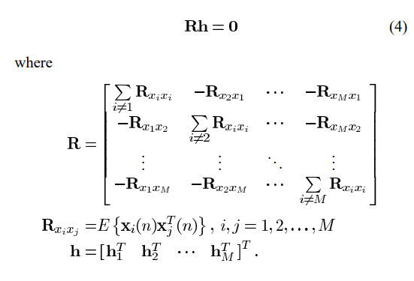
Benesty approach

Slide 21
White noise

Slide 22
Simulation result (6 mics, source:white noise)

Slide 23
Speech

Slide 24
Simulation result (6 mics, source:speech)

Slide 25
Summary
Performance will increase with number of microphones.
Numerical problem of MATLAB will result in a drop on log-scale eigenvalue plot , but we should still pick the last eigenvalue.
Adding diagonal loading to Rxx will shift all eigenvalue to positive part. Thus, it will avoid numerical problem.
While in AEDA white noise treated as source can achieve acceptable results, speech somehow does not.
AEDA outperforms Benesty approach a lot in all source, and Benesty approach somehow will give non-positive eigenvalue (non-positive definite).

Slide 26


