Slide 1
Blind estimation of acoustic transfer functions (ATFs) and dereverberation based on convolutive transfer functions (CTFs) Date：2024. 08. 07
Telecom Electroacoustics Audio(TEA) Lab
Presenter:
Anchi Yuan
Notes:
Hello everyone
I’m today’s presenter siang. I’m going to share some of my present work in source separation problem. My topic is comparative studies of source separation using semi-blind and blind source separation approaches.

Slide 2
Outline
Why do our methods outperform MCLMS ?
TDOA-based localization result
Dereverberation using estimated ATFs or RIRs
Source separation using Tikhonov regularization method
Speech enhancement using MPDR beamformer

Slide 3
Why do our methods outperform MCLMS ?
Normalized root mean square projection misalignment (NRMSPM)
Eigenvalues of the microphone
covariance matrix in MCLMS
Estimated eigenvector versus
its ground-truth part
 | NRMSPM (dB)
MCLMS | -7.4119
Wiener | -9.3472
Kalman | -9.3561
n
Wiener filter approach
Kalman filter approach
n

Slide 4
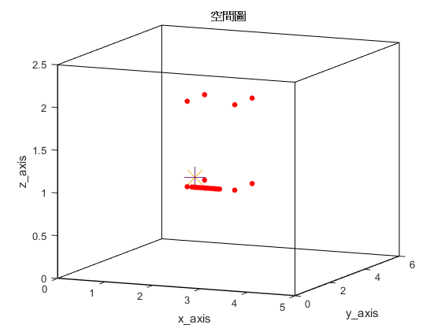

TDOA-based localization result
Ground-truth location
Estimated location
Compact Mics array (ULA)
for beamforming
Distributed Mics array
for TDOA-based localization
 | x-coordinate | y-coordinate | z-coordinate
Ground-truth location (m) | 2.1 | 2.15 | 1.1
Estimated location (m) | 2.1019 | 2.1481 | 1.1019

Slide 5
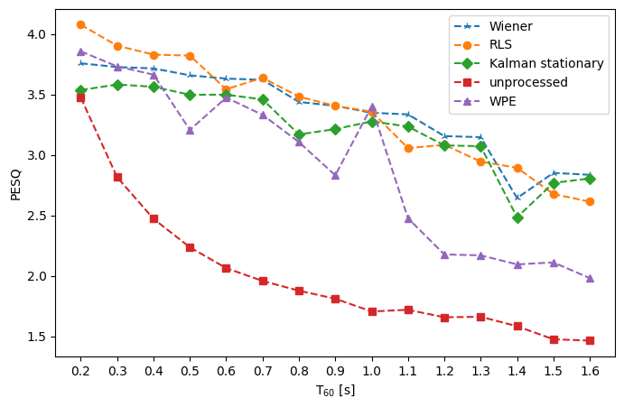
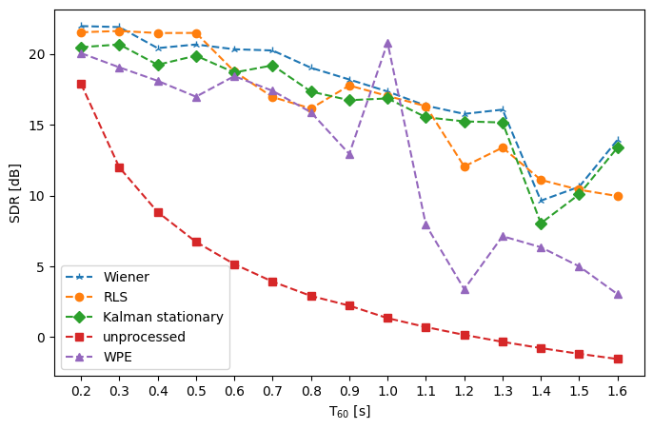
Dereverberation using estimated ATFs or RIRs
PESQ
SDR

Slide 6
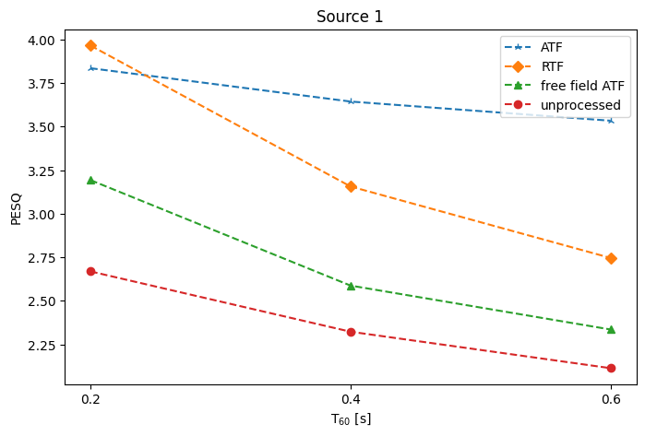
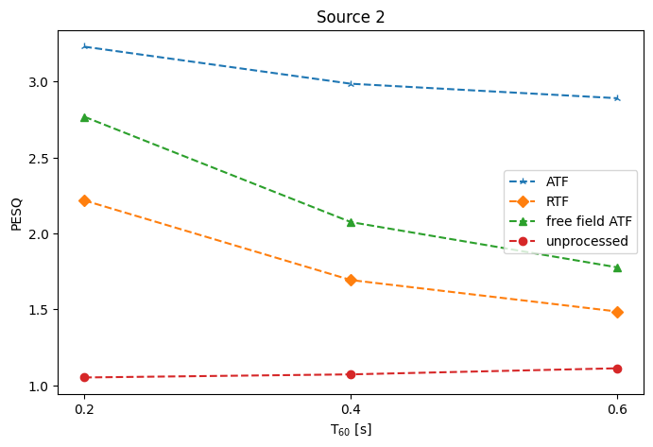
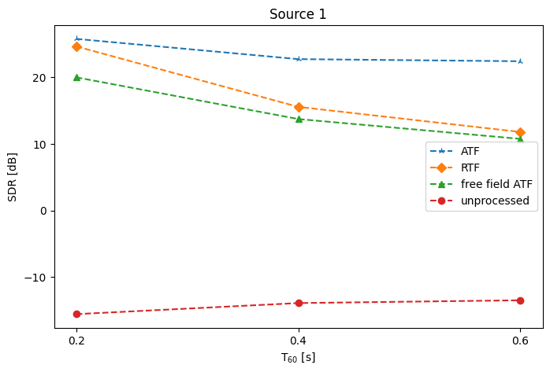
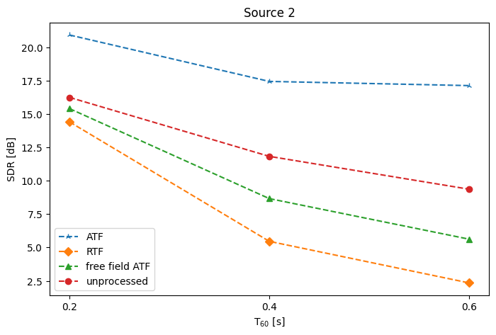
Source separation using Tikhonov regularization method
 | Source 1 | Source 2
PESQ
SDR

Slide 7
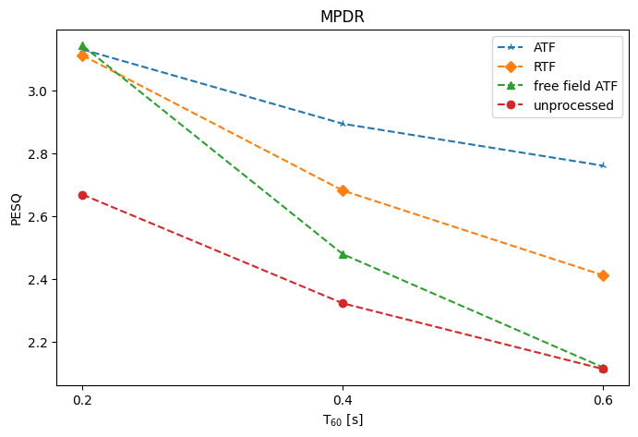
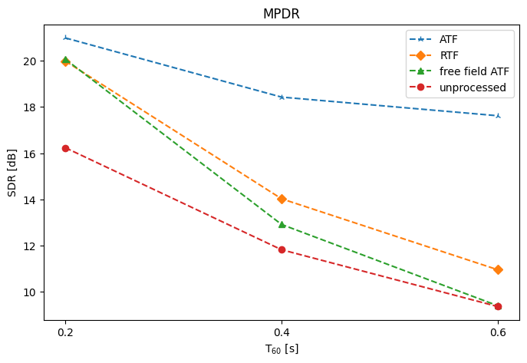
Speech enhancement using MPDR beamformer
PESQ
SDR

Slide 8



