Slide 1
Blind estimation of acoustic transfer functions (ATFs) and dereverberation based on convolutive transfer functions (CTFs) Date：2022. 09. 20
Telecom Electroacoustics Audio(TEA) Lab
Presenter:
Anchi Yuan
Notes:
Hello everyone
I’m today’s presenter siang. I’m going to share some of my present work in source separation problem. My topic is comparative studies of source separation using semi-blind and blind source separation approaches.

Slide 2
Outline
CTF estimation procedure using WPD
Simulation setting
Simulation result
Future work

Slide 3
CTF estimation procedure using WPD

Slide 4
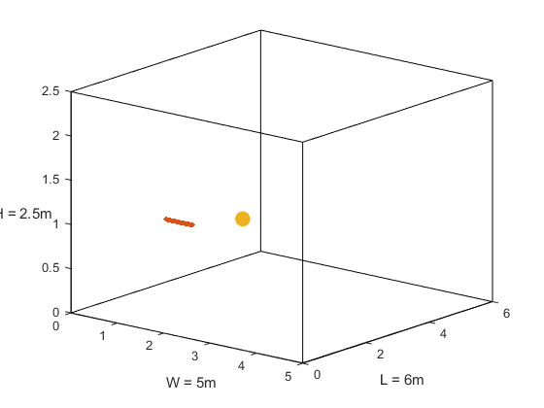

Simulation setting
Uniform linear array (ULA)
Number of microphones = 30
Spacing = 0.02m (2cm)
Aperture = (30-1)*0.02 = 0.58 m
Room size = 5m $×$6m $×$2.5m
Sampling frequency = 16kHz
Reverberation time T₆₀ =0.4s, 0.6s, 0.8s and 1s
First mic (1, 1.5, 1)
Source (2, 2.6, 1)
mic spacing = 0.02m
z
y
x

Slide 5
Simulation result
ATF matching error
T₆₀ (s) Method | 0.4 | 0.6 | 0.8 | 1.0
WPD Wiener filter method | 0.1086 | 0.1550 | 0.2494 | 0.2666
WPD RLS method | 0.1091 | 0.1563 | 0.2489 | 0.2676
ICASSP Wiener filter method | 0.1089 | 0.147 | 0.179 | 0.2002
ICASSP RLS method | 0.1096 | 0.1484 | 0.184 | 0.2049

Slide 6
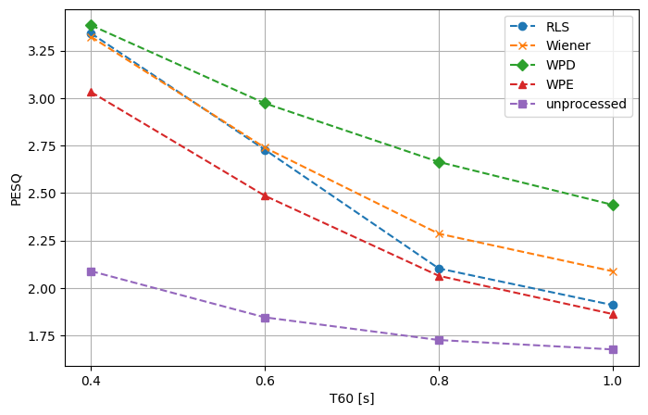
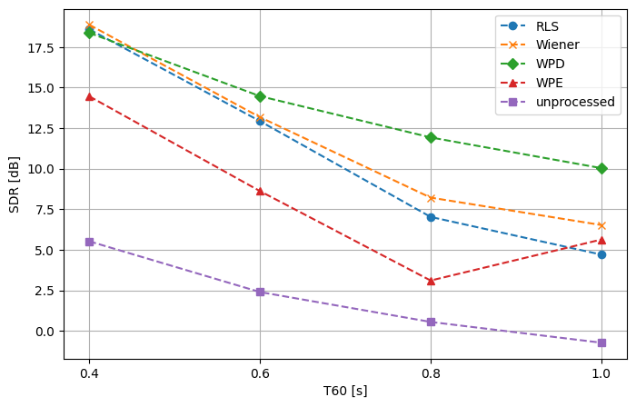
Simulation result
--- WPD output source
--- MINT with ATF calculated by Wiener filter using WPD output
--- MINT with ATF calculated by RLS using WPD output
--- WPE output signal
--- unprocessed mic signal
PESQ
SDR

Slide 7

Future work
Predict $σ_{n}^{2}$ with other methods

Slide 8


Slide 9
sec_rough = ones(1, SorLen)*0.2;
threshold_rough = 0.01;
for i = 1:SorLen
if abs(source(:, i)) < threshold_rough
sec_rough(:, i) = 0;
end
end
sec_speech = ones(1, SorLen)*0.2;
point_for_mean = 100;
threshold_speech = 0.2*point_for_mean/(point_for_mean*2+1);
for i = point_for_mean+1:SorLen-(point_for_mean+1)
if mean(sec_rough(:, i-point_for_mean:i+point_for_mean)) < threshold_speech
sec_speech(:, i) = 0;
end
end
figure(20)
plot(source(1, :), 'r');
hold on
plot(sec_speech(1, :), 'b');
hold off
title('speech section')
xlabel('points')
ylabel('magnitude')
legend('source', 'section')
Shg
if mean(sec_speech(:, FrameNo*hopsize:FrameNo*hopsize+100)) == 0
R_bar = R_bar + Y_bar_now*Y_bar_now'/sigma;
end
Threshold method 判斷 speech section

