Slide 1
Blind estimation of acoustic transfer functions (ATFs) and dereverberation based on convolutive transfer functions (CTFs) Date：2022. 10. 18
Telecom Electroacoustics Audio(TEA) Lab
Presenter:
Anchi Yuan
Notes:
Hello everyone
I’m today’s presenter siang. I’m going to share some of my present work in source separation problem. My topic is comparative studies of source separation using semi-blind and blind source separation approaches.

Slide 2
Outline
Particle swarm optimization (PSO)
A novel hybrid particle swarm optimization using adaptive strategy (ASPSO)
Simulated annealing (SA)
Simulation setting
Simulation result
Future work

Slide 3
PSO
Randomly initialize particle locations X and velocities V
Calculate fitness of particle
Update pbest gbest
Update particle velocities and locations
Stopping criteia met ?
No
Yes
Output gbest

Slide 4
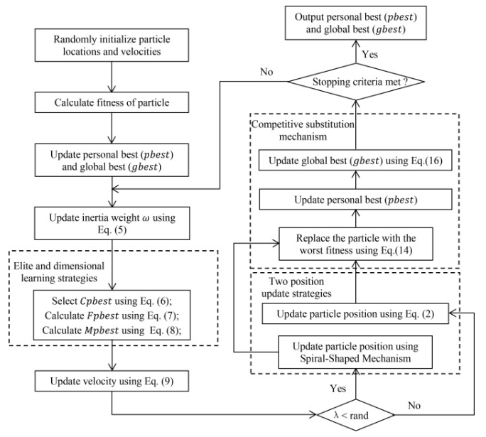
ASPSO
4
1
Inertia weight with chaotic
2
3
Ref:
Rui Wang, Kuangrong Hao, Lei Chen, Tong Wang, Chunli Jiang,A novel hybrid particle swarm optimization using adaptive strategy,Information Sciences,Volume 579,2021,Pages 231-250,ISSN 0020-0255

Slide 5
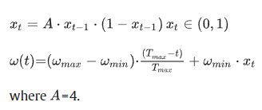
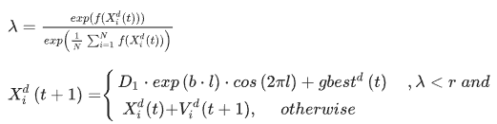

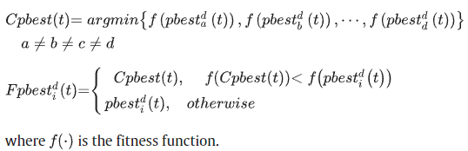

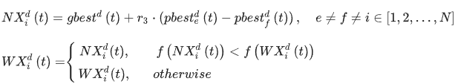

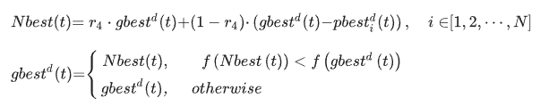
ASPSO
1. Inertia weight with chaotic
3. Adaptive position update strategy
2. Elite and dimensional learning strategies
4. Competitive substitution mechanism
If gbest does not update the value after ten iterations
Ref:
Rui Wang, Kuangrong Hao, Lei Chen, Tong Wang, Chunli Jiang,A novel hybrid particle swarm optimization using adaptive strategy,Information Sciences,Volume 579,2021,Pages 231-250,ISSN 0020-0255

Slide 6
SA
Randomly initialize solution x and calculate fitness f(x)
Add random disturbance to get new solution x' and calculate fitness f(x')
Yes
No
Accept new solution x = x' f(x) = f(x')
Use Metropolis criteion
No
Maximum iteration reached ?
Yes
Stopping criteia met ?
No
Decrease the temperature and reset the iteration
Yes
Output best solution

Slide 7
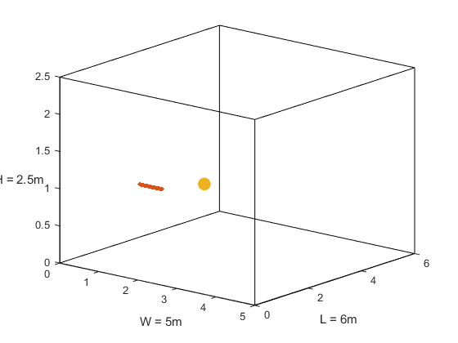

Simulation setting
Uniform linear array (ULA)
Number of microphones = 30
Spacing = 0.02m (2cm)
Aperture = (30-1)*0.02 = 0.58 m
Room size = 5m $×$6m $×$2.5m
Sampling frequency = 16kHz
Reverberation time T₆₀ =0.6s
First mic (1, 1.5, 1)
Source (2, 2.6, 1)
mic spacing = 0.02m
z
y
x

Slide 8
Simulation result
Below is with respect to one microphone.
T₆₀ =0.6s | Without optimization | PSO | ASPSO
ATF Matching error | 5.12 | 5.0489 | 5.0487
Runtime | 27s | 15hr | 8hr
Initial temperature = 100
Minimum temperature = 1
Cooling rate = 0.9
Maximum iteration = 100
Particle number = 50
Maximum iteration = 100

Slide 9
Future work
PME proposal

Slide 10


