Slide 1
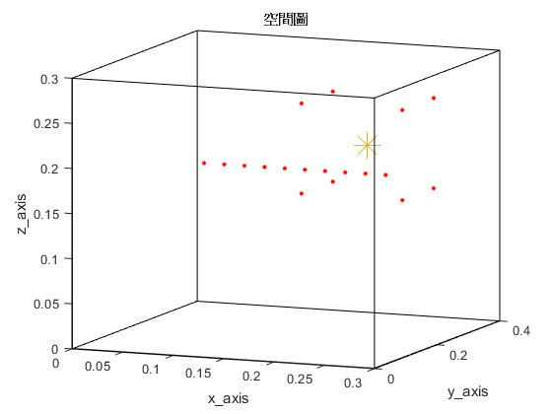
Source
(0.2, 0.3, 0.2)
H=0.3m
First mic of ULA
(0.1, 0.1, 0.2)
First mic of distributed array
(0.15, 0.25, 0.15)
z
y
x
L=0.4m
W=0.3m

Slide 2
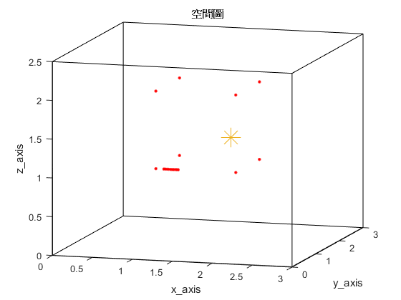
Source (1.7, 1.8, 1.3)
H=2.5m
z
y
First of ULA (1.1, 1, 1)
x
L=3m
W=3m

Slide 3
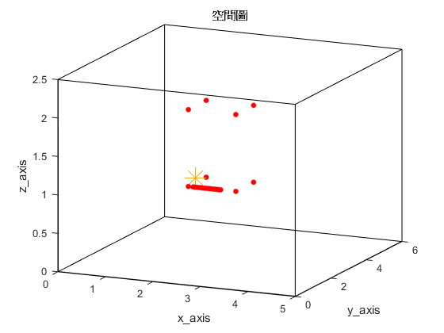
Source (2.1, 2.15, 1.1)
H=2.5m
z
y
First of ULA (2.1, 2, 1)
x
L=6m
W=5m

Slide 4
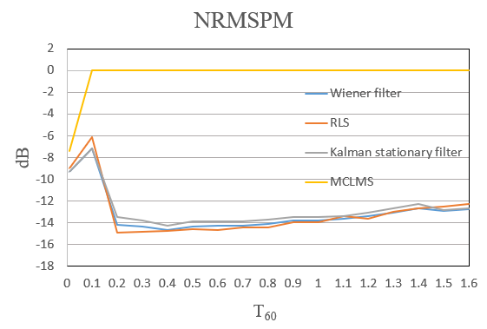

Slide 5
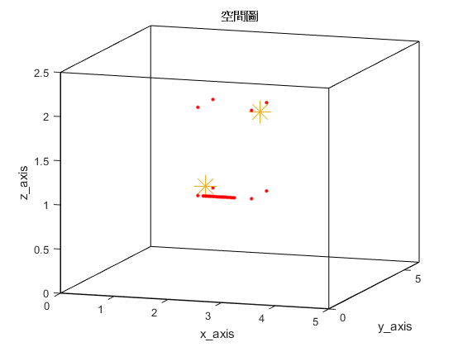
Source 2 or interferer (2.9, 2.9, 1.9)
Source 1 (2.1, 2.15, 1.1)
H=2.5m
First of ULA (2.1, 2, 1)
z
y
x
L=6m
W=5m

Slide 6
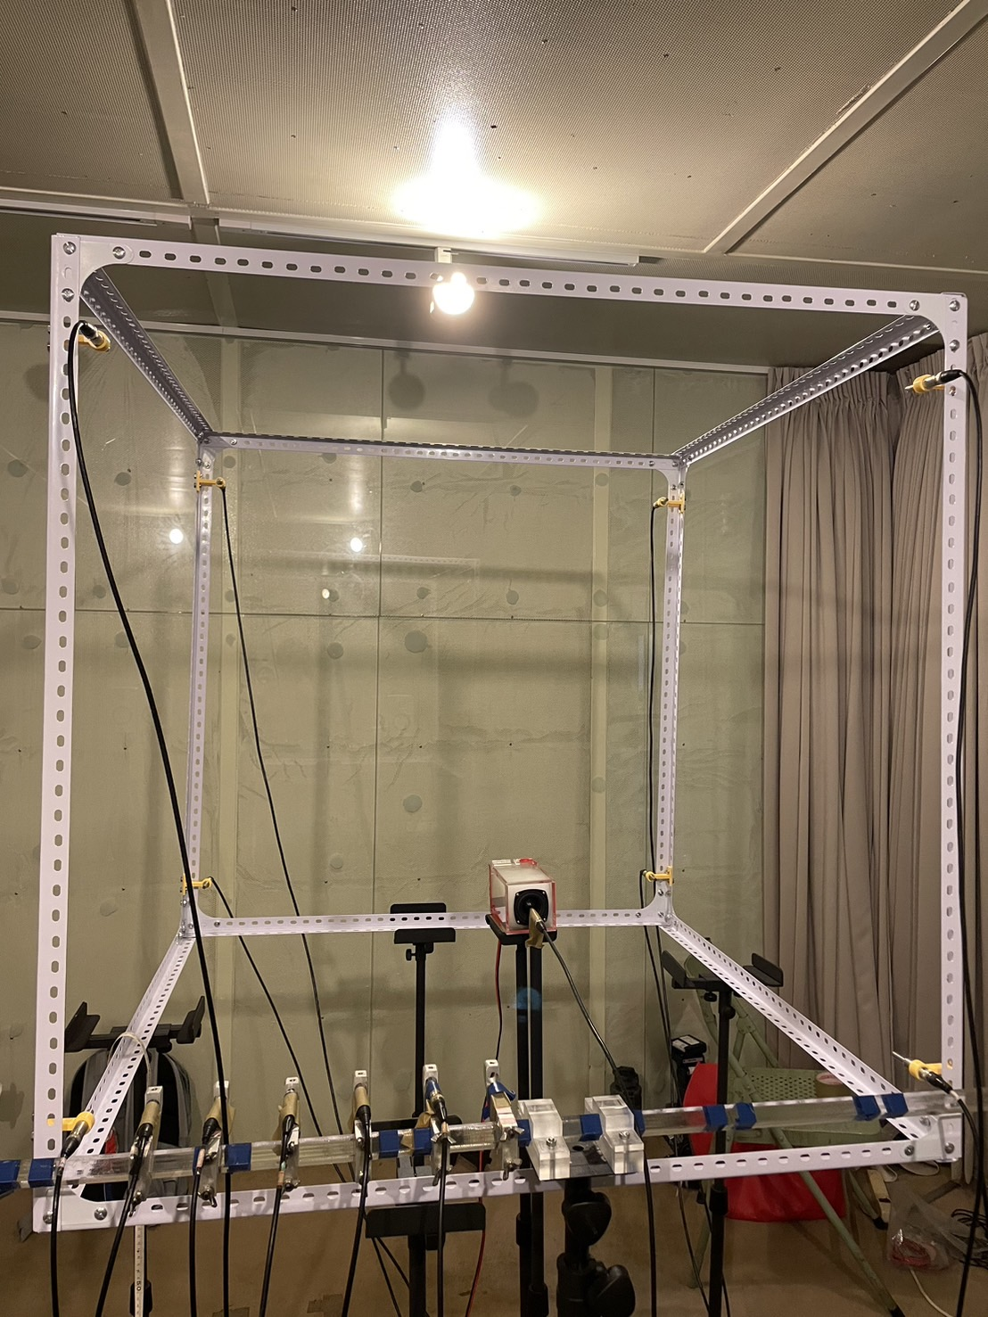
Loudspeaker
First mic of ULA
Reference mic
Left bottom mic of distributed part

