Slide 1
Blind estimation of acoustic transfer functions (ATFs) and dereverberation based on convolutive transfer functions (CTFs) Date：2024. 08. 07
Telecom Electroacoustics Audio(TEA) Lab
Presenter:
Anchi Yuan
Notes:
Hello everyone
I’m today’s presenter siang. I’m going to share some of my present work in source separation problem. My topic is comparative studies of source separation using semi-blind and blind source separation approaches.

Slide 2
Outline
Why do our methods outperform MCLMS ?
Dereverberation using estimated ATFs or RIRs
Source separation using Tikhonov regularization method
Speech enhancement using MPDR beamformer

Slide 3
Why do our methods outperform MCLMS ?
Eigenvalues of the microphone covariance matrix in MCLMS

Slide 4
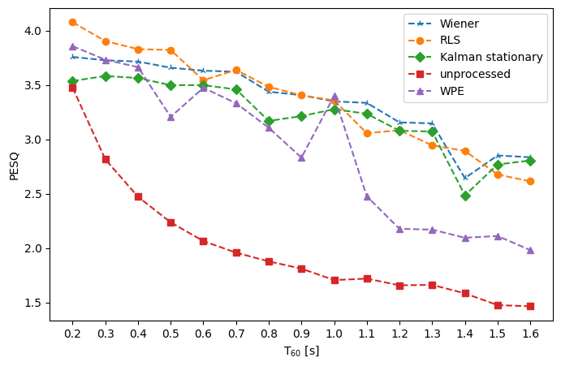
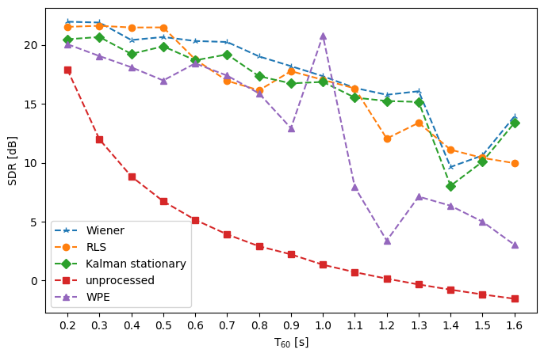
Dereverberation using estimated ATFs or RIRs
PESQ
SDR

Slide 5
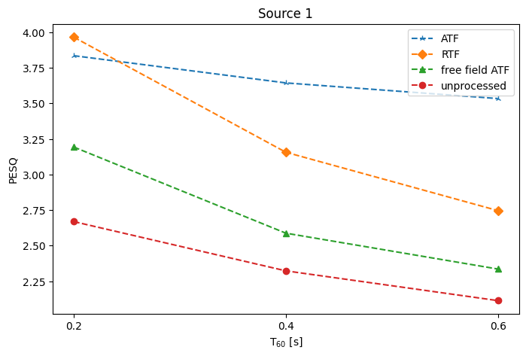
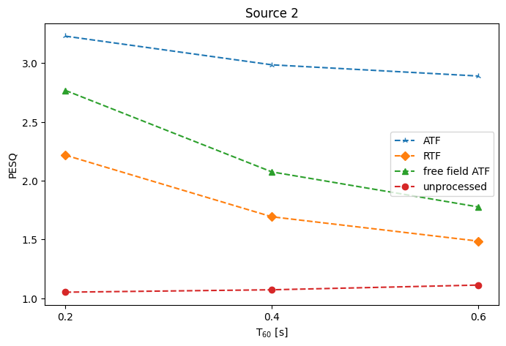
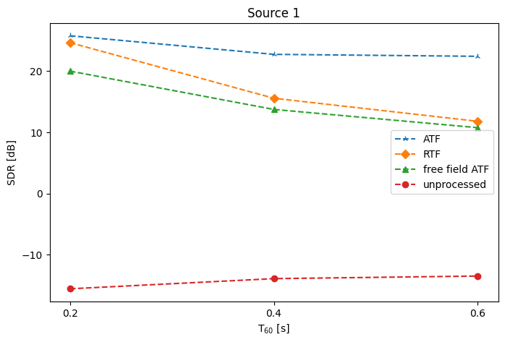
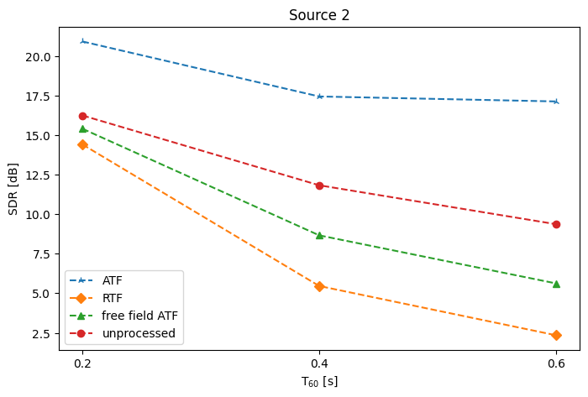
Source separation using Tikhonov regularization method
 | Source 1 | Source 2
PESQ
SDR

Slide 6
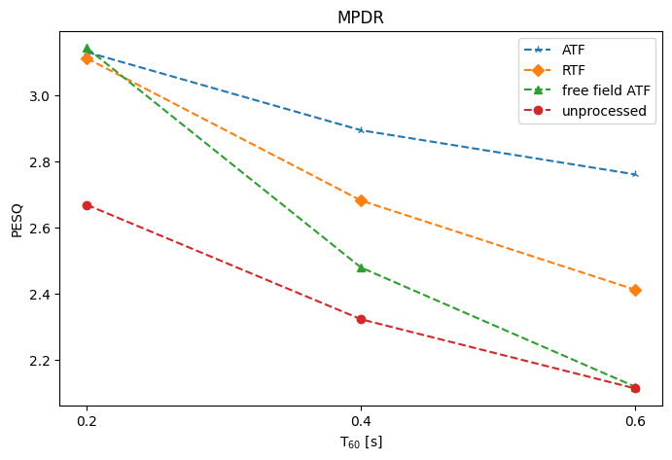
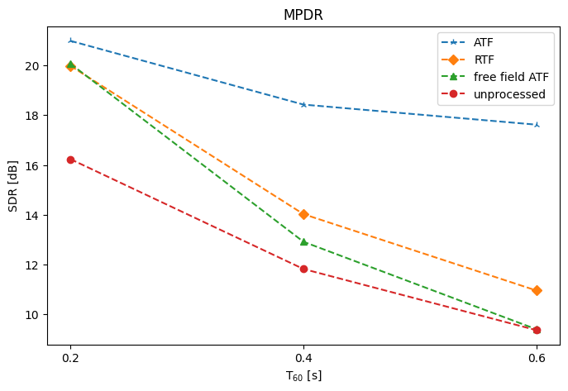
Speech enhancement using MPDR beamformer
PESQ
SDR

Slide 7
