Slide 1
Dereverberation with
WPE
Extraction with
DAS
CTF coefficient estimations

Slide 2
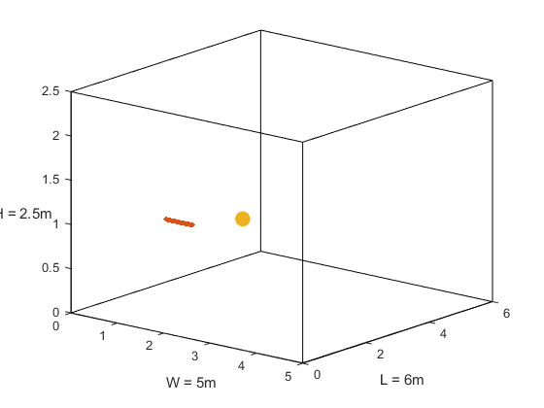
First mic (1, 1.5, 1)
Source (2, 2.6, 1)
mic spacing = 0.02m
z
y
x

Slide 4
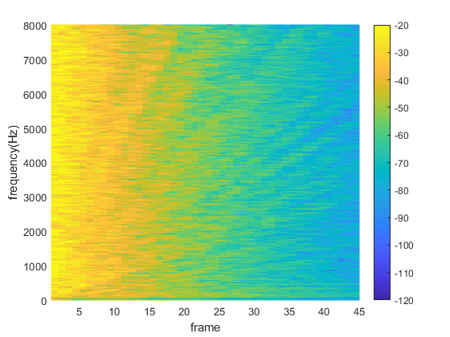
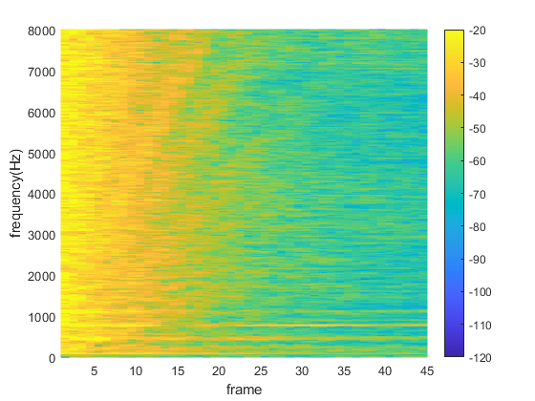
[ATF, ~, ATF_t_vector] = stft(h(look_mic, :).', fs, Window=win, OverlapLength=NFFT-hopsize, FFTLength=NFFT, FrequencyRange='onesided');
ATF_dB = mag2db(abs(ATF));
figure(20);
mesh(1:1:size(ATF_t_vector, 1), freqs_vector, ATF_dB)
colorbar
clim([-120 -20])
view(2)
xlim([1 size(ATF_t_vector, 1)])
xlabel('frame')
ylabel('frequency(Hz)')
shg

Slide 5
10
-10
-30
-50
-70
Magnitude (dB)
0 1000 2000 3000 4000 5000 6000 7000 8000
x10⁴
2
-2
-5
-10
-12
phase (deg)
------ ground-truth ATF
------ estimated ATF
0 1000 2000 3000 4000 5000 6000 7000 8000
frequency (Hz)

Slide 6
ATF = fft(h(look_mic, :));
ATF_estimated = fft(A_tdomain_forplot);
figure(20)
subplot(2,1,1);
plot(linspace(0, fs/2, points_rir/2+1), mag2db(abs(ATF(:, 1:points_rir/2+1))), 'r')
hold on
plot(linspace(0, fs/2, points_rir/2+1), mag2db(abs(ATF_estimated(:, 1:points_rir/2+1))), 'b')
hold off
ylabel('magnitude')
xlim([20 8000])
subplot(2,1,2);
plot(linspace(0, fs/2, points_rir/2+1), unwrap(angle(ATF(:, 1:points_rir/2+1)))/pi*180, 'r')
hold on
plot(linspace(0, fs/2, points_rir/2+1), unwrap(angle(ATF_estimated(:, 1:points_rir/2+1)))/pi*180, 'b')
hold off
xlabel('frequency (Hz)')
ylabel('phase (deg)')
xlim([20 8000])

Slide 7
10
0
-10
-20
-30
-40
-50
-60
magnitude (dB)
0 1000 2000 3000 4000 5000 6000 7000 8000
frequency (Hz)
0.06
0.05
0.04
0.03
0.02
0.01
0
-0.01
------ ground-truth
------ estimated
magnitude
0 2000 4000 6000 8000 10000 12000
point

Slide 8
ATF = fft(h(look_mic, :));
ATF_estimated = fft(A_tdomain_forplot);
figure(20)
subplot(2,1,1);
plot(linspace(0, fs/2, points_rir/2+1), mag2db(abs(ATF(:, 1:points_rir/2+1))), 'r')
hold on
plot(linspace(0, fs/2, points_rir/2+1), mag2db(abs(ATF_estimated(:, 1:points_rir/2+1))), 'b')
hold off
xlabel('frequency (Hz)')
ylabel('magnitude(dB)')
xlim([20 8000])
subplot(2,1,2);
plot(h(look_mic, :), 'r');
hold on
plot(A_tdomain_forplot, 'b');
hold off
xlabel('point')
ylabel('magnitude')
xlim([0 13000])

Slide 9
1
0.9
0.8
0.7
0.6
0.5
0.4
0.3
0.2
0.1
0
Absolute error
1000 2000 3000 4000 5000 6000 7000 8000
frequency (Hz)
0.06
0.05
0.04
0.03
0.02
0.01
0
-0.01
------ ground-truth
------ estimated
RIR
0 1000 2000 3000 4000 5000 6000
time samples

Slide 10
ATF = fft(h(look_mic, :));
ATF_estimated = fft(A_tdomain_forplot);
figure(20)
subplot(2,1,1);
plot(linspace(0, fs/2, points_rir/2+1), abs(abs(ATF(:, 1:points_rir/2+1))-abs(ATF_estimated(:, 1:points_rir/2+1))))
xlabel('frequency (Hz)')
ylabel('error')
xlim([20 8000])
subplot(2,1,2);
plot(h(look_mic, :), 'r');
hold on
plot(A_tdomain_forplot, 'b');
hold off
xlabel('point')
ylabel('magnitude')
xlim([0 6000])

Slide 11
Matching error
T₆₀ (s) Method | 0.4 | 0.6 | 0.8 | 1.0 | 1.2 | 1.4 | 1.6
Proposed Wiener filter method | 0.1089 | 0.147 | 0.179 | 0.2002 | 0.2122 | 0.23 | 0.2696
Proposed RLS method | 0.1096 | 0.1484 | 0.184 | 0.2049 | 0.2312 | 0.2545 | 0.2961

Slide 12
PESQ
T₆₀ (s) Method | 0.4 | 0.6 | 0.8 | 1.0 | 1.2 | 1.4 | 1.6
Proposed Wiener filter method | 3.641 | 2.913 | 2.573 | 2.305 | 2.244 | 2.131 | 1.522
Proposed RLS method | 3.612 | 2.996 | 2.174 | 2.327 | 1.898 | 1.588 | 1.448
WPE | 3.075 | 2.572 | 1.961 | 2.017 | 1.499 | 1.518 | 1.536
Unprocessed | 1.992 | 1.708 | 1.66 | 1.618 | 1.452 | 1.457 | 1.439

Slide 13
SDR
T₆₀ (s) Method | 0.4 | 0.6 | 0.8 | 1.0 | 1.2 | 1.4 | 1.6
Proposed Wiener filter method | 21.454 | 13.665 | 8.449 | 5.947 | 5.701 | 3.111 | 0.053
Proposed RLS method | 22.74 | 13.098 | 2.224 | 5.947 | 1.982 | 1.307 | -1.539
WPE | 18.992 | 10.27 | 2.137 | 3.199 | 1.413 | 0.89 | -2.92
Unprocessed | 5.407 | 2.117 | 0.195 | -1.119 | -2.101 | -2.874 | -3.511

