Slide 2
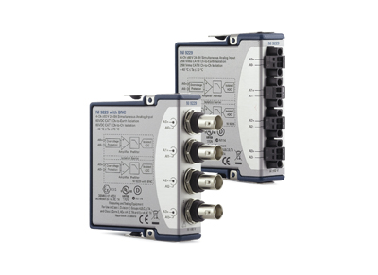
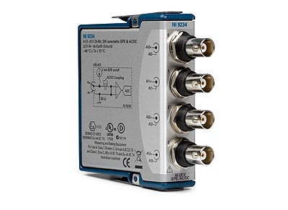
Crio9229 & Crio9234 Interface Implementation and Test
Bo Zhang, 7/16/2015

Slide 3
Agenda
About me
Project details
Problems encountered
Q & A

Slide 4


About Me
University: University of Michigan
Major: Mas. Electrical Engineering
Home Town: Hebei, China
Mentor Name: Jie Liu

Slide 5
Project details
Crio9229
Modify sub-modules to make them applicable to both 9229 and 9234
Ni9229ModResConfighandler
Ni9229ModResIoHandler
Ni9229ModResStateHandler
Component-level testbench
System-level testbench
Crio9234
Implement ModRes and ModResWrapper
System-level testbench
Simulation with sim_crio9234
Following the requirement of
Testbench Framework for NEXTGEN

Slide 6
Project Details
NI9229
IoHandler
9229 ModResWrapper
NI9229
StateHandler
9234 ModResWrapper
NI9229
ConfigHandler

Slide 7
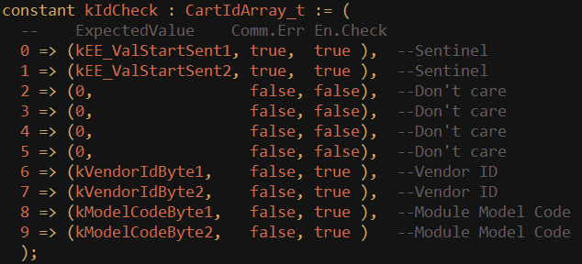
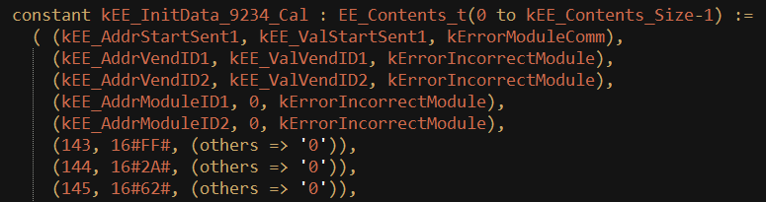
Problems Encountered
Commint does not recognize Crio9234
Commint will check 6 bytes data to identify the module.
Cannot change commint,
I changed the Sim_Crio9234
Sim_Crio9234 only accept
CartIn.EE_Contents_t with 5 bytes of specified data.

Slide 8
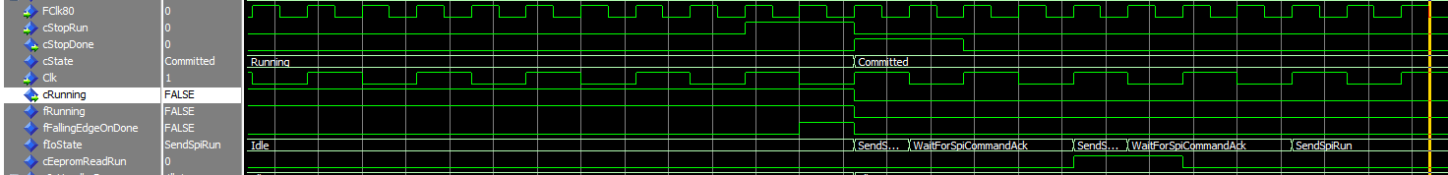
Problems Encountered
Bug: error happens when send cStopRun while running, and read EEPROM right after stop
StateHandler shows the module is not running.
However, the IoHandler still receiving data from module.
When EepromRead also wants to use SPI, error happens

Slide 9
Problems Encountered
Bug: error happens when send cStopRun right after tSendConvert
When start I/O node is applied in LabView, tSendConvert would be asserted.
When stop I/O node is applied in LabView, cStopRun would be asserted
But StateHandler waits cSynPulseSent and cStopRun.
Due to some delay, cStopRun asserted ahead of cSynPulseSent.

Slide 10
Questions?
Thanks for your attention!

