Slide 1

视频 2.1
CJ Taylor

Slide 2

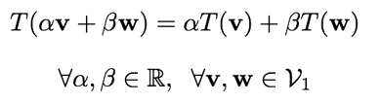

线性变换
设T为一个函数，让T成为一个函数它将元素在一个向量空间$ν_{1}$中映射到另一个向量空间$ν_{2}$中的元素
我们会说，函数T是一个线性变换，它满足以下性质:
这里，$α，β∈R，v，w∈V_{1}$，$T\left(v\right)，T\left(w\right)∈V_{2}$
也就是说，T是一个线性变换：

Slide 3
一些线性变换的例子
扩展：
反射：
投影：

Slide 4
视频 2.2
CJ Taylor

Slide 5
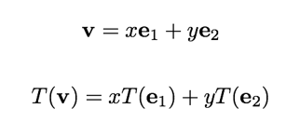

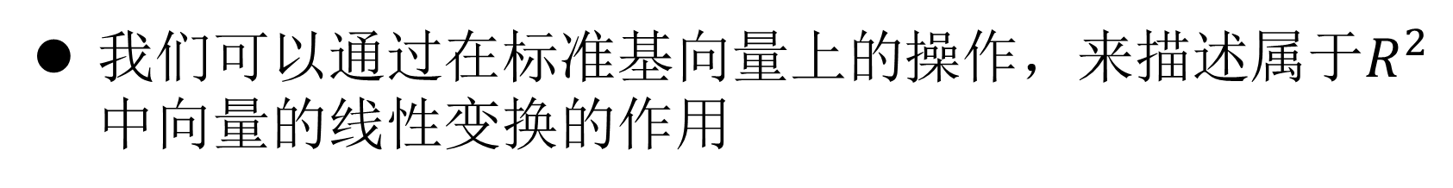
矩阵和线性变换
我们可以通过在标准基向量上的操作，来描述属于$R^{2}$中向量的线性变换的作用
例如，如果$v∈R^{2 }$则：

Slide 6
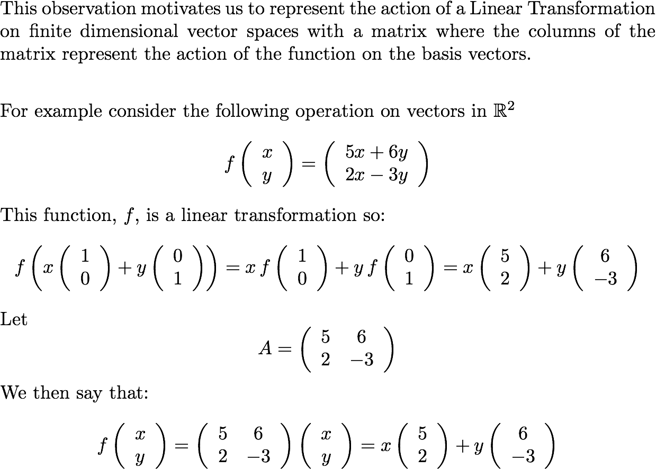
Matrices and Linear Transforms

Slide 7
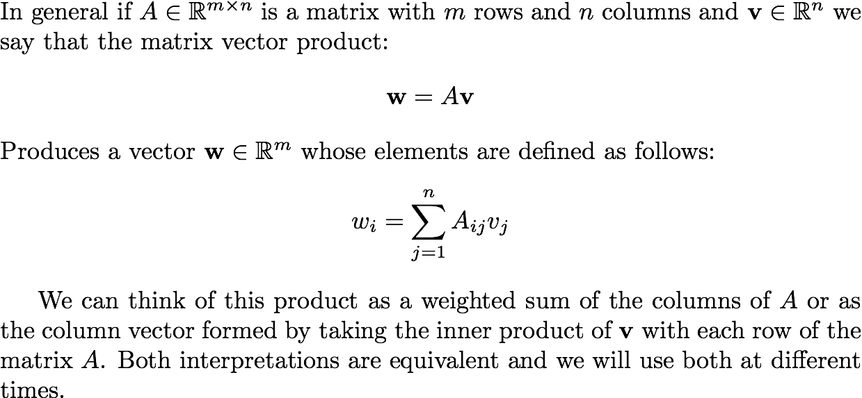
Matrix Vector Multiplication

Slide 8
Linear Transformations
For any linear transformation that maps one finite dimensional vector space onto another you can construct a matrix that represents the action of that function

Slide 9
Examples of Matrix Vector Multiplication

Slide 10
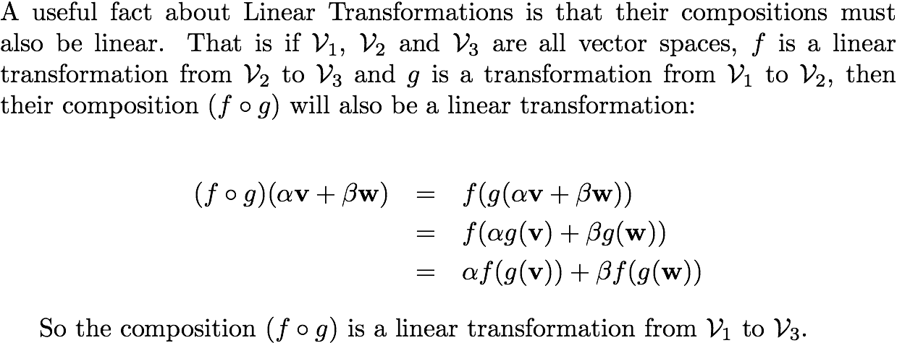
Composing Linear Transforms
Robo1x-2 10

Slide 11
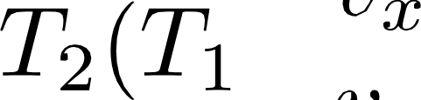


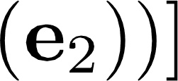

Composing Linear Transformation
Consider a situation where we have two linear transformations, T; and T2 ,
that we want to apply one after the other to a vector in I&² , v p‘ .
2 tr . T;(e;) —l— r , *1(e2))
v. 2(*i(e1)) + v, T (T;(e2))
[ 2(*1(e1)). *z(*i
*
If we represent the transformations T; and *2 with matrices 4f1 and M; we see that the net result of applying the two transformations back to back can be captured by a third matrix M$ which is formed by applying Mz to the columns of M;.
M$
[ f2 f1 › ), f2 f1(., 2)
(4)

Slide 12
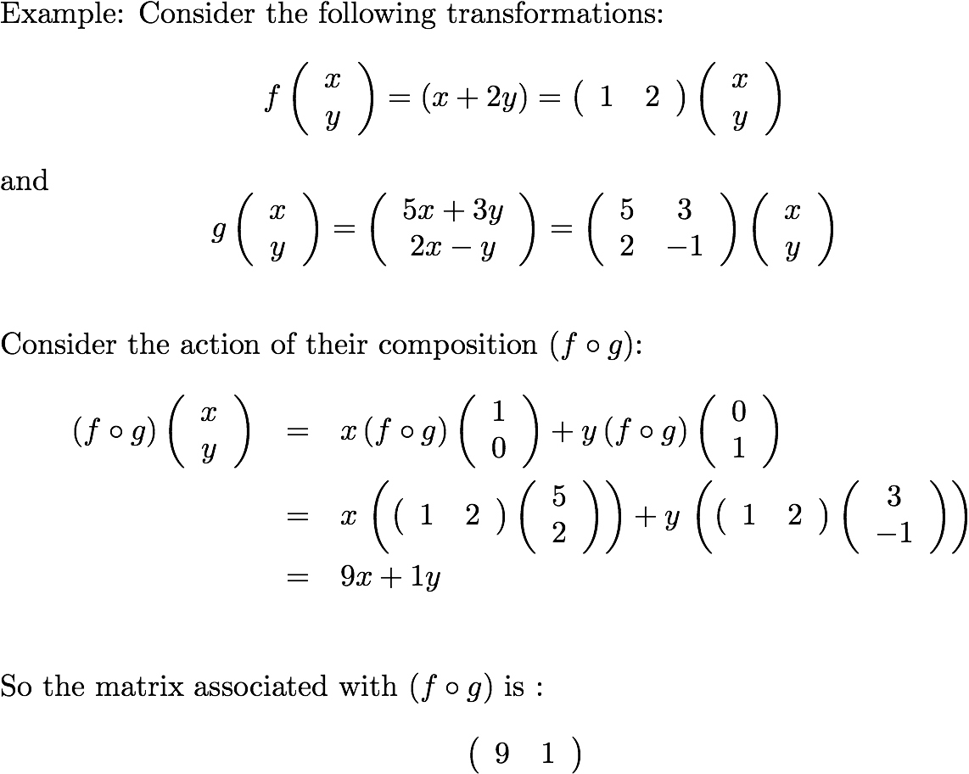
Composing Linear Transforms

Slide 13
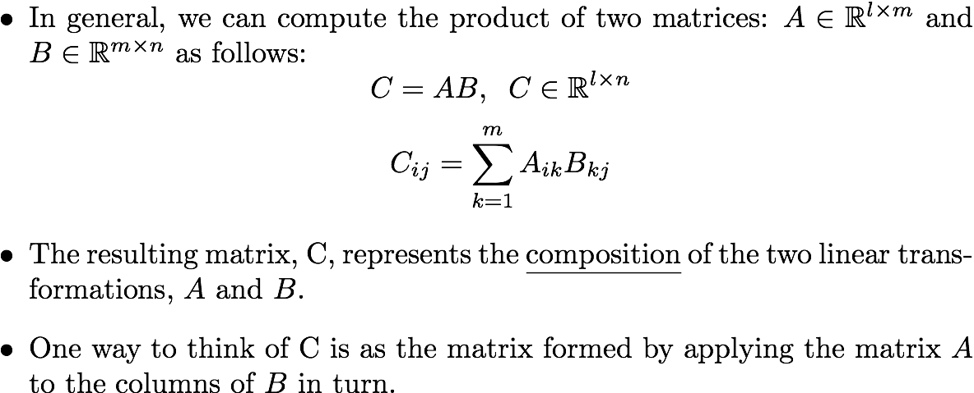
Matrix Multiplication

Slide 14
Examples of Matrix multiplication

Slide 15
Matrix Operations
We can multiply a matrix by a scalar in the usual manner by multiplying all of the elements.
We can add two matrices of the same size element by element.
These operations correspond to scaling or adding the corresponding linear transformations.

Slide 16
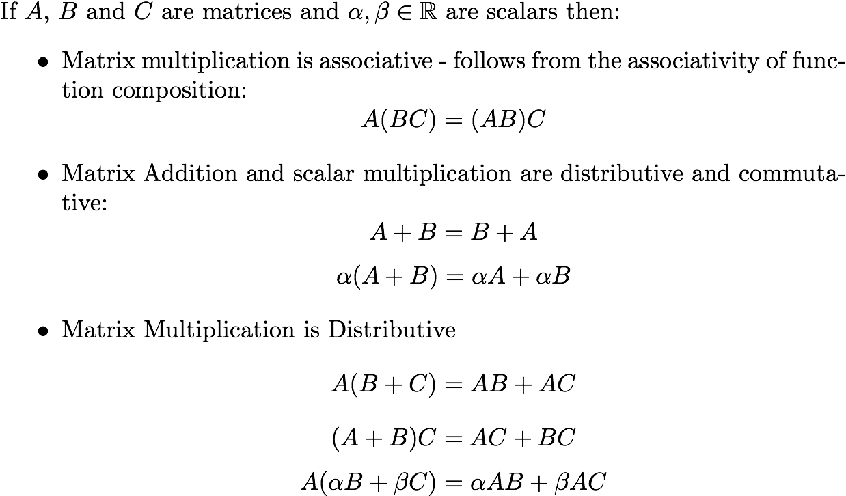
Matrix Operations

Slide 17
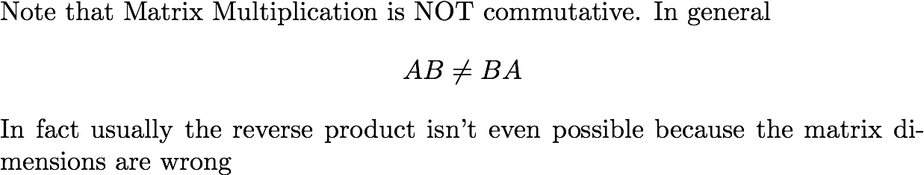
Matrix Multiplication IS NOT COMMUTATIVE

Slide 18
Matrix Multiplication in Matlab
Matrix multiplication is built in to MATLAB.
If you have an mxn matrix A and and nx1 vector x then typing y = A*x will compute the matrix vector product.
Similarly if B is an nxk matrix then C = A*B will compute the matrix product
Note the distinction between ‘*’ and ‘.*’, the former gives you matrix multiplication the latter gives you pointwise multiplication. They are very different operations.

Slide 19
Video 2.3
CJ Taylor

Slide 20
Matrix Multiplication Revisited
When we consider the product of 2 matrices, f7 AB , we can compute the result by applying the first matrix, A, to each column of & in turn.
Equivalently we can think of the entries in the product, G;j , as the inner product of the ith row of Al and the jth column of &
Robo1x-2 20

Slide 21
Examples of Matrix multiplication

Slide 22



Transposition

Slide 23


Transposition and Matrix Multiplication

Slide 24
Video 2.4
CJ Taylor

Slide 25

Coordinate Transformation
Let’s begin by imagining 2 distinct coordinate frames in the plane, A and B.
Let p_{A} denote the coordinates of a point wrt frame A and p_{B} the coordinates of the same point wrt frame B.
p_{B}
p_{A}
B
A

Slide 26
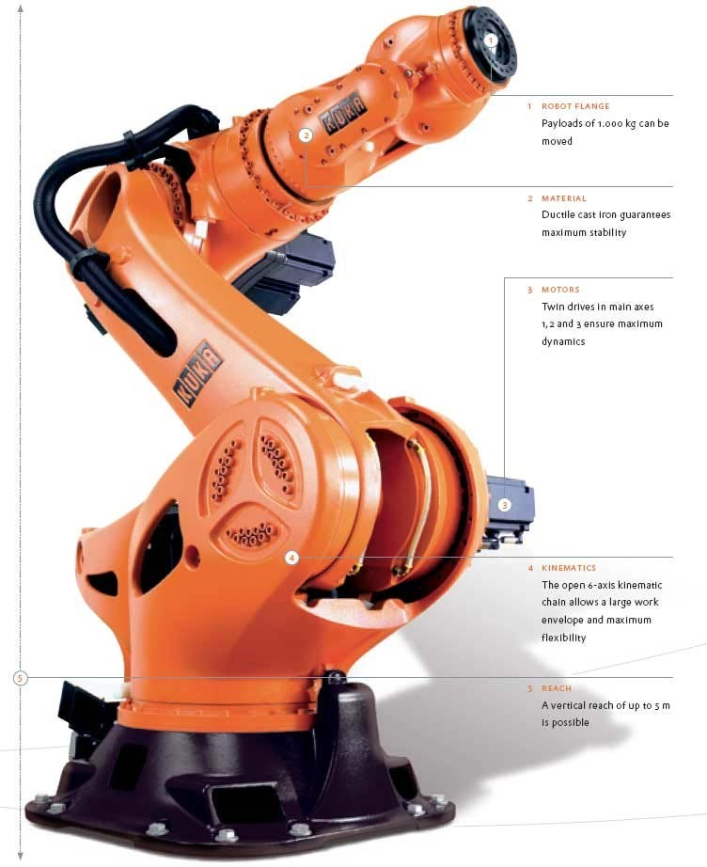
Applications of Coordinate Transforms
Robotic manipulators typically consist of a chain of links and we use coordinate transformations to determine where the links are wrt each other and a global frame

Slide 27

Computer Graphics
In virtual worlds and CAD systems we typically model scenes as a collection of parts and then use coordinate transformations to specify where things are with respect to each other and to the camera.

Slide 28











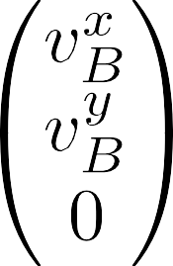
Homogenous Coordinates

Slide 29










Coordinate Transformation

Slide 30
Video 2.5
CJ Taylor
Robo1x-2 30

Slide 31
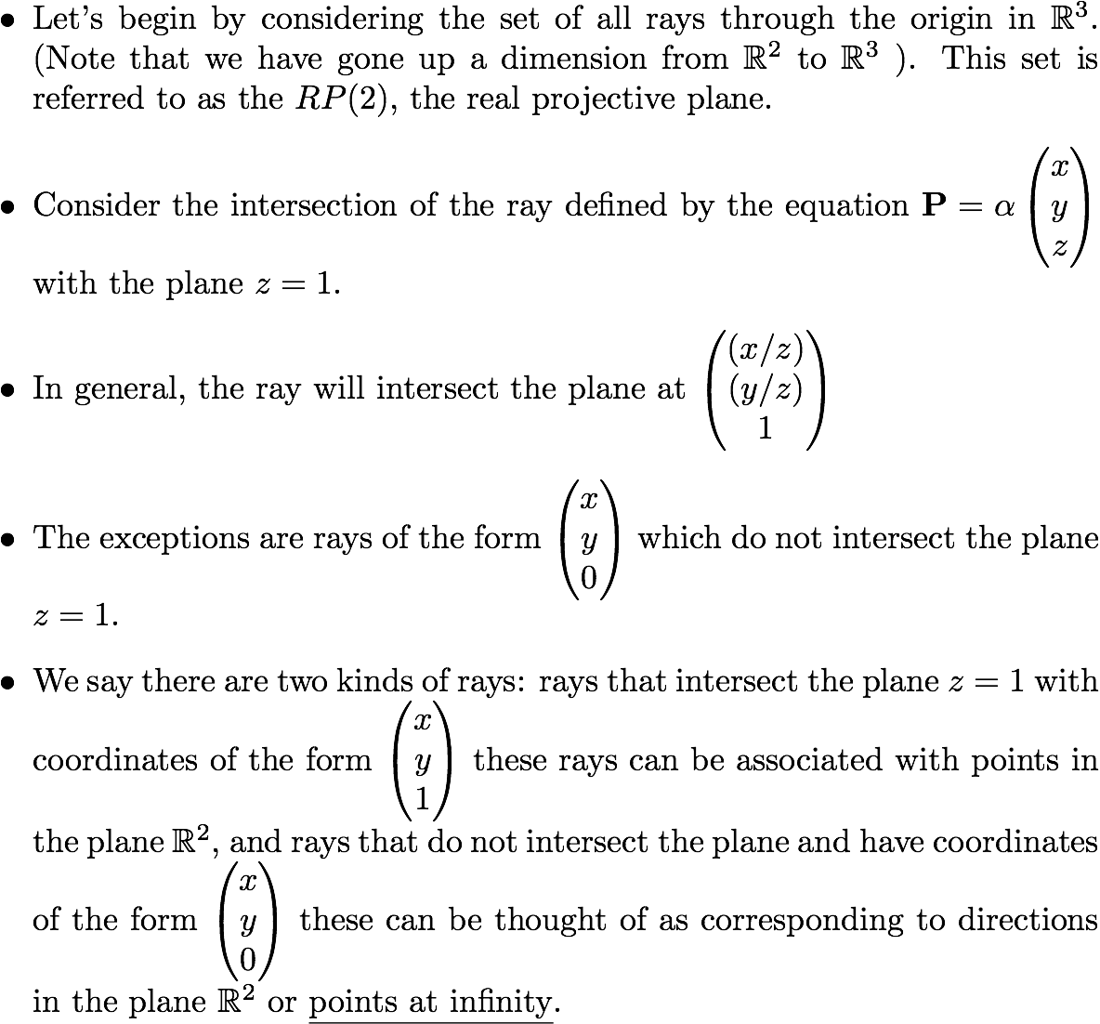
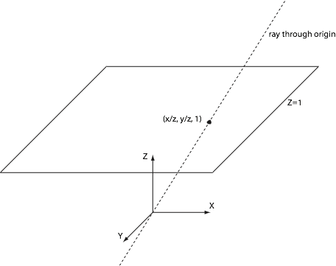
The Projective Plane

Slide 32
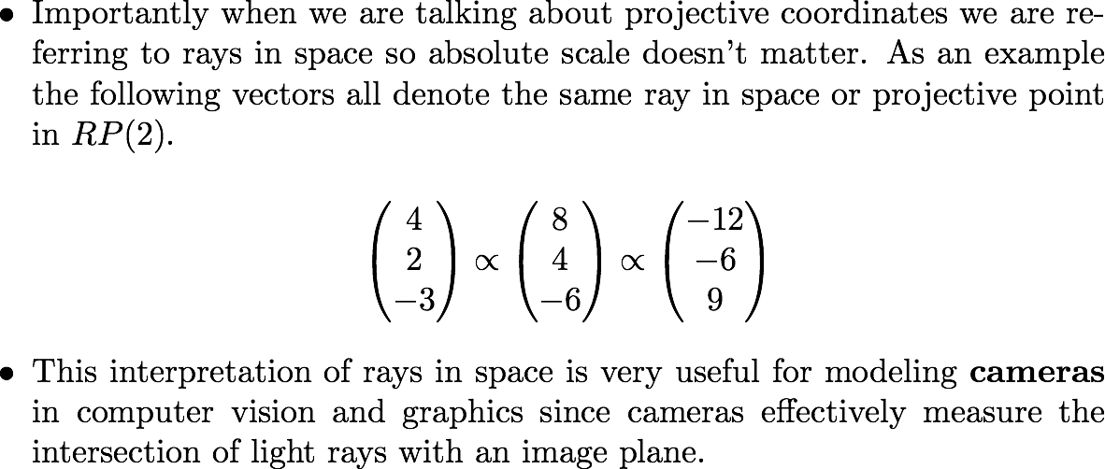
Homogenous Coordinates

Slide 33
Projective Transformations
From the perspective of projective geometry, the transformations that we are applying to the homogenous coordinates are simply examples of projective transformations that map the projective plane onto itself.

Slide 34
Computing Elementary Transformations using Matrix Multiplication : Scaling
A
B
Scaling

Slide 35
Computing Elementary Transformations using Matrix Multiplication: Rotation
A
B
θ
Rotation

Slide 36
Constructing Transformation Matrices
A good way to construct a transformation matrix is by considering how it maps the coordinate axes and the origin from one frame of reference to another. These lead directly to the columns of the transformation matrix.

Slide 37
Computing Elementary Transformations using Matrix Multiplication: Translation
B
A
(tx, ty) Translation

