Slide 1

视频 2.1
CJ Taylor

Slide 2

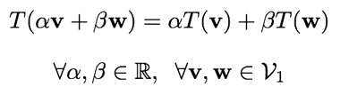

线性变换
设T为一个函数，让T成为一个函数它将元素在一个向量空间$ν_{1}$中映射到另一个向量空间$ν_{2}$中的元素
我们会说，函数T是一个线性变换，它满足以下性质:
这里，$α，β∈R，v，w∈V_{1}$，$T\left(v\right)，T\left(w\right)∈V_{2}$
也就是说，T是一个线性变换：

Slide 3
一些线性变换的例子
扩展：
反射：
投影：

Slide 4
视频 2.2
CJ Taylor

Slide 5
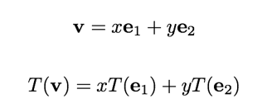

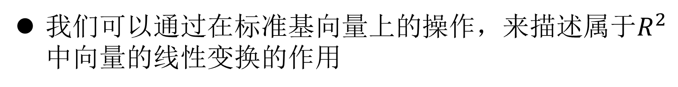
矩阵和线性变换
我们可以通过在标准基向量上的操作，来描述属于$R^{2}$中向量的线性变换的作用
例如，如果$v∈R^{2 }$则：

Slide 6





矩阵和线性变换
这个发现激发我们在有限维向量空间上，用一个矩阵来表示一个线性变换的作用，和矩阵的列表示在基向量上的作用。
例如，考虑在$R^{2 }$中对向量进行以下操作：
这个函数f，是一个线性变换所以：
当
有以下

Slide 7



矩阵向量乘法
一般来说，如果$A∈R^{m×n}$是一个有m行n列和$V∈R^{n}$的矩阵我们说这个矩阵向量积:
产生一个向量$w∈R^{m}$，其元素的定义如下:
我们可以把这个乘积看作是A的列向量的加权和，或者，通过把V的内积和矩阵A的每一行相加。两种解释都是等价的，我们会在不同的时间使用不同的解释。

Slide 8
线性变换
对于任何将一个有限维向量空间映射到另一个空间的线性变换，你可以构造一个表示该函数作用的矩阵。

Slide 9
矩阵向量乘法的例子

Slide 10
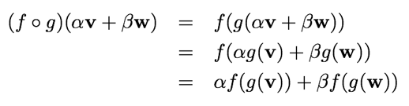
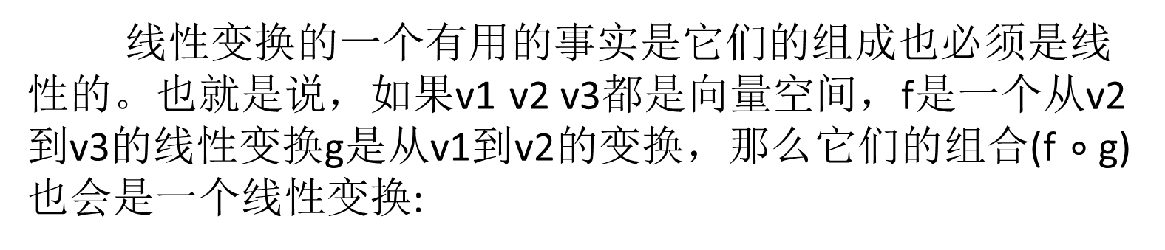
构成线性变换
线性变换的一个有用的事实是它们的组成也必须是线性的。也就是说，如果v1 v2 v3都是向量空间，f是一个从v2到v3的线性变换g是从v1到v2的变换，那么它们的组合(f $∘$g)也会是一个线性变换:
所以合成(f $∘$g)是一个从v1到v3的线性变换。
Robo1x-2 10

Slide 11
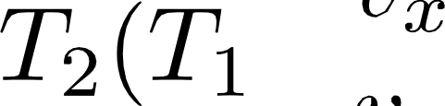


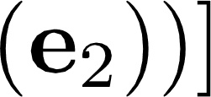

Composing Linear Transformation
Consider a situation where we have two linear transformations, T; and T2 ,
that we want to apply one after the other to a vector in I&² , v p‘ .
2 tr . T;(e;) —l— r , *1(e2))
v. 2(*i(e1)) + v, T (T;(e2))
[ 2(*1(e1)). *z(*i
*
If we represent the transformations T; and *2 with matrices 4f1 and M; we see that the net result of applying the two transformations back to back can be captured by a third matrix M$ which is formed by applying Mz to the columns of M;.
M$
[ f2 f1 › ), f2 f1(., 2)
(4)

Slide 12
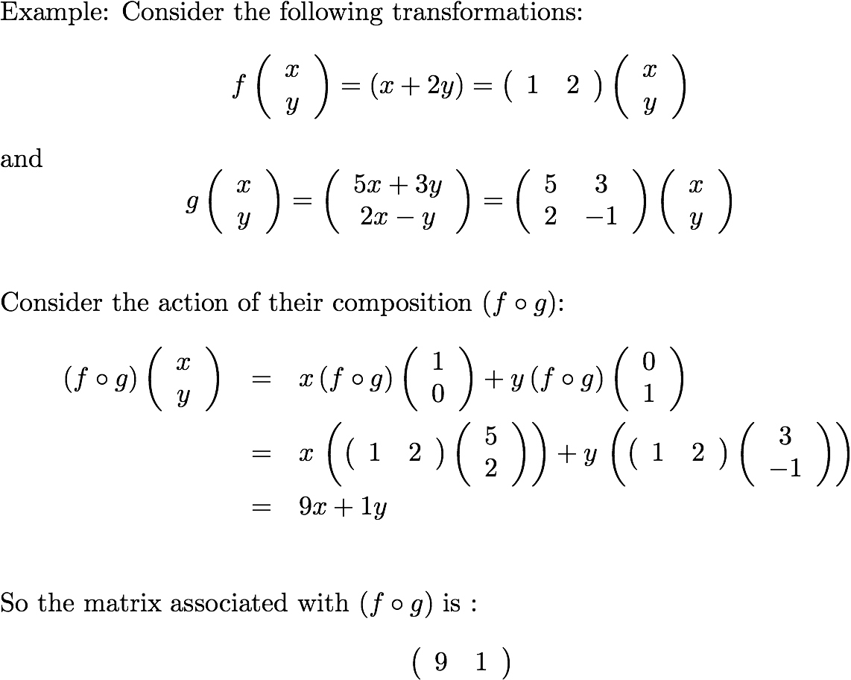
Composing Linear Transforms

Slide 13
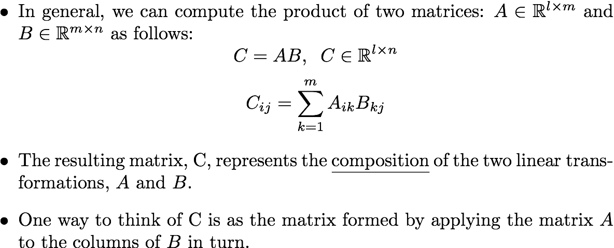
Matrix Multiplication

Slide 14
Examples of Matrix multiplication

Slide 15
Matrix Operations
We can multiply a matrix by a scalar in the usual manner by multiplying all of the elements.
We can add two matrices of the same size element by element.
These operations correspond to scaling or adding the corresponding linear transformations.

Slide 16
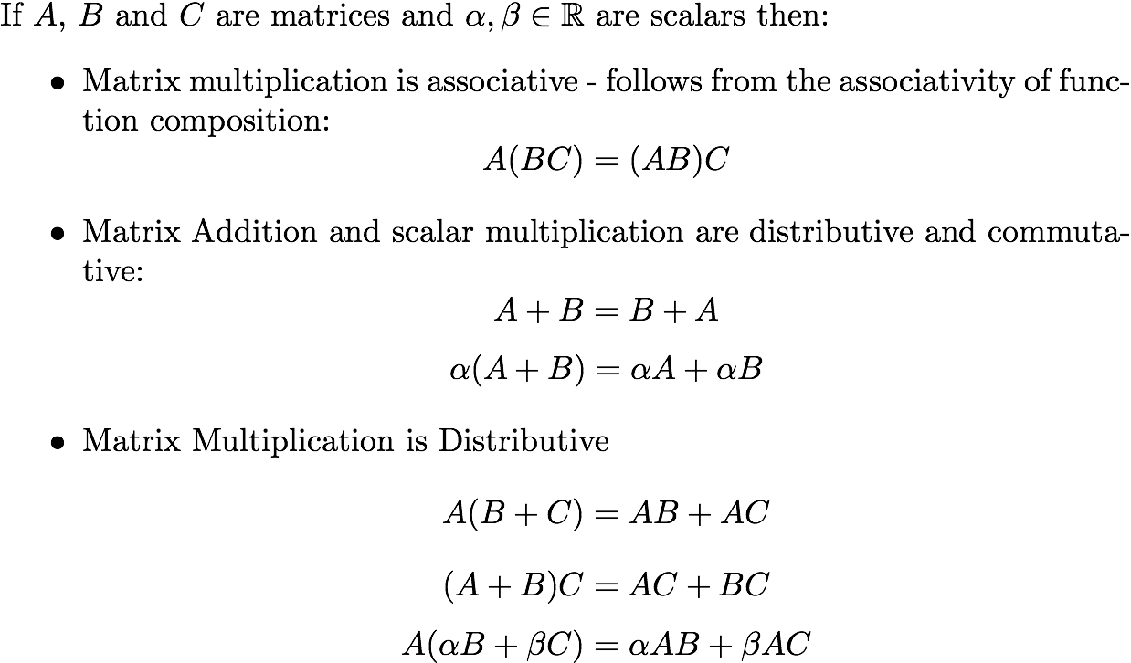
Matrix Operations

Slide 17
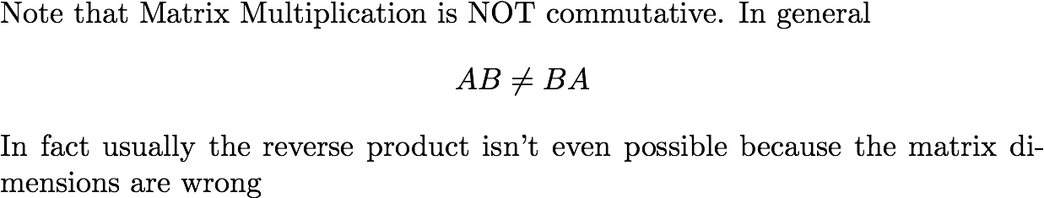
Matrix Multiplication IS NOT COMMUTATIVE

Slide 18
Matrix Multiplication in Matlab
Matrix multiplication is built in to MATLAB.
If you have an mxn matrix A and and nx1 vector x then typing y = A*x will compute the matrix vector product.
Similarly if B is an nxk matrix then C = A*B will compute the matrix product
Note the distinction between ‘*’ and ‘.*’, the former gives you matrix multiplication the latter gives you pointwise multiplication. They are very different operations.

Slide 19
Video 2.3
CJ Taylor

Slide 20
Matrix Multiplication Revisited
When we consider the product of 2 matrices, f7 AB , we can compute the result by applying the first matrix, A, to each column of & in turn.
Equivalently we can think of the entries in the product, G;j , as the inner product of the ith row of Al and the jth column of &
Robo1x-2 20

Slide 21
Examples of Matrix multiplication

Slide 22



Transposition

Slide 23


Transposition and Matrix Multiplication

Slide 24
Video 2.4
CJ Taylor

Slide 25

Coordinate Transformation
Let’s begin by imagining 2 distinct coordinate frames in the plane, A and B.
Let p_{A} denote the coordinates of a point wrt frame A and p_{B} the coordinates of the same point wrt frame B.
p_{B}
p_{A}
B
A

Slide 26
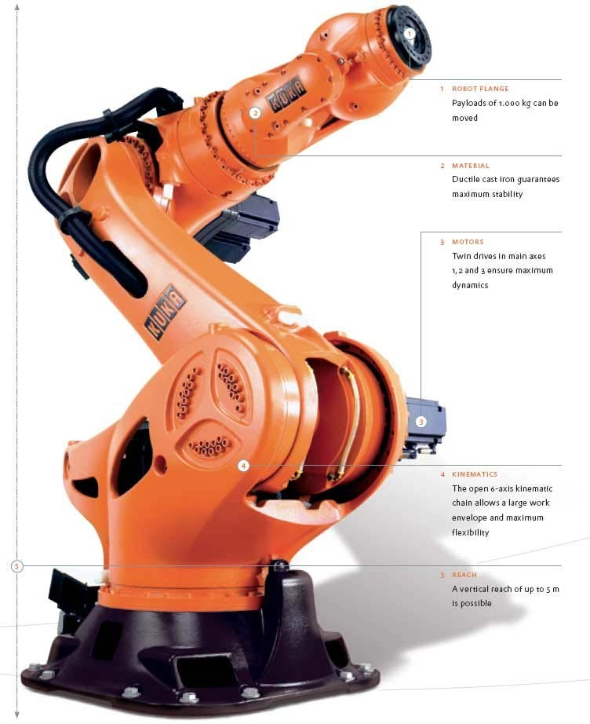
Applications of Coordinate Transforms
Robotic manipulators typically consist of a chain of links and we use coordinate transformations to determine where the links are wrt each other and a global frame

Slide 27

Computer Graphics
In virtual worlds and CAD systems we typically model scenes as a collection of parts and then use coordinate transformations to specify where things are with respect to each other and to the camera.

Slide 28











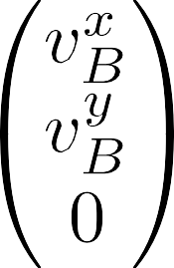
Homogenous Coordinates

Slide 29










Coordinate Transformation

Slide 30
Video 2.5
CJ Taylor
Robo1x-2 30

Slide 31
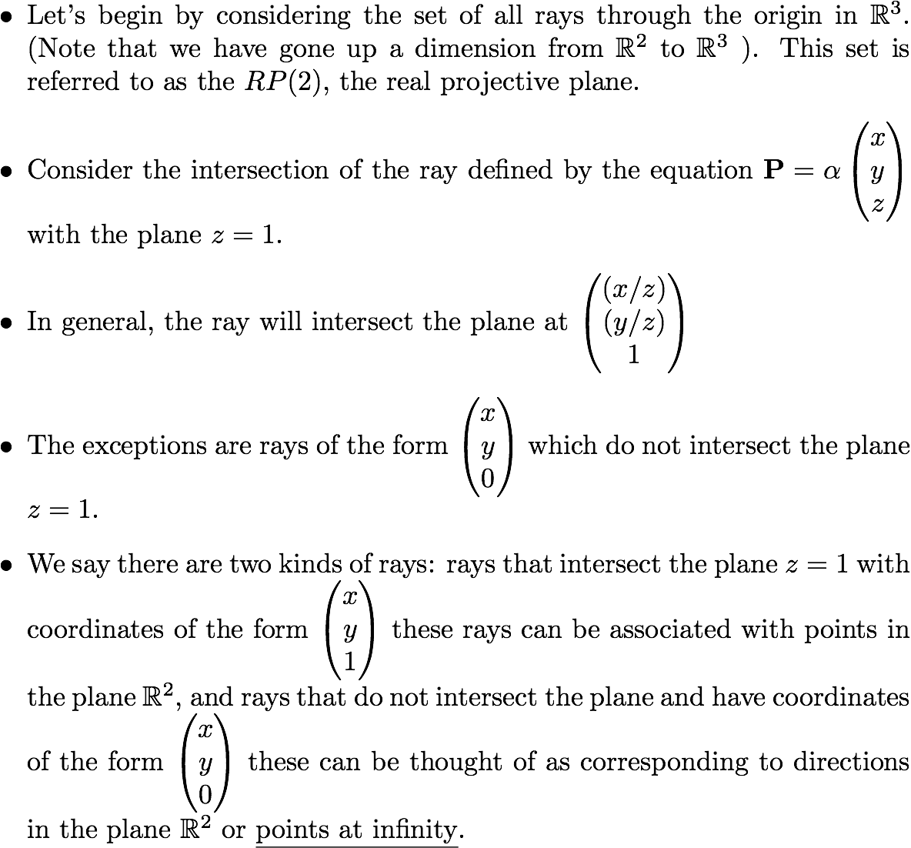
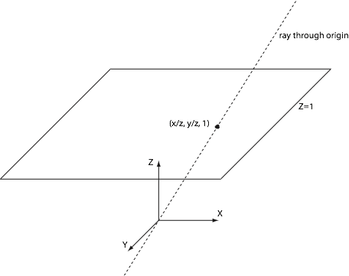
The Projective Plane

Slide 32
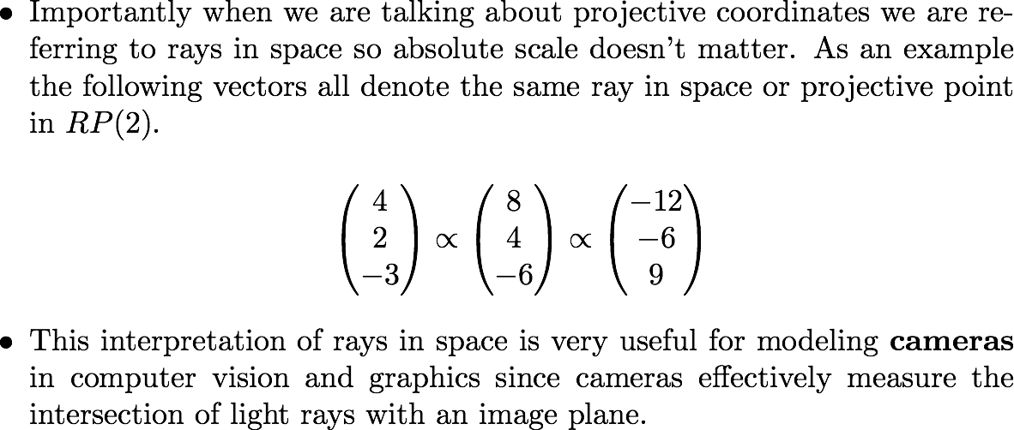
Homogenous Coordinates

Slide 33
Projective Transformations
From the perspective of projective geometry, the transformations that we are applying to the homogenous coordinates are simply examples of projective transformations that map the projective plane onto itself.

Slide 34
Computing Elementary Transformations using Matrix Multiplication : Scaling
A
B
Scaling

Slide 35
Computing Elementary Transformations using Matrix Multiplication: Rotation
A
B
θ
Rotation

Slide 36
Constructing Transformation Matrices
A good way to construct a transformation matrix is by considering how it maps the coordinate axes and the origin from one frame of reference to another. These lead directly to the columns of the transformation matrix.

Slide 37
Computing Elementary Transformations using Matrix Multiplication: Translation
B
A
(tx, ty) Translation

