Slide 1
Robotics: Fundamentals
Prof. C.J. Taylor University of Pennsylvania

Slide 2

Video 1.1 CJ Taylor

Slide 3
The Goal
Develop the mathematical tools that we need to talk about where things are in space.
Where things are depend on where you are looking at them from. How do we make this more precise?

Slide 4
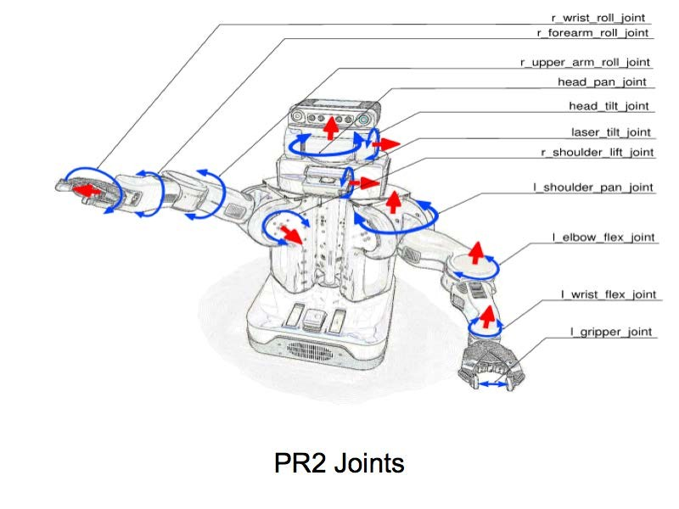
Coordinate Transforms in Robotics

Slide 5


Descartes
Consider the Cartesian coordinate plane
Points in the plane can be denoted with tuples denoting their coordinates with respect to the frame of reference
y
v
(2,1)
x

Slide 6
Descartes
Note that we can also talk about vectors. Corresponding to directions in the plane or to displacements between points.
These can also be represented by tuples
(1,3)
y
v
(2,1)
x
© University of Pennsylvania
Robo1x-1 6

Slide 7
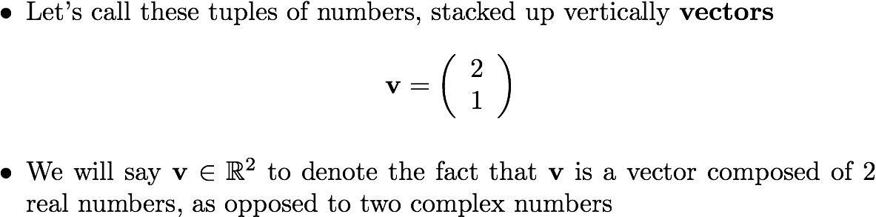
Vectors

Slide 8
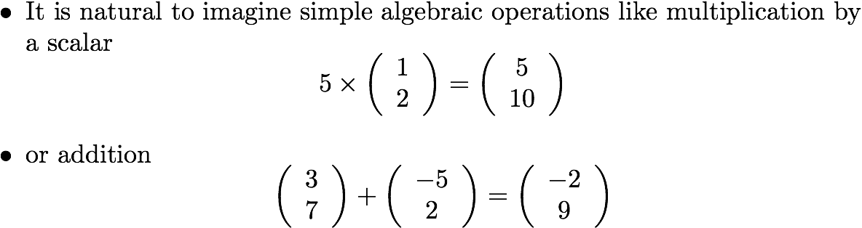
Operations on Vectors

Slide 9
Geometric Interpretation
It is not hard to see that multiplication by a scalar value corresponds to scaling a vector by that amount.
Similarly adding two tuples corresponds to adding the corresponding vectors head to tail
y
y
(w+v)
a*v
w
v
v
x
x
© University of Pennsylvania
Robo1x-1 9

Slide 10
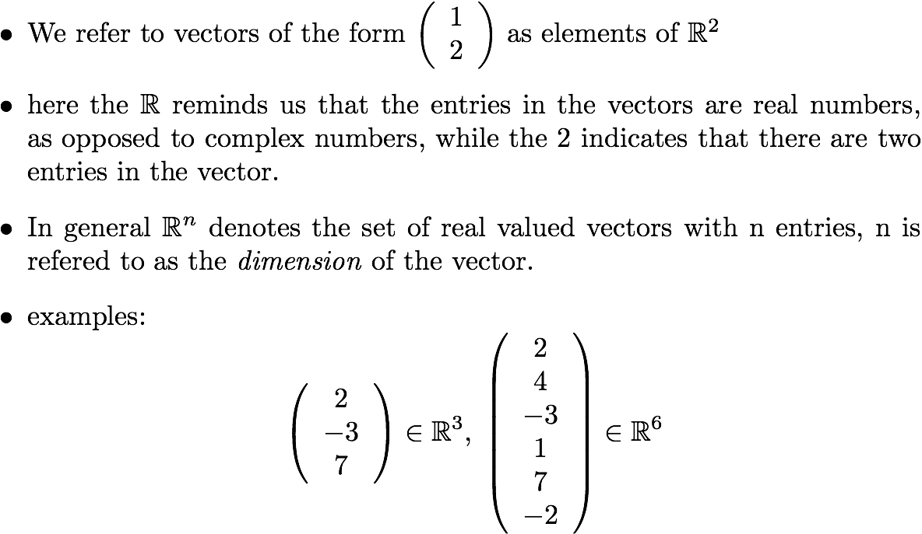
Adding Dimensions

Slide 11

Descartes in 3D
We will also be interested in talking about the location of objects in space. Here R³ will be helpful.
y
(1, 3, 2)
v
x
z

Slide 12
Video 1.2 CJ Taylor

Slide 13
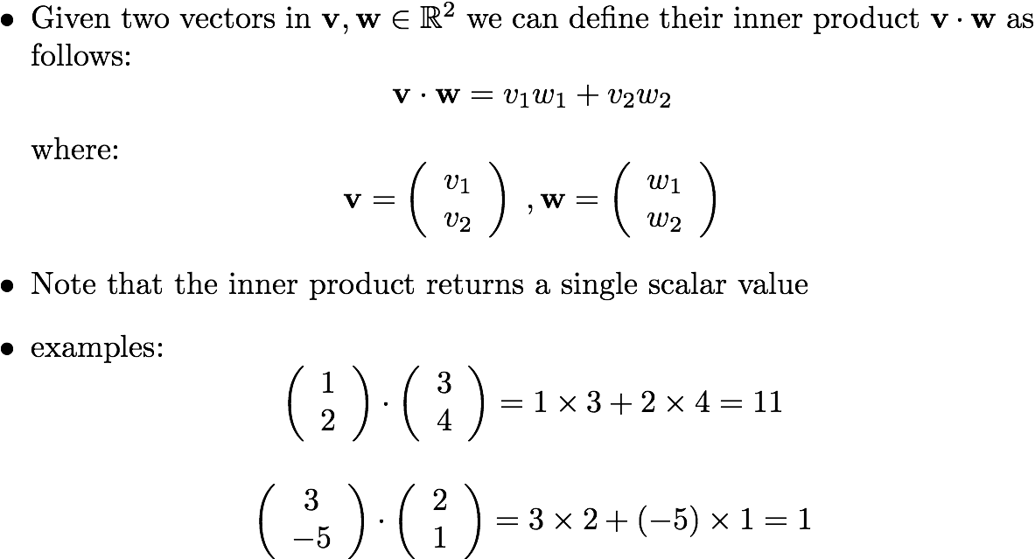
Inner Product

Slide 14
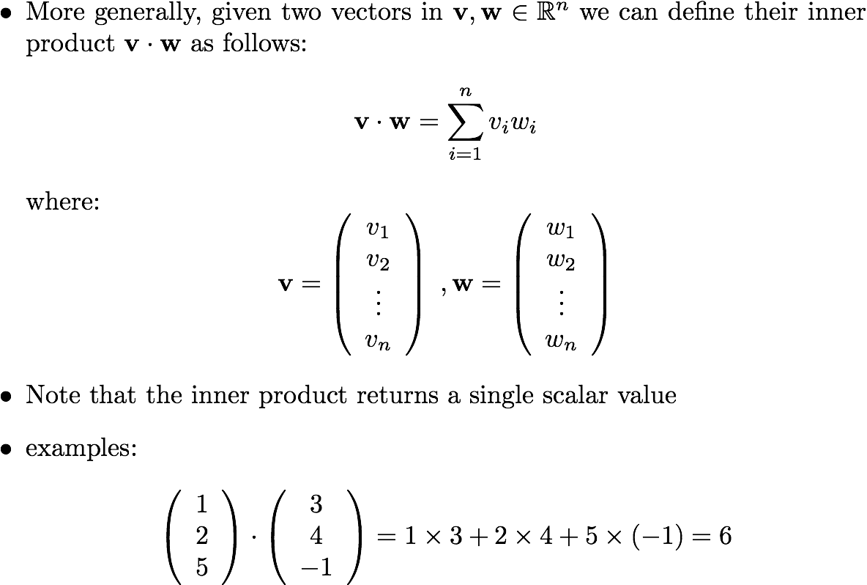
More Inner Products

Slide 15
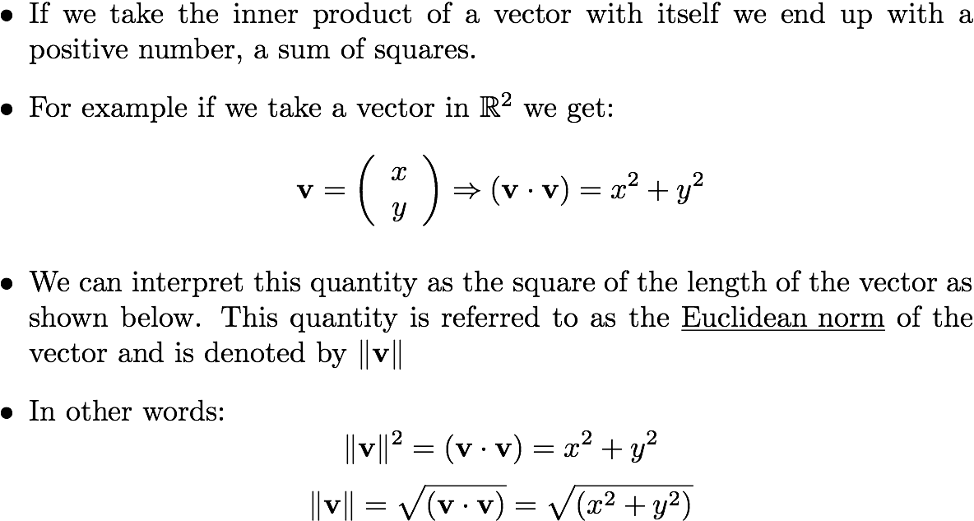
The Euclidean Norm

Slide 16

Euclidean Norm
v
y
x

Slide 17
Video 1.3 CJ Taylor

Slide 18
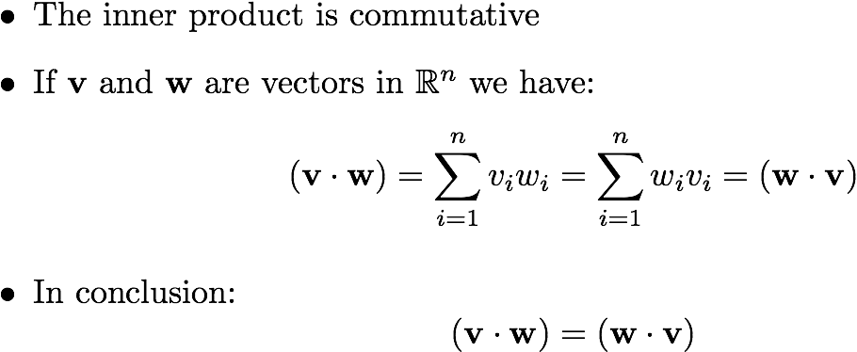
Inner Product Properties

Slide 19
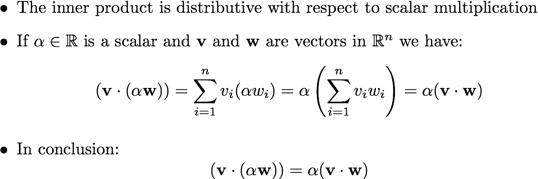
Inner Product Properties

Slide 20
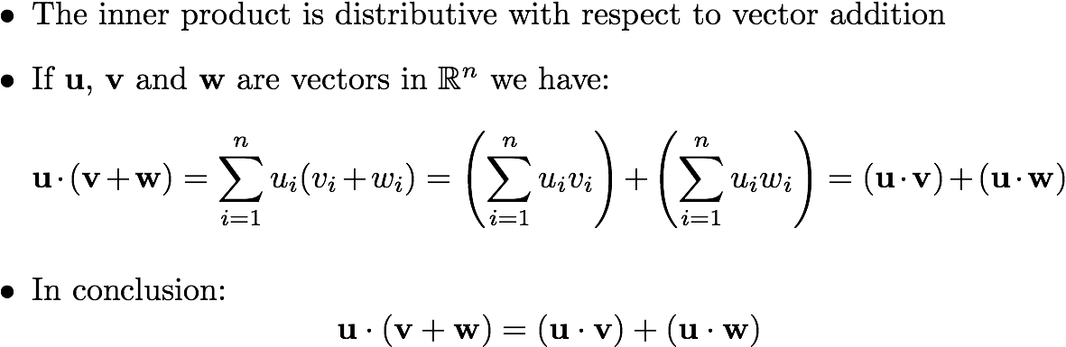
Inner Product Properties
Robo1x-1 20

Slide 21
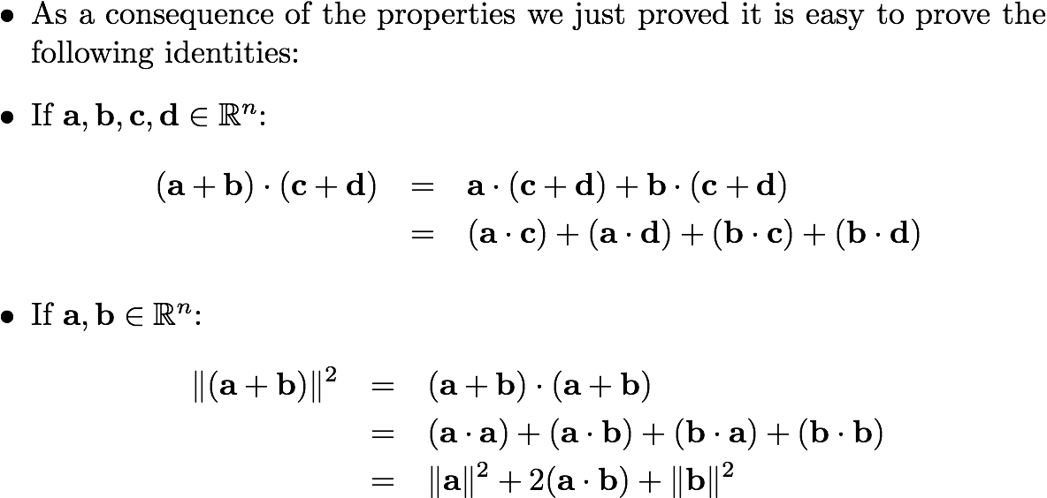
Inner Product Properties
Robo1x-1 21

Slide 22
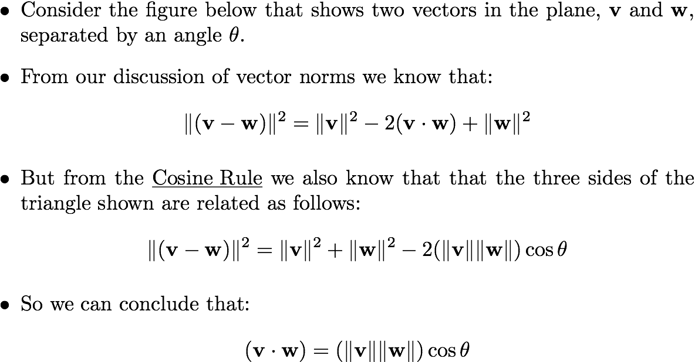
Cosine Rule
v
(v-w)
w
© University of Pennsylvania
Robo1x-1 22

Slide 23






Geometric Interpretation
v
v
v
w
w
w

Slide 24
Orthogonality
Whenever the inner product of two vectors is zero we say that they are orthogonal.
The idea of two vectors at right angles generalizes to higher dimensions
v
w

Slide 25
Video 1.4 CJ Taylor

Slide 26
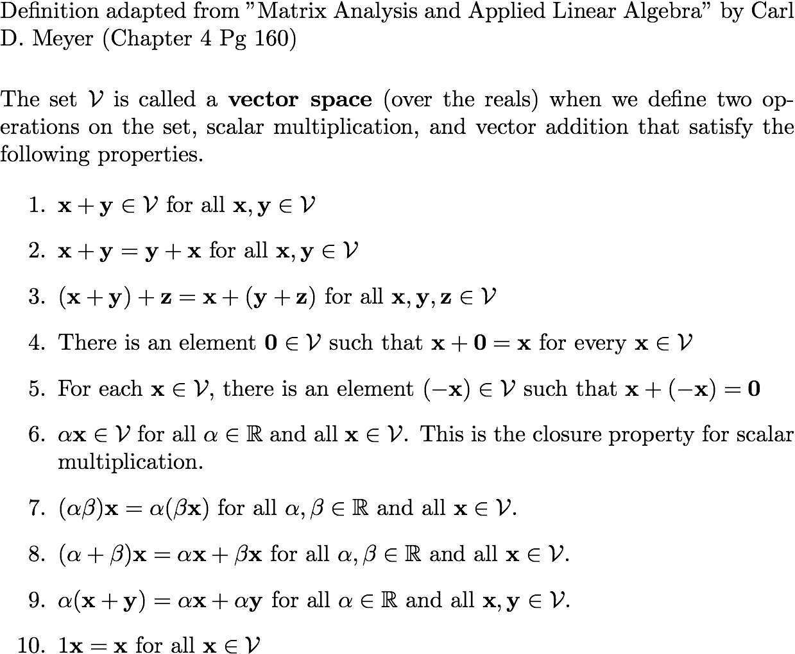
Vector Spaces

Slide 27
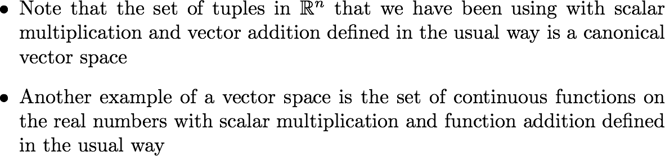
Vector Spaces

Slide 28
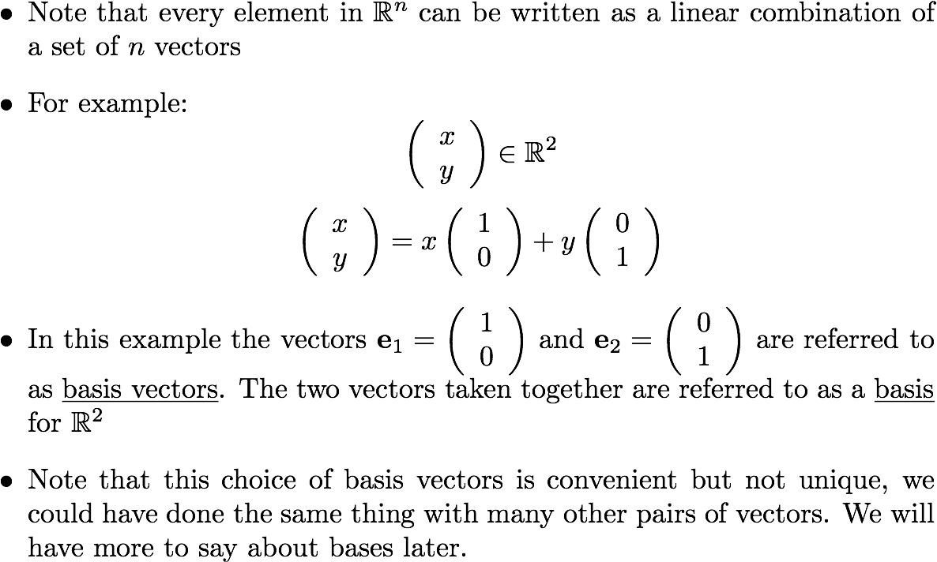
Basis

