Slide 1
机器人: 基础篇
Prof. C.J. Taylor University of Pennsylvania

Slide 2

视频 1.1 CJ Taylor

Slide 3
目标
在开发数学工具时，我们需要讨论空间中物体的位置。
物体的位置取决于你从哪个角度来看待它们。那么，我们如何才能使它测量的更精确呢?

Slide 4
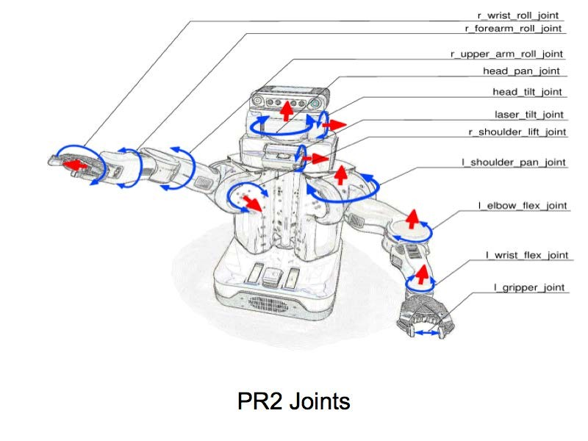
机器人的坐标转换

Slide 5


Descartes
Consider the Cartesian coordinate plane
Points in the plane can be denoted with tuples denoting their coordinates with respect to the frame of reference
y
v
(2,1)
x

Slide 6
Descartes
Note that we can also talk about vectors. Corresponding to directions in the plane or to displacements between points.
These can also be represented by tuples
(1,3)
y
v
(2,1)
x
© University of Pennsylvania
Robo1x-1 6

Slide 7
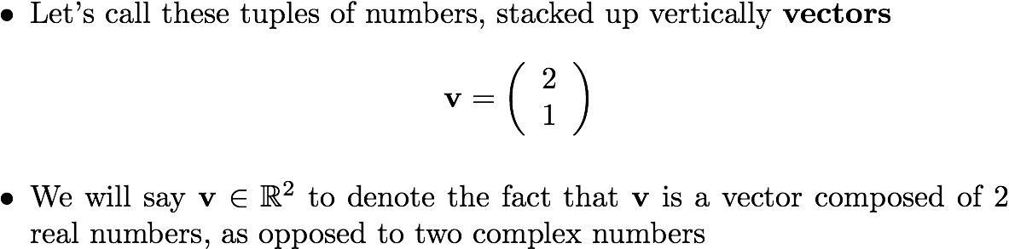
Vectors

Slide 8
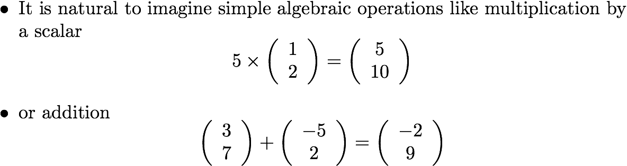
Operations on Vectors

Slide 9
Geometric Interpretation
It is not hard to see that multiplication by a scalar value corresponds to scaling a vector by that amount.
Similarly adding two tuples corresponds to adding the corresponding vectors head to tail
y
y
(w+v)
a*v
w
v
v
x
x
© University of Pennsylvania
Robo1x-1 9

Slide 10
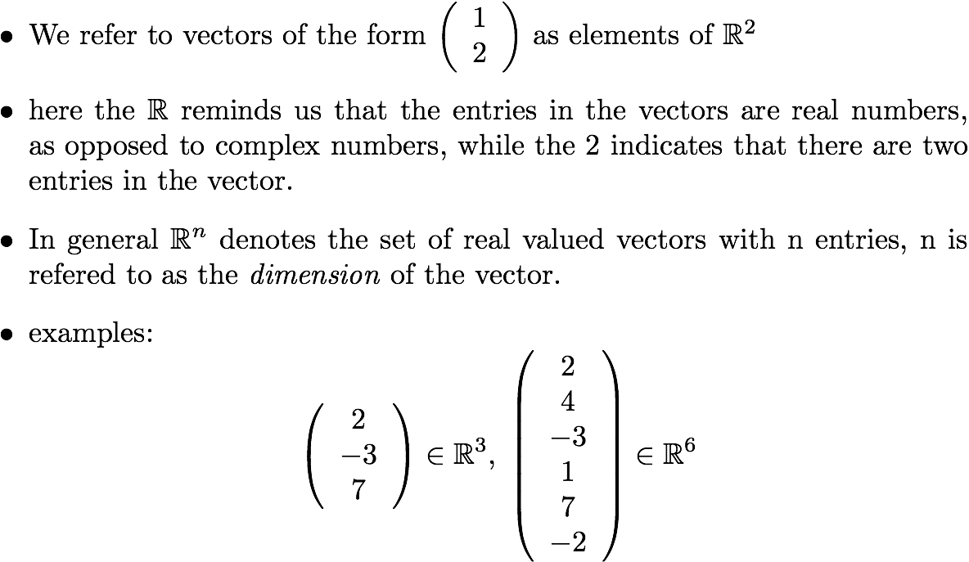
Adding Dimensions

Slide 11

Descartes in 3D
We will also be interested in talking about the location of objects in space. Here R³ will be helpful.
y
(1, 3, 2)
v
x
z

Slide 12
Video 1.2 CJ Taylor

Slide 13
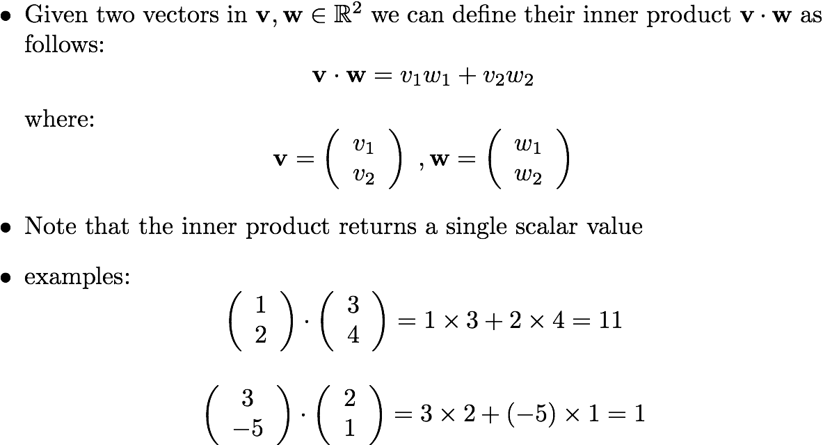
Inner Product

Slide 14
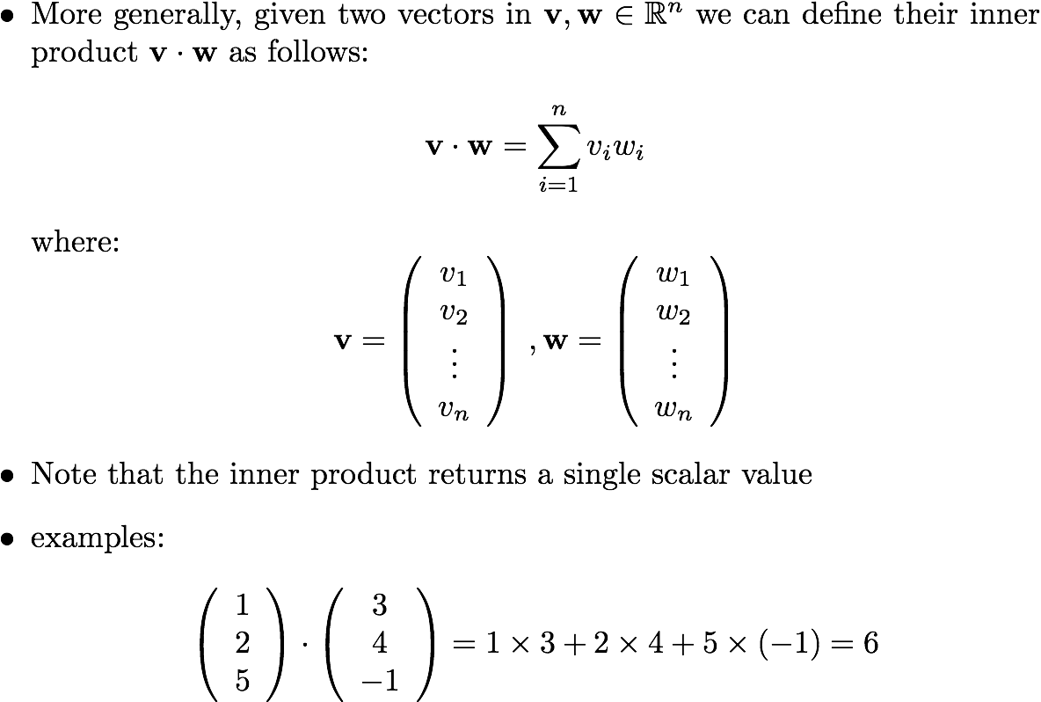
More Inner Products

Slide 15
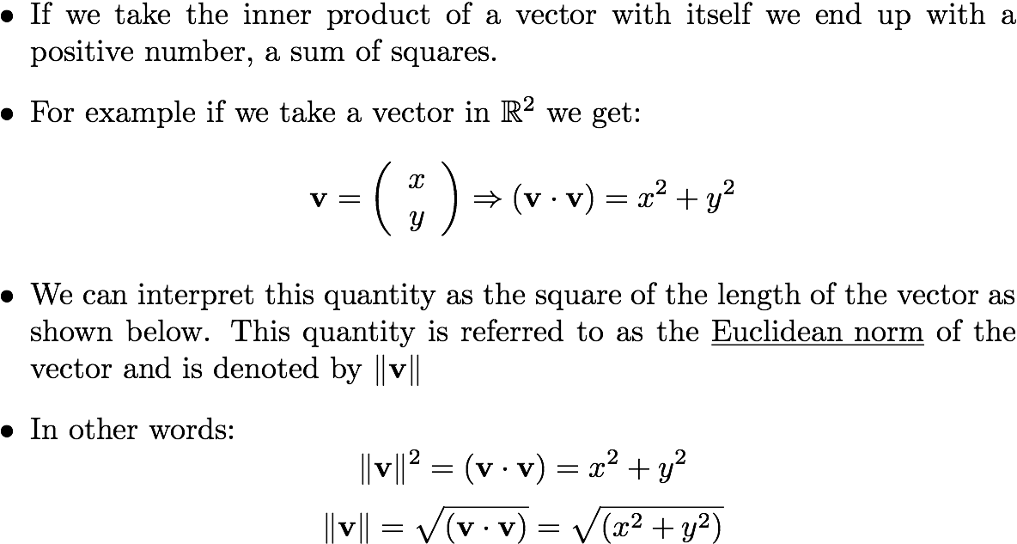
The Euclidean Norm

Slide 16

Euclidean Norm
v
y
x

Slide 17
Video 1.3 CJ Taylor

Slide 18
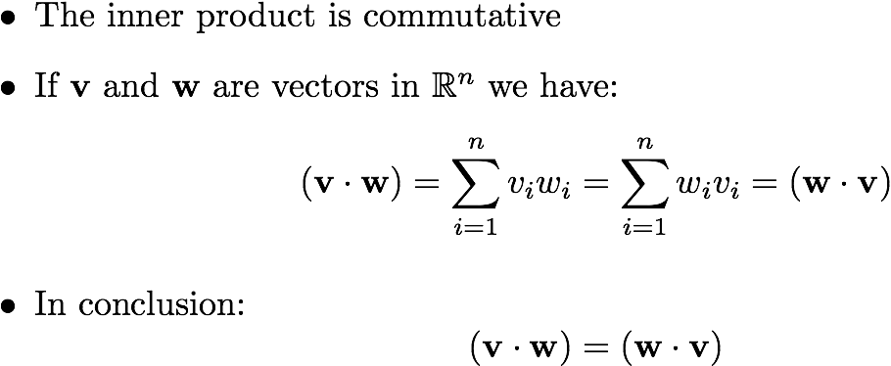
Inner Product Properties

Slide 19
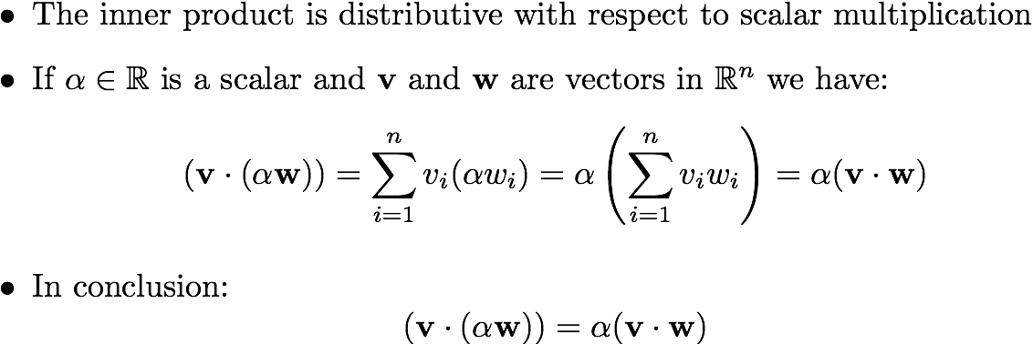
Inner Product Properties

Slide 20
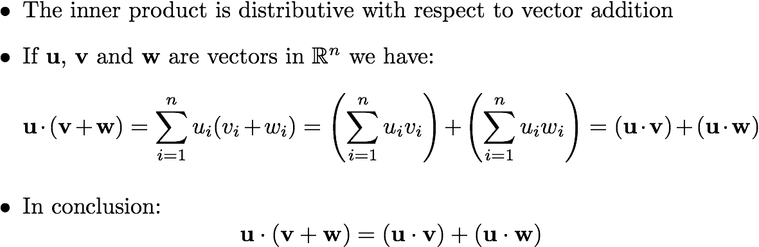
Inner Product Properties
Robo1x-1 20

Slide 21
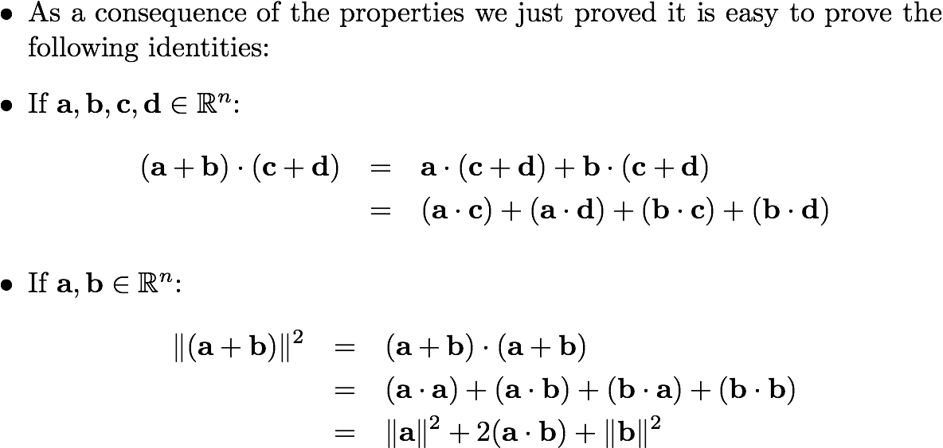
Inner Product Properties
Robo1x-1 21

Slide 22
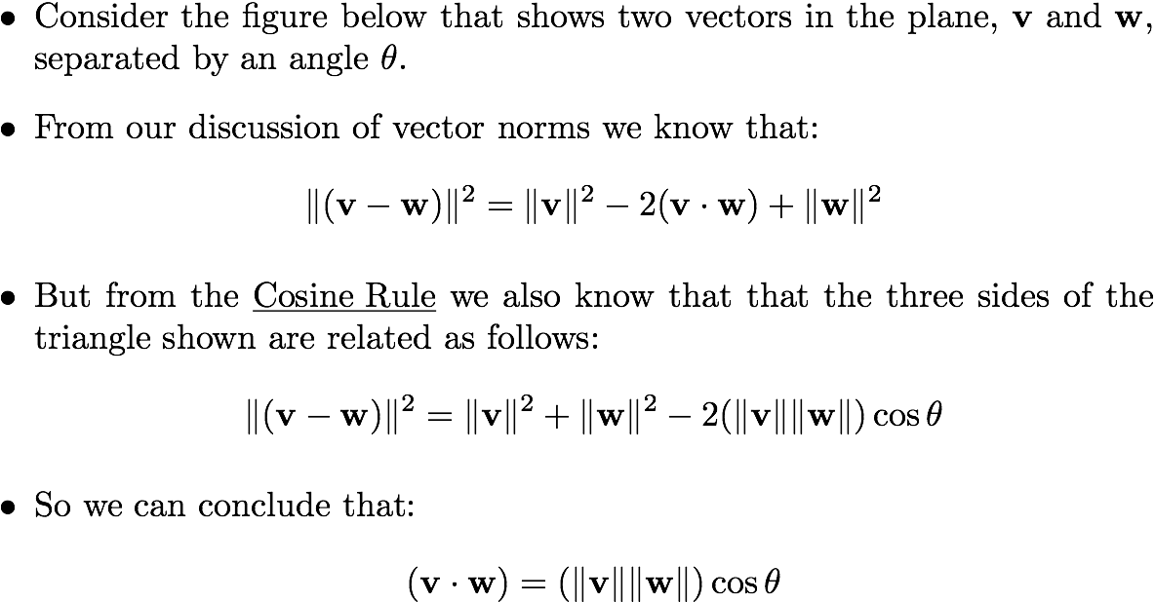
Cosine Rule
v
(v-w)
w
© University of Pennsylvania
Robo1x-1 22

Slide 23






Geometric Interpretation
v
v
v
w
w
w

Slide 24
Orthogonality
Whenever the inner product of two vectors is zero we say that they are orthogonal.
The idea of two vectors at right angles generalizes to higher dimensions
v
w

Slide 25
Video 1.4 CJ Taylor

Slide 26
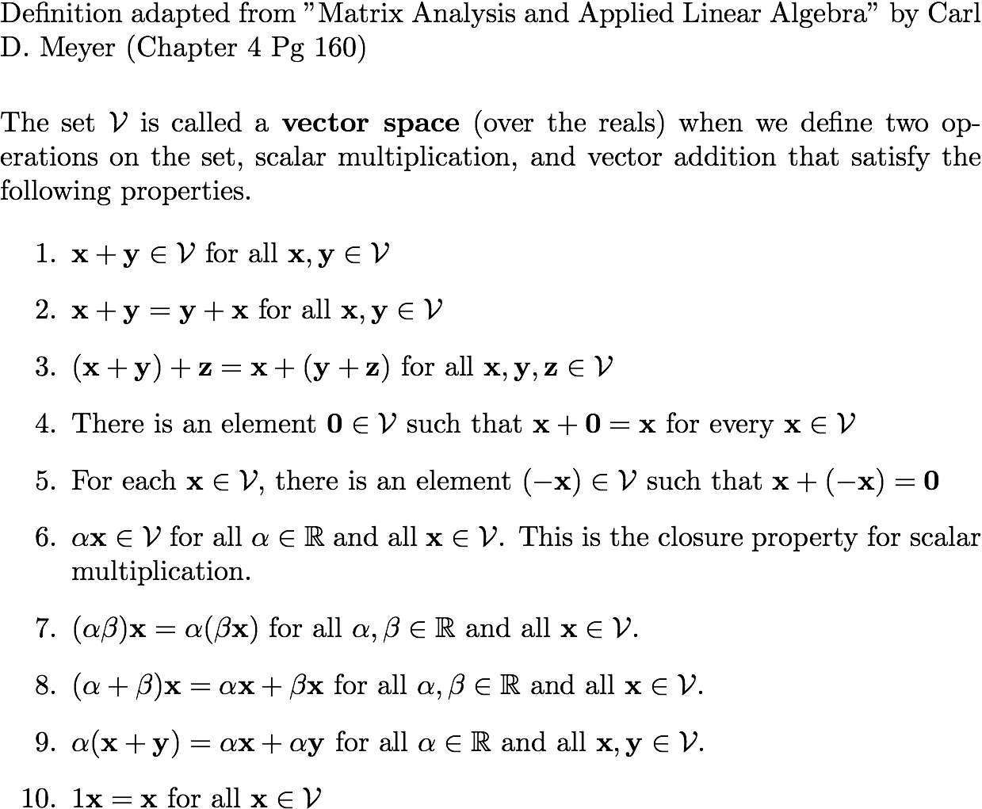
Vector Spaces

Slide 27
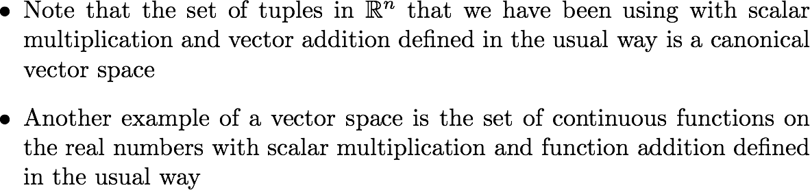
Vector Spaces

Slide 28
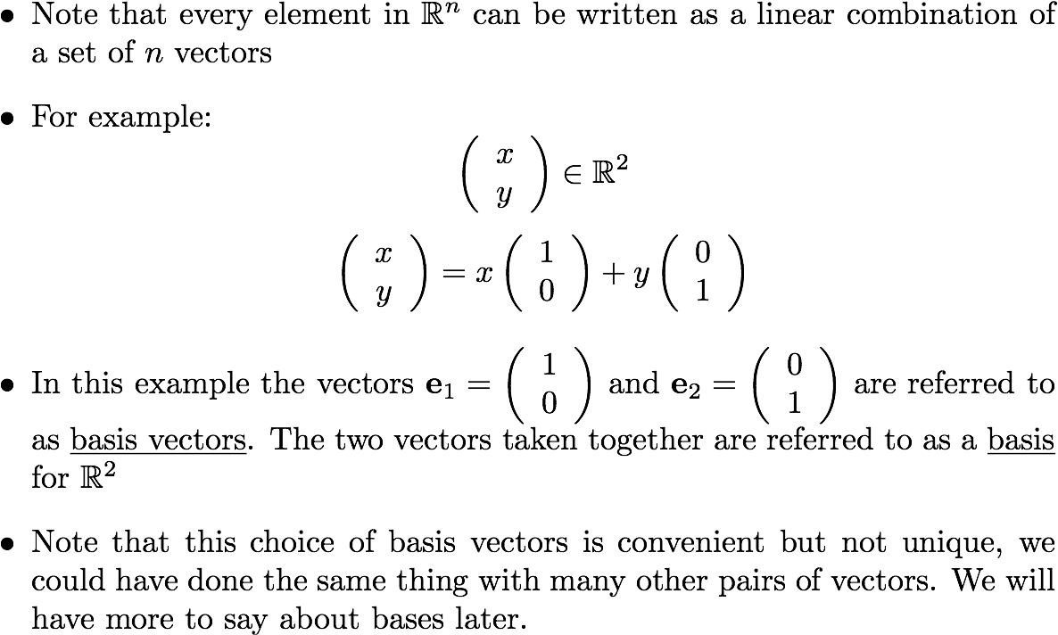
Basis

