Slide 1

视频 3.1 CJ Taylor

Slide 2


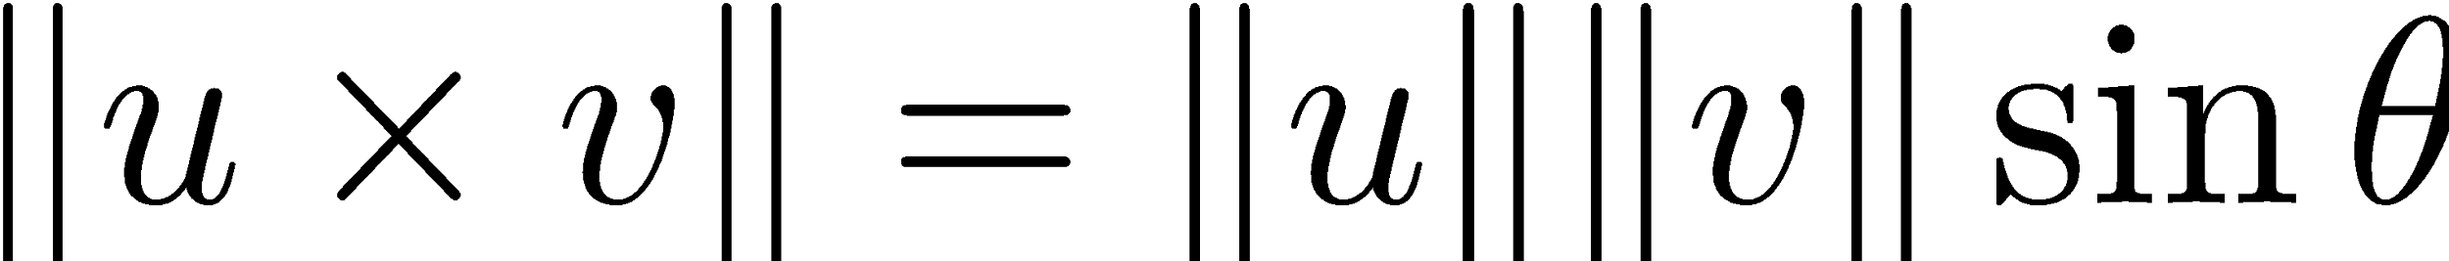
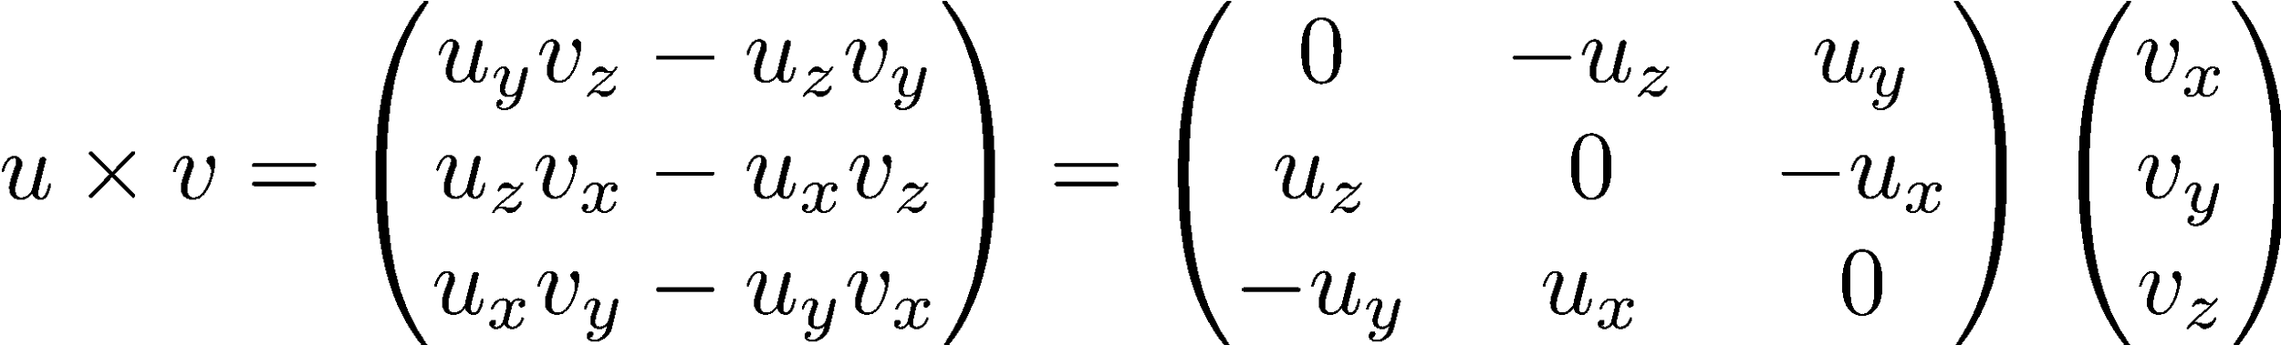
向量积
u w
v

Slide 3
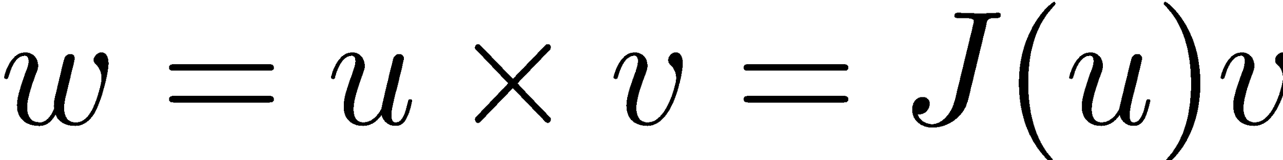
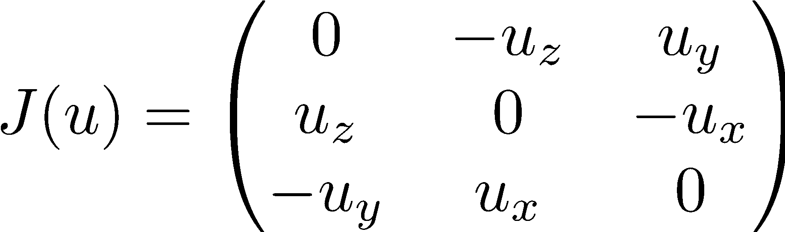
向量积
u w
v

Slide 4
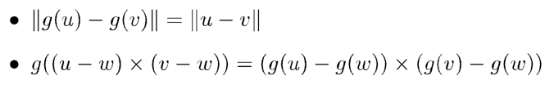
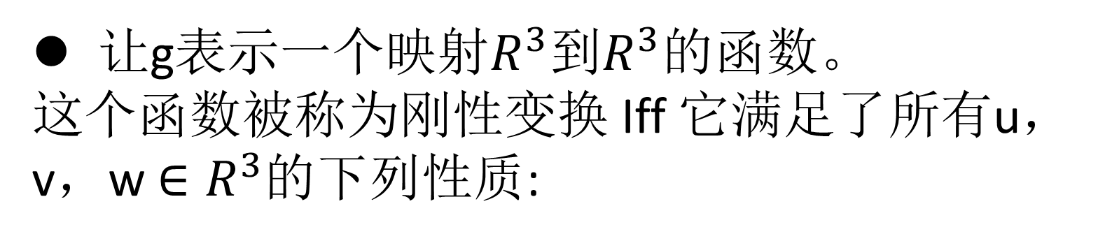
刚性转换
让g表示一个映射$R^{3}$到$R^{3}$的函数。
这个函数被称为刚性变换 Iff 它满足了所有u，v，w $∈R^{3}$的下列性质:

Slide 5




刚性转换
可以看出，所有的刚性转换都可以如下所示:
在这个方程中，矩阵R，被称为旋转矩阵，有以下特殊性质:
所有列都是单位长度

Slide 6

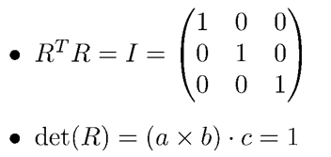
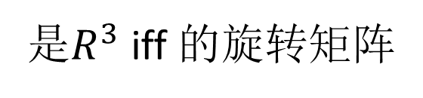
矩阵旋转
一组具有下列属性的3 x 3矩阵，再加上矩阵乘法的运算形成一个称为SO(3)的组
是$R^{3}$ iff 的旋转矩阵

Slide 7
Video 3.2 CJ Taylor

Slide 8
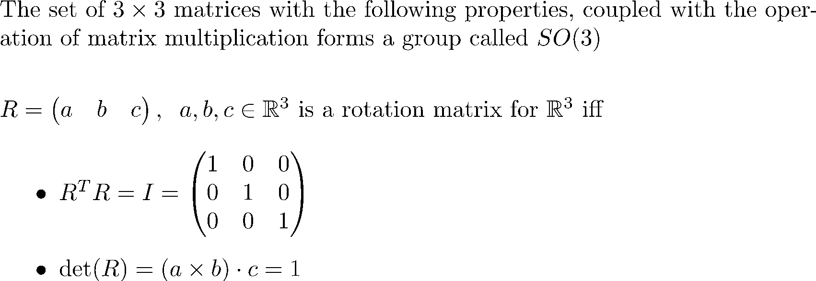
Rotation Matrices

Slide 9
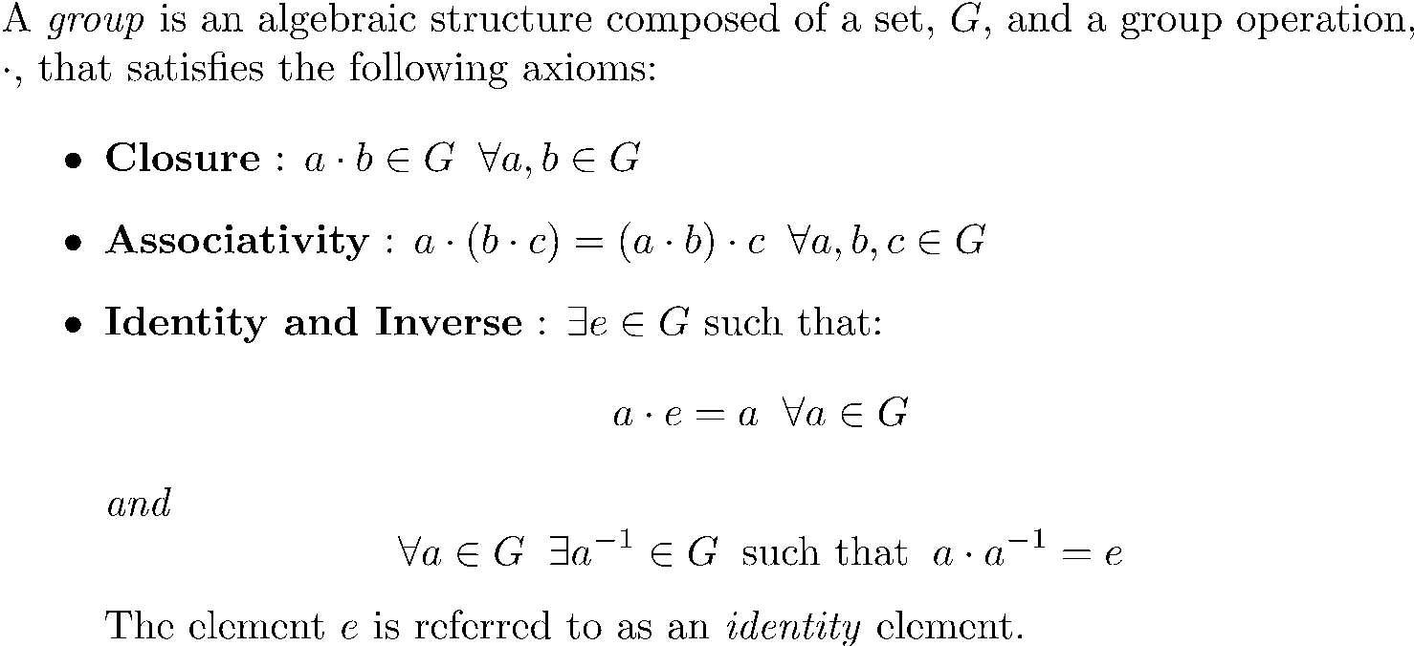
Groups

Slide 10
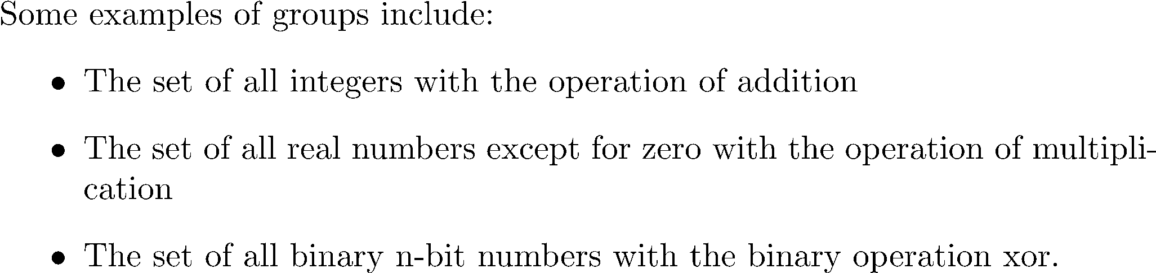
Groups
Robo1x-3 10

Slide 11
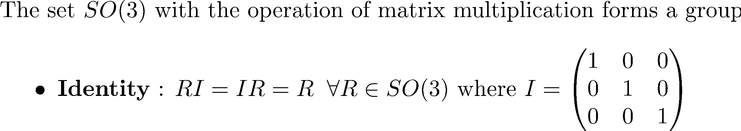
SO(3)

Slide 12
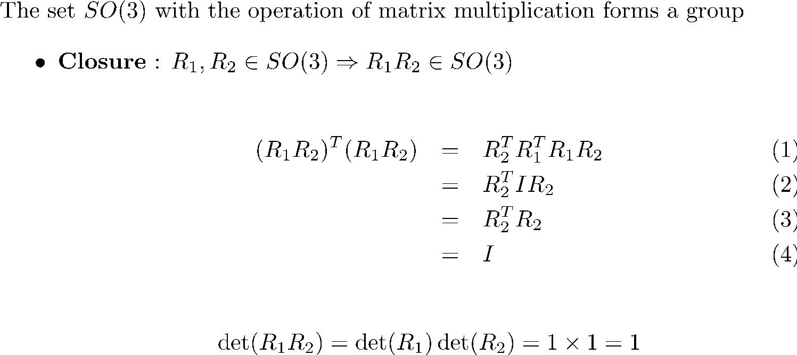
SO(3)

Slide 13
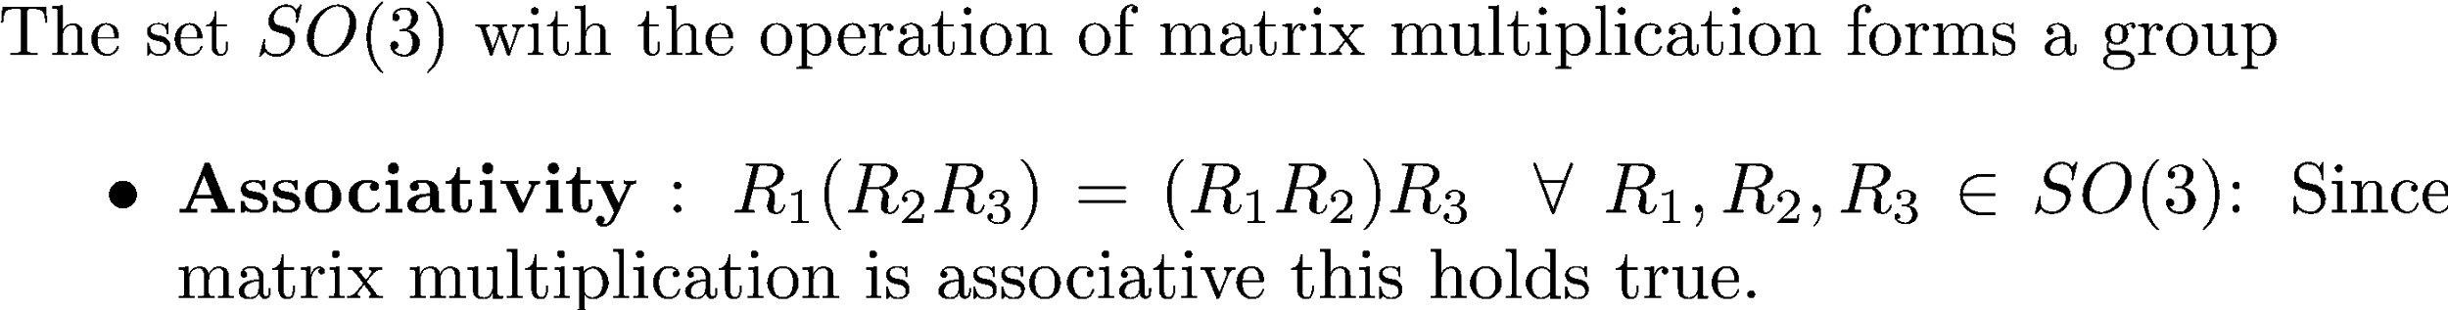
SO(3)

Slide 14
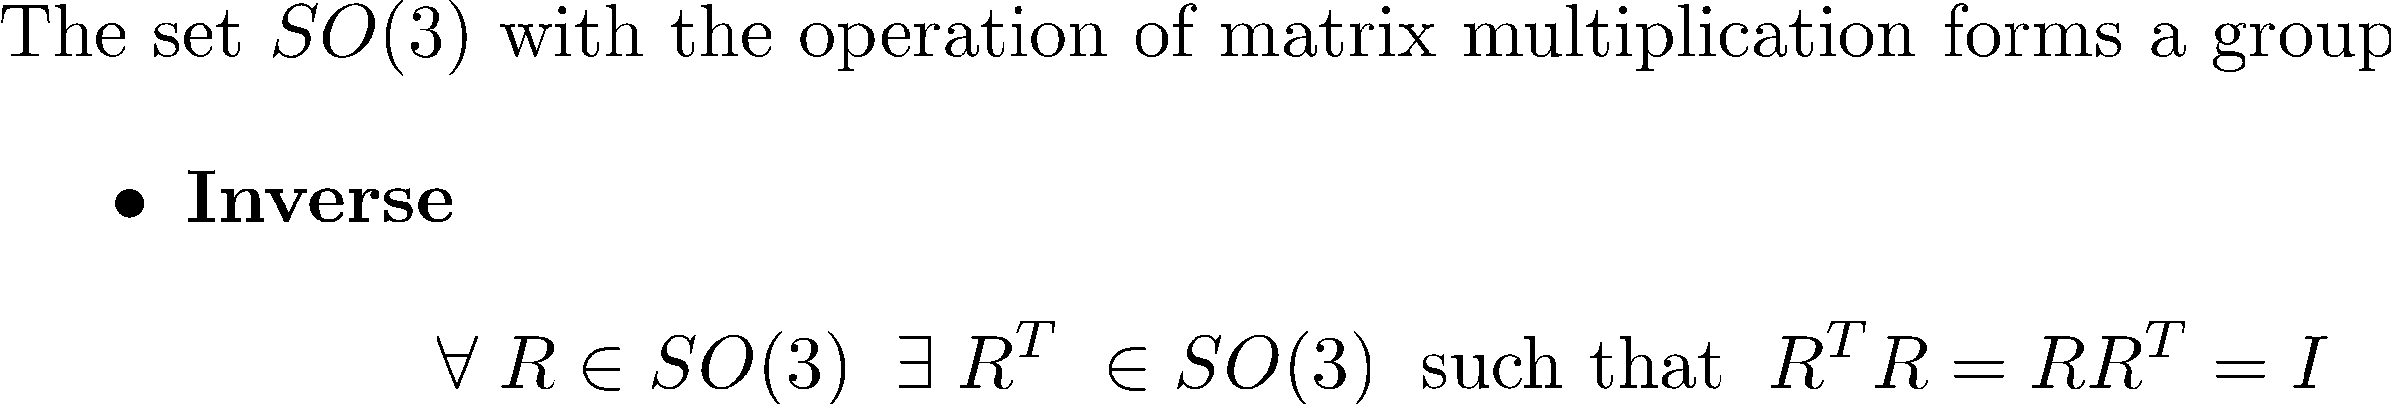
SO(3)

Slide 15
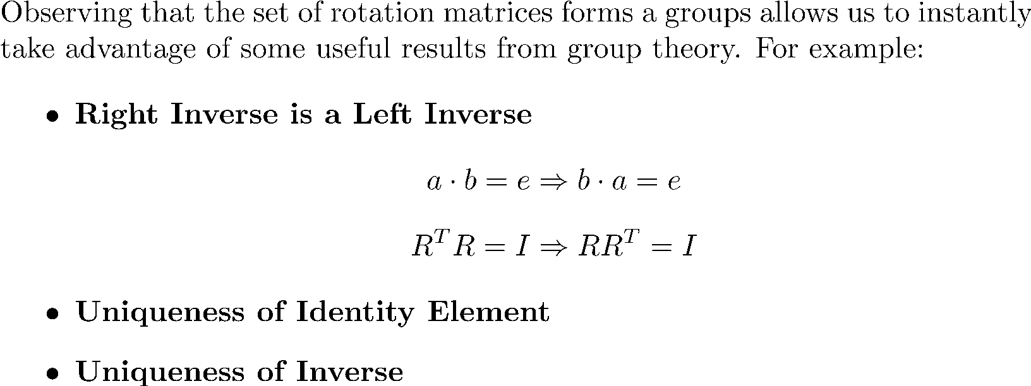
Group Properties

Slide 16
Video 3.3 CJ Taylor

Slide 17
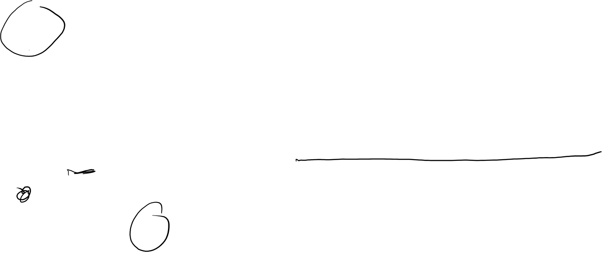

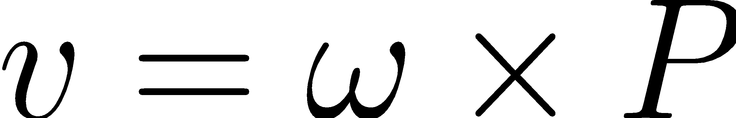


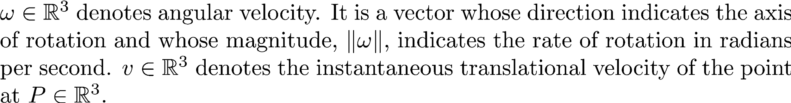
Angular Velocity

Slide 18
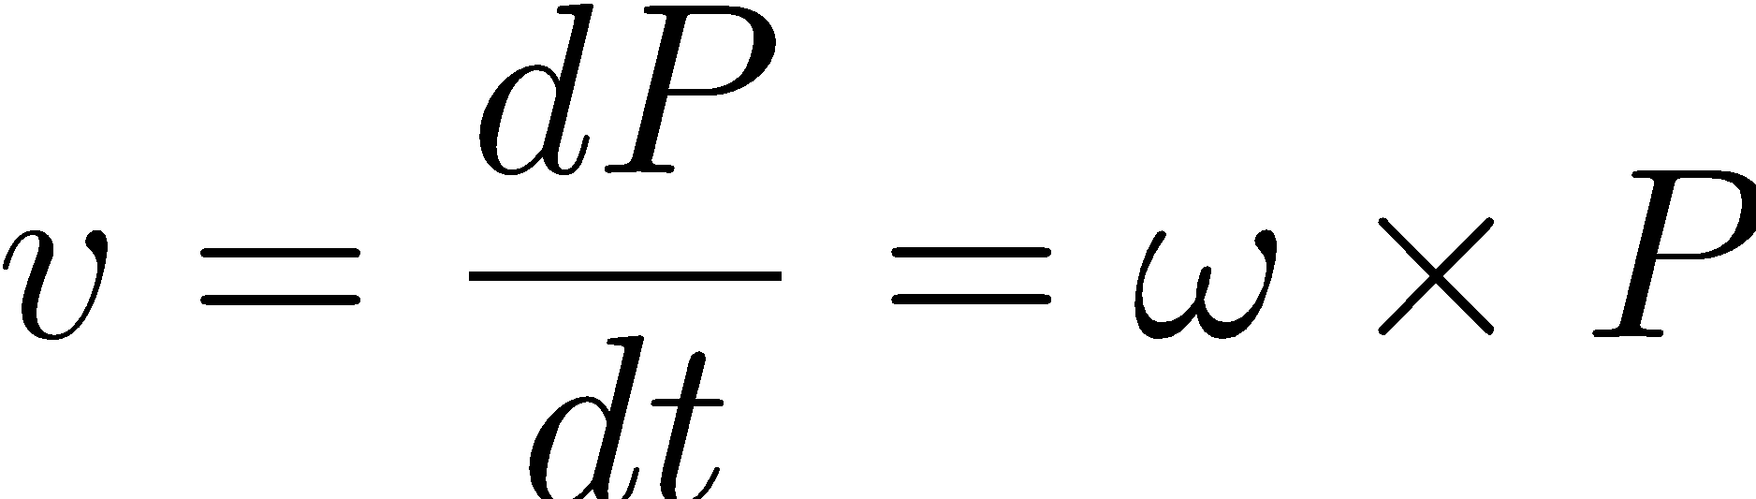
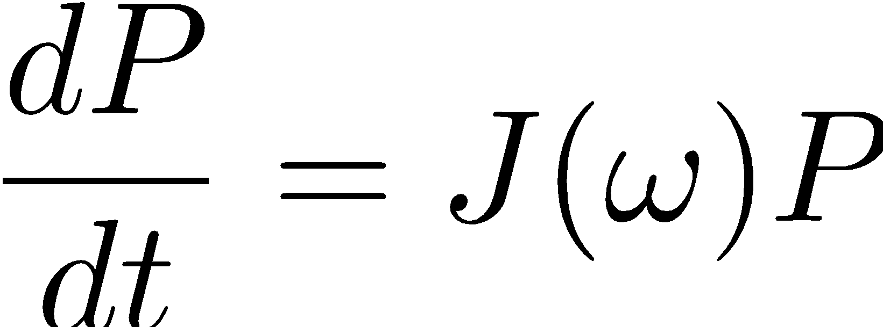
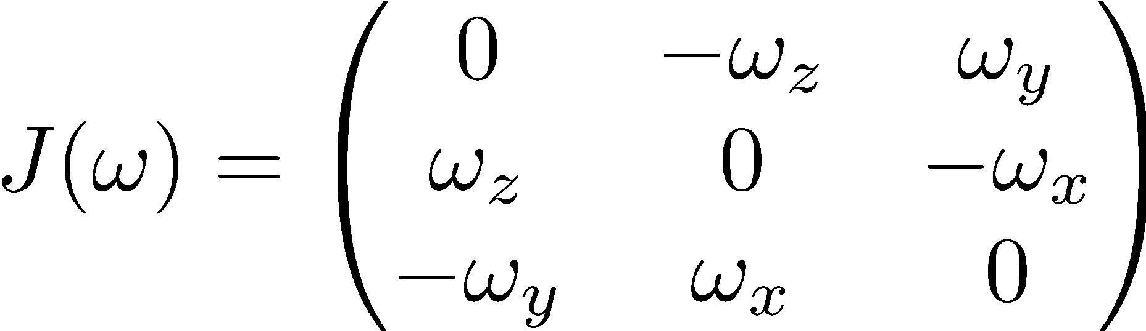
Angular Velocity

Slide 19
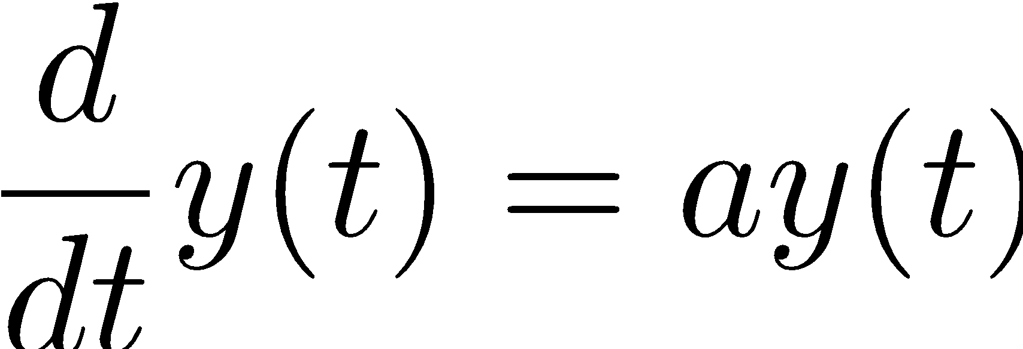
Linear Differential Equations

Slide 20
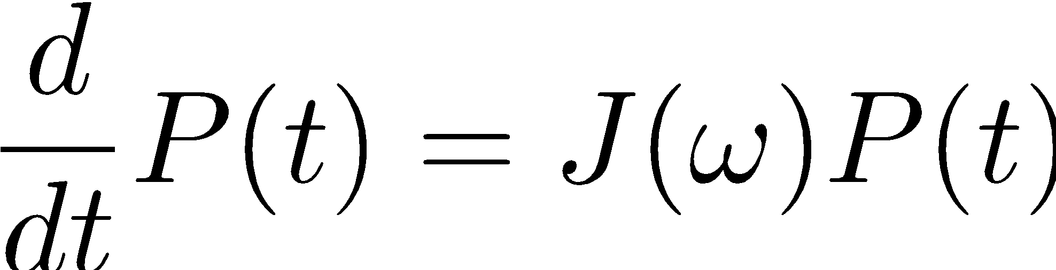
Linear Differential Equations
Robo1x-3 20

Slide 21
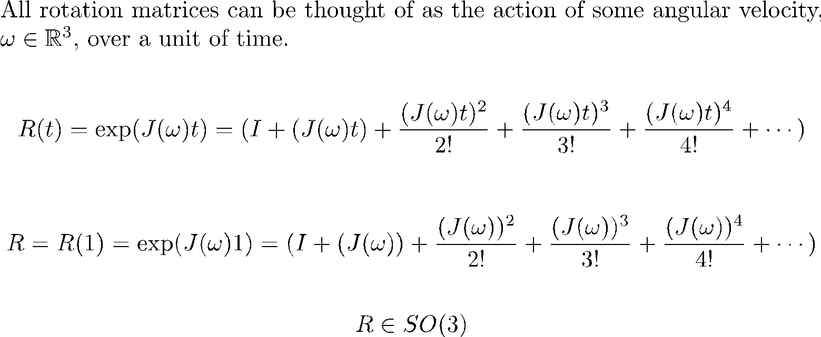
Rotations as Matrix Exponentials

Slide 22
Video 3.4 CJ Taylor

Slide 23
Rotations as Matrix Exponentials

Slide 24
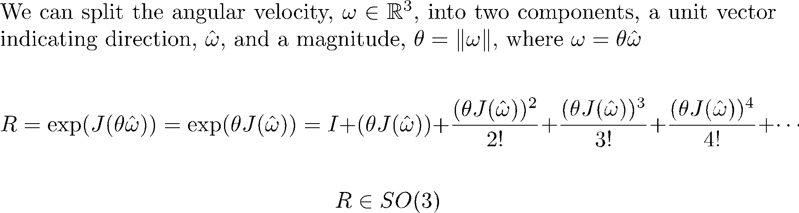
Rotations as Matrix Exponentials

Slide 25
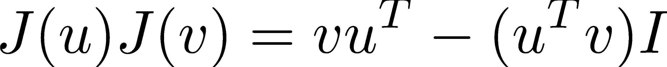
Skew-Symmetric Products

Slide 26
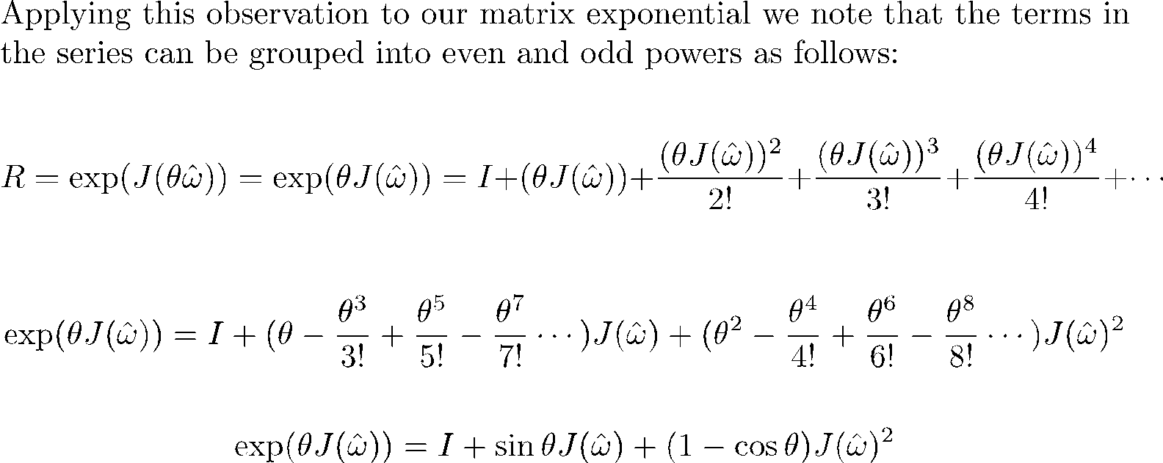

The Rodrigues Formula

Slide 27
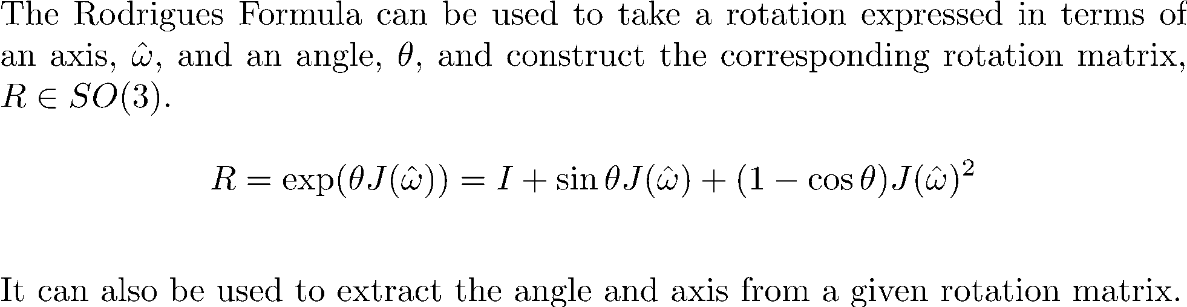
The Rodrigues Formula

Slide 28
Video 3.5 CJ Taylor

Slide 29
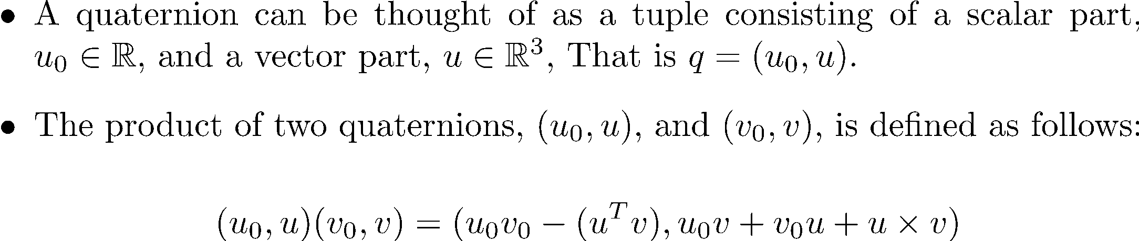
Quaternions

Slide 30
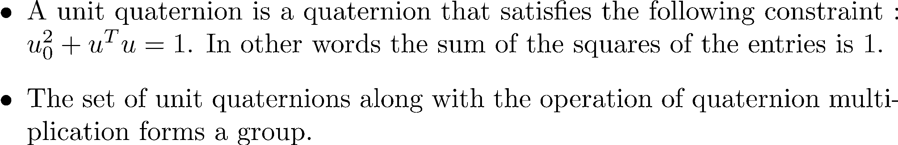
Unit Quaternions
Robo1x-3 30

Slide 31
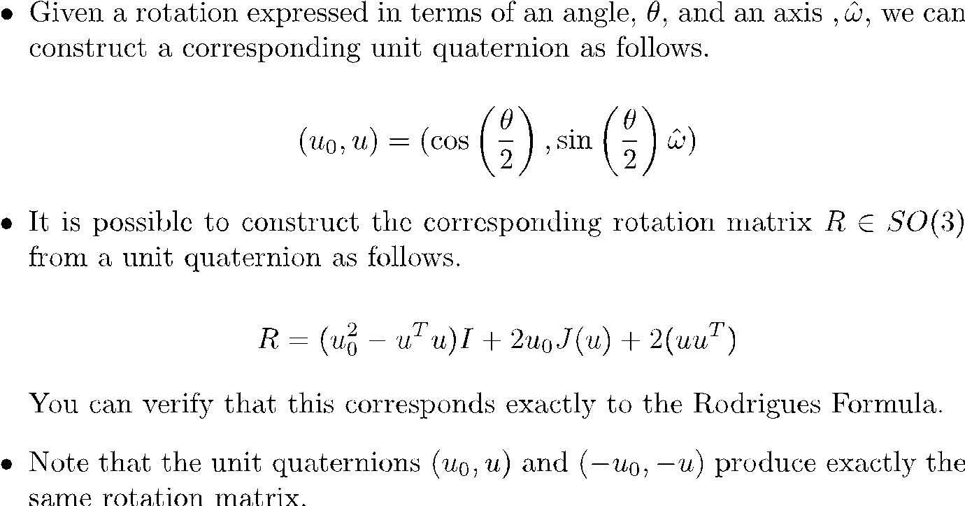
Unit Quaternions and Rotations

Slide 32
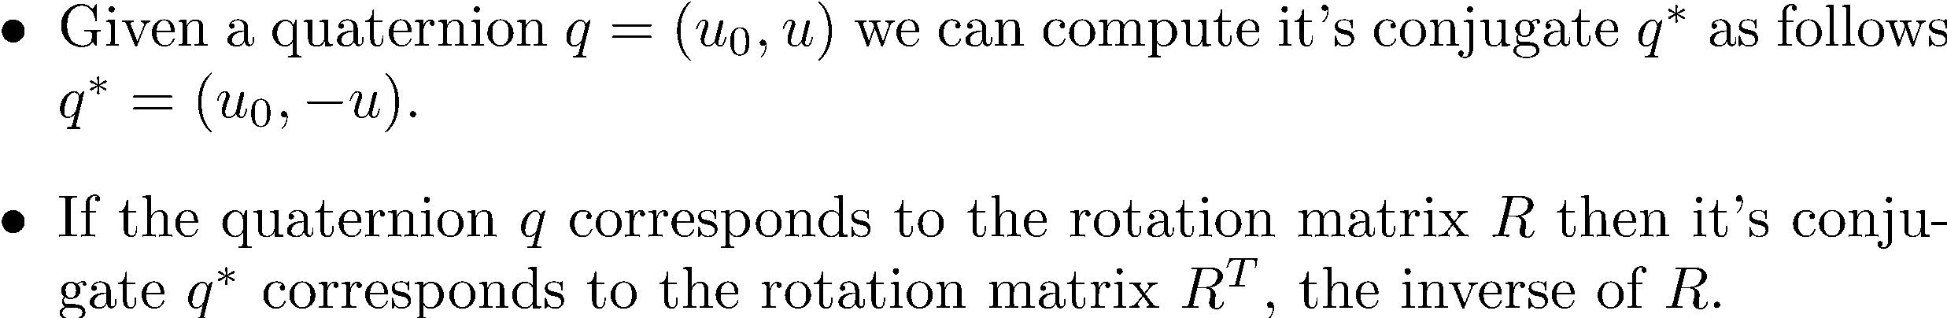
Quaternion Conjugate

Slide 33
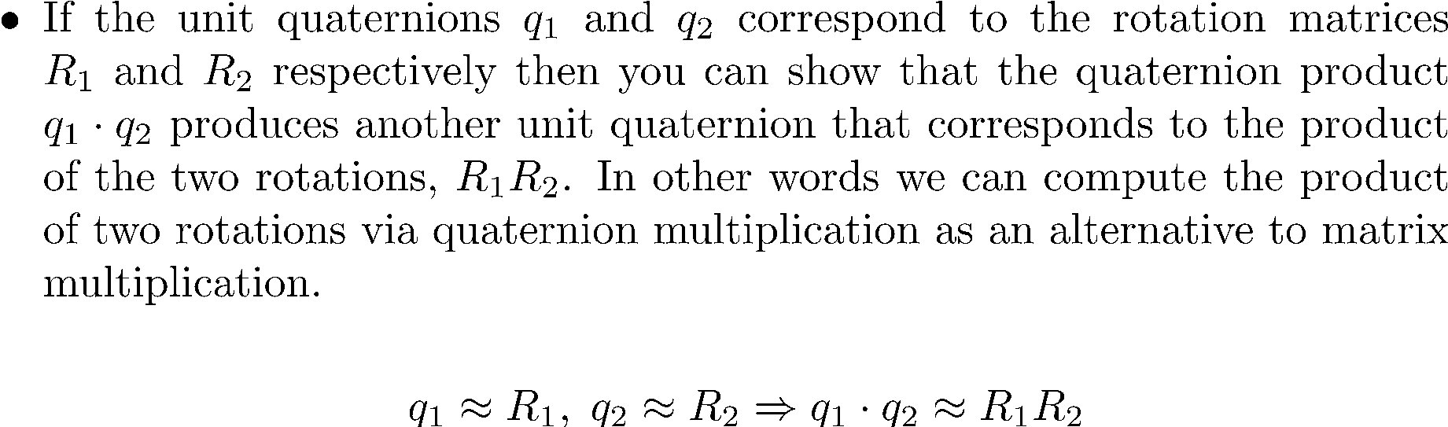
Unit Quaternions

Slide 34
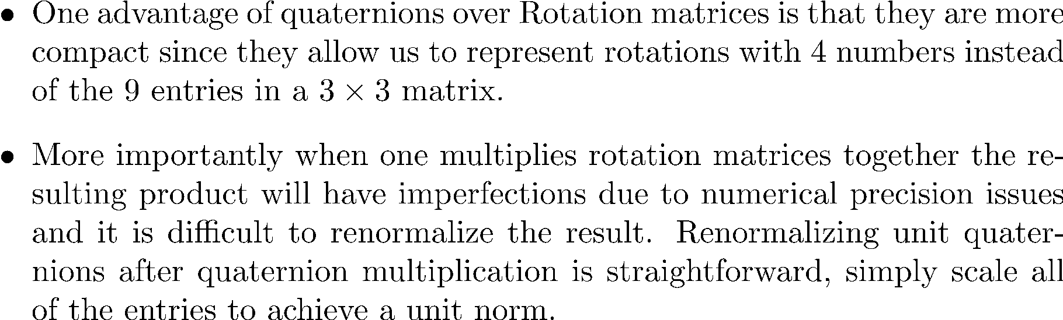
Advantages of Quaternions

Slide 35
Video 3.6 CJ Taylor

Slide 36
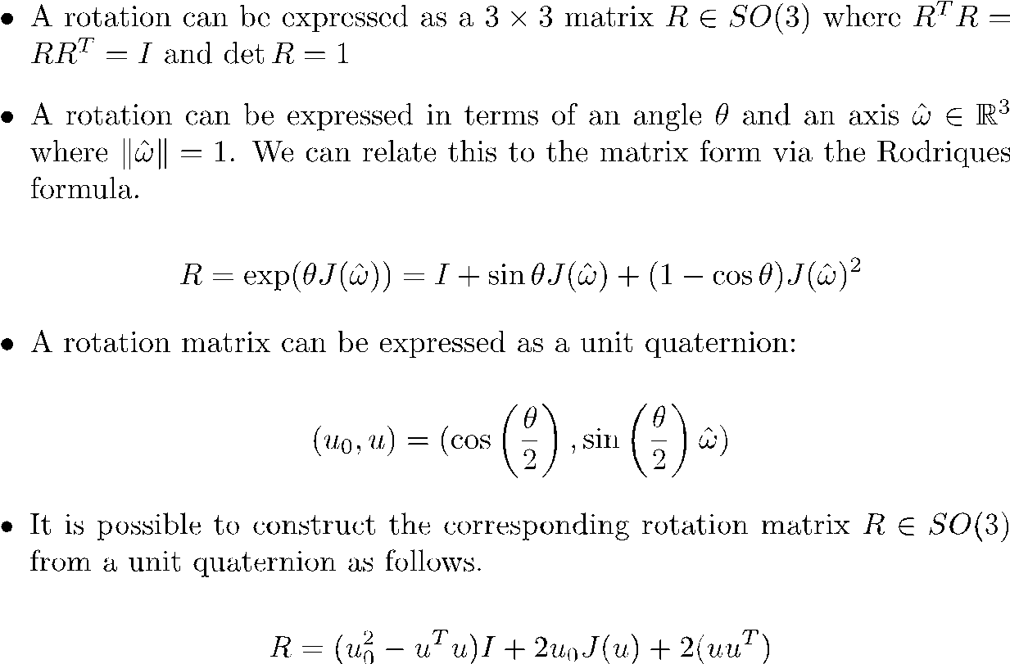
Summary of Rotation Representations

Slide 37
Video 3.7 CJ Taylor

Slide 38
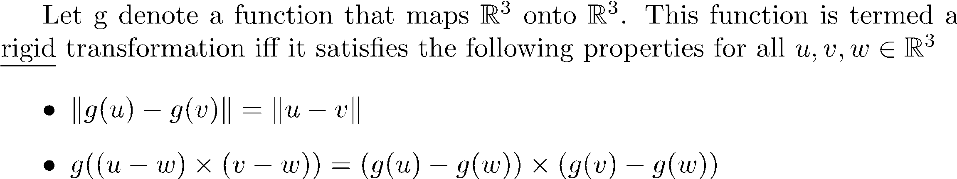
Rigid Transformations

Slide 39
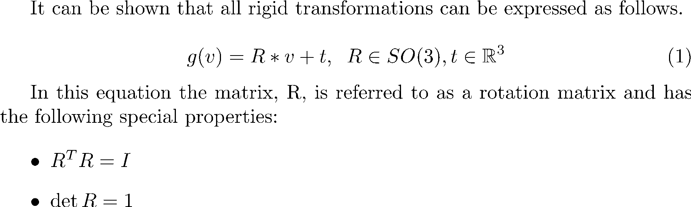
Rigid Transformations

Slide 40
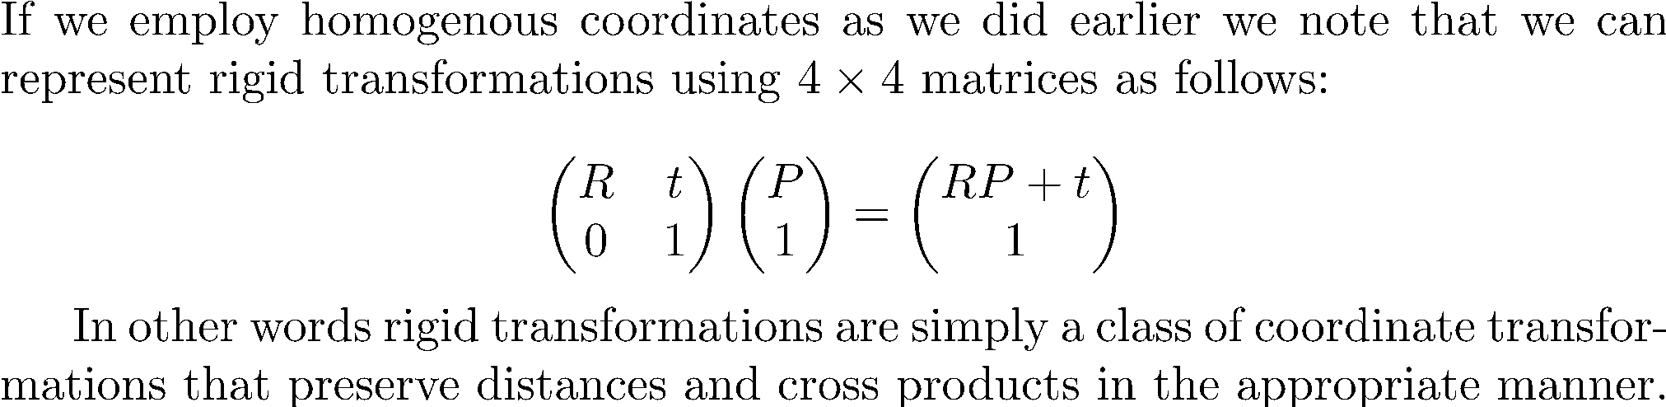
Rigid Transformations
Robo1x-3 40

Slide 41
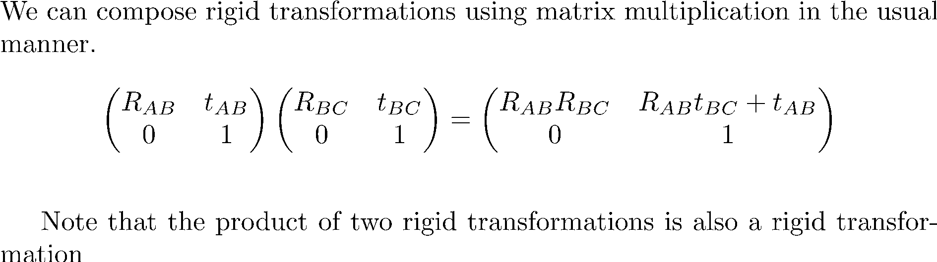
Composing Rigid Transformations

Slide 42
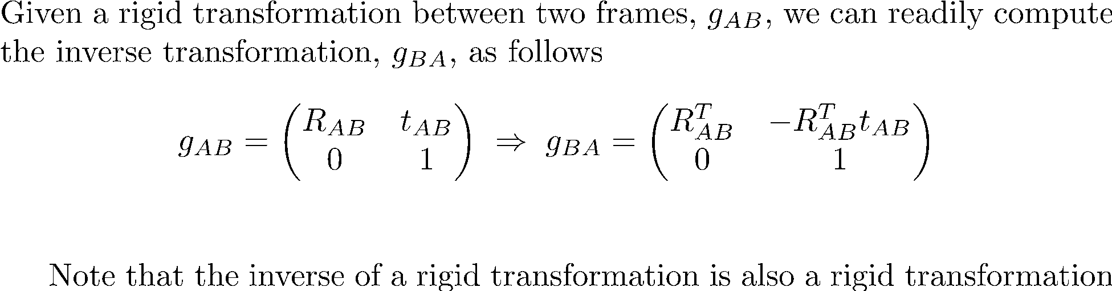
Inverting Rigid Transformations

Slide 43
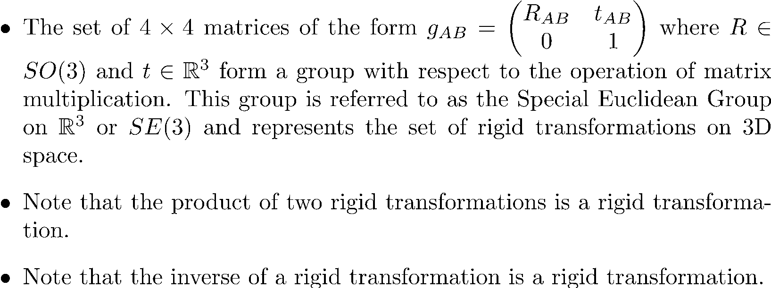
SE(3)

Slide 44
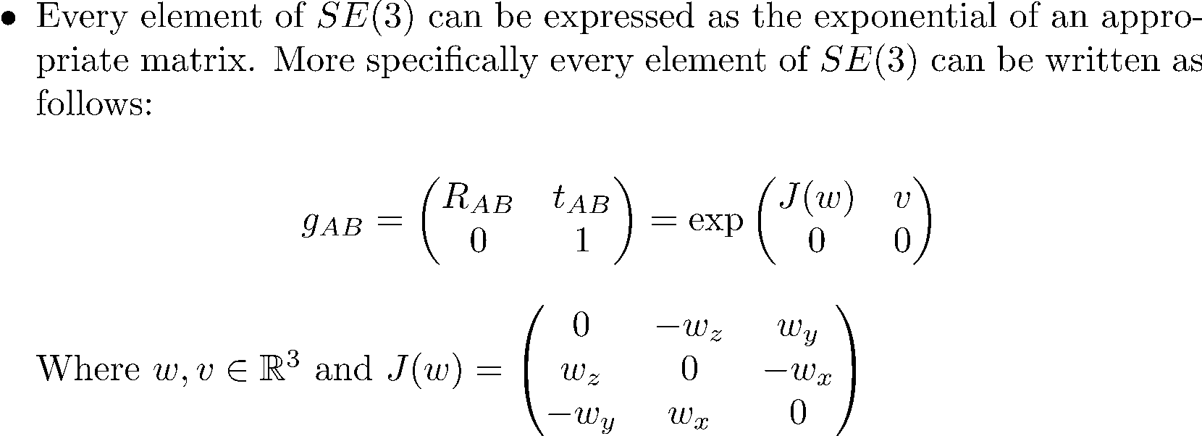
SE(3) and Matrix Exponentials

