Slide 1



HYBRID
ANT COLONY
GENETIC
COURSE TIMETABLE GENERATOR
Done by
Akhila Joseph
Anchu R S
Guided By
Biju Abraham N

Slide 2
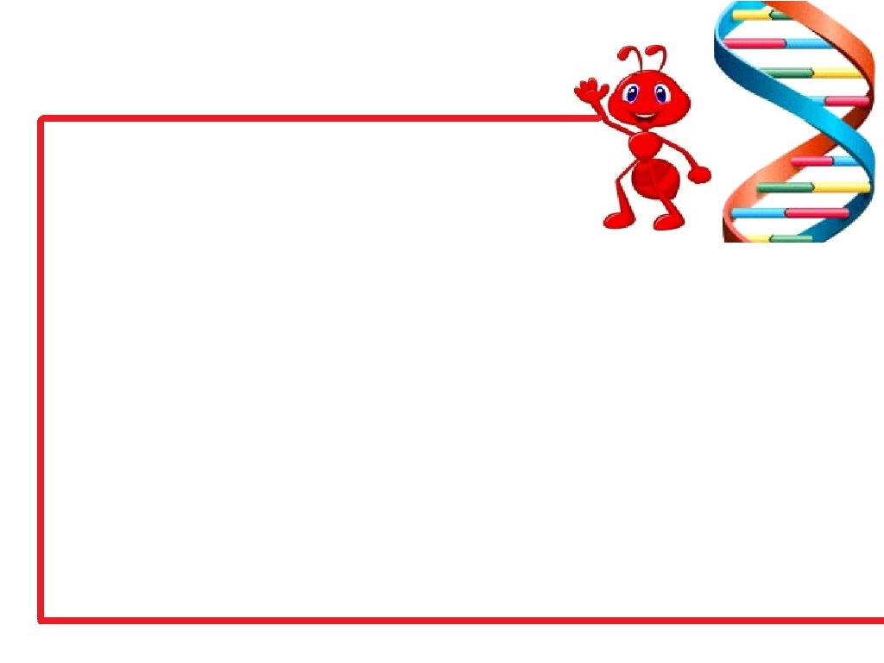
OUTLINE:
Introduction
Need for Timetable Generator
Phases for Computation
Input and Output Formats
About timetabling problem
Algorithm used
  Ant Colony algorithm
  Genetic algorithm
Hybrid ant colony genetic algorithm
Conclusion
References

Slide 3
OBJECTIVE:
The main objective of this project is
to develop a course timetable for B.Tech in Rajagiri
School of Engineering and Technology satisfying all the constraints specific to the institution.

Slide 4
WHY OUR TIMETABLE GENERATOR?
1 and a half months
to
3 minutes

Slide 5
PHASES FOR COMPUTATION:
Get Details in Excel sheets
Extract details to data structures
Generate solutions
Optimise
TIME TABLE

Slide 6
INPUT AND OUTPUT FORMATS:
Input
Teacher-Subject-Class allocation’s excel file
Syllabus details specification’s excel file
Prealloted lab hours’ excel file
Output
Timetable for a week for all classes generated in an excel sheet

Slide 7
ABOUT THE PROBLEM:
NP-HARD
No polynomial time solution can be found
HOW TO COMPUTE IN A POLYNOMIAL TIME?
Some Approaches
-Tabu Search
-Ant Colony Based Approach
-Genetic Algorithm
A solution close to optimal is obtained

Slide 8
ALGORITHM USED:
HYBRID ANT-COLONY GENETIC ALGORITHM
Ant colony generates inputs for optimisation
Genetic optimises and fixes the solution

Slide 9



ANT COLONY ALGORTHM
Ants are agents that start from nodes of graph
Each ant deposits pheromone along the edges of path it chooses
Ants are more likely to take path with more pheromones
in it
EVENTUALLY FOLLOWS THE OPTIMAL PATH

Slide 10



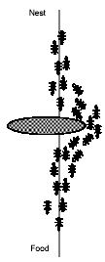
NATURAL BEHAVIOUR OF ANTS:

Slide 11
ANT COLONY ALGORITHM:
1.Initialise ants to the nodes of the graph
2.For each ants do
2.1Select next node for the ants to move with a good
probability value
3. Repeat step 2 until the stopping criterion for an ant is met
4. Increment pheromones for the edges taken by the ant
5.Evaporate pheromones of all edges by an evaporation factor
6.Repeat steps 2-5 till required solution is obtained

Slide 12
ANT COLONY ALGORITHM:
PROBABILITY(i,j)=PHEROMONE(i,j)^{α}*VISIBILITY(i,j)^{β}
Σ PHEROMONE(i,j)^{α}*VISIBILITY(i,j)^{β}

Slide 13
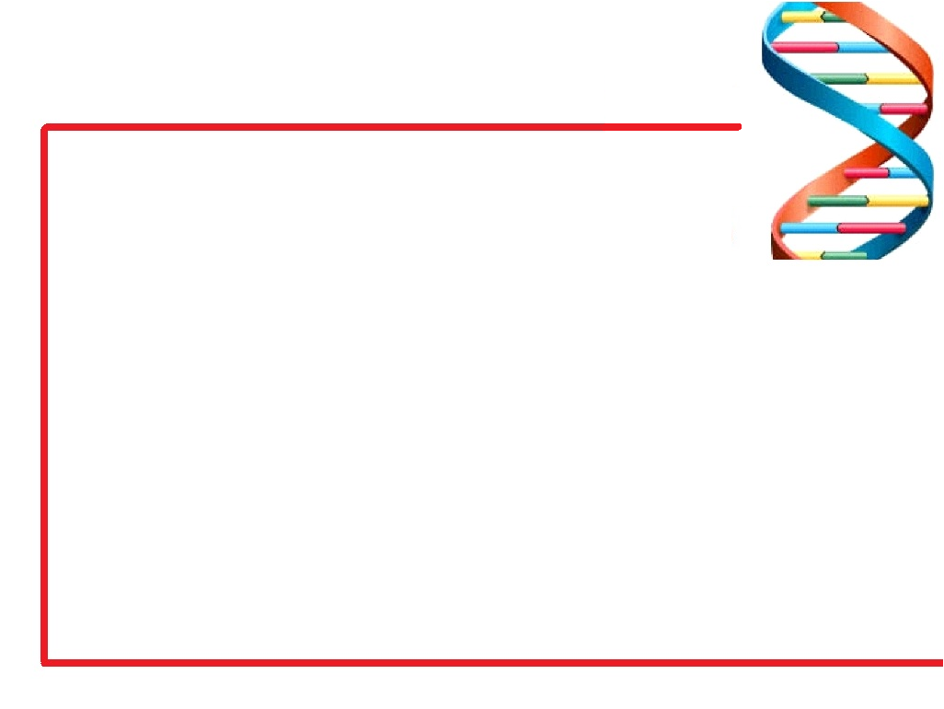
GENETIC ALGORITHM
Search algorithm using process of natural selection.
Major components are:
Population
Fitness Function
Individual element of the population Chromosome
The Chromosome represents a potential solution and is divided into multiple genes.

Slide 14
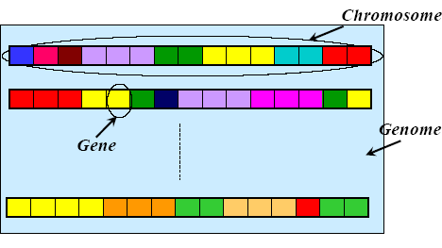
GENETIC ALGORITHM
Genome - Collection of all chromosomes

Slide 15
GENETIC ALGORITHM
Basic Operations:
Selection
Crossover
Mutation
Selection :
selects the chromosome with maximum fitness for evolution

Slide 16
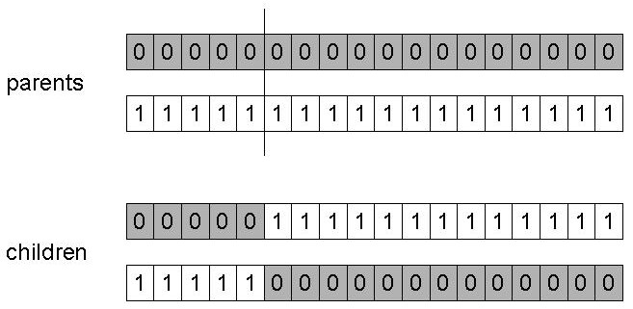
GENETIC ALGORITHM
Crossover:
Choose a random point on 2 chromosomes
Split parents at this crossover point
Create children by exchanging gene

Slide 17
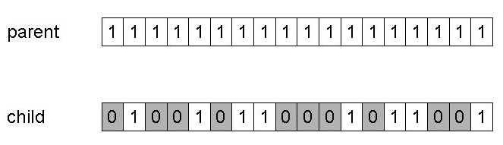
GENETIC ALGORITHM
Mutation:
Mutation is fairly simple
just change the selected genes

Slide 18
GENETIC ALGORITHM
Choose initial population
Evaluate fitness of each individual
Repeat
Select best-ranking individuals to reproduce
Breed new generation through crossover and mutation (genetic operations)
Evaluate the individual fitness of the offspring
Replace worst ranked part of population with offspring
Until <terminating condition>

Slide 19
ANT COLONY INDETAIL:
CLASS
SUBJECT
ROOM
TEACHER
DAY
HOUR
TSCD

Slide 20
ANT COLONY INDETAIL:
TSCD4
P=0
TSCD0
TSCD1
TSCD4
P=0.06
.
.
.
P=0.05
TSCD5
.
.
.

Slide 21
ANT COLONY INDETAIL:
ANT 1:
TSCD1
TSCD0
TSCD4
TSCD3
TSCD2
TSCD0
TSCD5

Slide 22
GRAPHICAL REPRESENTATION:
Edges are between TSCD
of an hour to TSCD of next hour
Two data structures:
Pheromone
Distance

Slide 23
GRAPHICAL REPRESENTATION:
Distance is inversely proportional
to visibility
Distance gives a measure of possibility of a subject following other
Pheromone gives the possibility of a subject being allotted to a particular time slot

Slide 24
GENETIC OPERATIONS:
Cross Over:
0 2 5 7 1 6 4
1 5 4 3 7 2 6
1 5 4 7 1 6 4
0 2 5 3 7 2 6

Slide 25
GENETIC OPERATIONS:
Mutation:
0 2 5 7 7 6 4
1 3 5 7 2 6 4

Slide 26
HYBRID ANT COLONY GA ALGORITHM
1.For each day of the week repeat the
following steps
2.For each class repeat steps 3-10
3.Initialise pheromone and distance for each edge
4. Initialise initial position of 7 ants for 7 hours
5.Move all ants 7times and initialise chromosomes for genetic

Slide 27
HYBRID ANT COLONY GA ALGORITHM
6. Update pheromone levels and
evaporate pheromones
7.Repeat steps 4 to 6, n times(n chosen by the programmer)
8.Evaluate fitness of each chromosome
9.Repeat until fitness value reaches target

Slide 28
HYBRID ANT COLONY GA ALGORITHM
9.1.Choose chromosomes with
maximum fitness,n1,n2
9.2.Apply crossover on n1,n2
9.3.Evaluate fitness if meeting target exit
9.4.Mutate n1 and n2
9.5.Evaluate fitness if meeting target exit, Else add to pool if it meets validating criteria
10.Fix the chromosome as solution

Slide 29
CONCLUSION:
The implemented system for
Timetable generation automates the task of timetable generation. It is scalable to add new constraints and for further future modifications.

Slide 30
REFERENCES:
NguyenBa Phuc , Tran Thi Hue Nuong
. “A New Hybrid GA-Bees Algorithm for
a Real-world University Timetabling Problem” - 2011 International Conference on Intelligent Computation and Bio-Medical Instrumentation
K.Socha, J.Knowles and M.Samples. "A max-min ant system for the university course timetabling problem”. In Proceedings of Ants 2002 - Third International Workshop on Ant Algorithms (Ants'2002), vol 2463, pp. 1-13, Springer-Verlag, Berlin, 2002.

Slide 31
REFERENCES:
H.Arntzen and A.Lkketangen. "A tabu search heuristic for a university timetabling problem". Metaheuristics: Progress as Real Problem Solvers, vol. 32, pp. 65-86, Springer-Verlag, Berlin, 2005.
https://github.com/ameya005/
AntColonyAlgorithms
http://www.codeproject.com/Articles/644067/Applying-Ant-Colony-Optimization-Algorithms-to-Sol

Slide 32
REFERENCES:
https://github.com/trevlovett/Python
-Ant-Colony-TSP-Solver
http://www.ai-junkie.com/ga/intro/gat1.html
http://insightforfuture.blogspot.in/2012/04/creating-timetable-using-genetic.html
http://jgap.sourceforge.net/doc/tutorial.html

