Slide 1
Social Robotics 2
Weekly Report for 29 Mar – 2 April 2021
Social Interactivity Mentor for Youth with Autism using the NAO Robot (SIMYAN)
Andrew Nguyen | Bryce George | Colton Homuth | William Ross
Sponsor - Dr. Adham Atyabi
Faculty Advisor - Mr. Bill Michael
March 26, 2021

Slide 2
Project Status
Current Phase: Development
Started: 2/1
Ends: 4/11
Current Sprint: 4 (of 6)
Started: 3/24
Ends: 4/11
Days Remaining: 10
Epics:
Core SDK [CRITICAL]
Activities Master Module [In Progress – 90% (Paused)]
Adv. Speech Recognition Module [In Progress – 75%]
Adv. Motor Control Module [In Progress – 50% ]
Adv. Computer Vision Module [In Progress – 70%]
Drawing Activity [AT RISK]
Drawing Specification Generator [In Progress – 10%]
Activity User Interaction Flow [Not Started]
Motor Control Integration [Blocked]
Vision Integration [Blocked]
Speech Integration [Blocked]
Kinect Integration [Not Started]

Slide 3
Development Accomplishments
Used Cartesian Control API (CCAPI) to move robot
Designed DSG workflow
Mathematical approach to convert image to drawing instructions
Defined Adv. Motor Control Module Interface
Motion Sequence Contexts
Point Interpolations

Slide 4
Drawing Activity Workflow
Drawing Specification Generator
Import & fit image
Drawing Activity
Load image spec file
Motor Control Module
Add registered Motion Context
Remap to normalized dimensions: width = 1
Sort edges by length
Extract edges
Write spec to output file
Register Planar Motion Context
Feed edges to Motor Control Module: $e_{ij}≔{(P}_{i}, P_{j})$
Feed edges to Motor Control Module: 𝑒_𝑖𝑗≔〖(𝑃〗_𝑖, 𝑃_𝑗)
Receive edge from Drawing Activity
Move to start position
Calculate world-space coords of edge end points
Use windowing transformation to convert to drawing-space
Calculate interpolation
Execute motion

Slide 5


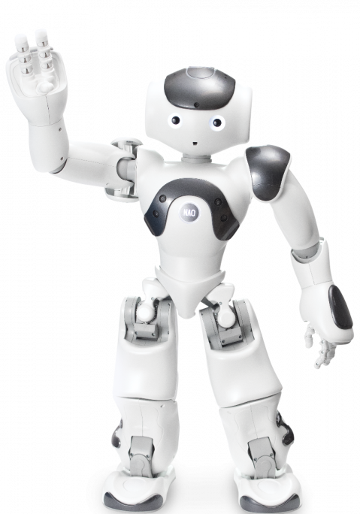


Visualize Drawing Activity
Whiteboard
Input Image
Drawing Space
480x720
Frame-aligned Image Space
1
+z
Normalized Image
+y
+x
Edge List
X_{c}

Slide 6
Impediments
Schedule/Workload
Conflicts from work/class/extracurricular schedules
Deficiencies in ALMotion Documentation
Attempted to use CCAPI sample scripts for testing
Result: Could not move/control end effector(s)
Solution: Found example in GitHub repository to base scripts on
API method documentation limited/missing
Solution: Inspect C++ source code

Slide 7
Any Questions?

