Slide 1
Social Interactivity Mentor for Youth with Autism using the NAO Robot (SIMYAN)
Design Review
Andrew Nguyen, Bryce George, Colton Homuth, William Ross
Sponsor: Dr. Adham Atyabi
Faculty Sponsor: Mr. Bill Michael
February 26, 2021
Notes:
Bryce

Slide 2
Project Recap
Objective:
Create a framework for the NAO robot to support future implementation of ASD treatment/intervention activities designed by medical professionals and researchers.
Social Interactivity for Youth with Autism using the NAO robot
Core SDK
Supports advanced social interactivity behaviors
Framework for building Activity Modules
Orchestrates Activity Module execution
Social Interactive Drawing Module
PoC Activity Module
Guides human subject through a drawing exercise
Incorporates social interaction
Notes:
Bryce

Slide 3
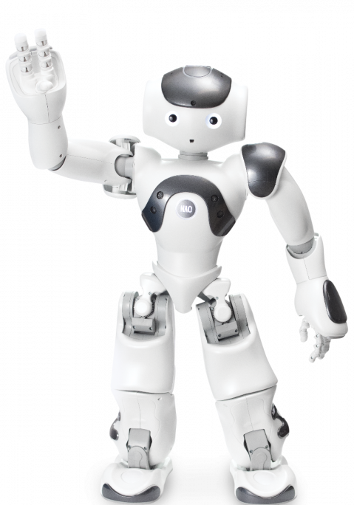
Presentation Overview
Proposal Background
Design Trade-Offs
Hardware
Software
Hardware Selection
Requirements Updates
Design
Schematics and Parts
Software
Software Progress
Project Schedule
Schedule Updates
Remaining Work
Gantt Chart
Budget
Knowledge Integration
https://www.eduporium.com/media/catalog/product/cache/c687aa7517cf01e65c009f6943c2b1e9/n/a/nao-print_06_4.png
Notes:
Bryce

Slide 4
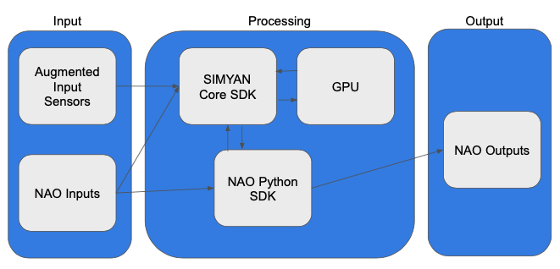
Proposal Background
System Design
Hardware System Design
Use of Nvidia Jetson Nano to do all real-time image processing
Use of LiDAR depth sensor or Xbox Kinect
Software System Design
Using core SDK and existing functionality from NAOqi framework
Notes:
Andrew

Slide 5
Proposal Background
Test Plan
1. Unit Testing
2. Integration Testing
3. Demonstration Plan
Development Strategy
Agile Development | Test Driven Development | Paired-Programming
Notes:
Andrew

Slide 6
Hardware Design Trade-Offs
Configuration | NAO (no GPU) | NAO + Jetson Nano
Pros | No additional integration needed Simplifies software No additional hardware to manage | Can handle image processing load Can handle machine learning workloads Can handle additional peripheral video/camera inputs Off-load tasks from NAO processor
Cons | Cannot handle sufficient image processing load Cannot handle additional peripheral video/camera inputs | Additional integration required Requires software to function in a distributed system Adds hardware management concerns (power, bandwidth, etc.)
Notes:
Andrew

Slide 7
Software Design Trade-Offs
Configuration | Wrap NAOqi SDK | Extend NAOqi SDK
Pros | Condense code needed for SIMYAN activity modules Improve code readability | Decreased team workload Keeping SIMYAN Core SDK simple leaves smaller region for testing and validation
Cons | Increase the size of the SIMYAN Core SDK May require development of modules that are not useful beyond current project | Less modular design Requires activity implementors to know NAOqi SDK Mixing of calls & responsibilities between SIMYAN SDK and NAOqi SDK
Notes:
Andrew

Slide 8
Hardware Selection
Need two additional pieces of hardware for design
A depth sensor to augment NAO’s vision capabilities
A GPU/Developer kit to handle all the image/graphics processing
Selected depth sensor: Xbox Kinect
Existing examples of it being used with NAO robot
Much cheaper than the other options
Will be testing to make sure the Kinect can integrate with NAO and provide additional camera accuracy
Selected GPU: Jetson Nano
Free from advisor Bill Michael
4GB of ram and 128 GPU cores which will allow us to run complex vision detection algorithms
We will be testing GPU using a separate camera feed making sure it can detect objects outside of NAO’s camera initially
Notes:
Colton – (Will)

Slide 9
Requirements Updates
Eliminated extensions
Most extension features removed
Automated Object Drawing Specification Generator added to core feature set
Reduced robot autonomy
Marker collection
Mobility
Wireless connection to Jetson Nano
Power supply needs
Notes:
Will

Slide 10
Specification Updates
Wireless communication with Jetson Nano
Minimum Transmission Rate: 25 Mbps
Wifi card for Jetson Nano
No need for GPU ”backpack”
OpenCV for object detection / tracking
Canny Edge Detection
GOTURN
CSRT
Kinect integration with SIMYAN only – not strictly required for drawing activity
Notes:
Will

Slide 11
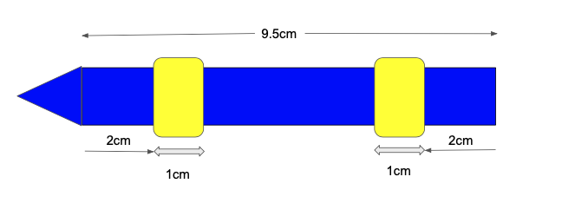
Marker Schematic
Rubber Washers
Notes:
Will

Slide 12
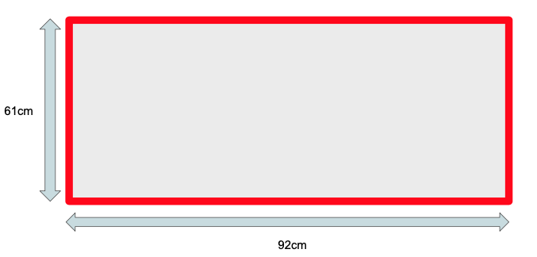
Whiteboard Schematic
Colored Tape
Whiteboard Surface
Notes:
Will

Slide 13
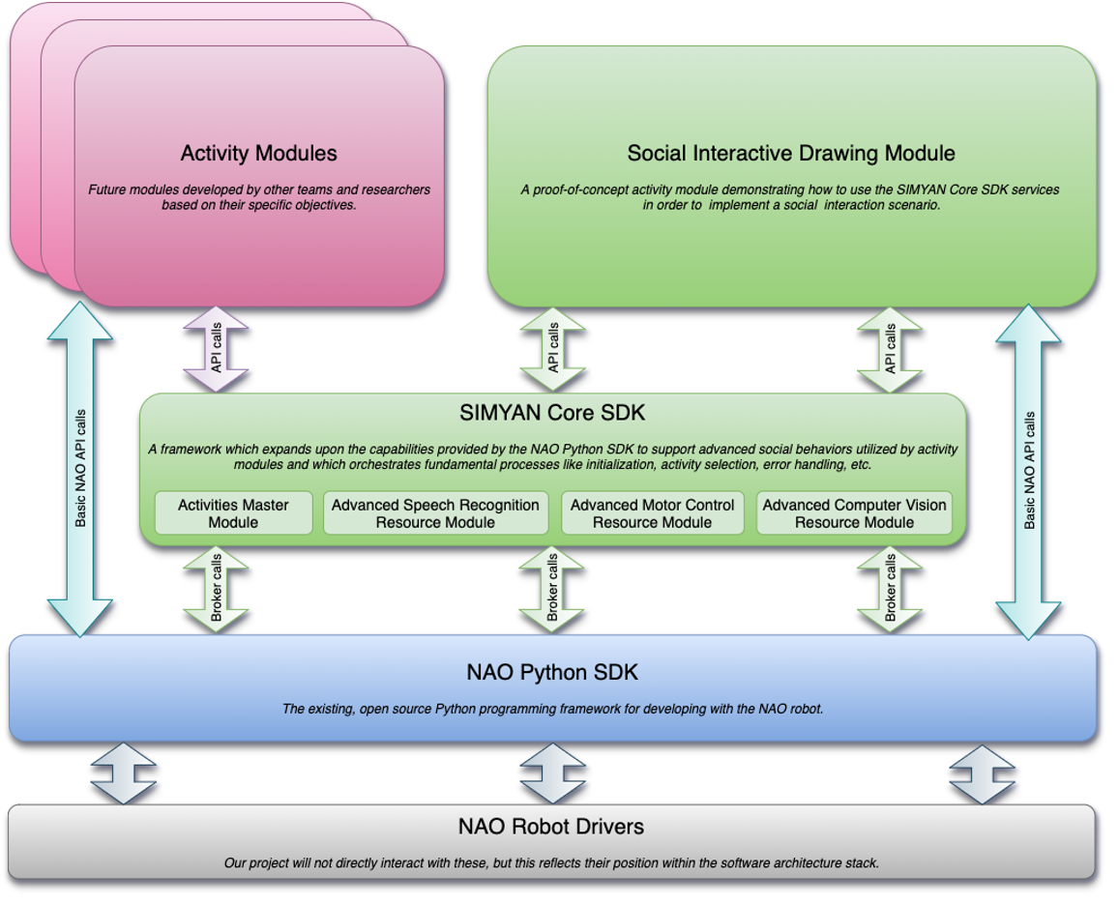
Software Design
Standalone NAO activities activated within the context of the SIMYAN Master Activity
Using STK NAO Interface
Standalone NAO activity which discovers and activates SIMYAN activities
NAO Services registered by the SIMYAN Master Activity
Notes:
Bryce

Slide 14
Software Progress
Development Tools
Robot Jumpstarter
A repository containing NAO/Pepper project templates, utilities for creating named projects using the templates, and ability to add custom templates
Studio Tool Kit (STK)
A set of python scripts which provide a simplified interface for accessing NAOqi resources
qibuild
A python-based command line package for bootstrapping, building, and deploying packages to the NAO robot
Created, built, and deployed a test Application
Application template from Robot Jumpstarter
Uses STK
Built and deployed using qibuild
Core SDK development in progress
Notes:
Bryce

Slide 15
Remaining Work
Core SDK Development | Social Interactive Drawing Module Development
Activities Master Module ^{B} Activity Module Loader Activity Module Manager Command Recognition Manager Speech Recognition Resource Module ^{A} Advanced Motor Control Resource Module ^{AB} Advanced Computer Vision Resource Module ^{CW} Jetson Nano GPU Integration ^{C} | Drawing Activity Command Recognition ^{A} Marker Detection ^{C} Marker Collection ^{W} Marker Handling ^{B} Drawing Surface Detection ^{C} Drawable Object Loader ^{B} Object Drawing Manager ^{CW} Social Interaction Manager ^{AB} Automated Object Drawing Specification Generator ^{BC}
Changes:
Core SDK Extensions and Social Interactive Drawing Module Extensions Epics Dropped (consistent with scope reductions)
Automated Object Drawing Specification Generator Epic moved to Social Interactive Drawing Module Development
Integration Testing | End-to-end Testing | Final Presentation | Final Report | LEGEND
Run Integration Test Cases * Fix Failures * Re-Test Failed Cases * | Run End-to-end Test Cases * Fix Failures * Re-Test Failed Cases * | Prepare Final Presentation * Prepare Demonstration * Deliver Final Presentation * | Prepare Final Report * Deliver Final Report * | * – All A – Andrew B – Bryce C – Colton W – Will Italic – In-Progress Superscript = Primary Owner(s)
Notes:
Bryce

Slide 16
Schedule Updates
Sprint 1 | Sprint 2 | Sprint 3 | Sprint 4 | Sprint 5 | Sprint 6
Feb 1 - Feb 16 | Feb 22 - Mar 5 | Mar 8 - Mar 19 | Mar 24 - Apr 9 | Apr 12 - Apr 23 | Apr 26 - May 7
Design Review
Final Presentation
Core SDK Development
Final Report
Social Interactive Drawing Module Development
Integration Testing
End-to-end Testing
Notes:
Bryce

Slide 17
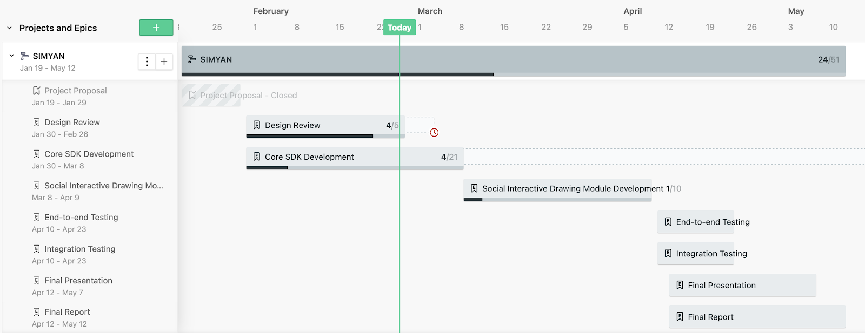
Gantt Chart
Core SDK Development extended through end of Sprint 2 (3/5)
Start of Drawing Module Development moved to Sprint 3 (3/8), extended through Sprint 4 (4/9)
Notes:
Bryce

Slide 18
Budget
Item | Quantity | Cost per Unit ($)
Jetson Nano GPU | 1 | 0 (borrowed from advisor Bill Michael)
Realtek RTL8187L Chipset 2000mW Wireless USB Wifi Adapter 54Mbps Card | 1 | 24
Xbox Kinect | 1 | 50
Markers | 1+ | 0 (provided by team)
Whiteboard | 1 | 0 (provided by team)
Rubber Washers | 2 | 5
Total | 84
Allowance | 400
Notes:
Will

Slide 19
Knowledge Integration
Agile Development
Test Driven Development
System Design and Analysis
Problem Decomposition
Requirement Identification
Architecture
Systems Engineering
Machine Learning
Computer Vision
Natural Language Processing
Notes:
Andrew

Slide 20
Conclusion
Deliver a solution that is extensible and will expand the existing capabilities of the NAO robot
SIMYAN Core SDK fulfills this goal
Apart from this, we will be using our core SDK to enact a scenario involving drawing with a human
Demonstrate functionality of Core SDK
Demonstrate a situation that will promote social interaction between a human and NAO
Overall, we are supplementing the NAO architecture to make it more powerful and easy-to-use in future endeavors
Notes:
Colton – (Andrew)

Slide 21
Any Questions?
Notes:
Bryce

