Slide 1
Caspar
Extracting and Synthesizing User Stories of Problems from App Reviews

Slide 2
Authors
Hui Guo
Munindar Singh

Slide 3
Motivation and background
Manual review of user feedback is very costly and time consuming when done by humans
NLP can help with finding what parts of the code / system process are flawed in order to direct troubleshooting and bugfixing efforts

Slide 4
Basic breakdown / introduction
Use / extend NLP techniques to extract information from mobile app reviews
Use ML techniques to classify the extracted information as either user action or app problem
Synthesize the reviews

Slide 5
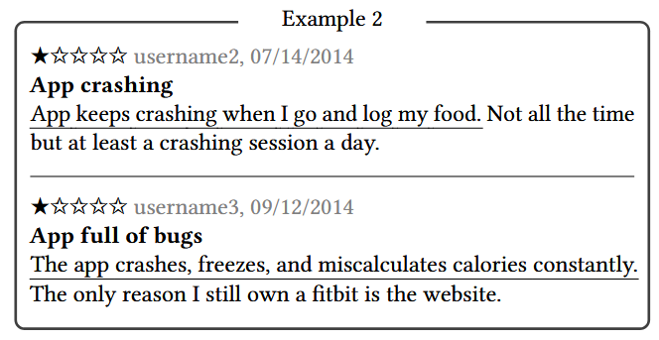
Example app reviews *Negative reviews have most valuable information

Slide 6
Definitions
Story- Ordered list of events detailing a user’s interaction with the app
Event- Fragment of a sentence describing a single action (user or app)
Event Phrase- An event as it is depicted in language
App Problem- App behavior that violates a user’s expectation
User Action- Action taken by the user
Action-Problem Pair- A connected action and problem

Slide 7
Approach
Extraction
Synthesis
Inference

Slide 8
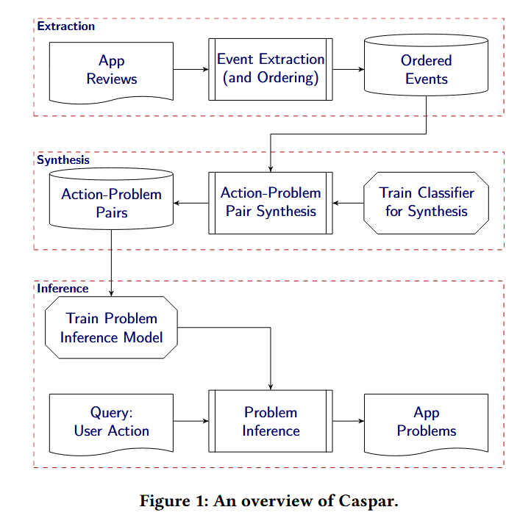

Slide 9
Extraction
We are looking for events
Find key sentences and surrounding ones
Find event phrases in the key sentences and the ones surrounding them
Order the events using heuristics
Collect other phrases in the order of when they are found
POS tagging (Part of Speech)
Mark words based on part of speech (verb, noun, … etc)
Looking for verbs

Slide 10
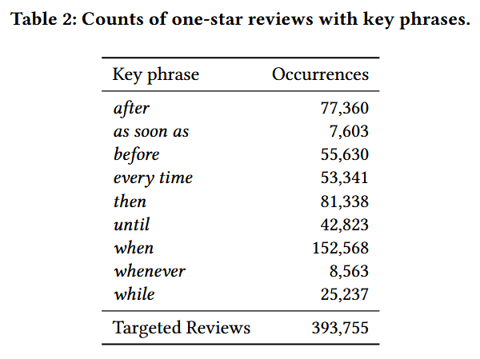
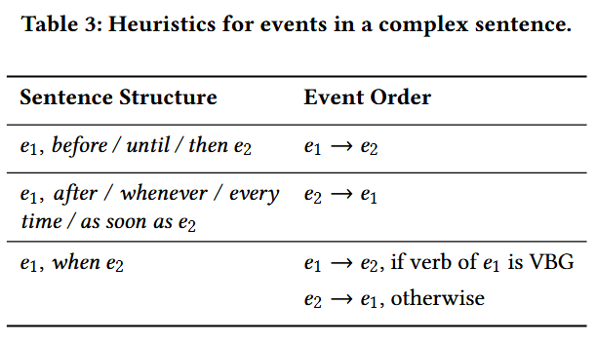
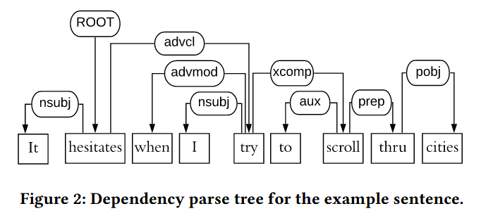
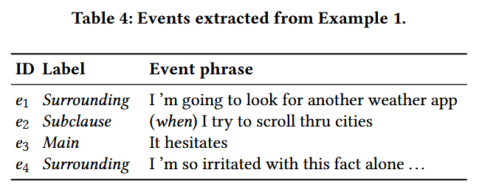

Slide 11
synthesis
Traditional ML approaches can be used to categorize the extracted event phrases
User Action (UA)
App Problem (AP)
Neither
Universal Sentence Encoder (USE) for encoding events
Manual labeling was used for training

Slide 12
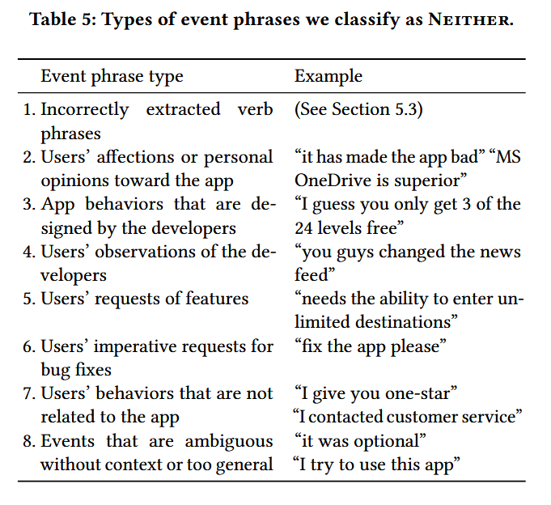

Slide 13
inference
Looking for Action Event Pairs
UAs and APs in the same sentence or nearby ones
Strategies tested
IT-IDF + SVM
USE + SVM
BI-LTSM
Negative Sampling
Has challenges
Clustering: K-means (cosine) on USE vectors
Shuffling: Take first event found outside of some cosine similarity threshold

Slide 14
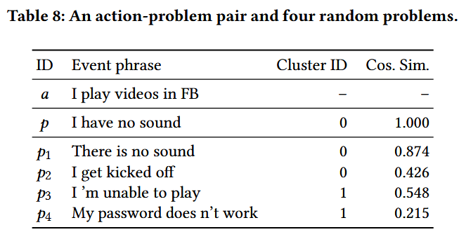

Slide 15
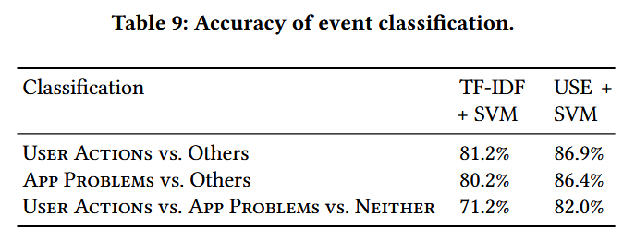
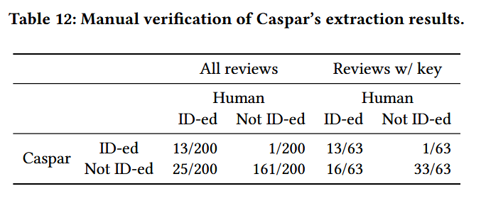
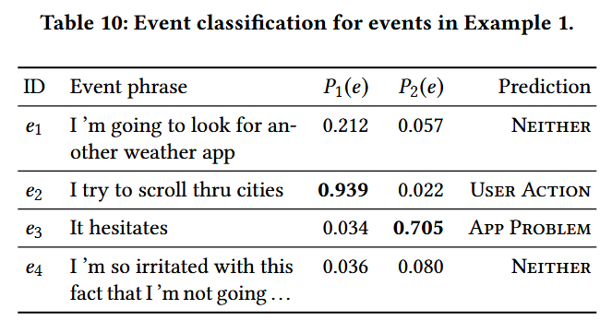
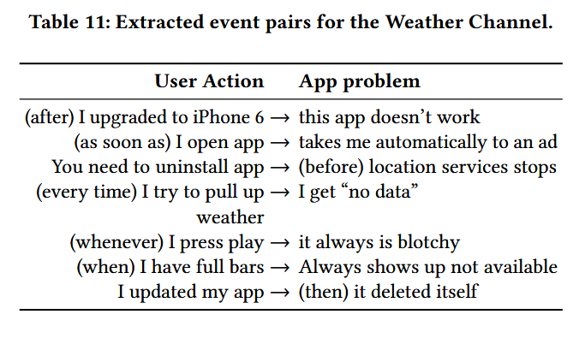

Slide 16
conclusion
Successful and novel idea
A very interesting idea that could be expanded upon

