Slide 1
ENTERPRISE TECH SOLUTION BRIEFING
Blockchain-Based AML/CFT Monitoring
& Financial Crime Detection System
A decentralized, real-time approach to cross-border financial surveillance,
fusing permissioned ledgers, smart contracts, and deep graph behavioral learning.
Prepared By: Ancilla Dsouza
UNIFIED LEDGER STATE
AUTOMATION ENGINES
DEEP NEURAL LAYERS
Cross-border permissioned consensus
replacing isolated database silos.
Dynamic smart contracts executing
compliance thresholds on-chain.
GNN graph learning structures
identifying hidden multi-hop shell loops.
Slide 1 of 16

Slide 2
THE THREAT
Global Problem: Real-Time Cross-Border Detection Failure
Suspicious Transaction Velocity
Exploitation of Time Delays
Billions of dollars in suspicious transactions move daily across international banking networks (SWIFT, correspondent banking systems).
Criminals exploit time delays between different countries' banking systems to move and layer illicit funds.
The Multi-Jurisdiction Window
Absence of Global Ledger State
Funds move through 5–10 countries in minutes/hours, but AML alerts are generated days or weeks later.
No global unified system exists where all banks and regulators can see the same real-time transaction trail.

Slide 3
SYSTEM BOUNDS
Why This Problem Still Exists Today
01
02
03
Isolated National Systems
No Universal Shared Database
Privacy Regulatory Boundaries
Banks operate in isolated national systems, creating structural data silos.
No universal global AML ledger or shared tracking database exists.
National privacy laws strictly prevent full, raw data sharing between countries.
04
05
06
Messaging-Only Protocols
Reactive, Post-Analysis Alerting
Operational Delays
SWIFT messages are only communication-based, providing no real-time shared visibility.
AML systems are reactive, not real-time, operating primarily on post-analysis historical data.
Criminal networks operate exponentially faster than complex compliance reporting systems.

Slide 4
CASE STUDY
Real Case Study: Nirav Modi – PNB Scam
₹13,000+ CRORE FRAUD
The Nirav Modi–Punjab National Bank (PNB) scam is one of the largest banking frauds in India, involving financial irregularities estimated at around ₹13,000+ crore. The fraud came to light in 2018 but involved transactions going on for several years. Modi allegedly misused the system by obtaining fraudulent Letters of Undertaking (LoUs) from PNB's Brady House branch in Mumbai without proper authorization or entry into the core banking system.
These LoUs allowed his companies to secure credit from overseas branches. The funds were routed through multiple shell companies and foreign entities across different jurisdictions to hide the origin and destination — a classic money laundering technique.
The fraud remained undetected for years due to weak internal controls, lack of real-time monitoring, and poor integration between banking databases. Since the LoUs were not recorded properly, other institutions were unaware. The scheme collapsed during a routine audit. By then, significant funds had already been moved abroad. This case highlights major weaknesses in traditional AML systems: lack of transparency, delayed detection, and absence of real-time cross-border monitoring.

Slide 5
ROOT CAUSES
Systemic Failure Modes of Legacy AML Frameworks
Historical Data Reliance
Static, Rule-Based Engines
Zero Real-Time Monitoring
AML systems rely on historical data, failing to detect emerging fraud patterns.
Most systems are rule-based and static, lacking adaptation to evolving criminal techniques.
No real-time tracking of transaction states across independent banks and countries.
Isolated Data Silos
Cross-Border Restrictions
Post-Analysis Auditing
Financial institutions exist in strictly isolated, non-communicative data silos.
Limited data sharing due to local privacy policies and sovereign regulatory restrictions.
Fraud detection occurs post-analysis—long after the suspicious transaction has cleared.
Layering & Shell Web Obfuscation
High False-Positive Fatigue
Delayed Reporting Pipeline
Criminal networks utilize complex layering and shell companies to hide money flow.
AML alerting generates massive false positives while missing true fraud cases.
Slow reporting cycles give criminals time to route funds out of jurisdiction before detection.

Slide 6
LEGACY PIPELINE
Current AML/CFT System & Loopholes
CURRENT SYSTEM MECHANICS
LOOPHOLES IN CURRENT SYSTEM
Banks operate in separate, centralized systems.
Lack of real-time transaction monitoring frameworks.
No global shared transaction database between banking networks.
No unified global AML database or shared ledger.
International transfers rely on SWIFT messaging (communication-only, no tracking).
Financial institutions operate in isolated data silos.
AML architectures are mostly rule-based and threshold-based.
Weak cross-border transaction visibility and coordination.
Surveillance is limited to historical patterns and past fraud profiles.
Heavy operational dependency on manual reporting and audits.
Suspicious Activity Reports (SARs) generated after transactions clear.
Delayed detection of highly suspicious financial activities.
Criminals exploit layering and multiple intermediary accounts.
Processes are fundamentally post-transaction (reactive model).
Static systems fail to detect modern and complex fraud patterns.
Data sharing extremely constrained due to regulations and privacy laws.
High dependency on historical data (completely non-adaptive).
Total lack of real-time visibility on end-to-end multi-bank flows.
Limited transparency in end-to-end money flow tracking.

Slide 7
PROPOSED TECH
Proposed Blockchain-Based AML/CFT System
SYSTEM SPECS
ORACLE BRIDGE LAYER
A permissioned blockchain network connecting banks, financial institutions, and regulators.
OUTSIDE WORLD
(LEGACY CORPS)
INSIDE
BLOCKCHAIN
All transactions recorded in a shared distributed ledger.
Enables real-time visibility of financial transactions across institutions.
SWIFT Messaging
Network
Smart Contracts
+
Permissioned
Ledger
ORACLE
API
BRIDGE
Uses smart contracts to automatically enforce AML rules and policies.
Integrates AI/ML models for fraud detection and risk scoring.
Provides a tamper-proof and immutable transaction history.
Bank's Core CBS
(Local Ledger)
Enables cross-border transaction traceability in real time.
Creates a single trusted source of transaction truth for all participating nodes.
Regulators monitor suspicious activity through a central dashboard.
Reduces dependency on post-transaction audits and manual reporting.

Slide 8
SYSTEM GRAPH
System Architecture Diagram
Multi-Bank Ledger Surveillance System Architecture
Bank A
Transaction Node
Bank B
Transaction Node
Bank C
Transaction Node
Blockchain Network (Ledger Platform)
(Permissioned Distributed Ledger State)
Smart Contracts Engine
(On-Chain Rules & Validation)
AI / ML Processing Layer
(Dynamic Behavioral Pattern Analysis)
Regulator / AML Body Authority
(Real-Time Compliance & Security Dashboard)

Slide 9
WORKFLOW
Workflow: Blockchain-Based AML/CFT System
1
Transaction Initiation
2
Broadcast to Network
3
Ledger Verification
A customer initiates a financial transaction through Bank A.
The transaction is sent to the permissioned blockchain network shared by banks and regulators.
The transaction is recorded and validated by the blockchain network nodes.
4
Smart Contract Evaluation
5
AI/ML Fraud Analysis
6
Decision Making
Smart contracts check AML rules: amount threshold, suspicious frequency, high-risk entity involvement.
AI/ML models analyze transaction patterns and assign a risk score based on behavior and history.
Low risk → Approved. Medium/High risk → Flagged for review.
7
Alert Generation
8
Regulator Monitoring
9
Immutable Record Storage
Suspicious transactions trigger alerts to compliance teams and regulators.
AML authorities monitor flagged transactions through a real-time dashboard.
Final transaction status is permanently stored in the blockchain ledger.

Slide 10
LOGIC MODULE
Smart Contract Logic — Active Consensus Rules Executed In-Flight
VALUE CHECK
VELOCITY CHECK
SOVEREIGN STATE
STRUCTURING CHECK
Threshold Guard
Velocity Alert
Sovereign Risk Check
Structuring Sentinel
If transaction amount > predefined threshold (e.g., ₹10 lakh) → Flag as high risk.
If multiple rapid transactions from same account in short time → Trigger alert.
If transaction involves high-risk country/entity → Increase risk score.
If funds are split into multiple small transactions (structuring) → Mark as suspicious.
ANOMALY CHECK
INCUBATION CHECK
HALT EXECUTION
REGULATORY ROUTING
Behavior Warnings
Incubation Checks
Sanction Enforcement
Dashboard Reporting
If unusual transaction pattern compared to user history → Generate warning.
If account is newly created and high-value transfer occurs → Flag for verification.
If blacklisted wallet/account is involved → Block transaction immediately.
If risk score exceeds threshold → Send alert to regulator dashboard.

Slide 11
SOLUTION VALUE
How Blockchain Resolves Systemic Roadblocks
TAMPER
PROOF
Tamper-Proof Ledger
REAL
TIME
Real-Time Visibility
NO
SILOS
Dismantling Silos
Provides an immutable ledger of all transactions, making ledger state adjustment impossible.
Enables real-time shared visibility across multiple banks and regulators, eliminating the timing window gap.
Removes data silos by using a distributed ledger system to share transaction security signals globally.
E2E
TRACE
End-to-End Tracing
AUDIT
TRAIL
Clean Auditing Trails
VERIFY
FAST
Immediate Verification
Improves end-to-end traceability of money flow across multiple accounts, banks, and borders.
Ensures transparent audit trail for compliance and forensic criminal investigation teams.
Reduces risk of data manipulation and supports faster investigation and verification of transactions.

Slide 12
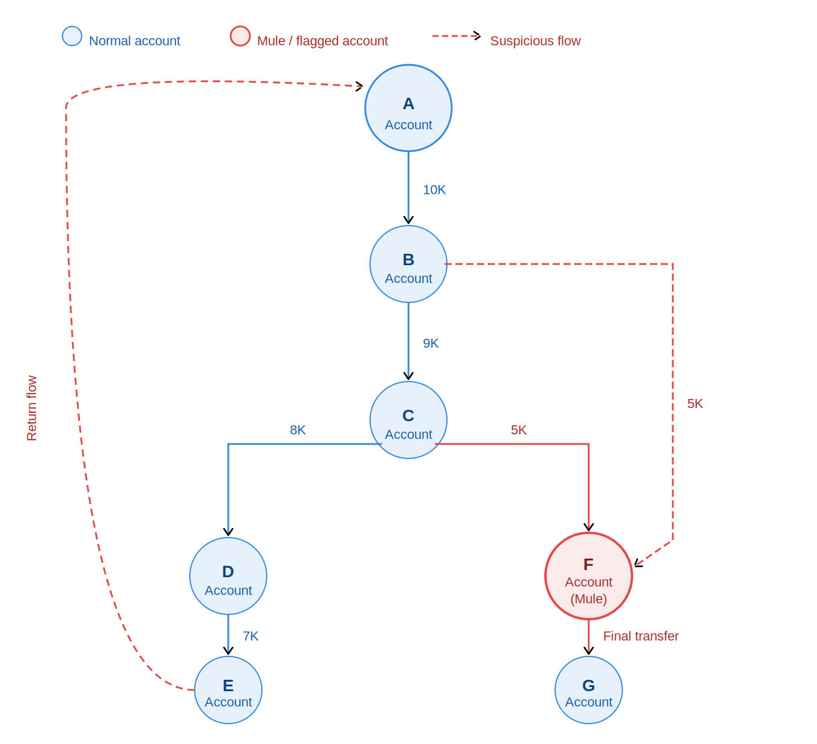
AI INFRASTRUCTURE
AI/ML Role & Graph Neural Networks
Multi-Bank Cognitive Graph Processing
Our hybrid model utilizes Graph Neural Networks (GNN) to analyze inter-bank connection vectors on-chain, mapping relationships across nodes to flag suspicious rings in seconds.
Bank A
Bank B
Detects fraud patterns and anomalies in transaction behavior.
Assigns a predictive, unified risk score to each transaction.
Identifies unknown, emerging, and zero-day fraud patterns.
Handles concept drift (changing fraud techniques over time).
Reduces false positives and false negatives in detection.
Bank C
Bank D
Analyzes user behavior patterns for predictive fraud detection.
Uses GNN to detect hidden money laundering networks.

Slide 13
SYSTEM COMPARISON
Current Banking AI vs Hybrid Blockchain AI System
Feature
Current Banking AI (Today)
Hybrid Blockchain AI (Solution)
Data Visibility
Isolated silos: AI only sees internal bank data.
Shared blockchain ledger: global end-to-end visibility of all transactions.
How It Sees Data
Tabular (flat rows): analyzes individual transactions separately.
Graph-based (networks): maps relationships between accounts and detects hidden fraud chains.
Data Sharing & Privacy
Restricted: banks cannot freely share data due to privacy laws.
Federated Learning: AI trains locally in each bank and shares only model updates, not raw data.
Reaction Speed
Post-transaction: detection happens after money has moved.
Real-time: smart contracts + AI flag or block suspicious transactions instantly.

Slide 14
SECURITY ATTACK
Attack Handling, Fraud Scenarios & System Benefits
ACTIVE THREAT HANDLING
SYSTEM BENEFITS
Data Tampering Prevention: Blockchain's immutable ledger prevents modification or deletion of recorded transactions.
Enables real-time monitoring of financial transactions across banks.
Fraud Transaction Blocking: Smart contracts automatically block transactions that violate AML rules in real-time.
Improves transparency and end-to-end traceability of money flow.
Reduces risk of fraud and money laundering activities.
Suspicious Activity Detection: AI/ML models detect abnormal patterns such as layering, structuring, and rapid transfers.
Provides a shared ledger across multiple banks and regulators.
Unauthorized Access Control: Permissioned blockchain ensures only verified banks and regulators can participate.
Enhances auditability and compliance reporting accuracy.
Real-Time Alert System: High-risk transactions trigger instant alerts to compliance teams and regulators.
Reduces dependency on manual and delayed investigations.
Double-Spending Protection: Consensus mechanisms ensure no duplicate or fake entries can be added.
Supports faster detection of suspicious transactions.
Audit & Traceability Protection: Every transaction is permanently traceable, supporting forensic investigation.
Strengthens overall financial system security and trust.

Slide 15
SYNTHESIS
Limitations & Conclusion
SYSTEM LIMITATIONS
CONCLUSION
Blockchain alone cannot perform intelligent fraud detection.
Blockchain-based AML/CFT systems improve transparency, traceability, and real-time monitoring of financial transactions. However, to effectively detect evolving financial crimes, blockchain must be combined with AI/ML techniques.
Requires integration with AI/ML systems for full effectiveness.
Privacy and regulatory challenges in data sharing between institutions.
High implementation and infrastructure cost.
"This hybrid approach can significantly enhance the efficiency and reliability of global financial crime detection systems."
Scalability issues in handling very high transaction volumes.
Requires global cooperation and standardization, which is difficult.
Still in pilot/research stage, not fully adopted worldwide.
Federated Learning: allows AI training without sharing sensitive bank data.

