Slide 1
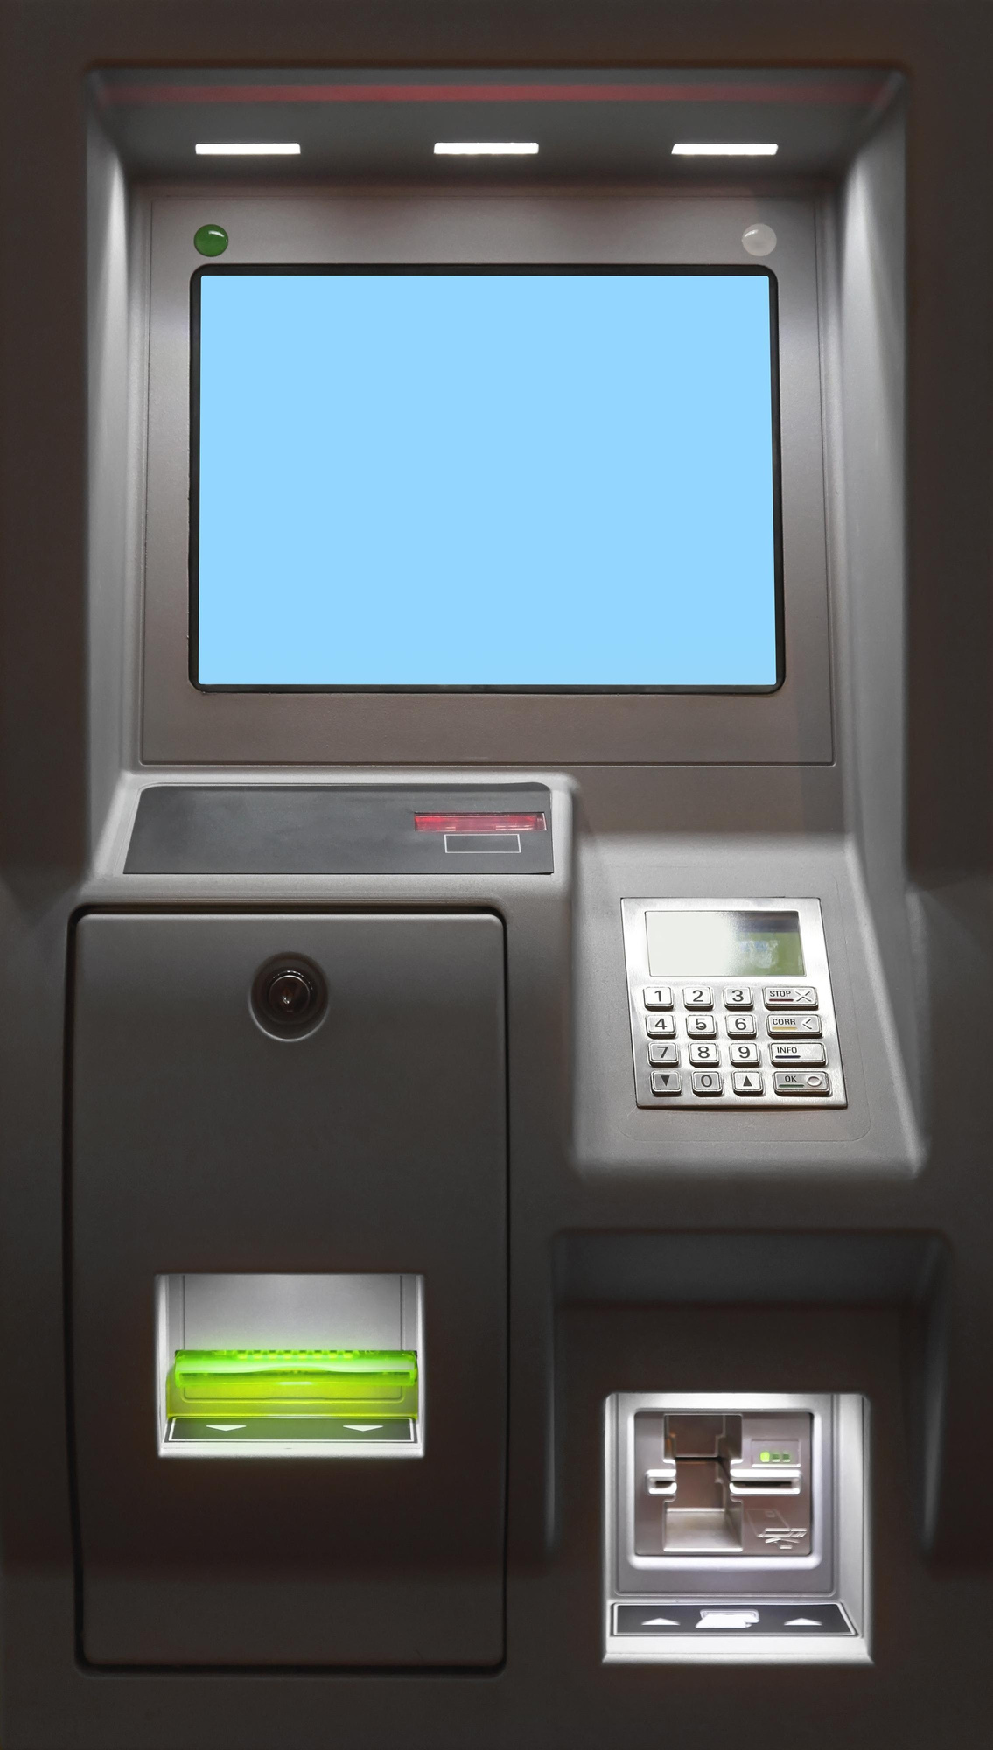
ATM Withdrawal Consumption Trend, Refill Optimization & Customer Service Enhancement Study
Model Practical
This study delves into ATM cash usage patterns, aiming to develop an optimal refill strategy.
Notes:
1

Slide 2
Problem Statement
1
2
Problem 1: Cash Demand Prediction
Problem 2: Refill Cycle & Replenishment
Inaccurate forecasting → 30–40% excess cash in ATMs, tying up capital and losing interest. Forecasting must consider weekly/monthly cycles, holidays, events, ATM downtime, and denomination patterns.
Static refill schedules result in unnecessary, high-cost Cash-in-Transit (CIT) trips. Each trip involves a GPS-enabled van, two custodians, and two armed guards.
Goal: Minimize CIT trips while maintaining 99.8% ATM uptime using data-driven insights and routing optimization.
3
4
Problem 3: Women’s Safety & Convenience in ATM Usage
Problem 4: Difficulties Faced by Senior Citizens in ATM Transactions
Women often face safety and security risks while using ATMs at night or in isolated areas — leading to discomfort or avoidance of ATM usage by women.
Senior citizens often find ATM usage difficult because of vision problems, complexity of steps, fear of mistakes or fraud, and lack of confidence — which discourages many of them from using ATMs regularly.
These challenges affect both ATM operational efficiency and customer experience, highlighting the need for data-driven optimization and customer-focused service improvements.
Notes:
2

Slide 3
Project Objective
To analyze ATM withdrawal patterns and determine how much cash should be maintained in each ATM at different times.
To identify the most efficient schedule for refilling ATMs to reduce operational cost and improve service availability.
To understand the ATM usage challenges faced by women and explore ways to make ATM transactions safer and more comfortable for them.
To examine the ATM difficulties experienced by senior citizens and suggest improvements to make ATM services easier and more
To propose customer-centric innovations that improve ATM safety, accessibility, and convenience for women and senior citizens based on ATM service usage insights.
Future Innovation
.
Based on ATM withdrawal trends, refill analysis, and customer service requirements, the following innovations are proposed to improve ATM accessibility, safety, and user experience.
Pink ATM Card for women
Priority ATM Card for Senior Citizen
A new ATM card can be introduced especially for women to provide a safer and more comfortable ATM experience. Key features can include:
Safe ATM locator to suggest nearby secure ATM locations
Night-time emergency support (SMS alert or help button)
Priority ATM queue access during rush hours
Exclusive cashback/rewards for women-focused purchases
A dedicated ATM card designed to make ATM transactions easier for senior citizens. Key features can include:
Fast-track priority ATM service (reduced waiting time)
Larger font display when the card is used at the ATM
Simplified ATM steps for faster cash withdrawal
Option for limited manual assistance if needed

Slide 4
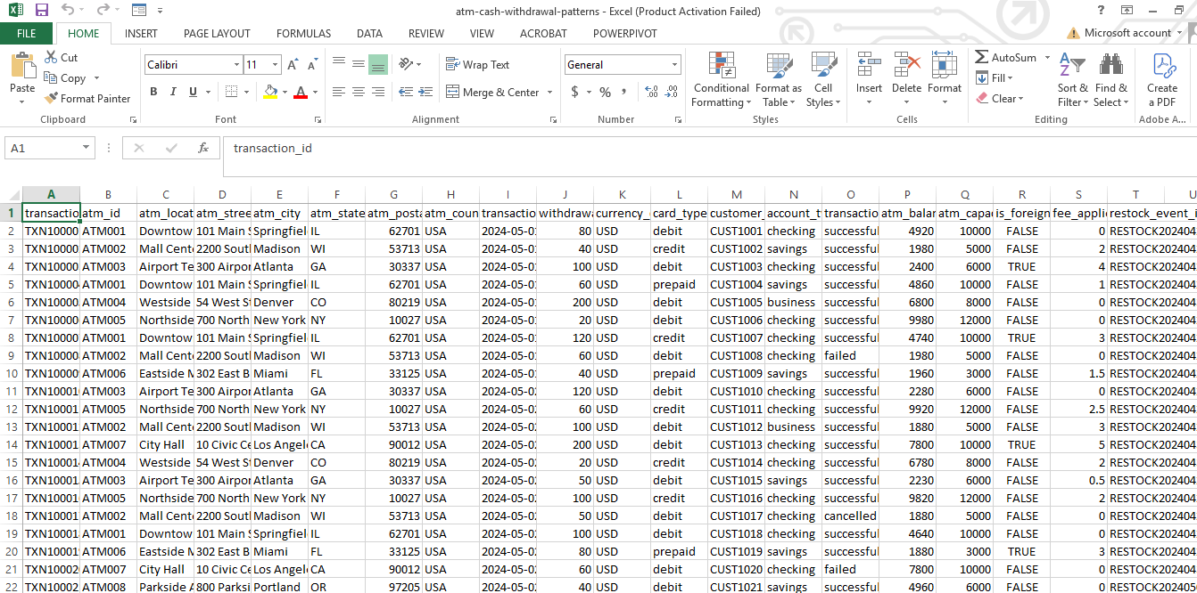
Dataset Description & Sample Data
The dataset, sourced from an online Excel file, comprises over 200 rows, with each row detailing transactions for a single ATM on a specific date. This rich data is instrumental for:
Analyzing cash withdrawal patterns.
Building an interactive Power BI dashboard for actionable insights.
Predicting future refill needs and overall cash demand.
Main columns:
ATM_ID – unique ATM identifier
Date – transaction date
Cash Withdrawn – total amount withdrawn
refill_needed_flag – 1 if refill needed, 0 otherwise
Sample of raw ATM transaction data (Excel)
Notes:
3

Slide 5



Tools & Technologies Used
Microsoft Excel
Python (Google Colab)
Used to store and view the raw ATM transaction dataset.
Helped in checking rows, columns and basic structure of the data.
Final cleaned file (DAF_PROJECT_clean_for_PowerBI.xlsx) is also saved in Excel format for use in Python and Power BI.
Used for data cleaning and transformation using pandas.
Performed EDA (Exploratory Data Analysis) and plotted trends in ATM cash usage.
Exported the cleaned dataset from Python for use in Power BI visualizations.
Microsoft Power BI
Used to create an interactive dashboard.
Connected to:
Cleaned dataset → DAF_PROJECT_clean_for_PowerBI.xlsx
Created simple visuals like line charts and bar charts.
Used slicers ( ATM_ID, Date) for basic filtering.
Visualized ATM cash withdrawal trends and usage patterns.
Notes:
4

Slide 6
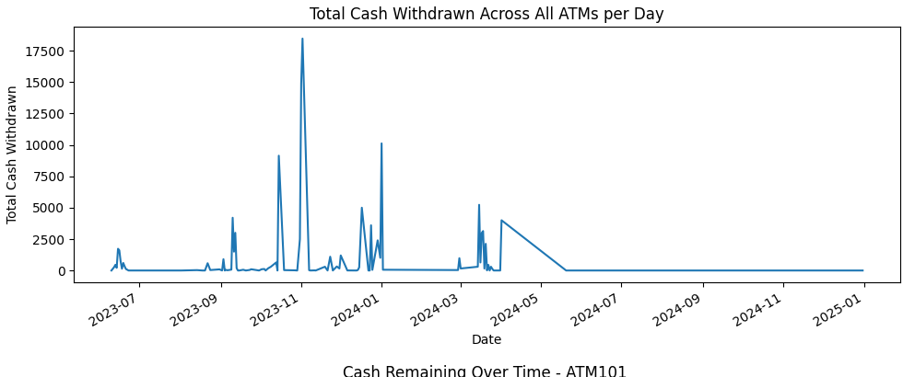
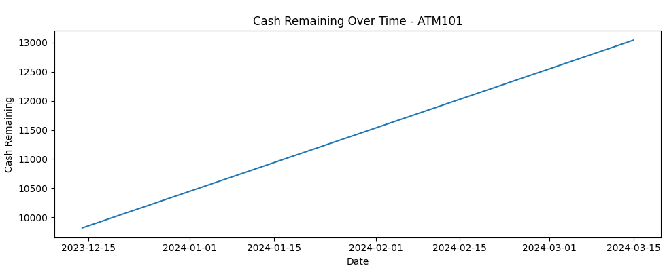
Methodology / Workflow
1
2
3
Data Collection
Data Cleaning (Python – Google Colab)
Initial Analysis (EDA)
Collected ATM transaction data in Excel format from an online source.
Dataset contains 200+ rows, each row represents one ATM on one date.
Main fields include: ATM_ID, Date, Cash Withdrawn, refill_needed_flag, etc.
Loaded the Excel file into Python (pandas).
Converted Date to proper datetime format and created numeric date features.
Checked and handled missing or inconsistent values..
Saved the cleaned data as DAF_PROJECT_clean_for_PowerBI.xlsx
Performed exploratory data analysis on the cleaned dataset.
Plotted the trend in ATM cash usage (Cash_Withdrawn over time).
Analyzed patterns in refill_needed_flag (0 vs 1).
Used these insights to understand cash usage and refill behavior.
Python – Data Cleaning & Output
Python – Trends in ATM Cash Usage
Notes:
5

Slide 7
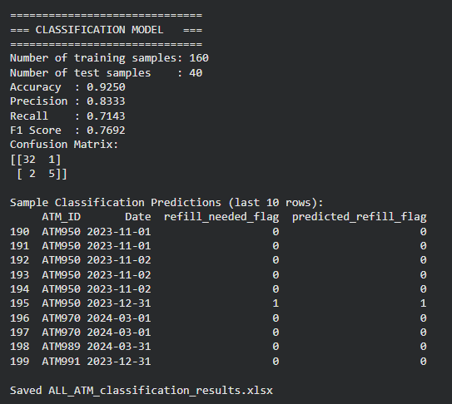
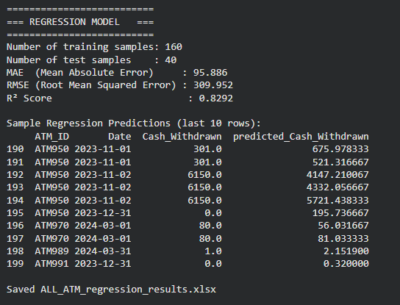
Classification & Regression Models
1. Classification Model – Refill Prediction
2. Regression Model – Cash Withdrawal Prediction
Target variable: refill_needed_flag (0 = No refill, 1 = Refill needed)
Target variable: Cash_Withdrawn
Algorithm: Random Forest Regressor
Algorithm: Random Forest Classifier
Goal: Predict daily cash withdrawal amount for each ATM
Input: Cleaned feature set
Output file: ALL_ATM_classification_results.xlsx
Output file: ALL_ATM_regression_results.xlsx
Performance Metrics:
Performance Metrics:
Accuracy: 0.9250
MAE (Mean Absolute Error): 95.886
Precision: 0.8333
RMSE (Root Mean Squared Error): 309.952
Recall: 0.7143
F1 Score: 0.7692
R² Score: 0.8292
Notes:
6

Slide 8
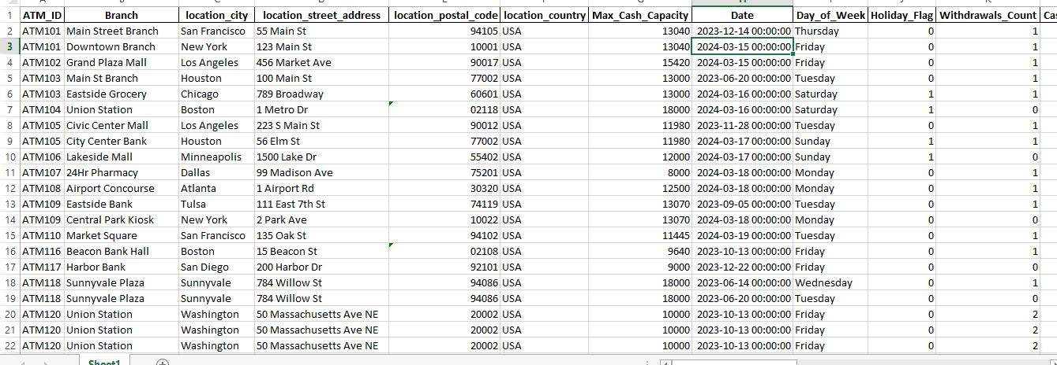
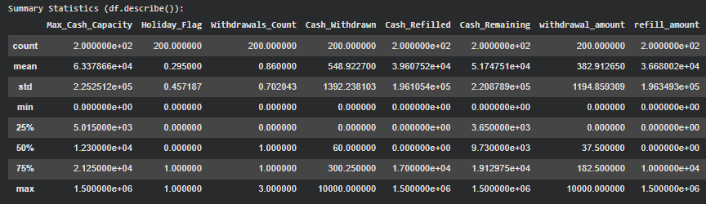
Partial output / Initial Analysis
The dataset has been cleaned by handling missing values and duplicates.
The cleaned dataset preview shows the first few rows after cleaning.
Summary statistics show basic details like mean, min, max, and standard deviation.
These give a quick view of the data before further analysis.
Preview of the dataset after cleaning, showing the first few records.
Overview of numeric columns showing basic statistics after data cleaning.

Slide 9
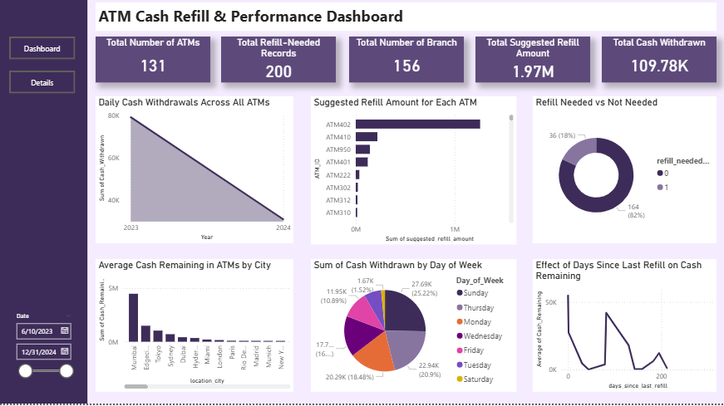
Power BI Dashboard – ATM Cash & Refill Insights
Data Sources Used
Cleaned ATM dataset: DAF_PROJECT_clean_for_PowerBI.xlsx
Classification results: ALL_ATM_classification_results.xlsx
Regression results: ALL_ATM_regression_results.xlsx
Usage
From the charts, they can see how much cash is used and when cash becomes low.
This helps them decide how much cash to keep in the ATM and when to refill it.
Notes:
7

Slide 10
Recommendations & Service Improvements
Women’s Safety Recommendations
Senior Citizen Recommendations
Better lighting around ATM locations
CCTV surveillance
Emergency assistance button
Safe ATM locator feature
Larger display fonts
Voice-assisted ATM interface
Simplified transaction flow
Priority support options
.
Conclusion
ATM withdrawal patterns were analyzed successfully.
Cash demand and refill requirements were predicted using machine learning models.
Power BI dashboards provided actionable operational insights.
Recommendations were proposed to improve ATM safety, accessibility, and customer experience.
Future innovations can help banks deliver more efficient and customer-friendly ATM services.

