Slide 1
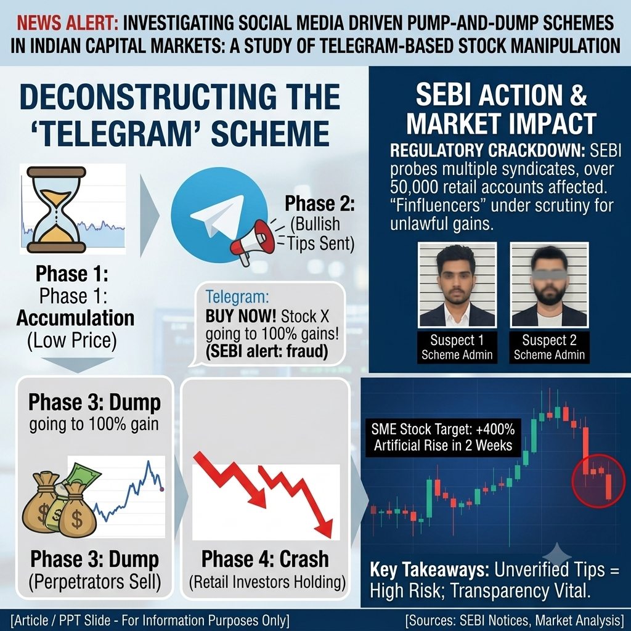
Social Media Driven Pump-and-Dump Schemes
in Indian Capital Markets: A Study of Telegram-Based Stock Manipulation
Project Area
Financial Crime Analytics
Capital Markets
Data Analytics
FinTech

Slide 2
Introduction
Background
Problem Statement
Retail investors often rely on social media recommendations without verifying their authenticity, making them vulnerable to market manipulation, artificial price inflation, and sudden financial losses.
India has experienced a significant increase in retail participation in the stock market due to the growth of online trading platforms, smartphone penetration, and simplified account opening processes. The number of Demat accounts has grown rapidly, making stock market investing accessible to a larger population.
While this democratization has increased financial inclusion, it has also created opportunities for fraudsters to exploit inexperienced investors through social media platforms. Traditional stock market fraud has evolved into digital pump-and-dump schemes coordinated through Telegram, WhatsApp, and X (Twitter).
Objectives
1. Analyze social media-driven stock manipulation.
2. Examine Telegram's role in pump-and-dump schemes.
3. Study SEBI enforcement actions.
4. Evaluate investor losses through Excel-based analysis.

Slide 3
Literature Background & Fraud Architecture
Social Media and Financial Markets
Multi-Channel Fraud Funnel
Social media platforms have transformed how investment information is shared. Financial influencers ("Finfluencers") can reach thousands of investors instantly.
While some provide educational content, others misuse their influence to promote stocks for personal financial gain.
X (Twitter) – Public Promotion
↓
WhatsApp Groups
↓
Telegram Channels – Stock Tips
Why Telegram?
↓
High anonymity
Retail FOMO Buying
Large channel capacities
↓
Automated bots
Artificial Price Increase
Fast message forwarding
↓
Difficulty identifying administrators
Operator Exit
↓
Market Crash

Slide 4
How the Pump-and-Dump Scheme Works : 5-Stage Fraud Lifecycle
1
2
3
4
5
Accumulation
Promotion
Retail FOMO
Dump
Crash
Fraudsters quietly purchase large quantities of illiquid small-cap or SME stocks while prices remain low.
Stock recommendations circulated via Telegram:
• "Multibagger Stock"
• "Guaranteed Returns"
• "Target 200%"
Retail investors buy shares due to fear of missing out, causing rapid increases in price and trading volume.
Operators sell their holdings at inflated prices while retail investors continue buying.
After operators exit, demand disappears and prices collapse, trapping investors with substantial losses.
→
→
→
→

Slide 5
Case Study 1 – Hemant Gupta Fin-Fluencer Family Scam (2026)
7
82
₹20.25 Cr
Operators Involved
Stocks Manipulated
Illegal Gains
Overview
Fraud Strategy
SEBI investigated a family of seven individuals accused of manipulating multiple SME and small-cap stocks through social media recommendations.
1. Accumulated illiquid shares quietly.
SEBI Findings
2. Promoted stocks aggressively through social media.
SEBI identified a strong relationship between recommendation dates and subsequent increases in trading activity, indicating coordinated market manipulation.
3. Encouraged retail participation via FOMO messaging.
4. Exited positions after price inflation.

Slide 6
Case Study 2 – Rajneesh Kumar vs SEBI
Outcome: ₹3.89 Crore in unlawful gains impounded — Key precedent in social media-based market manipulation investigations.
Overview
Manipulation Process
This case demonstrates how Telegram channels can be used as a tool for coordinated stock manipulation targeting retail investors.
Stock Tips Distributed
Telegram channels used to spread stock buy recommendations.
Target Company
Investors Encouraged to Buy
Superior Finlease Limited
Subscribers urged to purchase shares immediately.
Enforcement Action – SEBI Analyzed:
Artificial Demand Generated
Coordinated buying activity creates false momentum.
Digital communication records
Banking transactions
Prices Influenced
Coordinated activity drives price above fair value.
Mobile phone records

Slide 7
Research Methodology - Descriptive & Analytical Approach Based on Secondary Data
Research Design
Data Sources
Tools Used
Descriptive and analytical research approach based on secondary data sources.
• SEBI Interim Orders
• Publicly Available Regulatory Documents
• Case Study Information
• Market Trading Data
• Microsoft Excel
• Statistical Calculations
• Data Visualization Techniques
Event Study Analysis
Volume Variance Analysis
Retail Loss Analysis
Examines stock price and trading volume movements surrounding a major Telegram recommendation to detect abnormal activity.
Measures abnormal changes in trading volume after social media promotion to quantify manipulation intensity.
Calculates potential investor losses after the price collapse, expressing losses as a percentage of peak investment value.

Slide 8
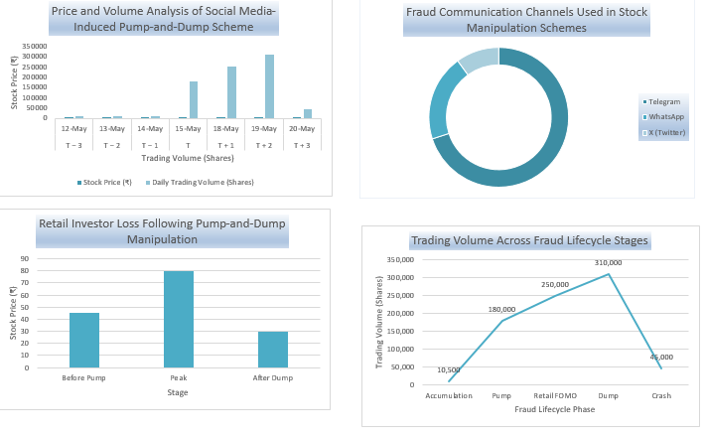
Excel Dashboard & Data Analysis
KPI Results
Metric | Value
Illegal Gains | ₹20.25 Crore
Stocks Manipulated | 82
Operators | 7
Trading Activity Increase | 86%
Event Study Findings
• Avg Pre-Pump Volume: 10,500 Shares
• Peak Trading Volume: 3,10,000 Shares
• Price Increased: ₹45 → ₹80
• Price Collapsed: ₹80 → ₹30
⚠ Retail Investor Impact: Investors purchasing at peak price (₹80) experienced a loss of approximately 62.5% when price collapsed to ₹30.

Slide 9
Regulatory Framework
SEBI (PFUTP) Regulations, 2003
SEBI Investment Advisers Regulations, 2013
Section 3
Regulation
Prohibits fraudulent and unfair trade practices.
Providing stock recommendations without valid SEBI registration is strictly prohibited.
Section 4
Prohibits artificial manipulation of prices and trading volumes.
Information Technology Act, 2000
Bharatiya Nyaya Sanhita (BNS)
Section 66D
Section 318(4)
Punishes online cheating and impersonation via digital platforms.
Addresses criminal cheating and fraudulent conduct.

Slide 10
Proposed Innovative Solutions
Investor DNA Profile System
A personalized investor protection mechanism that analyzes an investor's trading history, risk appetite, and investment behavior. If an investor attempts to buy a stock heavily influenced by social media hype and outside their usual investment pattern, the system generates a warning alert before the trade is executed.
Benefits of Proposed Solutions
Expected Impact:
Investor Protection
Reduces impulsive and emotion-driven trading.
Reduces impulsive investment decisions
Protects retail investors from pump-and-dump schemes.
Promotes informed and responsible investing.
.
Early Fraud Detection
Identifies manipulation before major losses occur.
Viral Stock Circuit Breaker
Market Transparency
Improves trust and information quality.
A market surveillance mechanism that temporarily flags or pauses trading in stocks experiencing unusual social media virility. The system monitors abnormal spikes in mentions, shares, comments, and online engagement, in addition to traditional price and volume indicators.
Market Stability
Reduces artificial price inflation.
Expected Impact:
Enables early detection of market manipulation.
Prevents artificial demand created through coordinated social media campaigns.
Improves market transparency and investor confidence.

Slide 11
Challenges, Recommendations & Conclusion
Key Challenges
Existing Regulatory Recommendations
Investor Protection
Anonymous Telegram operators
Regulatory Measures
Financial literacy campaigns
Encrypted communication platforms
Stronger monitoring of financial influencers
Awareness programs on social media fraud
Enhanced disclosure requirements
Cross-border server locations
Technological Measures
Delays in obtaining digital evidence
AI-based surveillance systems
Real-time social media monitoring
Conclusion
This study demonstrates that social media platforms, particularly Telegram, can significantly influence stock prices and trading volumes through coordinated pump-and-dump schemes. The analysis highlights how artificial promotions generate abnormal market activity, resulting in substantial losses for retail investors. Strengthened regulation, technological surveillance, and investor education are essential to protect investors and maintain market integrity.

Slide 12
Thank You
Social Media Driven Pump-and-Dump Schemes in Indian Capital Markets
Presented By
Ancilla Dsouza
RA2532271010013
SRM Institute of Science and Technology

