Slide 1
A TALE OF TEXT CLASSIFICATION
By- Group 11

Slide 2
INTRODUCTION
Explore the blend of literature and technology as we teach machines to recognize author’s name. Journey through algorithms, surprises, and decoding the secrets hidden in words.
Started with Project Gutenberg, picked six diverse books, and randomly selected 200 snapshots from each. Balanced and representative dataset ready for machine learning.

Slide 3
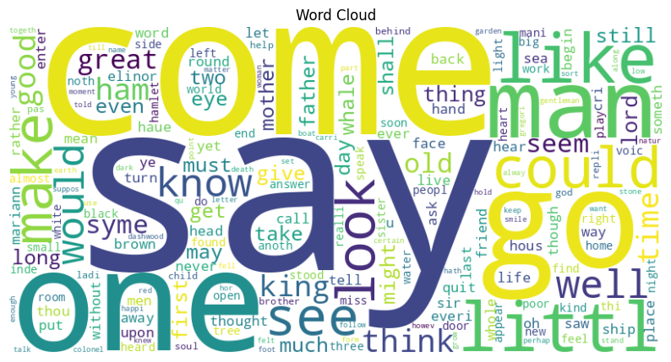
DATA PREPROCESSING
Techniques used:
Tokenization
Stopwords
Stemming
Lemmatization
POS Tagging
TF-IDF

Slide 4
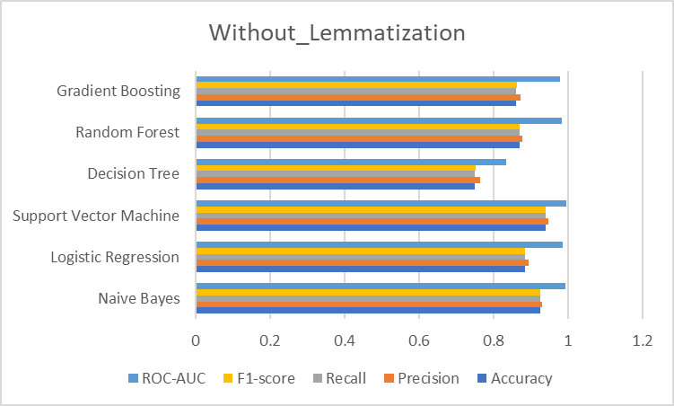
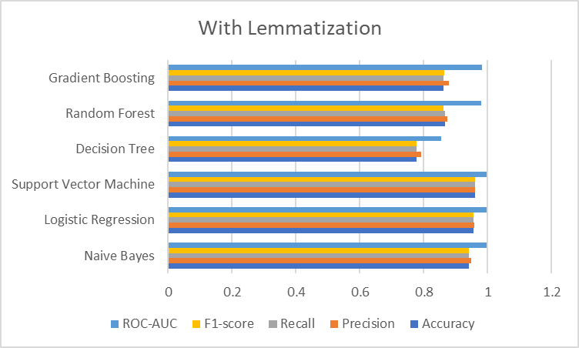
MODEL TUNING
Naive Bayes
Logistic Regression
SVM
Decision Tree
Random Forest
Gradient Boosting
KNN

Slide 5
CHAMPION MODEL?
Classifier | Accuracy | Precision | Recall | F1-Score | ROC-AUC
Naive Bayes | 94.16% | 94.71% | 94.16% | 94.06% | 99.71%
Logistic Regression | 94.58% | 95.01% | 94.58% | 94.59% | 99.44%
Support Vector Machine | 95.66% | 96.06% | 95.66% | 95.71% | 99.75%
Decision Tree | 58.83% | 60.55% | 58.83% | 58.88% | 75.53%
Random Forest | 90.58% | 90.98% | 90.58% | 90.50% | 98.77%
Gradient Boosting | 90.75% | 91.75% | 90.75% | 90.72% | 98.52%
KNN | 89.75% | 90.11% | 89.75% | 89.73% | 97.76%

Slide 6
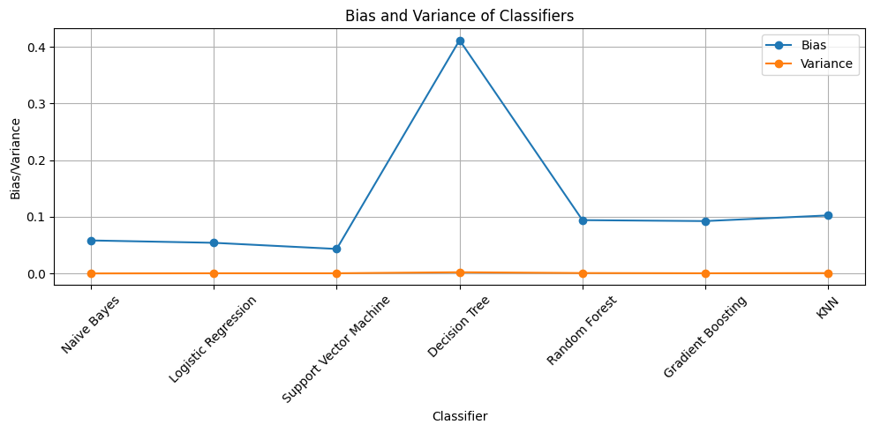
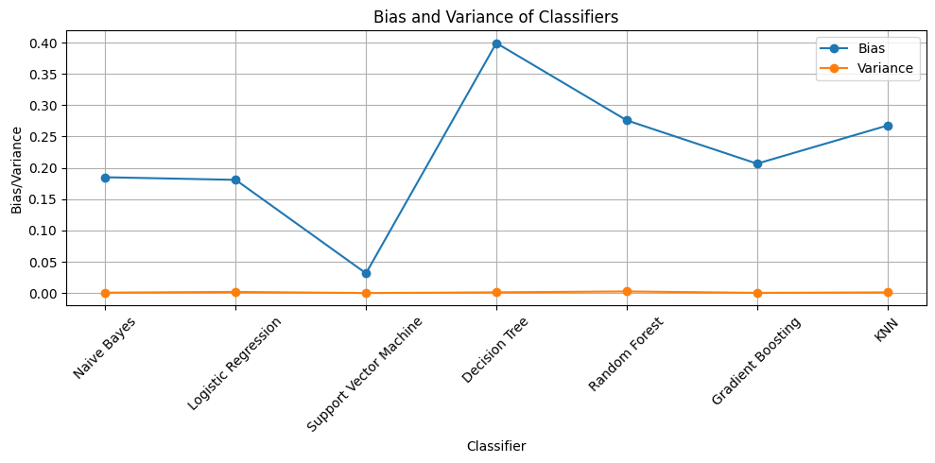
ANALYSIS OF BIAS AND VARIABILITY
Without Noise
With Noise

Slide 7
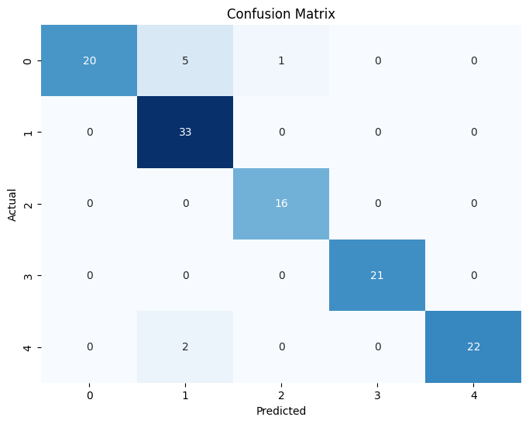
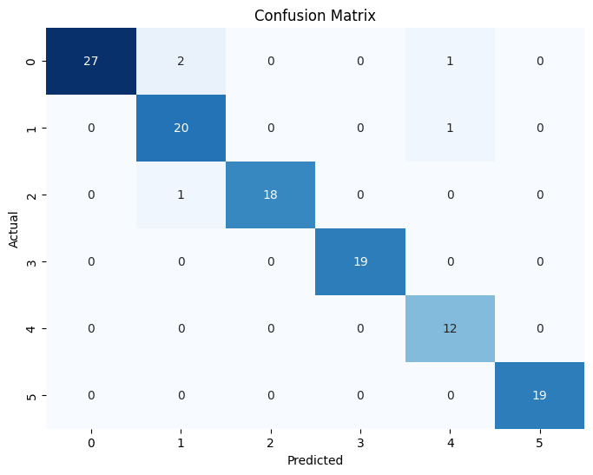
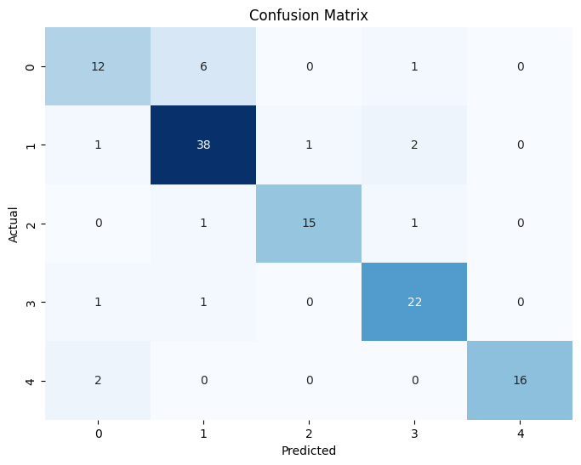
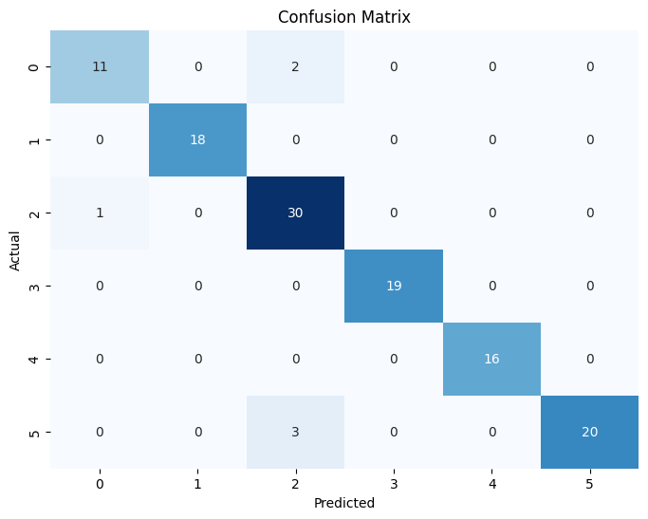
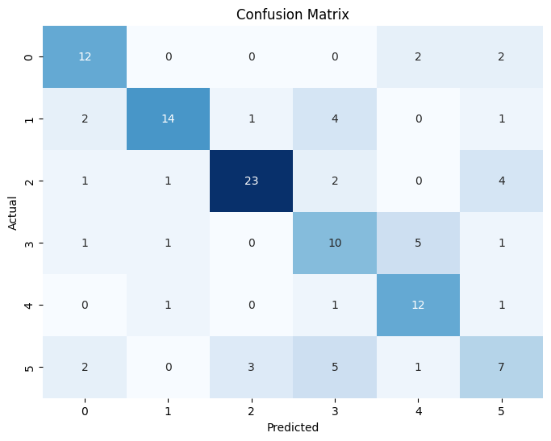
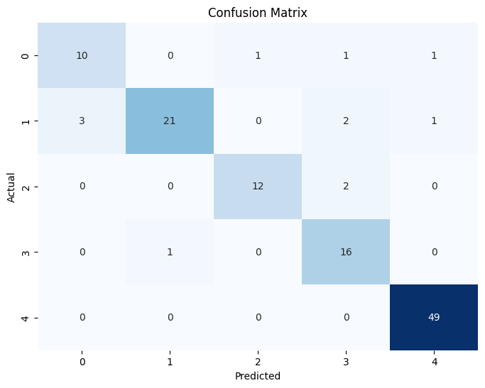
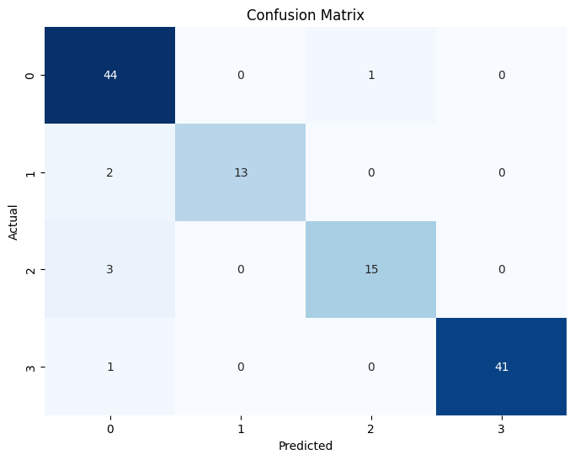
ERROR ANALYSIS
Naive Bayes
Logistic Regression
KNN
Support Vector Machine
Decision Tree
Random Forest
Gradient Boosting

Slide 8
THANK YOU!

