Slide 1
Quarterly Review
Northwind Trading B.V.

Slide 2
Highlights
Revenue grew 12%
Opened an office in Berlin
Notes:
Mention the Rotterdam warehouse.

Slide 3
Sales by region
Region | Q1 | Q2
North America | 1,200 | 1,350
Europe | 980 | 1,020

Slide 4
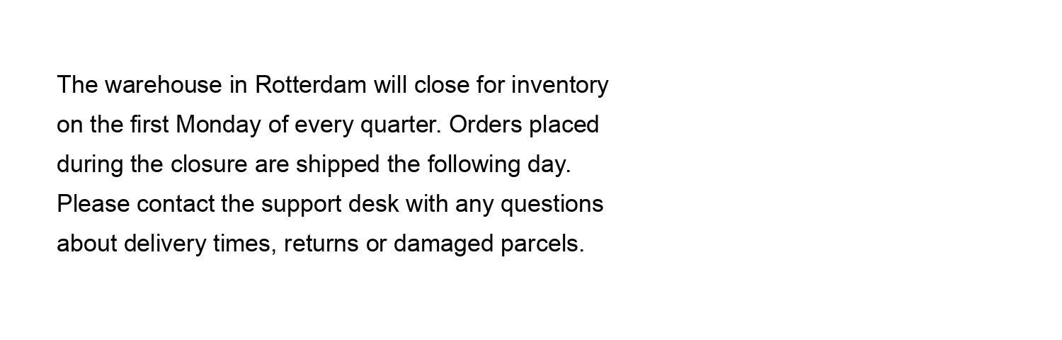
Warehouse

