Slide 1
Celebrando openSUSE Leap 15.1
Jornada sobre GNU/Linux y Software Libre

Slide 2
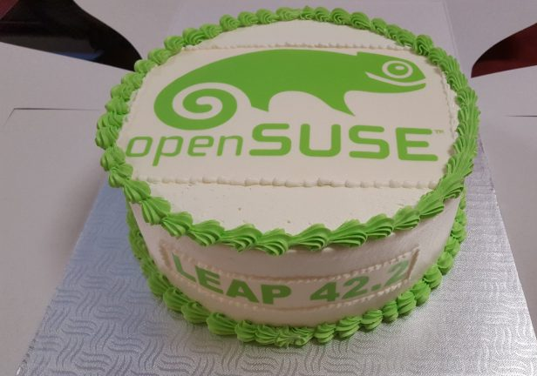
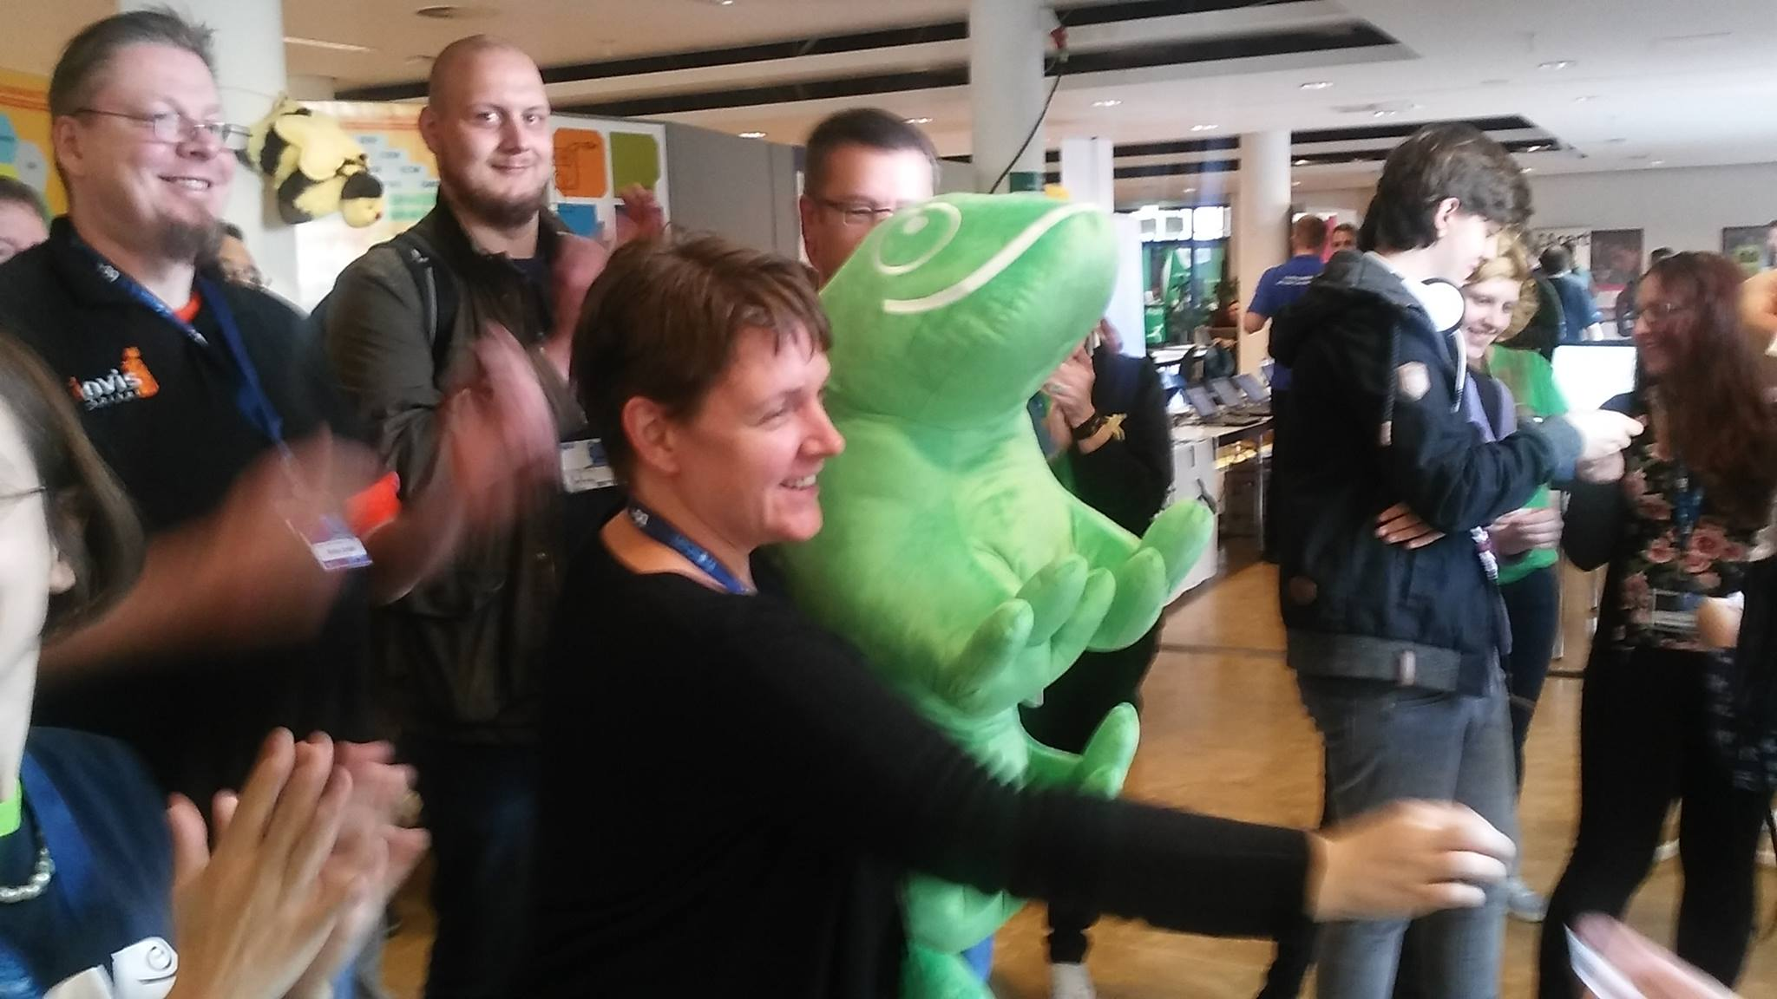
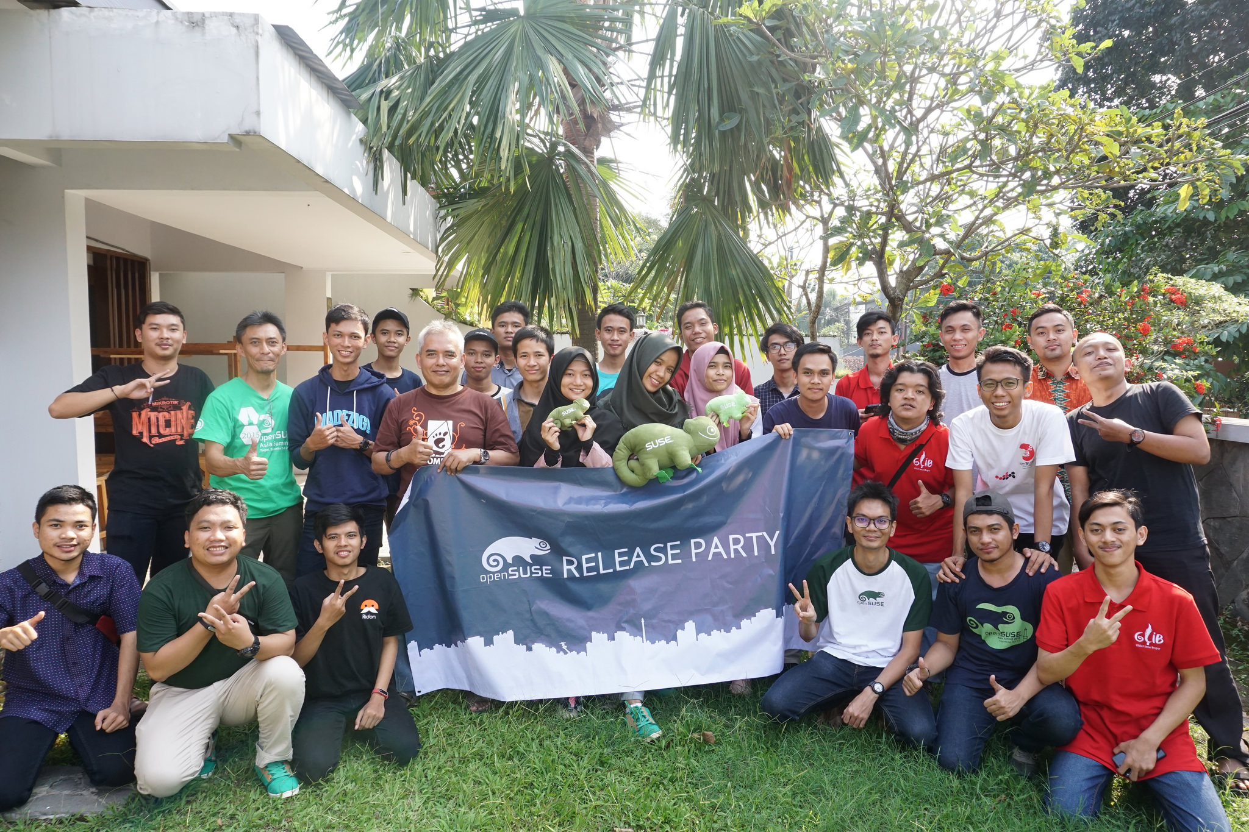
¿Qué hace esta gente aquí?
El motivo: Software Libre
La excusa: openSUSE Leap 15.1 launch party

Slide 3
openSUSE

Slide 4


SUSE y openSUSE
SUSE
  Open Source is in Our Genes
  Distribución comercial más antigua (1994)
openSUSE
  Have a lot of fun!
  Proyecto de software libre (2005)
  Patrocinado por SUSE, AMD, B1 Systems, Heinlein Support, IP Exchange y otros

Slide 5
openSUSE: peligro, geeks en libertad
Tres distribuciones Linux: Tumbleweed, Leap y Kubic
OBS - Open Build Service
OSEM - Open Source Event Manager
openQA
Kiwi
Portus
Jangouts
Snapper
...

Slide 6


Distributions
Latest packages
New versions daily
CI on OS level
55k systems
Stable release
Yearly service packs
3+ years maintenance
200k systems

Slide 7
Target audiences
Developers
Contributors
Power users
Production
ISVs, IHVs
Users

Slide 8
Características comunes
Sistemas de propósito general
Instalador potente y flexible
Excelente gestión de software
No sólo para tu PC
  Servidores, maquinas virtuales, containers, WSL
  LiveCD
  Multiarquitectura
  Despliegue masivo con AutoYaST
  Kiwi: haz tu propia imagen

Slide 9
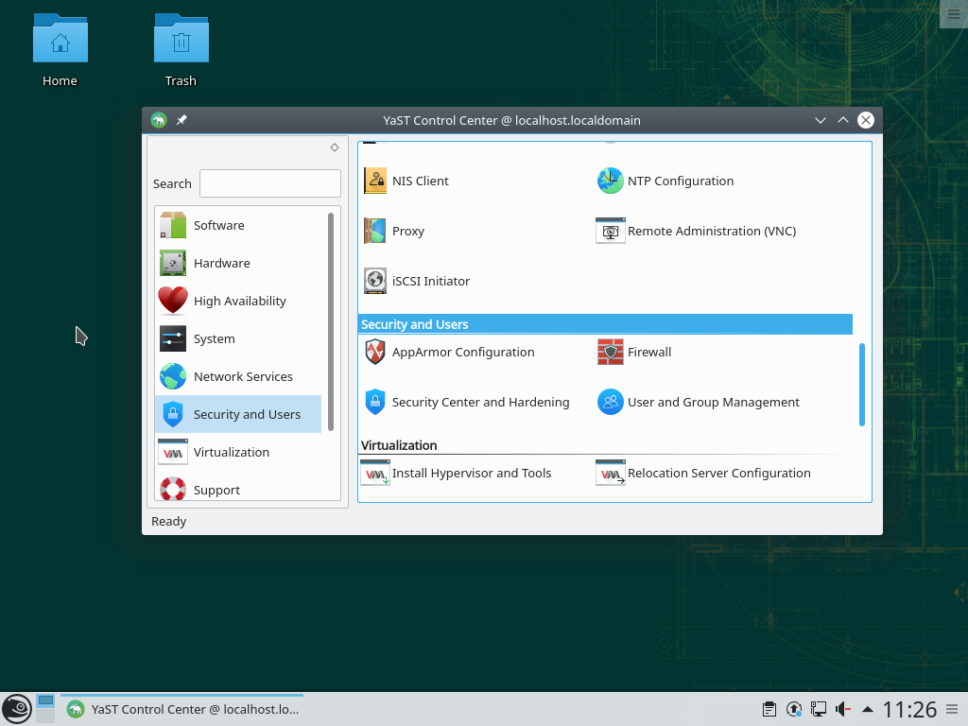
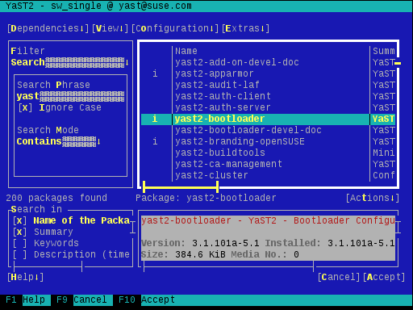
YaST

Slide 10
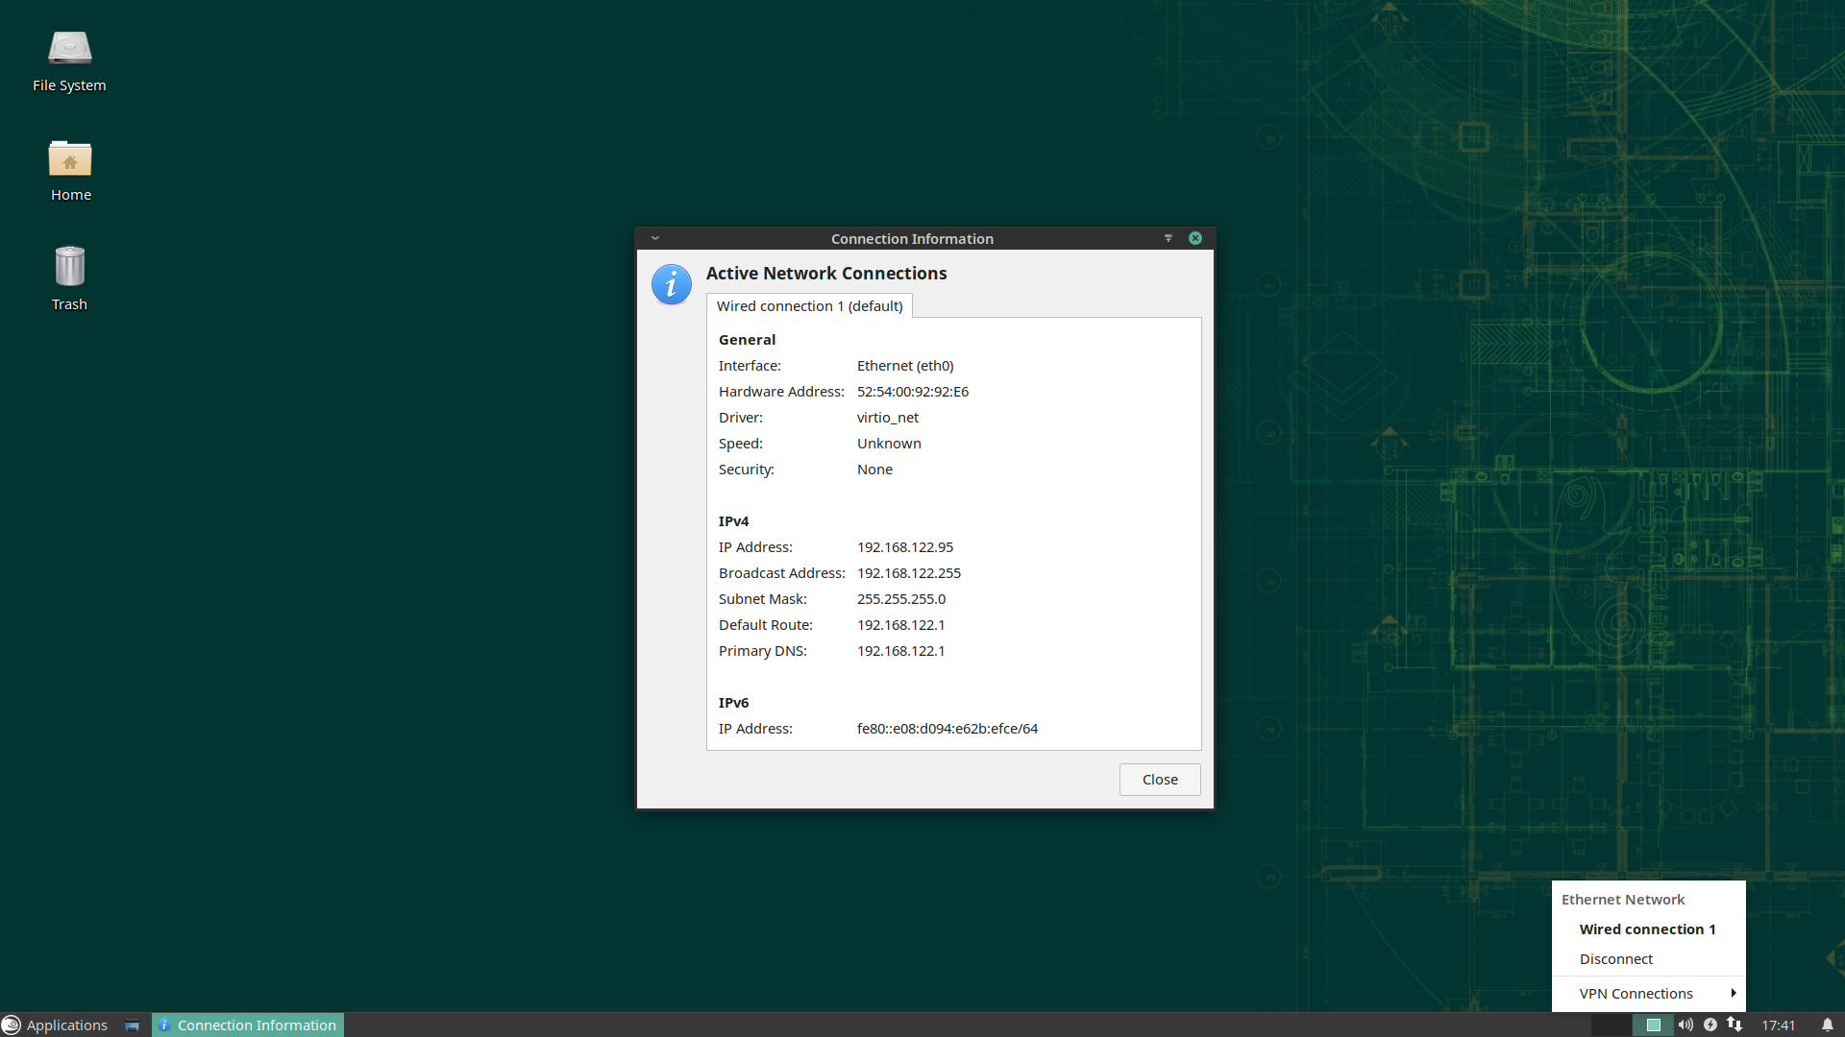
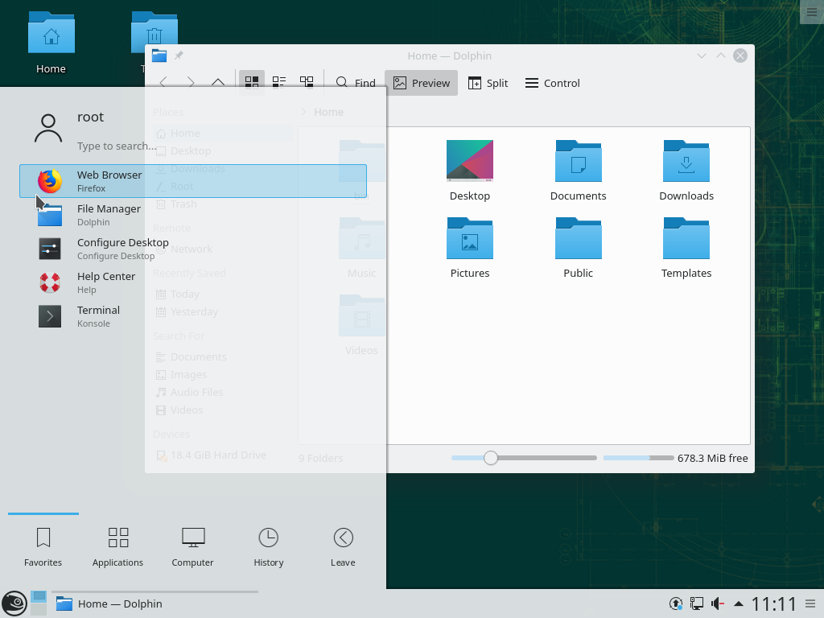
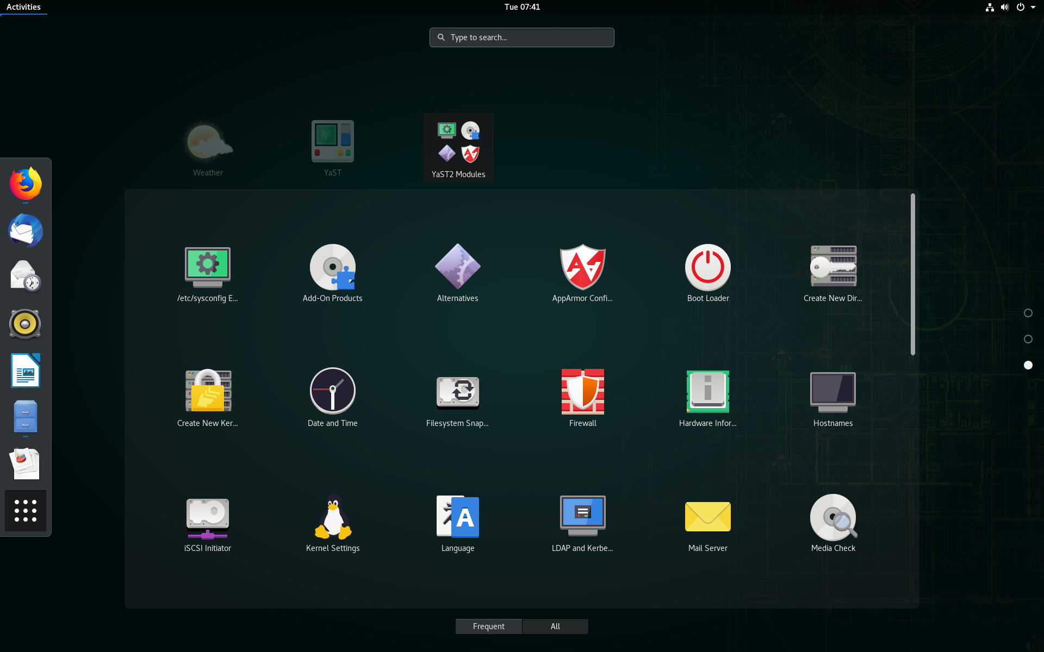
Varios entornos gráficos

Slide 11
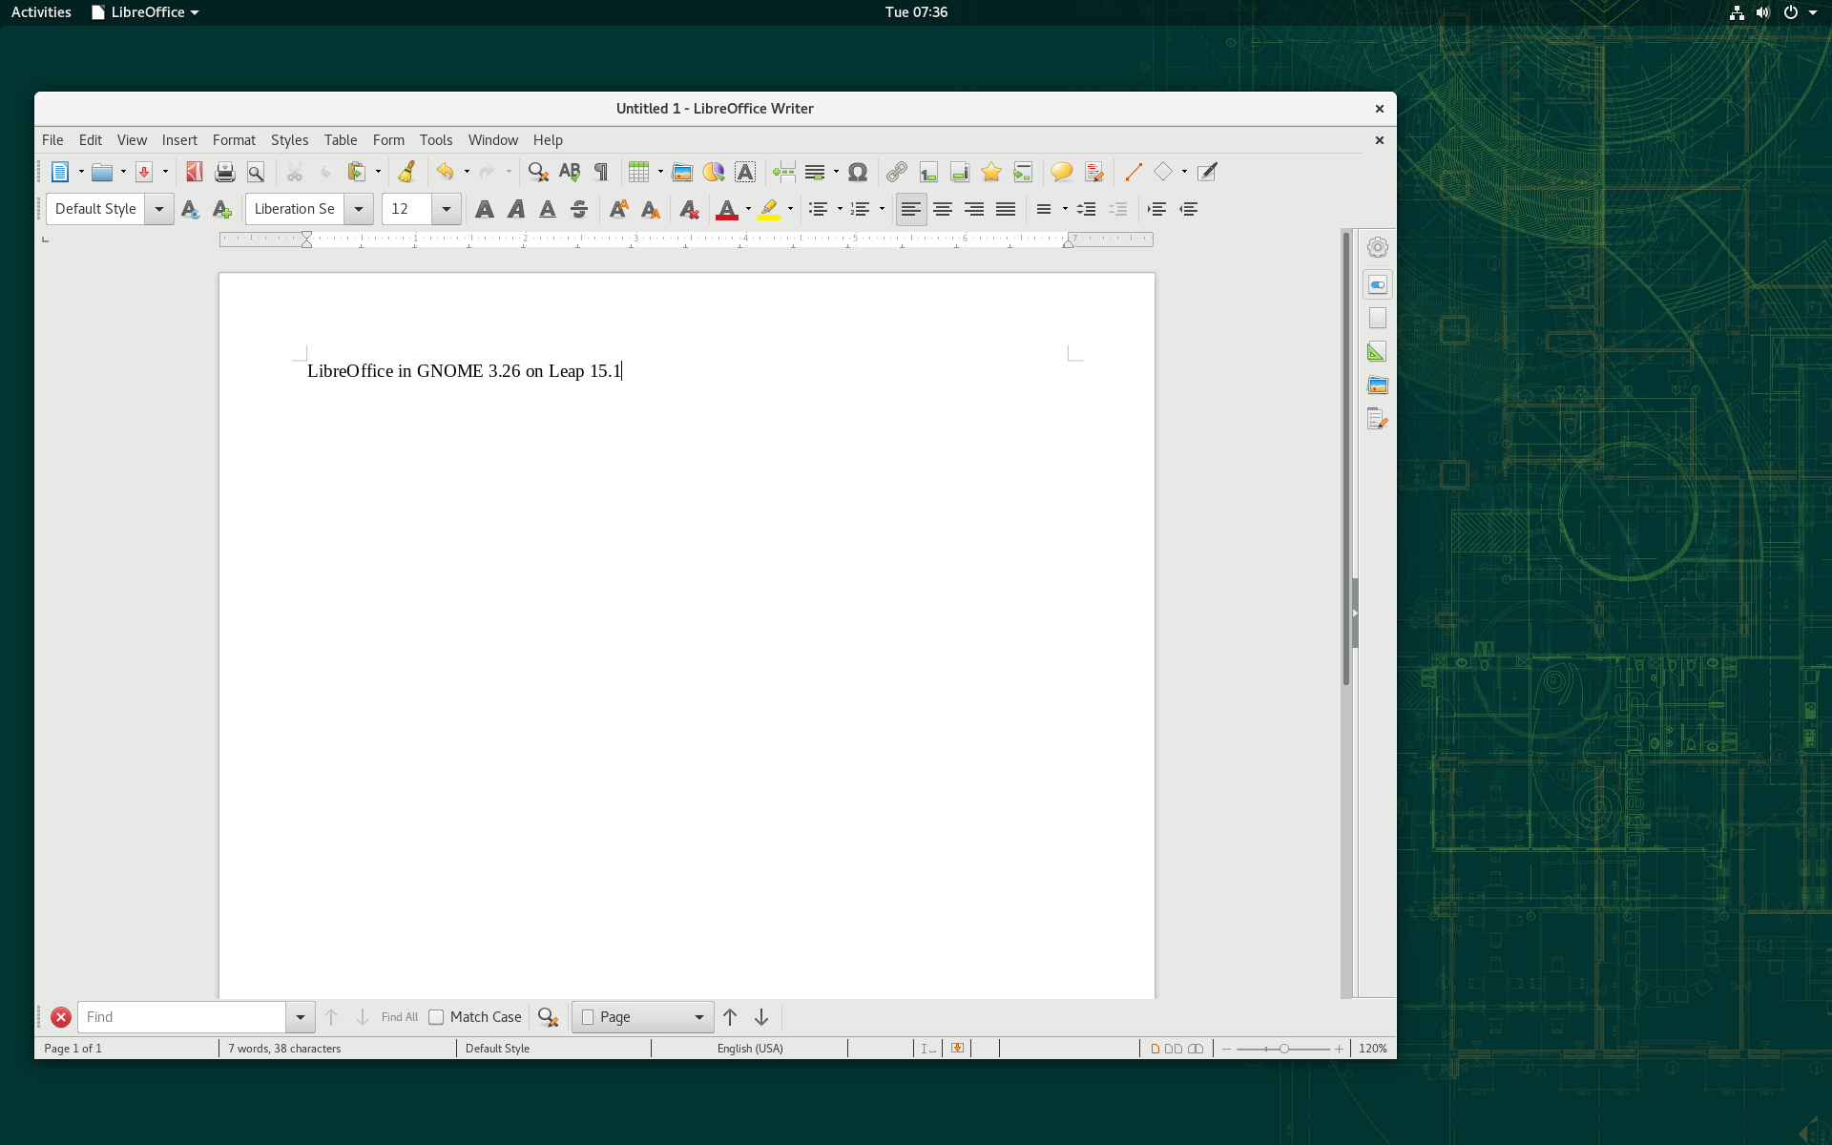
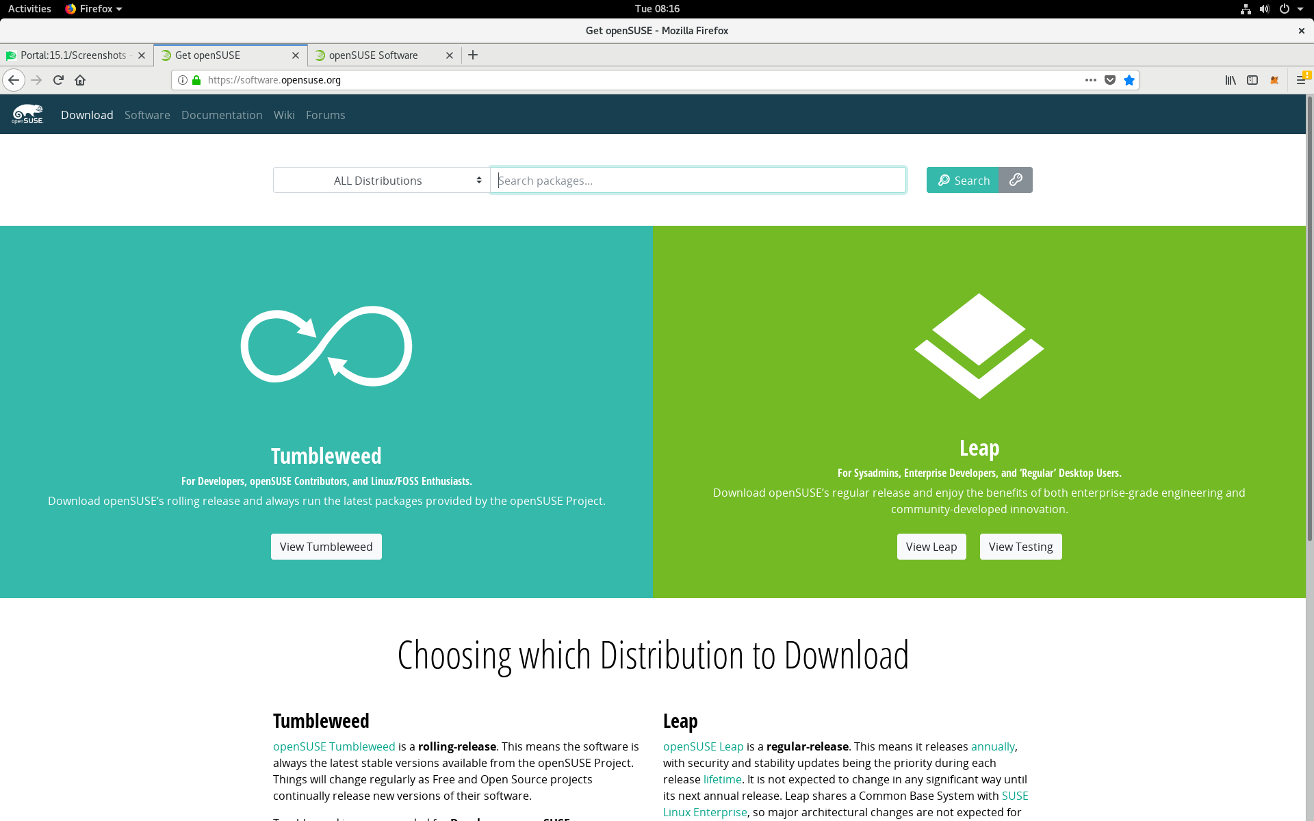
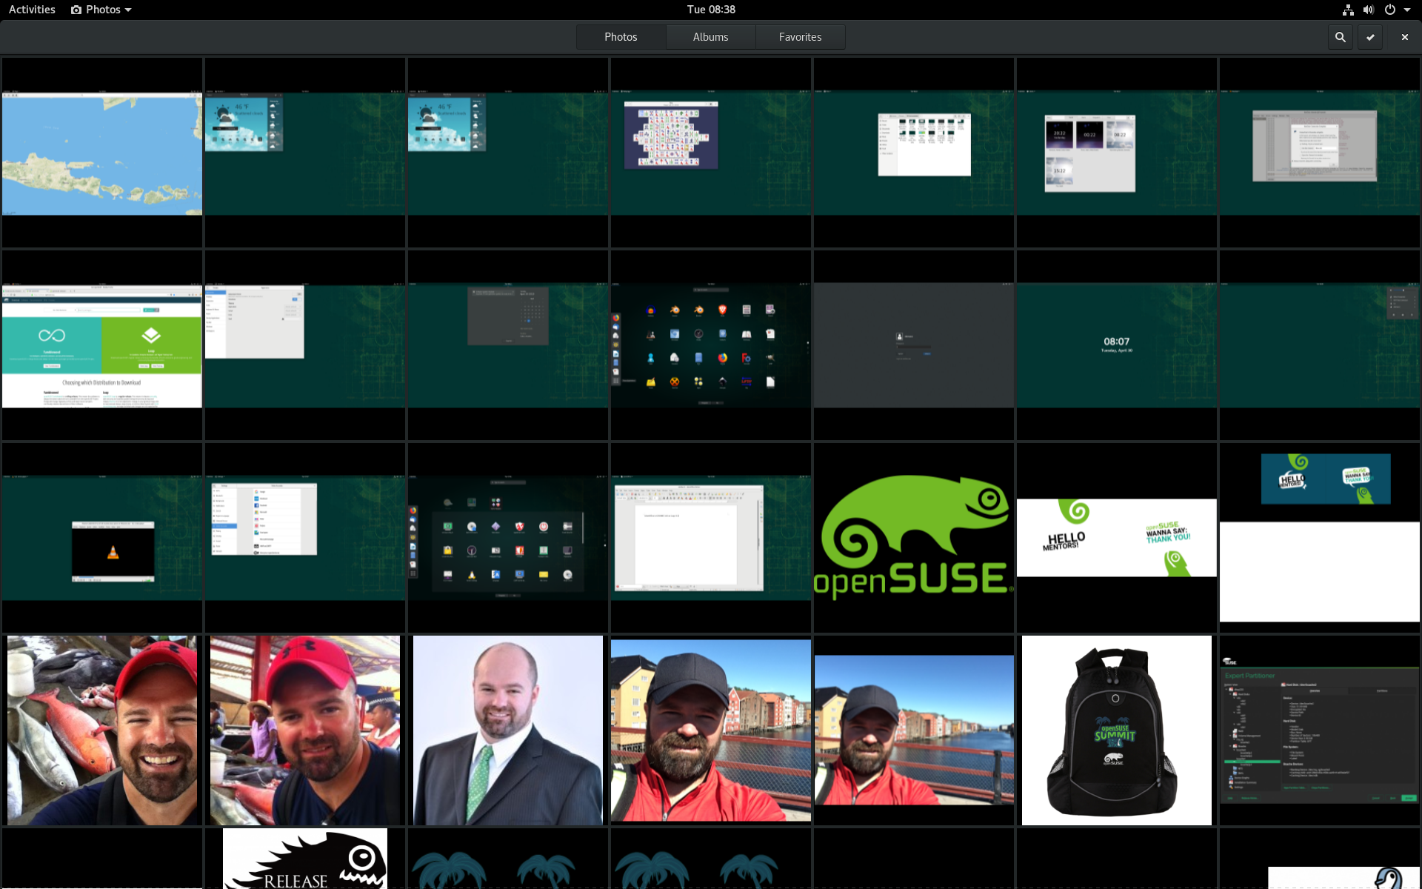
Miles de paquetes de software

Slide 12
Common Features
General purpose operating system
Separation between free and non-free components
Fine grained rpm packages
Source based development process
Self hosted and reproducible built in OBS
Open to anyone with an OBS account

Slide 13
Common Features
Traditional installations
Mass deployments
Preloads/OEM installations
Live images
JeOS VM images, containers, WSL
Kiwi for building custom images

Slide 14
openSUSE Tumbleweed
Fully rolling distribution
11k source packages
Continuous automated tests
Snapshot and rollback
x86, x86_64, ports to arm, aarch64, ppc64, s390
Base for the next SUSE Linux Enterprise

Slide 15
Tumbleweed for Developers
Always the latest Linux tech to develop against
Your release shipped the next day
Great for new, cool stuff
Issues can and will be fixed quickly
Easy recovery

Slide 16
openSUSE Leap
Base system from SLE
KDE and all the rest from TW on top
“frozen” for each major version
Maintenance updates for bug fixes
Yearly minor versions
x86_64, ports to arm and aarch64
Supported upgrade path to SUSE Linux Enterprise

Slide 17
openSUSE Leap Minor Versions
Service pack like upgrades
No complete rebase
May add features
Every other one also has bigger updates
Painless upgrades between service packs

Slide 18
Leap for Developers
Less is more
Stability and polishing is key
Can’t upgrade random components
Some upgrades possible after two years
Translations are important
Easy to port software to SUSE Linux Enterprise

Slide 19
El evento

Slide 20



Menú del día
Haciendo carrera con el Software Libre
Curso acelerado para la nube: introducción y administración automatizada
Configurando 100s de máquinas con Ansible
Gestión de configuraciones con SaltStack

Slide 21
Menú del día
Tutorial rápido de Ruby on Rails
Control de versiones con Git
Virtualización en Linux para videojuegos y otros usos
Integración continua a lo grande: openSUSE Tumbleweed
La importancia del Software Libre en la Salud Pública

Slide 22
Menú del día
¡A las 13:00h empieza la fiesta!
Instalación asistida de openSUSE para todos
Consultorio de Linux y Software Libre
¡Regalos!

Slide 23
Join the conversation,
contribute & have a lot of fun!
www.opensuse.org

Slide 24
License
This slide deck is licensed under the Creative Commons Attribution-ShareAlike 4.0 International license. It can be shared and adapted for any purpose (even commercially) as long as Attribution is given and any derivative work is distributed under the same license.
Details can be found at https://creativecommons.org/licenses/by-sa/4.0/
Credits
Template
Richard Brown
rbrown@opensuse.org
Design & Inspiration
openSUSE Design Team
http://opensuse.github.io/branding-guidelines/

