Slide 1
openSUSE Collaboration
How do we do what we do
Jos Poortvliet
openSUSE Community Manager
jpoortvliet@suse.com
Notes:
Let's talk about Merchandising.
But first, three points.
1.This is neither SUSE trying to get out of paying stuff nor taking control or telling people what to do. Yes, recent changes triggered this, but these plans are not from that. This is based on years of experience with running the merchandising thing from the SUSE side, together with others and talking to them. So, in short, I am not telling the ambassador program what it should be or how it should work. I DO propose a task they could take on them, which is reasonably well defined and prepared, and for which we'll do most of the work in setting things up – to get it going. But it is their call.
2. It is a PROPOSAL. It is not set in stone, not pushed, nothing like that. It is open for discussion and debate. I do want you on board, but also the COMMUNITY should be able to challenge this and improve it.
3. It is not perfect. It CAN NOT be perfect, we should not even TRY. That is for two reasons: first, even collectively, we simply don't know what will work or not. See USB sticks vs DVD's – we have to try things, then improve. Second, even if we collectively knew, we'd never get a consensus on all the details. So forget about details, focus on the big picture and keep in mind the details are flexible.
I kept most details out of this but will, once you agree on the big picture, come with a more complete proposal to the ambassador team.

Slide 2
Agenda
Governance
Communication
Tools & Processes
Questions

Slide 3
How are things set up

Slide 4
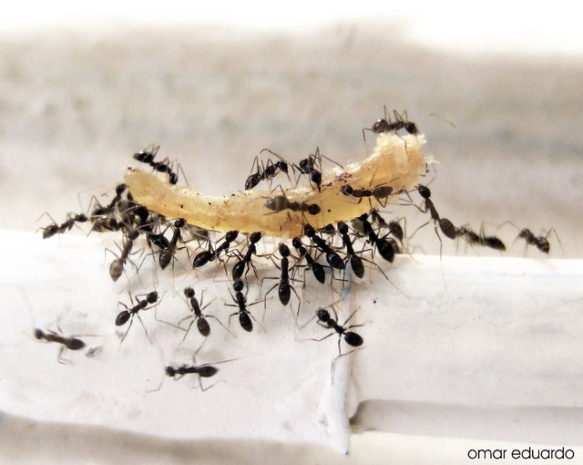
Ruling without rules

Slide 5

Commandments
Guiding Principles: transparency, collaboration, innovation, nice
Code of Conduct: Behave properly
Strategy: openSUSE for Professionals
Tagline: Have a lot of fun!

Slide 6
Culture
Who Codes, Decides™
Just Do It™
Talk is Cheap™
Collaborate Or Die™
Be Smart™ (RTFM)
Credit Where Credit is Due™
Say it Straight™
… … …

Slide 7

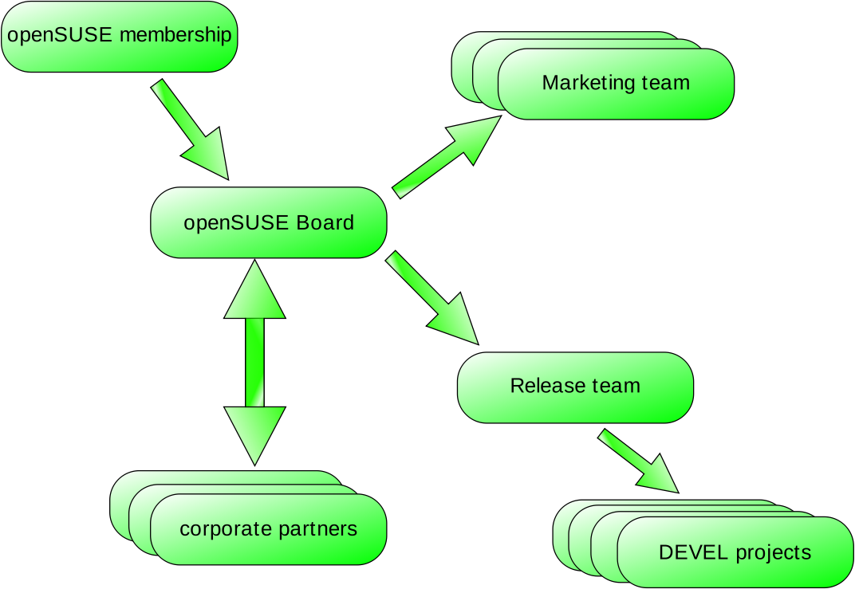
Governance
Notes:
Last year we did over 100 'events' globally. That goes from class rooms with 30 people up to FLISOL's with 10.000 visitors – but more classrooms than FLISOLS, of course. And many of these events are simply individuals who hand out some DVD's at a place they give a talk.

Slide 8
Communication

Slide 9








On-line
Notes:
To make this happen, we have a demand-based process: ambassadors ask us to send them stuff via a structured form at software.o.o, we check the requests as well as we can and send them a package with DVD's and some other things we happen to have hanging around like T-shirts, flyers, stickers and more.

Slide 10
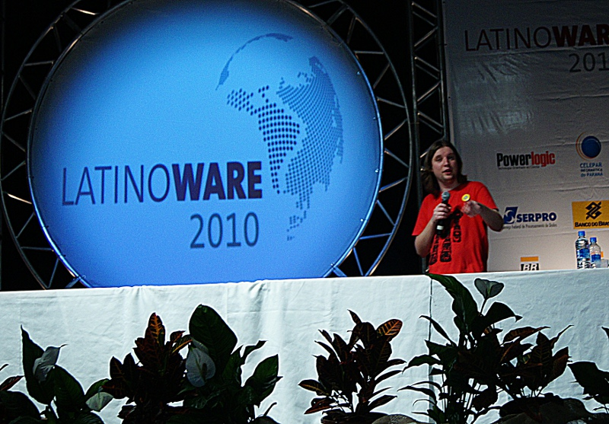
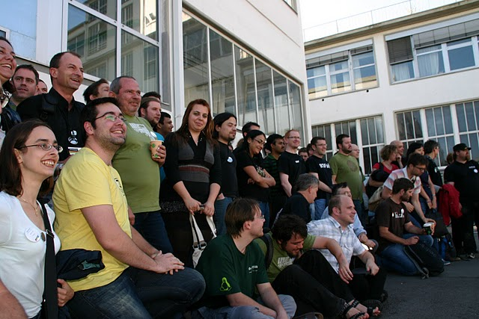
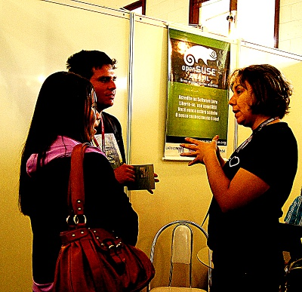
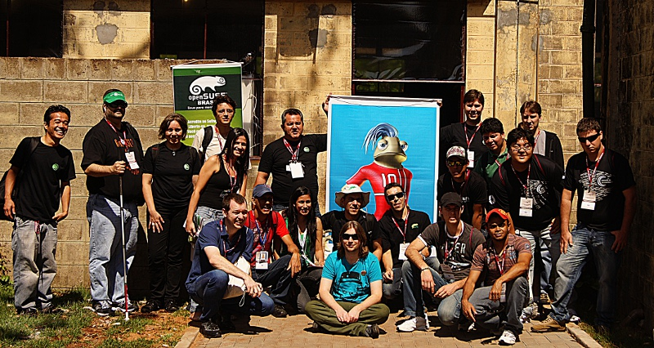
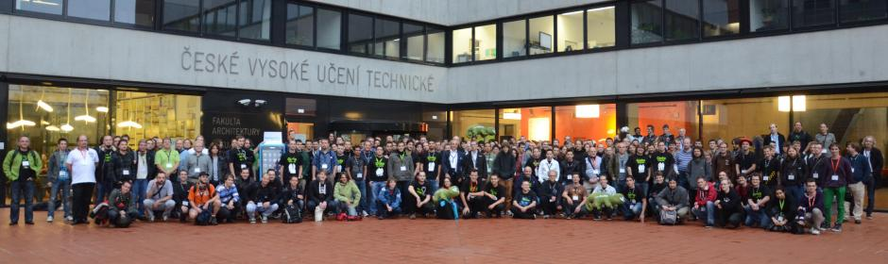
In person

Slide 11
Tools

Slide 12







Slide 13
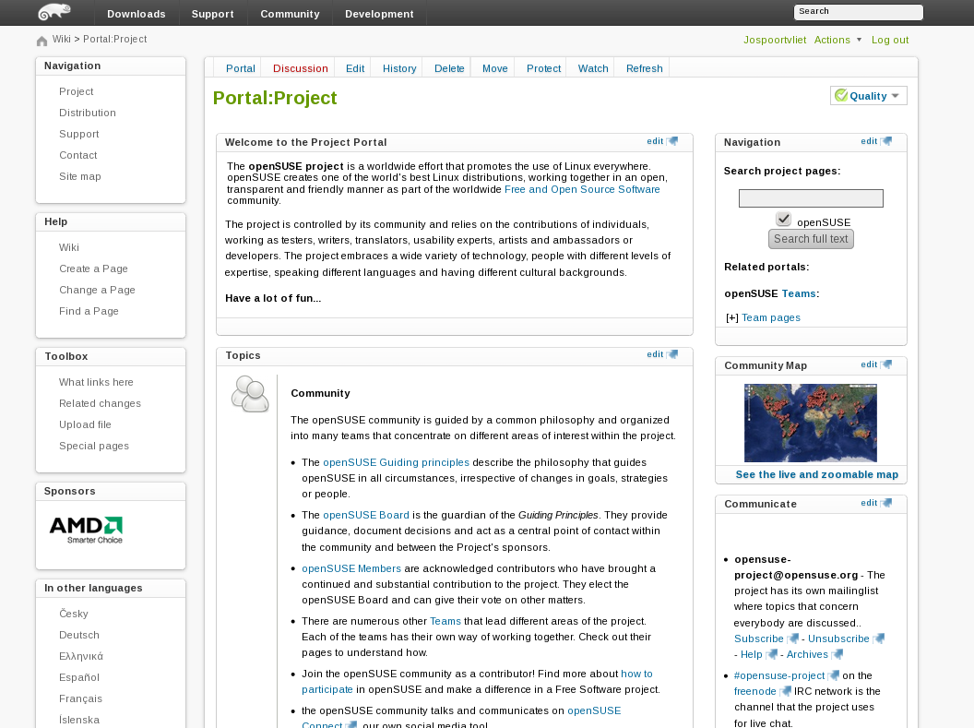

Slide 14
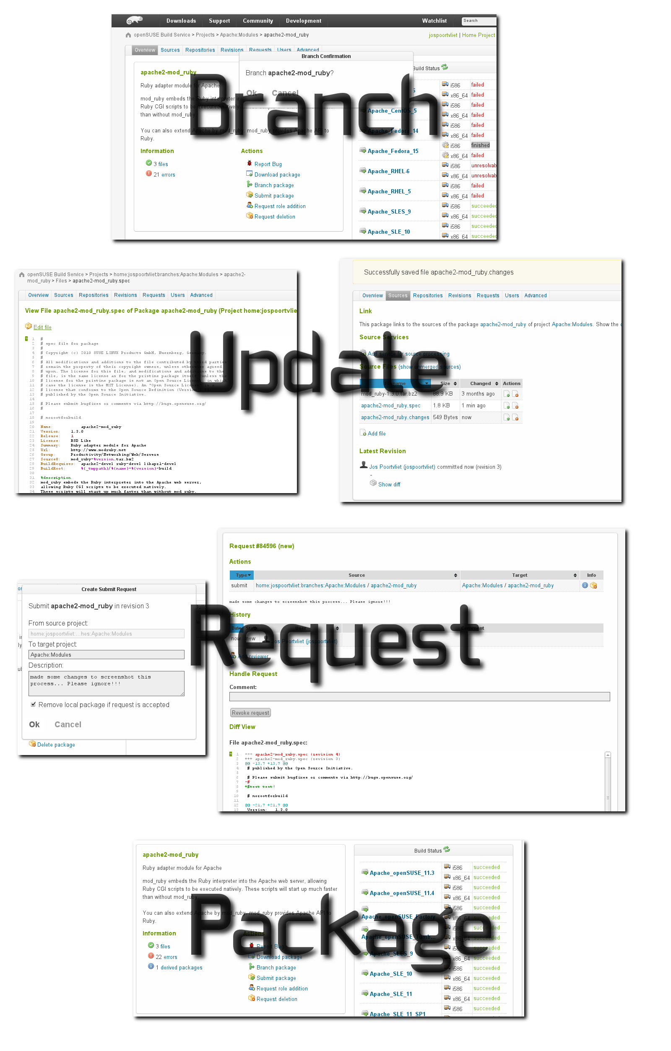
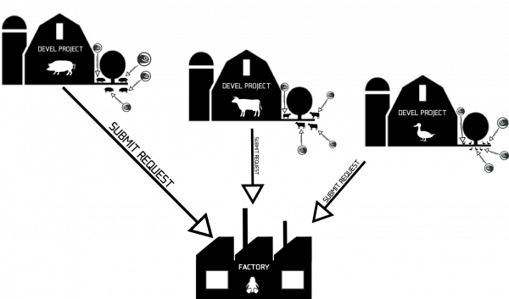
Process

Slide 15
Questions?
Notes:
Shoot!

