Slide 1
YaST: from the repository to the distributions
Continuous testing and delivery, the YaST way
Ancor González Sosa
YaST Team
ancor@suse.com

Slide 2




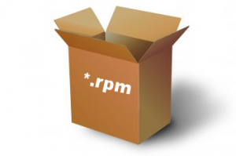

Slide 3
Challenges
Sharing the code between openSUSE and SLE
Development (TW and future releases) vs Bugfixing (maint.)
Coordinate developers together and with other players
Avoid manual work → rake
Tracking progress and versioning

Slide 4

Developer → Github
Pull request (only sane code checked into the relevant branches)
  Peer review
  Automated checks with Travis
    Unit tests + other quality checks: spell check, licenses, rubocop…
Travis: why?
  Perfect integration with Github’s pull requests
  Seamless integration with Coveralls, CodeClimate, Inch CI...
Travis: how?
  Rake tasks in docker containers

Slide 5

Github → Build Service
Code committed to devel project (automated tests run again)
From devel project submitted to Factory
Jenkins
  Rake tasks to automate the above for every change
  Just in case, extra check/submission once a day
  In addition, AutoYaST integration tests
  Bonus: trigger generation of Docker images for Travis

Slide 6

Build Service → Tumbleweed
Factory submission goes through openQA
Pre-integration tests (staging projects)
Post-integration tests (full ISO)
Green openQA = binary released

Slide 7
Continuous testing
http://yastgithubio.readthedocs.io/en/latest/how-to-write-tests
Unit tests on every pull request and package build
Pre-integration tests with openQA
AutoYaST integration tests continously run in Jenkins
Post-integration tests with openQA
Tests for the CLI with TAP (run during post-integration in openQA)
Manual QA and bugs catched by the user

