Slide 1
openSUSE: much more than Linux distributions
Projects under the openSUSE umbrella
Ancor González Sosa
ancor@suse.com

Slide 2
openSUSE as a breeding ground

Slide 3
openSUSE as a breeding ground
openSUSE is not (only) a distribution
The free software recipe:
Creative people
Infrastructure
Mix, shake and wait

Slide 4
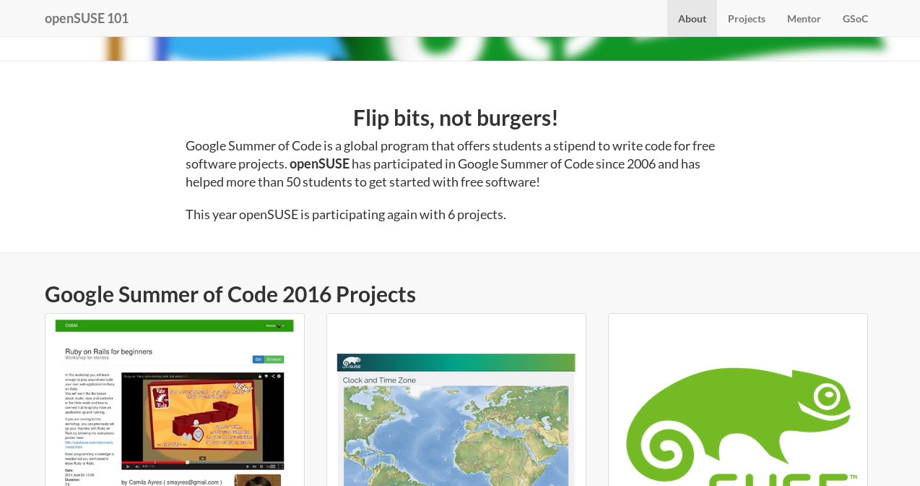

An umbrella for GSoC
http://101.opensuse.org/gsoc/

Slide 5
The usual suspects

Slide 6
The usual suspects
Open Build Service
openQA
Kiwi
...

Slide 7
Other cool stuff

Slide 8
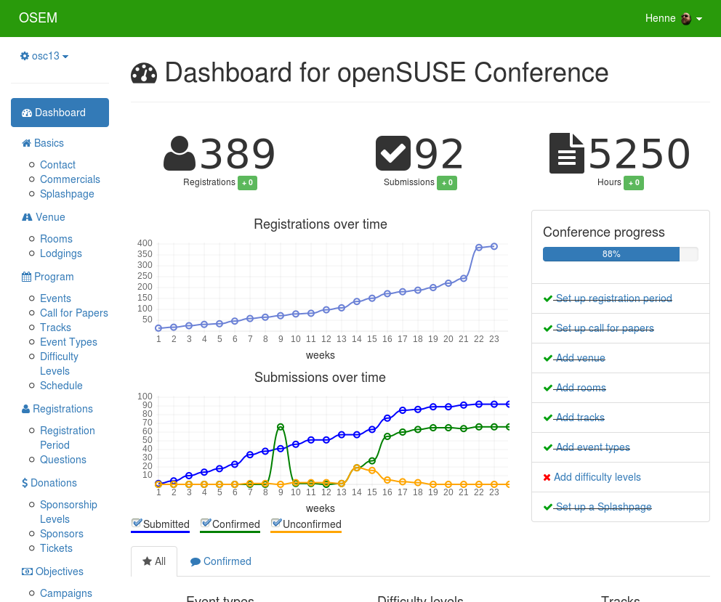
OSEM – Open Source Event Manager
http://osem.io

Slide 9
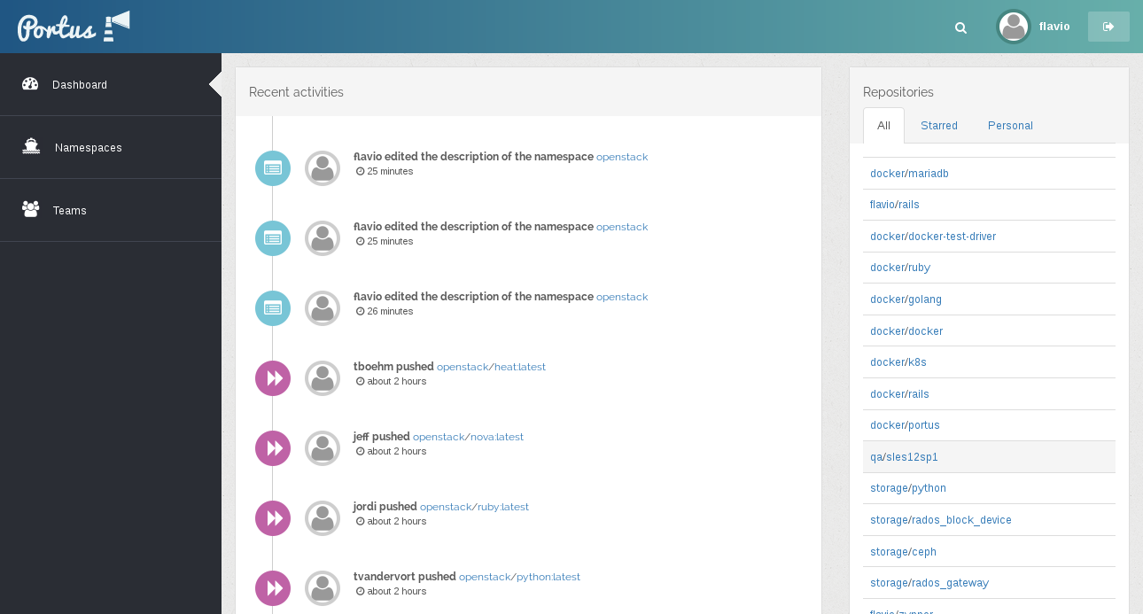
Portus
http://port.us.org

Slide 10
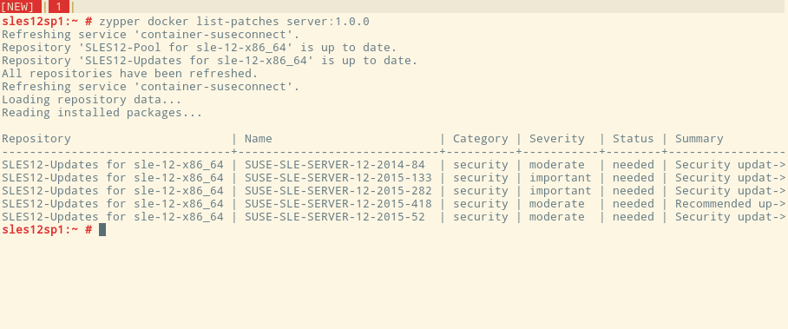
zypper-docker
https://github.com/SUSE/zypper-docker

Slide 11
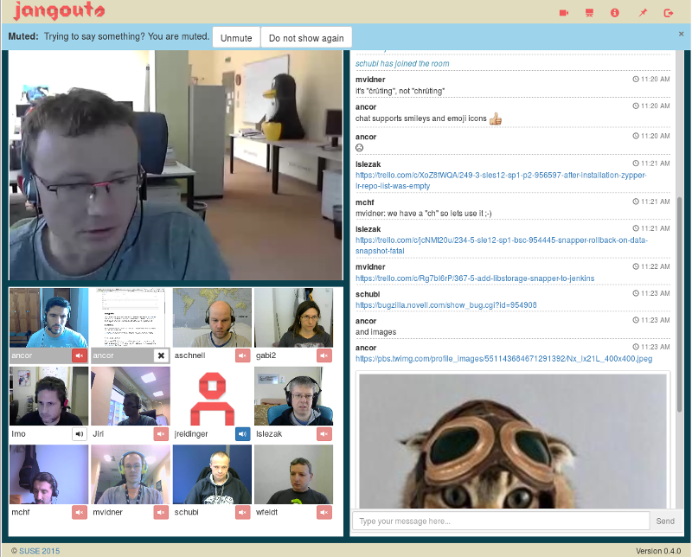
Jangouts
https://github.com/jangouts/jangouts

Slide 12
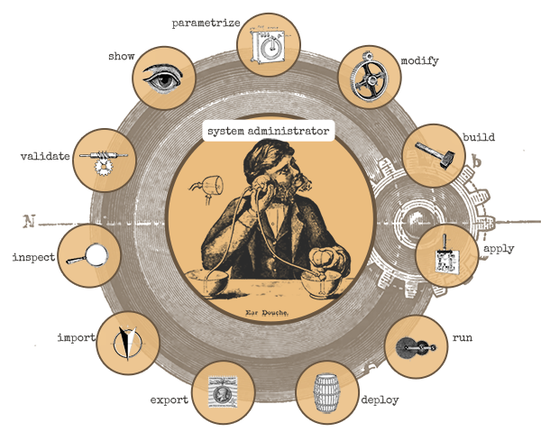
Machinery
http://machinery-project.org

Slide 13
Even more
Tell me about your favourite hidden gem!

Slide 14
Questions?

