Slide 1

Detecting Credit Card Fraud
DTSA-5509 Introduction to Machine Learning: Supervised Learning
Andrea Cruz

Slide 2

Outline
Executive Summary
Introduction
Methodology
Results
Conclusion
Appendix

Slide 3
Executive Summary
This project aims to implement Supervised Machine Learning models to help Identify fraudulent credit card transaction. The following methodology was used:
Collect Credit Card Transaction data with valid and fraudulent labels
Process and clean dataset as necessary
Perform exploratory data analysis by looking at descriptive statistics and data visualizations
Implement and evaluate supervised machine learning learning models to perform binary classification.
In conclusion, the highest performing model was selected as the predictor for valid/fraudulent credit card charges.

Slide 4

Introduction
With the increased usage of credit cards in this digital age, making purchases for buyers has never been easier. Unfortunately, with millions of transactions existing exclusively digitally and occurring every second of the day, it is also a prime opportunity for fraudulent records to make their way into the mix. Given the vast number of transactions that occur daily, it would be inefficient (if not impossible) and untimely for a human to review all the transactions for validity. The purpose of this analysis is to develop a supervised machine learning module that can detect fraudulent transaction activity.

Slide 5
Methodology: Data Collection
Data was provided by Machine Learning Group – ULB and was collected on Kaggle.com
Background information provided by the hosts indicated that the features in this data set were all numerical variables. Most resulting from a Principal Component Analysis transformation, with the exception of “Time” and “Amount”.
Due to confidentiality, practical details of each feature were not provided and therefore not much business interpretations of the models can be made as it relates to individual features.

Slide 6
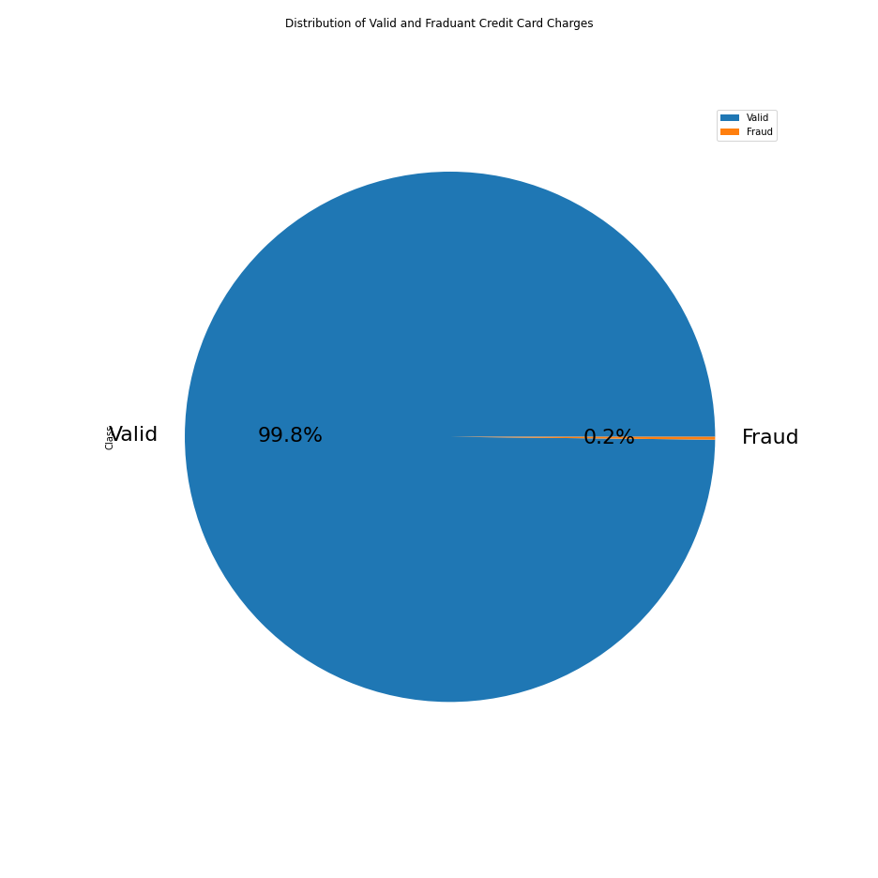
Methodology: EDA
Target attribute[“Class”] was determined to contain two unique values confirming a binary classification approach:
0 – Valid
1 – Fraud
The dataset’s distribution of the target attribute demonstrated a highly skewed bias towards valid transactions.
Given the heavy weighting towards valid transactions, Area Under the Precision-Recall Curve (AUPRC) was chosen as a performance tracking metric

Slide 7
Methodology: EDA (cont)
Additional exploratory analysis was performed using a correlation matrix of all 28 attributes to determine if any one or few attributes would be good leading indicators for the target attribute.
To further assess relationships between attributes simultaneously, a scatter matrix was produced for the attributes.

Slide 8
Methodology: Model implementation and evaluation
Data was split into training and testing sets, using an 80:20 split respectively
The main algorithms implemented were Logistic Regression and K Nearest Neighbors for binary classification. Both models were optimized and tuned to different parameters/hyperparameters using Sklearn.
Models were evaluated using Area under Precision-Recall curves and the best performing classification model was identified.

Slide 9
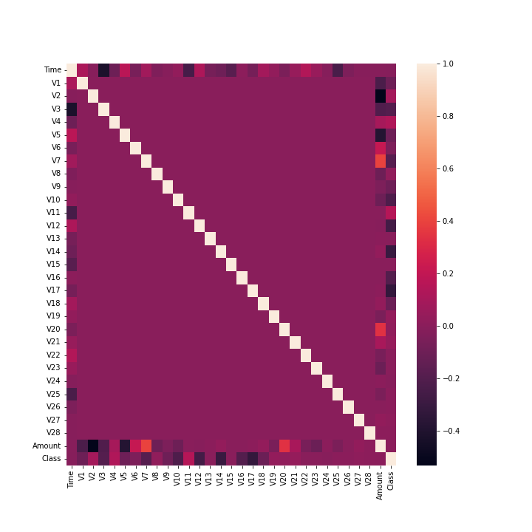
Results: EDA
Taking a look at the correlation matrix, it does not appear that any one or a few attributes would be good candidates for leading indicators for predicting "Class".
The scatter matrix also showed similar findings.

Slide 10
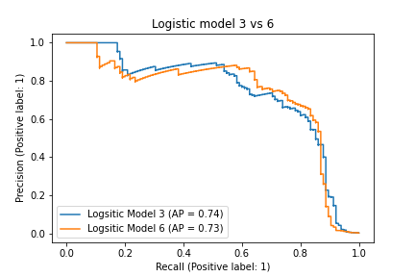
Results: Logistic Regression Implementation
Different Logistic Regression models were implemented to optimize the most appropriate combination of attributes to most accurately predict the target variable.
The 2 best performing models had the following parameters and performance metrics:
Logistic Model 3
Parameters = the first 10 attributes (V1-V10)
AP = 0.74
Run time = 0.9 s
Logistic Model 6
Parameters = middle 10 attributes (V11-V20)
AP = 0.73
Run time = 0.6 s

Slide 11
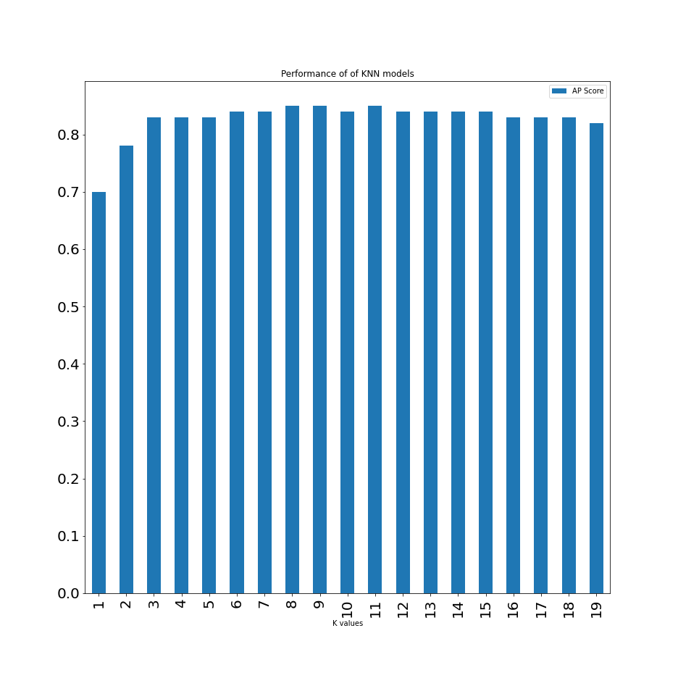
Results: K Nearest Neighbor Classifier
Different KNN models were implemented to optimize the most appropriate hyperparameters to most accurately predict the target variable.
The best performing model had the following hyperparameters and performance metrics:
Standardized features
N-neighbors = 8
AP = 0.85
Run time = 0.9 s

Slide 12
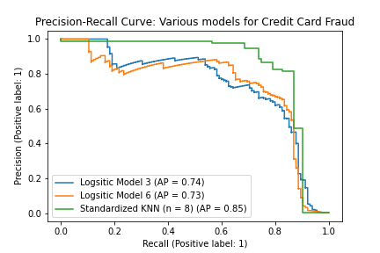
Results: Overall model implementation
The best models from the different algorithms were evaluated using the area under respective Precision-recall curve.
The Average Precision (AP) is our performance gauge metric, with a higher numeric value representing better performance.

Slide 13

Conclusions
Through implementation and optimization of different machine learning models, it was determined that the best model given this analysis for predicting transactions as credit card fraud is a Standardized K Nearest Neighbor model with the hyperparameter of the neighbors set to 8.

Slide 14

Appendix
All source code for Jupyter notebook and slides can be found in the following GitHub repository:
https://github.com/ancr8790/CreditCardFraud

Slide 15
Thank you!

