Slide 1
Style Transfer For Real-Time Videos & Images Using CNN
Guide: Presented by,
Miss . Joice T Ancy k j

Slide 2
Relevance of the topic
Style transfer allows us to recompose the content of an image in the style of another.
If you've ever imagined what a photo or video might look like if it were painted by a famous artist, then style transfer that turns this into a reality.
This new capability opens up endless doors in design, content generation, and the development of creativity tools.
It also helps in Photo and video editors, Artist-Community engagement, Commercial art, Gaming, Virtual Reality.

Slide 3
Description of the project
Style transfer is basically an algorithm which uses CNN to learn features from different images .
Then it mixes them together in a new image or real time video which is basically a combination of the two inputs.
For transfer learning we already have pretrained models like VGGnet which is a 19,16 layers deep neural network architecture to work on.

Slide 4
Objective of the study
The objective of this project is to recompose the content of an image or video in the style of another image .
Transfer artistic style from one painting to another picture or real time video using convolutional neural network.
It gives an artistic touch to your image and video by using the style configurations of the other image.

Slide 5
Existing system Vs Proposed system
Problem with Existing system
A major limiting factor for previous approaches has been the lack of image representations that explicitly represent semantic information and, thus, allow to separate image content from style.
Proposed system
Here we use image representations derived from Convolutional Neural Networks optimized for object recognition, which make high level image and video information explicit.

Slide 6
Input and Output
Input
Content image or content video
Style image
Output
output image or video with original content of the input and with the style of the style image.

Slide 7
Modules
Extract content.
Content: Global structure.
Extract content from the content image or real time video using higher layers of VGG19 and VGG16 which is a pretrained convolutional model.
Extract style.
Style: Colours, local structure
Extract style from the style image using lower layers of VGG19 and VGG16 which is a pretrained convolutional model.
Merge the content and style to get the output.

Slide 8
Image Style Transfer
A Neural Algorithm of Artistic Style that can separate and recombine the image content and style of natural images.
The algorithm allows us to produce new images of high perceptual quality that combine the content of an arbitrary photograph with the appearance of numerous well known artworks.
Video Style Transfer
video is nothing but a collection of a set of images. These images are called frames and can be combined to get the original video.
Each frame is stylized using style image . we can loop through the steps for all individual frames, recombine and generate the stylized video.

Slide 9
Description of the Methodology
Steps to perform style transfer:
Visualize data
Basic Preprocessing/preparing our data
Set up loss functions
Create model
Optimize for loss function

Slide 10
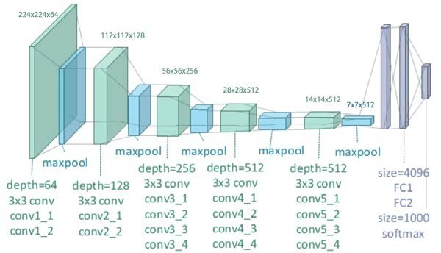
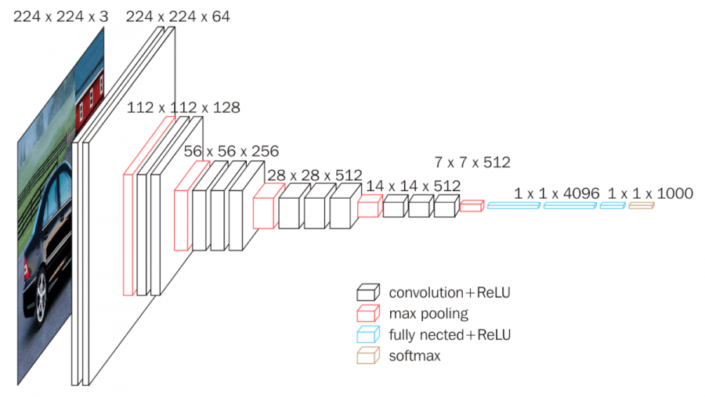
VGG19 VGG16
VGG19 is composed by 16 convolutional layers (with 5 pooling layers) and 3 fully-connected layers . You can load a pretrained version of the network trained on more than a million images from the ImageNet database .
VGG-16 is a convolutional neural network that is 16 layers deep. You can load a pretrained version of the network trained on more than a million images from the ImageNet database

Slide 11
Thank you

