Slide 1


AccessMap
ArcGIS II
Cole Anderson

Slide 2

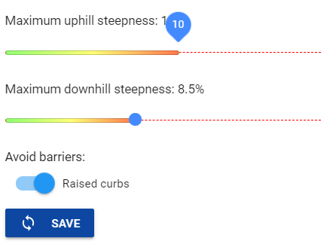
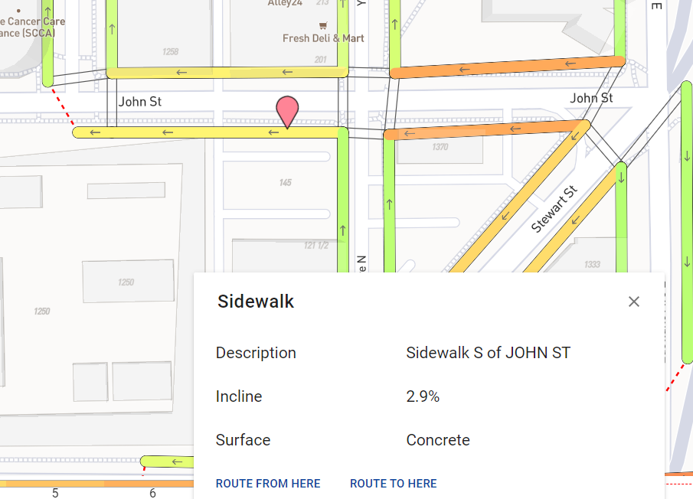
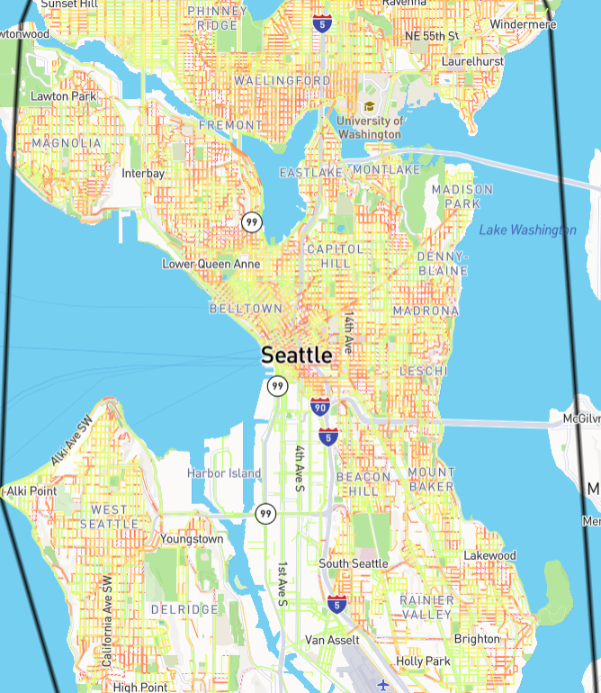
The Project:
N. Bolten, S. Mukherjee, V. Sipeeva, A. Tanweer and A. Caspi, "A pedestrian-centered data approach for equitable access to urban infrastructure environments," in IBM Journal of Research and Development, vol. 61, no. 6, pp. 10:1-10:12, 1 Nov.-Dec. 2017, doi: 10.1147/JRD.2017.2736279.

Slide 3
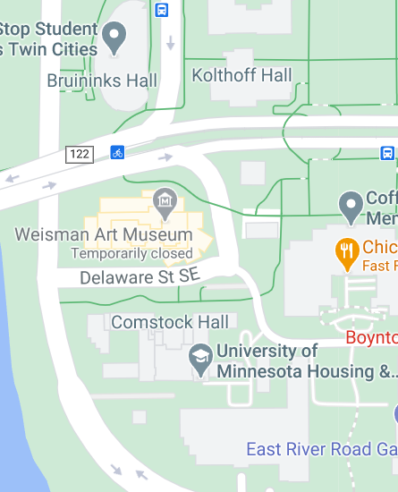
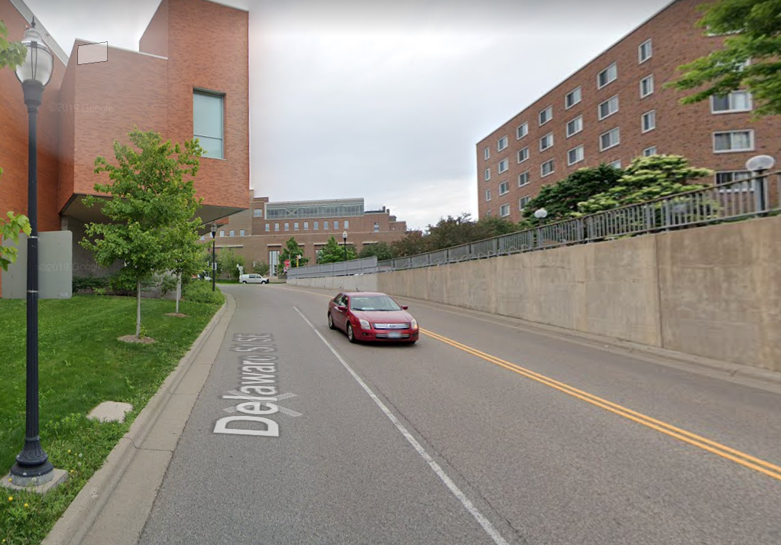
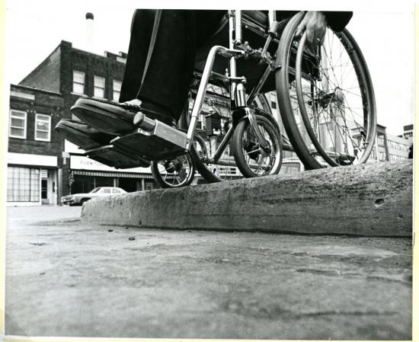
Problem Solving
Urban navigation for PWD or specific mobility needs
Navigating new areas spontaneously can be a nightmare
Fundamental lack of accessible-focused web apps
Difficulty in mapping sidewalks/pedestrian ways generally
Access and network data often stored separate
Currently designed for just Seattle; looking at expansion to other urban areas

Slide 4

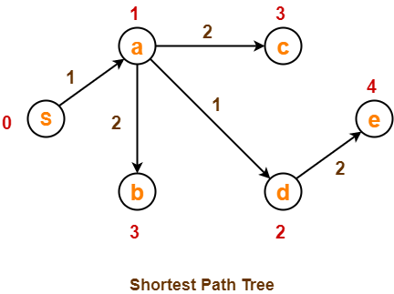
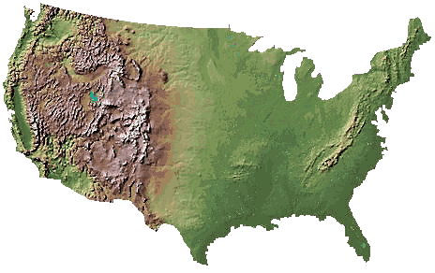
Utilizing GIS (and GIS)
What kinds of data:
National Elevation Dataset @ 1/3 arc-second (NED)
sidewalk network (SDOT) + rectification
accessibility attributes (SDOT)
ground truth (crowdsourced)
Sidewalk data is kept in unstandardized formats, if at all
Machine learning to connect sidewalks in space
Routing function uses Djikstra’s: cost weighted by slope, barriers

Slide 5
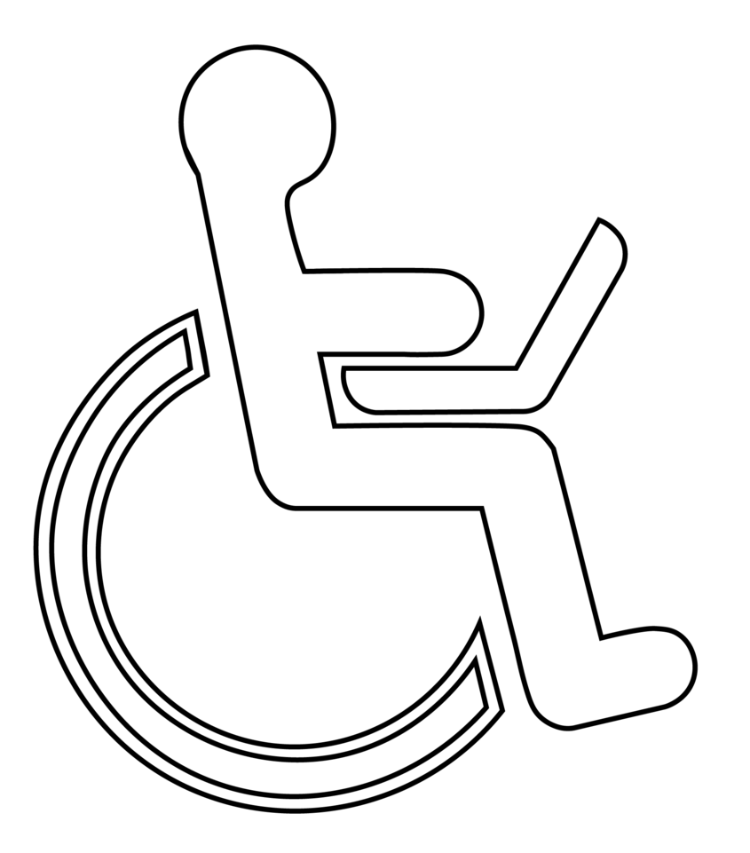
Relevancy
Use of network datasets and shortest path algorithms
Machine learning routing
Technology and GIS to improve practical accessibility for PWD
Not clunky and “extra”
Illustrates how accessibility can be integrated into current web-apps
Expandable + Crowd Sourced
Adjustable criteria

