Slide 1
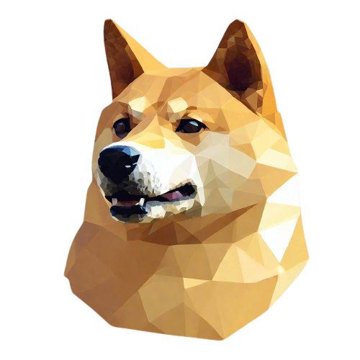


DogeFriends
github.com/and2684
@andmalikin

Slide 2
Microservices:
DogeFriendsApi – .Net Web API + Postgres Database
SettingsService - .Net Web API + Redis consistent storage
ImageService - .Net Web API + Mongo Database
IdentityService - .Net Core Identity + Identity Server 4 + Postgres Database
Frontend - Angular SPA

Slide 3







Структура приложения
IdentityService
(Identity server 4)
Angular SPA
DogeFriendsApi
(.Net core web api)
SettingsSerivce
(.Net core web api)
ImageService
(.Net core web api)

Slide 4
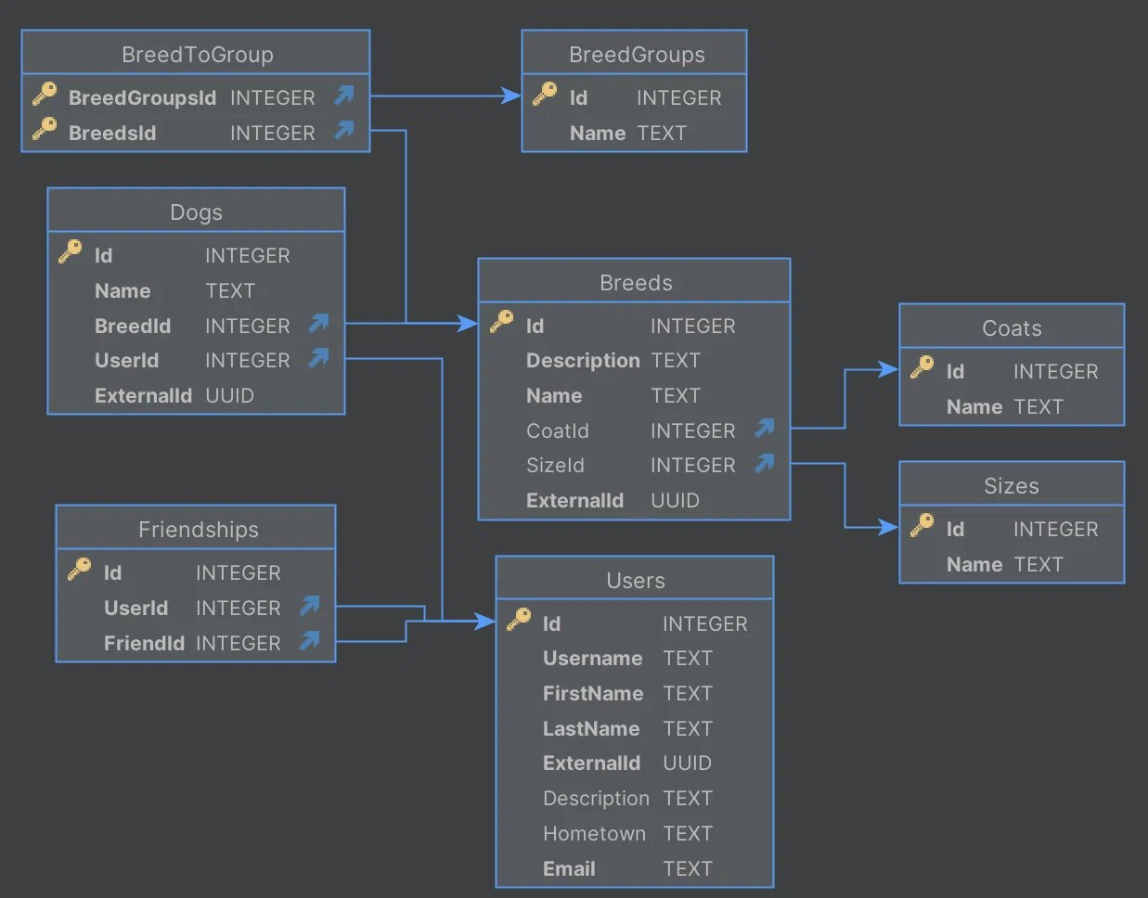
Структура основной БД проекта
(DogeFriends Api Postgres DB)

