Slide 1
StNor Data
Data Model Validation
in Machine Learning
Instructor: Dr. Andrei Borodich, “StNor Data”
Webinar ― LearnQuest ― 22 June 2020

Slide 2
OUTLINE
StNor Data
Intro notes
Types of Machine Learning
Model Learning and Model Validation
High-bias and High-variance Models
Validation Curves
Models’ Dependence on the Training Dataset Size
Learning Curves
Validation in Practice: Grid Search & Cross Validation
Grid Search & Cross Validation for a Best Fit Model in Python
Closure notes
OBJECTIVES
Learn the relationship between Model Learning and Model Validation
Understand Validation Curves’ behavior depending on the Model Complexity
Understand Learning Curves’ behavior depending on the Training Dataset Size
Learn how to perform GridSearch and CrossValidation for a Best Fit Model

Slide 3
What Is a Machine Learning?
Fundamentally, Machine Learning involves building mathematical models to help understanding data.
“Learning” starts when we give the models tunable parameters that can be computationally adapted to the observed data;
in this way a computer system does “learning” from the data.
Once the models have been fit to observed data, we can use them
to predict aspects of new data or explore structural patterns in the observed data.
Machine Learning is the process of teaching a computer system to
make accurate predictions for the new data or
identify hidden patterns in the existing data.

Slide 4



Machine Learning
Supervised
Unsupervised
Reinforcement
Task Driven Predict next values
Data Driven Identify exist. patterns
Learn From Mistakes

Slide 5
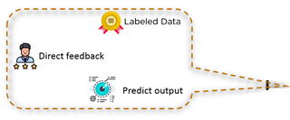
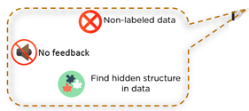
Types of Machine Learning
Supervised Learning
Machine gets labeled inputs and their desired outputs.
The goal is to learn rules how to map inputs to the outputs.
Unsupervised Learning
Machine gets unlabeled inputs without desired outputs.
The goal is to find structures or patterns as useful info in inputs.

Slide 6
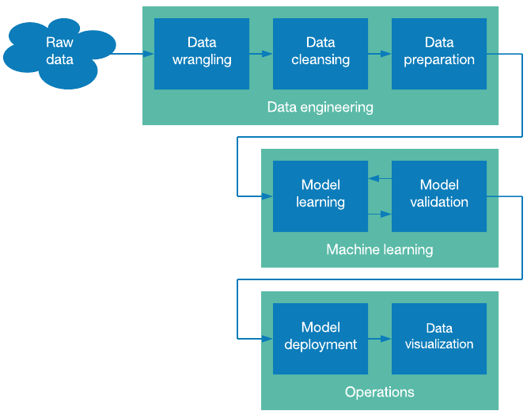
The Machine Learning Pipeline
https://developer.ibm.com/

Slide 7
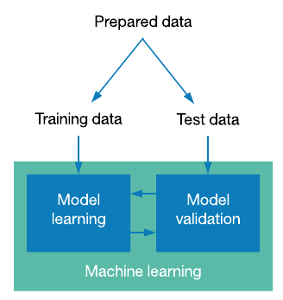
Model Learning as a Process
Model learning is referred to as the process
where the model’s parameters are calculating with a training data set.
Model learning begins as soon as model initialization phase has been completed.
Model learning is about a model training by fitting the model to a training data set.
Model initialization
1. Choose a class of model.
2. Choose model hyperparameters.

Slide 8
Model Validation as a Process
Model validation is referred to as the process
where a trained model is evaluated with a testing/validation data set.
Model validation begins after model training phase has been completed.
Model validation is about testing generalization ability of a trained model.
Data preparation
1. Training dataset
2. Testing data set

Slide 9
Model Validation as a Process
A typical ML task can be formalised as the following nested loop:
while (error in validation set > X) {
tune hyper-parameters
while (error in training set > Y) {
tune parameters
}
}
The outer loop is performed by human, on the validation/testing set.
The inner loop is done by machine, on the training set.
NOTE.
Often, in ML / AI researches, one can use 3 datasets (training, validation, and testing)
instead of 2 datasets (training and testing/validating).
Then, testing data is unseen while model training & validation are going on.

Slide 10
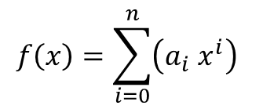
Model Validation as a Process
Model parameters are those which a machine finds for the model.
They are learnt during training.
For example, the polynomial coefficients in the Regression model.
Model hyperparameters are those which we supply to the model.
They cannot be learnt during training but are set beforehand.
For example, the degree “n” of the polynomial in the Regression model.
$$f\left(x\right)=\sum_{i=0}^{n}{\left(a_{i} x^{i}\right)}$$
Polynomial Regression model:

Slide 11
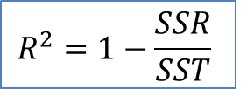
Selecting the Best Model
Consider: two regression fits to the same dataset
Compare: how two models represent existing data
Figure: Training and validation scores in two regression models.
R2-score (coeff. of determination) measures how well a model performs relative to a mean of the target values.
$$R^{2}=1−\frac{SSR}{SST}$$

Slide 12
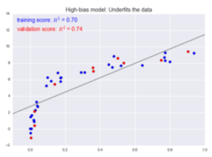
Selecting the Best Model
The model on the left attempts to fit
a linear function through the data.
Because the data are intrinsically more complicated than a straight line,
the straight-line model fit will never be able to describe this dataset well.
Such a model is said to underfit the data;
it does not have enough model flexibility to suitably account for all the features in the data.
The model has high bias.

Slide 13
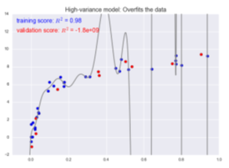
Selecting the Best Model
The model on the right attempts to fit
a high-order polynomial through the data.
The model fit has enough flexibility to well account for the fine features in the data.
However, it is extremely reflective of the particular noise properties of the data.
The model is said to overfit the data;
it has so much model flexibility that ends up accounting for random errors together with the underlying data distribution.
The model has high variance.

Slide 14
Selecting the Best Model
We can summarize:
For high-bias models, the performance of the model on the validation set is similar to the performance on the training set.
For high-variance models, the performance of the model on the validation set is far worse than the performance on the training set.
We can differentiate the models using the model complexity:
a high-bias model is a very low model complexity
a high-variance model is a very high model complexity
Fundamentally, the question of “the best model” is about finding
a sweet spot in the trade-off between bias and variance.

Slide 15
Selecting the Best Model
In statistics and machine learning,
the bias–variance tradeoff is the property of a set of predictive models:
models with a lower bias in parameter estimation
have a higher variance of the parameter estimates across samples,
and vice versa.
The bias is an error from erroneous assumptions in the learning algorithm.
High bias can cause an algorithm to miss the relevant relations between features and target outputs (underfitting).
The variance is an error from sensitivity to small fluctuations in the training set.
High variance can cause an algorithm to model the random noise in the training data, rather than the intended outputs (overfitting).

Slide 16
Validation Curve
A plot of the training/validation score with respect to the model complexity (polynomial degree) is known as a validation curve.
Model complexity, training score and validation score (a schematic relationship)

Slide 17
Validation Curve
The general behavior of a Validation curve:
The training score is everywhere higher than the validation score.
The model will be a better fit to data it has seen than to data it has not seen.
For very low model complexity, the training data is underfit.
The model is a poor predictor both for the training data and for any previously unseen data.
For very high model complexity, the training data is overfit.
The model predicts the training data very well, but fails for any previously unseen data.
The Validation Curve has a maximum at some intermediate value.
This level of complexity indicates a suitable trade-off between bias and variance. – This is a notable feature!

Slide 18
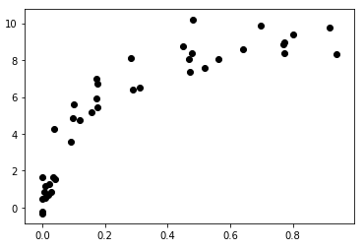
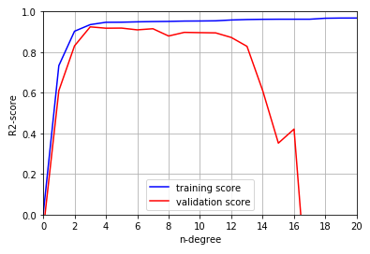
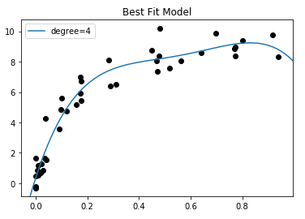
Validation Curve
How does the optimal model generally depend on the polynomial degree?
A generated data set of 40 pairs (X,y)
A Validation Curve
for the particular data (40) and
polynomial regression models
A Best Fit Model
(in a class of polynomial regression)
for the generated data set (40).

Slide 19
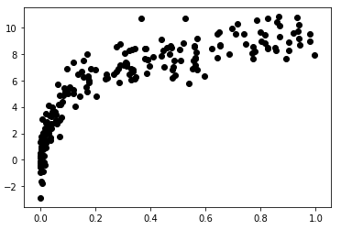
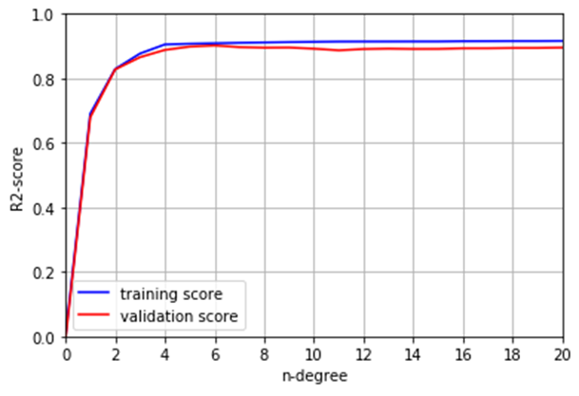
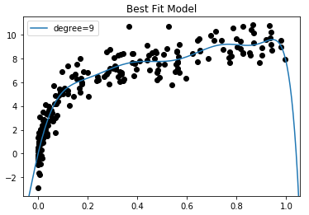
Validation Curve
How does the optimal model generally depend on the size of the training data?
A generated data set of 200 pairs (X2,y2)
A Validation Curve
for the particular data (200) and
polynomial regression models
A Best Fit Model
(in a class of polynomial regression)
for the generated data set (200).

Slide 20
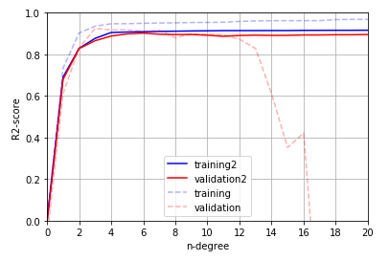
Validation Curve
Validation Curves
for 2 particular datasets
( the 1st is a subset of the 2nd )
The larger dataset can support a much more complicated model:
the peak here is around n=4, but even an n=20 model is not seriously overfitting the data as the validation and training scores remain very close.
The behavior of the validation curve has not one, but two, important inputs:
the model complexity and the number of training points.

Slide 21
Learning Curve
A plot of the training/validation score with respect to the size of the training set is known as a Learning Curve.
Dataset size, training score and validation score (a schematic relationship)

Slide 22
Learning Curve
The general behavior of a Learning Curve:
A model will never, except by chance, give a better score to the validation set than the training set: this means the curves keep getting closer together but never cross.
A model of a given complexity will overfit a small dataset:
the training score will be relatively high, while the validation score will be relatively low.
A model of a given complexity will underfit a large dataset:
the training score will decrease, but the validation score will increase.
The Learning Curve is converged to a particular score
as the number of training samples grows. – This is a notable feature!

Slide 23
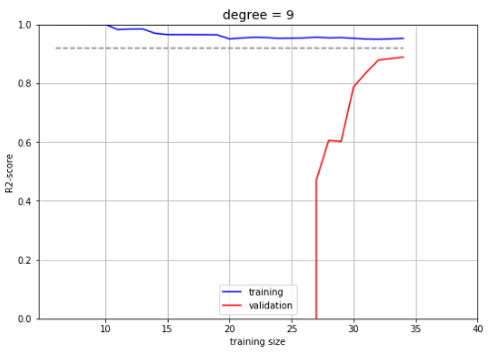
Learning Curve
Learning Curve of the Model for smaller training set (40)

Slide 24
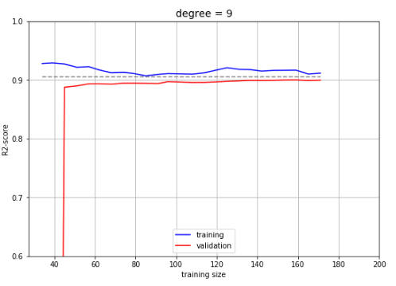
Learning Curve
Learning Curve of the Model for larger training set (200)

Slide 25
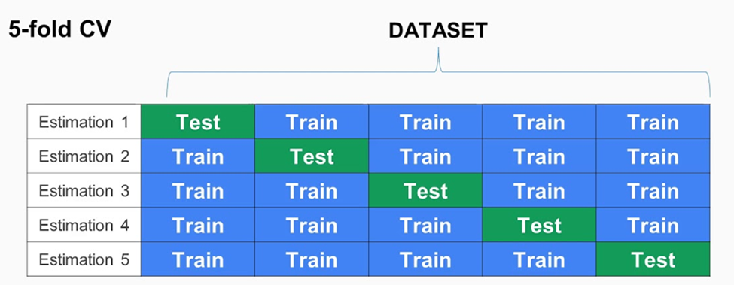
Validation in Practice: Grid Search & CV
Practical methodology:
Select a class of models using a grid of parameter values to find the particular model that maximizes the validation score.
Partition the prepared data set into K-folds and use a cross-validation to test effectiveness of each calculated model.

Slide 26

Validation in Practice: Grid Search & CV
Scikit-Learn: https://scikit-learn.org/
-- Python library / Python package
-- provides implementations of main machine learning algorithms
-- known for a complete online documentation
GridSearchCV : https://scikit-learn.org/stable/modules/grid_search.html
-- Scikit-Learn module / Scikit-Learn class
-- generates candidates from a grid of parameter values
-- has automated tools to do cross-validation

Slide 27

Validation in Practice: Grid Search & CV
from sklearn.model_selection import GridSearchCV
param_grid = {}
# GridSearchCV() estimator: it sets up the procedure; no dataset required
grid = GridSearchCV(PolynomialRegression(), param_grid, cv=7)
# fit the model at each grid point
grid.fit(X, y)
# ask for the best parameters
grid.best_params_
print(grid.best_params_)
# ask for the best model
model = grid.best_estimator_
{'linearregression__fit_intercept': True,
'linearregression__normalize': True,
'polynomialfeatures__degree': 4}
# use the best model and show the fit to our data
X_test = np.linspace(-0.1, 1.1, 40)[:, None]
y_test = model.fit(X, y).predict(X_test)
plot()
A Best Fit Model
(in a class of polynomial regression)
for the generated data set (40).

Slide 28
Validation in Practice: Grid Search & CV
from sklearn.model_selection import GridSearchCV
param_grid = {}
# GridSearchCV() estimator: it sets up the procedure; no dataset required
grid = GridSearchCV(PolynomialRegression(), param_grid, cv=7)
# fit the model at each grid point
grid.fit(X2, y2)
# ask for the best parameters
grid.best_params_
print(grid.best_params_)
# ask for the best model
model = grid.best_estimator_
{'linearregression__fit_intercept': True,
'linearregression__normalize': True,
'polynomialfeatures__degree': 9}
# use the best model and show the fit to our data
X_test = np.linspace(-0.1, 1.1, 200)[:, None]
y_test = model.fit(X2, y2).predict(X_test)
plot()
A Best Fit Model
(in a class of polynomial regression)
for the generated data set (200).

Slide 29
Conclusions
1. Together, model training and model validation aim to find an optimal data model with the best performance. ― This is an ultimate goal of machine learning.
2. The technique as a Validation Curve can be used to select the trained model of the optimal complexity to fit well our data.
3. The technique as a Learning Curve can be used to quantify the correspondence of our data set size to the trained model.
4. Practically, model validation is performed with an advanced computational module from the ML library. This module should incorporate both a grid (of parameter values) search and cross-validation algorithms to find a best fit model to our data.

Slide 30
The END
Thank you for your attention!

