Slide 1
Text to Image Generation with More Stable Deep Convolutional Generative Adversarial Networks (DCGANs)
Andac Demir

Slide 2
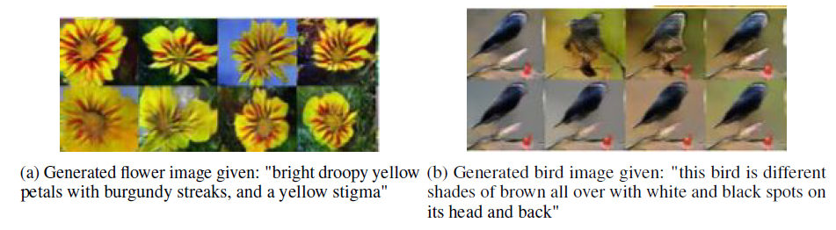
Problem Statement
To translate texts in the form of single sentence human written descriptions into images.
The Caltech-UCSD Birds dataset: 200 bird species with 6,033 images.
The Oxford-102 Flowers dataset: 102 flower categories, each class consists of between 40 and 258 large scale images with variations in pose and brightness/contrast.

Slide 3
Relevant Work
S. Reed, Z. Akata, X. Yan, L. Logeswaran, B. Schiele, and H. Lee, “Generative adversarial text to image synthesis”.
What we want:
To make the GAN training more stable and
To generate more realistic outputs, but also
Unique and not lazily copying the training data
So I added a set of constraints on the architectural topology to develop a text conditional DC-GAN using the guideline published in the paper of Alec Radford from Facebook AI Research.

Slide 4
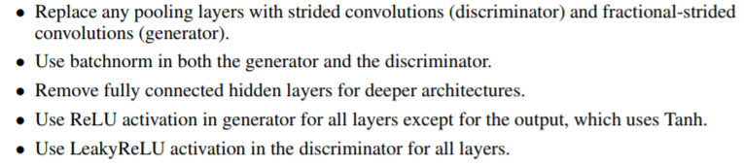
DC-GAN Guidelines

Slide 5
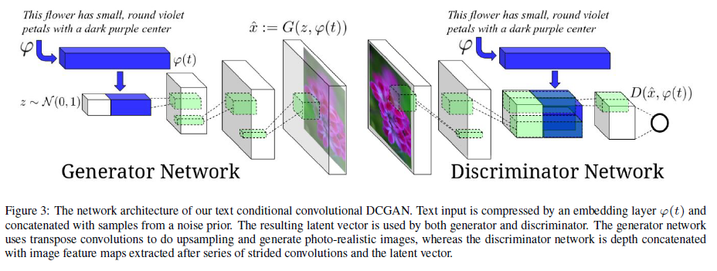
Implementation of Text Conditional DC-GAN

Slide 6
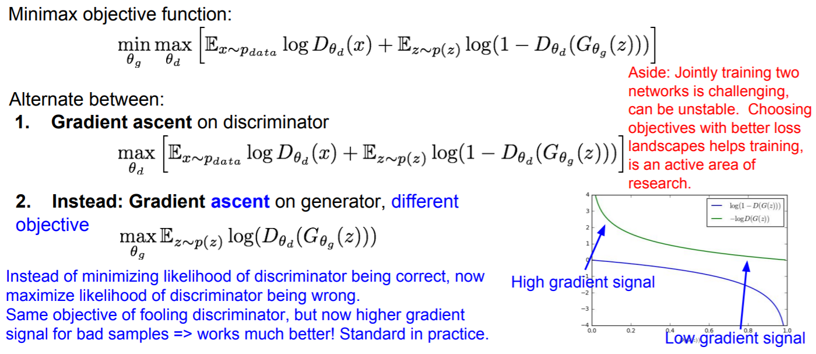
Training GANs: Two Player Game

Slide 7
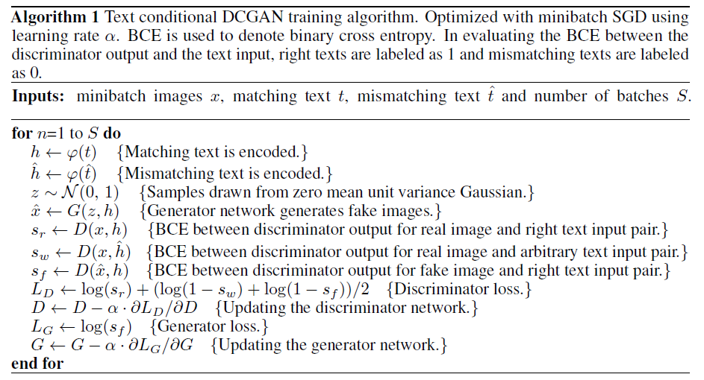
Training of Text Conditional DC-GAN

Slide 8
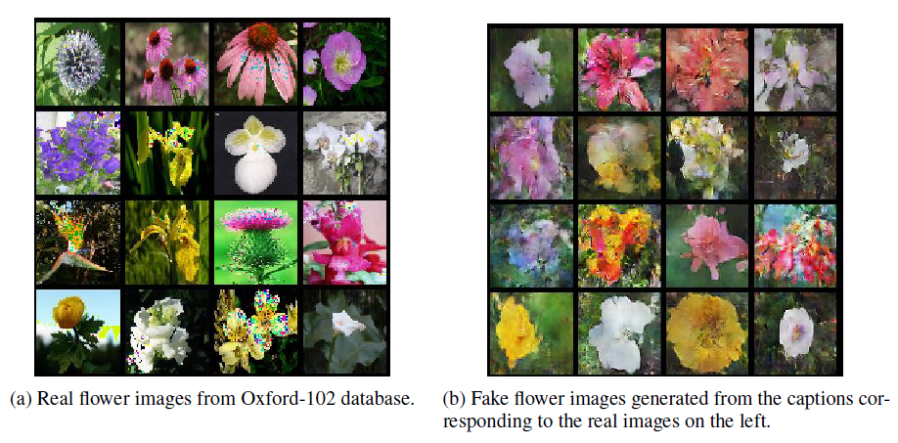
Experimental Results

Slide 9
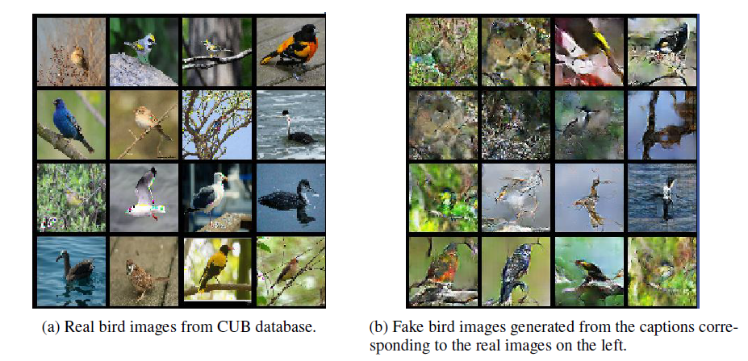
Experimental Results
It is easier to generate
flowers, perhaps because birds have stronger structural regularities across species that make it easier for the discriminator to spot a fake bird than to spot a fake flower.

Slide 10
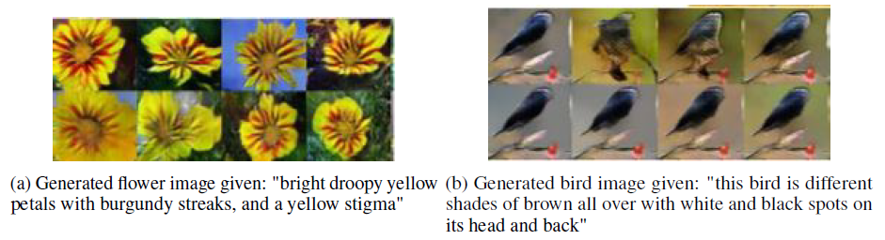
Experimental Results

Slide 11
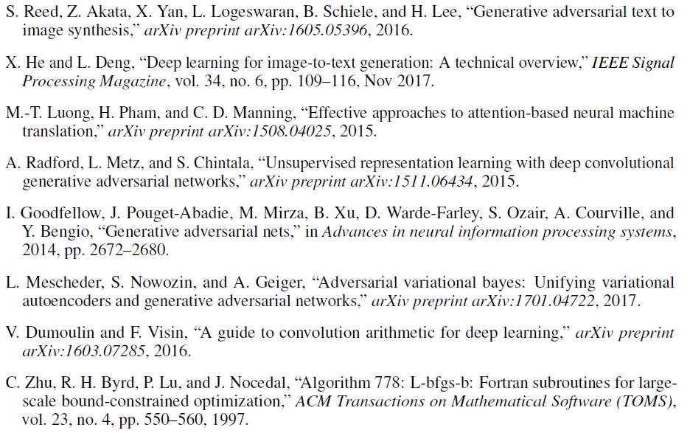
References

