Slide 1
A message for Parents: "Once a new technology rolls over you, if you're not part of the steamroller, you're part of the road" - Stewart Brand

Slide 2
Basic Concepts - Videos
Voltage and Current
https://www.youtube.com/watch?v=l8JS8BbrVOg
https://www.youtube.com/watch?v=8gvJzrjwjds
https://www.youtube.com/watch?v=exlRjDKHGRg
https://www.youtube.com/watch?v=mzSnz6ZDkFE
Resistor
https://www.youtube.com/watch?v=VPVoY1QROMg
https://www.youtube.com/watch?v=Gc1wVdbVI0E
Capacitor
https://www.youtube.com/watch?v=sy_G1oYRQmM
Diode
https://www.youtube.com/watch?v=ap7edIKkykA
Volts, Amps and Ohms
https://www.youtube.com/watch?v=WoN1nou5t1Q
https://www.youtube.com/watch?v=zYS9kdS56l8
https://www.youtube.com/watch?v=zYS9kdS56l8
https://www.youtube.com/watch?v=6Zxp8lSdn8M
Apps (The app costs $1 )
https://itunes.apple.com/us/app/mhos-resistance/id785181044?mt=8

Slide 3
Basic Concepts - Guides
http://www.me.umn.edu/courses/me2011/arduino/arduinoGuide.pdf

Slide 4
Quick Review of Concepts
Electricity flows from Negative to Positive (If you heard otherwise, blame Ben Franklin).
Arduino deals with Direct Current or DC.
Maximum voltage in Arduino circuits is less than 5 Volts.

Slide 5
Quick Review of Concepts
Resistor “resists” the flow of electric current.
LED is Light Emitting Diode.
LED’s +ve terminal is called Anode and its negative terminal is called Cathode. Electricity flows from Cathode to Anode.

Slide 6
Quick Review of Concepts
Analog signal in electronics is based on voltage – varying amounts of it.
Digital signal in electronics is either 0 or 1. In Arduino this is represented as +5V for 1 and 0V for 0. Presence or Absence of voltage.

Slide 7
Safety Tips
Be very careful when connecting and LED or it can blow or burn out.
Always work with USB cable disconnected.
Make sure to validate the circuit with parent or instructor before connecting USB cable.

Slide 8
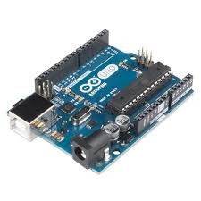
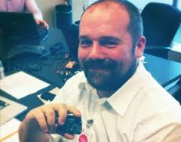
Who invented Arduino
Massimo Banzi made Arduino as a way to teach electronics to artists.

Slide 9
Applications of Arduino
http://blog.arduino.cc/2013/08/12/ardusat-successfully-launched-in-space/
http://blog.arduino.cc/2014/06/23/monitoring-glaciers-at-the-venice-14th-international-architecture-exhibition/
http://makezine.com/2011/02/10/why-the-arduino-won-and-why-its-here-to-stay/

Slide 10
What are we going to learn?
Making circuits with Arduino.
Drawing circuit diagrams using Fritzing.
Uploading sketches using Arduino IDE.

Slide 11
You must have…..
Arduino Budget Pack (https://www.adafruit.com/product/193) or equivalent
Laptop
Arduino IDE (http://arduino.cc/en/Main/Software)
Fritzing (http://fritzing.org/download/)

Slide 12
Arduino Budget Pack
Parts are very delicate handle with care
Arduino circuit board
Breadboard
Jumper cables
Resistors, LEDs and sensor packet
USB Cable
LED Packet

Slide 13
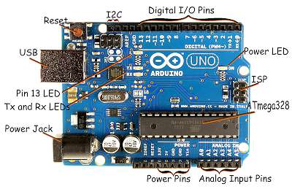
Arduino Circuit Board

Slide 14
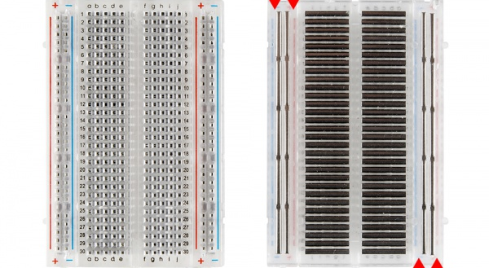
Breadboard Power rails

Slide 15
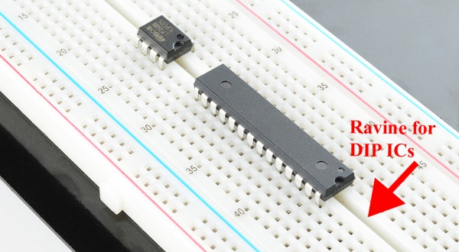
Breadboard Rows, Columns, IC ravine

Slide 16
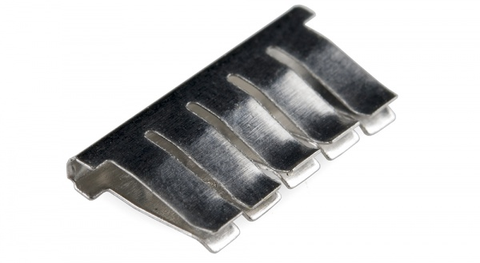
Breadboard clips

Slide 17
Practice 1 (2 minutes)
Take 1 Jumper wire and practice inserting and removing into/from one slot.
Take 1 Resistor and practice inserting and removing into/from one slot.

Slide 18
Resistor
A Resistor resists the flow of electrical current.
Resistance is measured in Ohms.
Analogy: Water flowing through a thin pipe vs large pipe

Slide 19
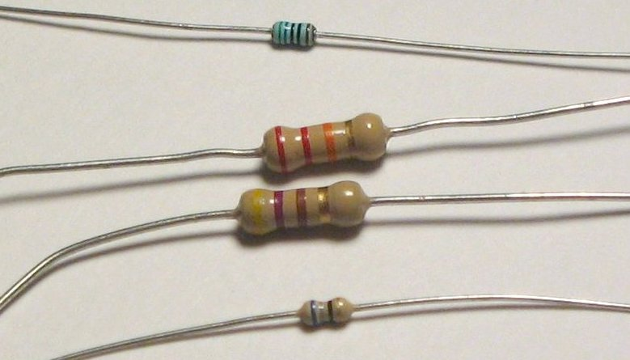
Resistor

Slide 20
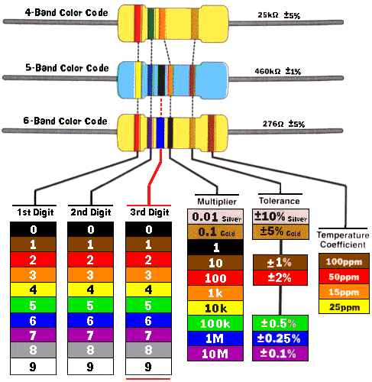
Resistor Color coding

Slide 21
Diode
Allows the flow of electrical current in one direction only.
Anode is +ve the Long leg.
Cathode is –ve the short leg.

Slide 22
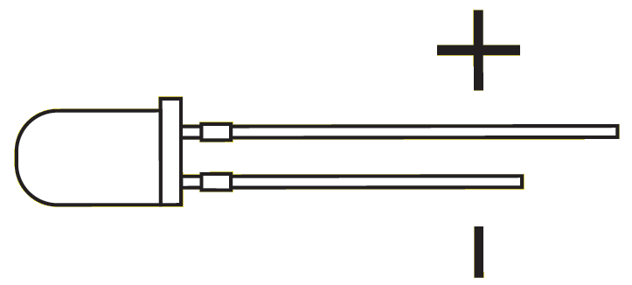
Light Emitting Diode (LED)

Slide 23
Precautions
Disconnect USB cable when making changes to circuit. One wrong connection, you could make the component burn out.
Highly recommended to wear safety goggles.
LEDs could burn out and emit gases.

Slide 24
Project 1 – Check list
Turn your laptop on.
Check to make sure Arduino IDE is installed.
Arduino, Breadboard, 100 Ohms resistor, 1 Red LED, Jumper wires, USB cable.

Slide 25
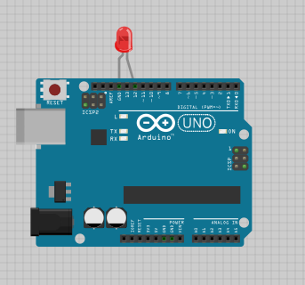
Project 1A Circuit

Slide 26
Project 1 Sketch
int led = 12;
void setup() {
pinMode(led, OUTPUT);
}
void loop() {
digitalWrite(led, HIGH);
delay(1000);
digitalWrite(led, LOW);
delay(1000);
}

Slide 27
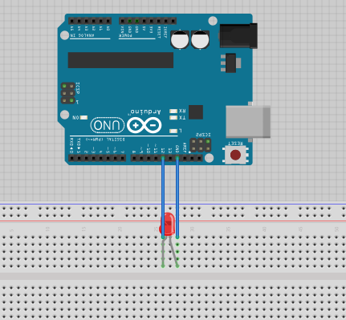
Project 1B Circuit

Slide 28
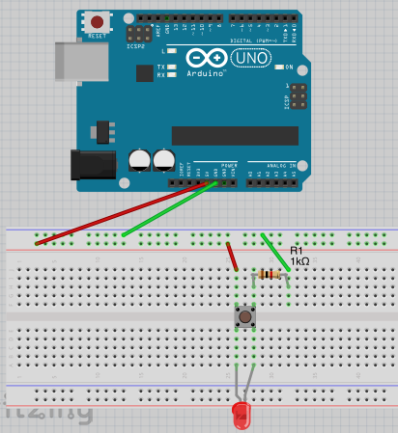
Project 2

Slide 29
Fritzing
Demo Fritzing for Project 2

Slide 30
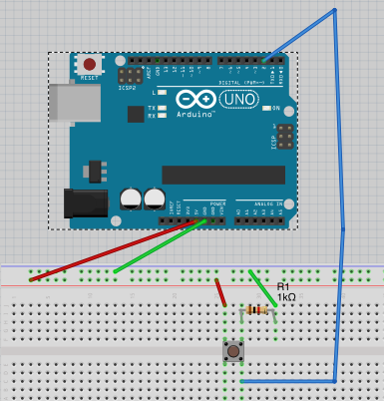
Project 3

Slide 31
Project 3 Sketch
Download Project 3 sketch from Github

Slide 32
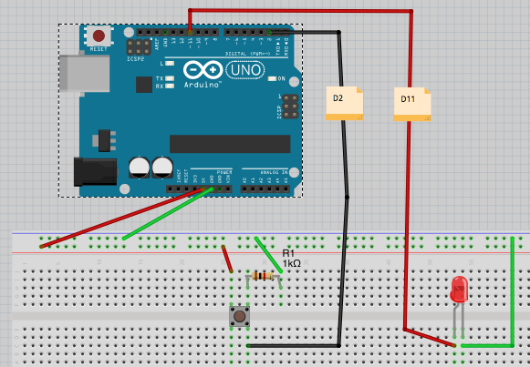
Project 4

Slide 33
Project 4 Sketch
Download Project 4 sketch from Github

Slide 34
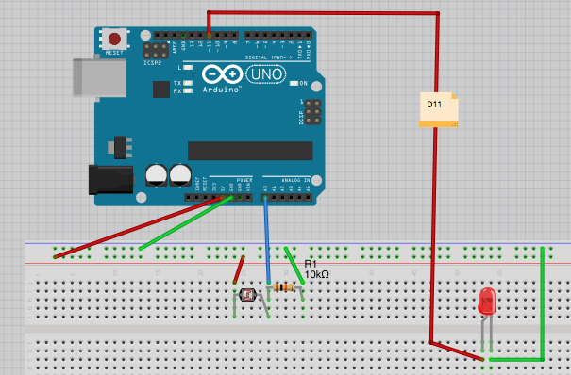
Project 5

Slide 35
Project 5 Sketch
Download Project 5 sketch from Github

Slide 36
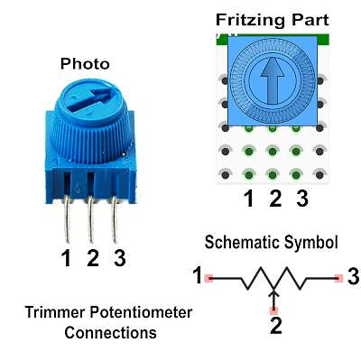
Project 6

Slide 37
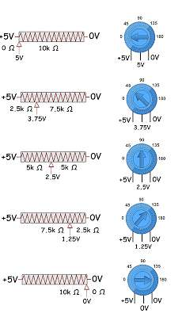
Potentiometer Voltage output

Slide 38
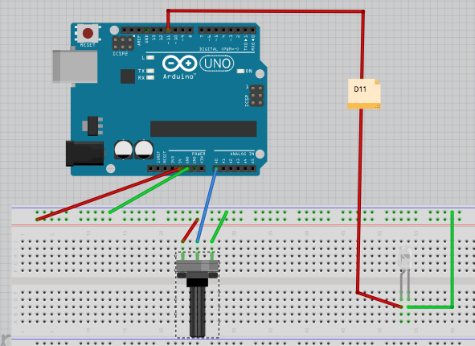
Project 6

Slide 39
Project 6 Sketch
Download Project 6 sketch from Github

Slide 40
Homework
Generate SOS Morse Code message using LEDs (Hint : Project 1)
Use LDR sensor to detect Sunrise and Sunset (Hint : Project 5)
Write a research report on PWM (Pulse Width Modulation)

Slide 41
Resources
https://learn.adafruit.com
https://learn.sparkfun.com
https://www.radioshackdiy.com
http://www.jameco.com/Jameco/workshop/techtip/techtip.html
http://arduino.cc/en/Tutorial/HomePage
http://www.arduinoclassroom.com

